Slide 1
Walk With the Word
Mark 14

Slide 2
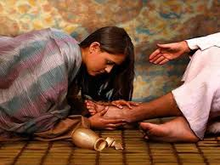
14:1-9 – Jesus is anointed by a woman with an alabaster vial.

Slide 3
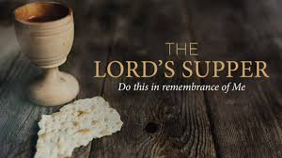
14:10-21 – After hearing Jesus predict His own death, Judas
Iscariot decides it is the right time to betray Him.
14:22-25 – Jesus institutes the Lord’s Supper.

Slide 4
14:26-31 – Jesus predicts His disciples will “fall away.”
Peter protests; like many of us, he has good intentions.
14:32-42 – Jesus knows what’s coming and doesn’t want it.
Nevertheless, out of love, He does what’s best for us all.

Slide 5
14:43-52 – Jesus is arrested, and all the disciples flee!
14:53-65 – Before His accusers, Jesus confirms He is the Son of God.
14:66-72 – Poor Peter! As Jesus predicted, he denies Him x3.

