Slide 1
Walk With the Word
Mark 2

Slide 2
Inductive Bible Study Method
1. Observation
2. Interpretation
3. Application

Slide 3
2:1-2 – Jesus has made His home base in Capernaum.

Slide 4
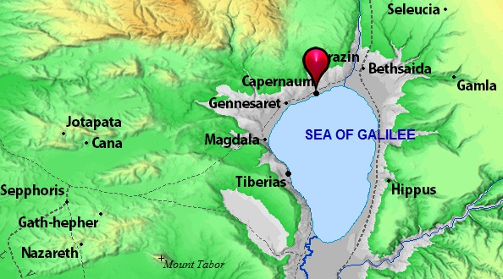

Slide 5
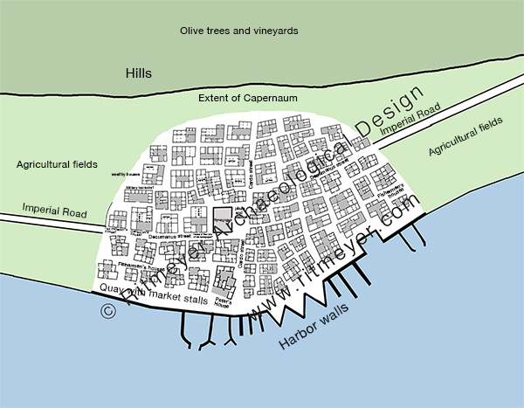

Slide 6
2:1-2 – Jesus has made His home base in Capernaum.
“…He was speaking to them the Word.”

Slide 7
2:1-2 – Jesus has made His home base in Capernaum.
“…He was speaking to them the Word.”
2:3-12 – The miraculous healing of the paralytic.
Key points:
1. Carrying the paralytic (no name) required four men.

Slide 8
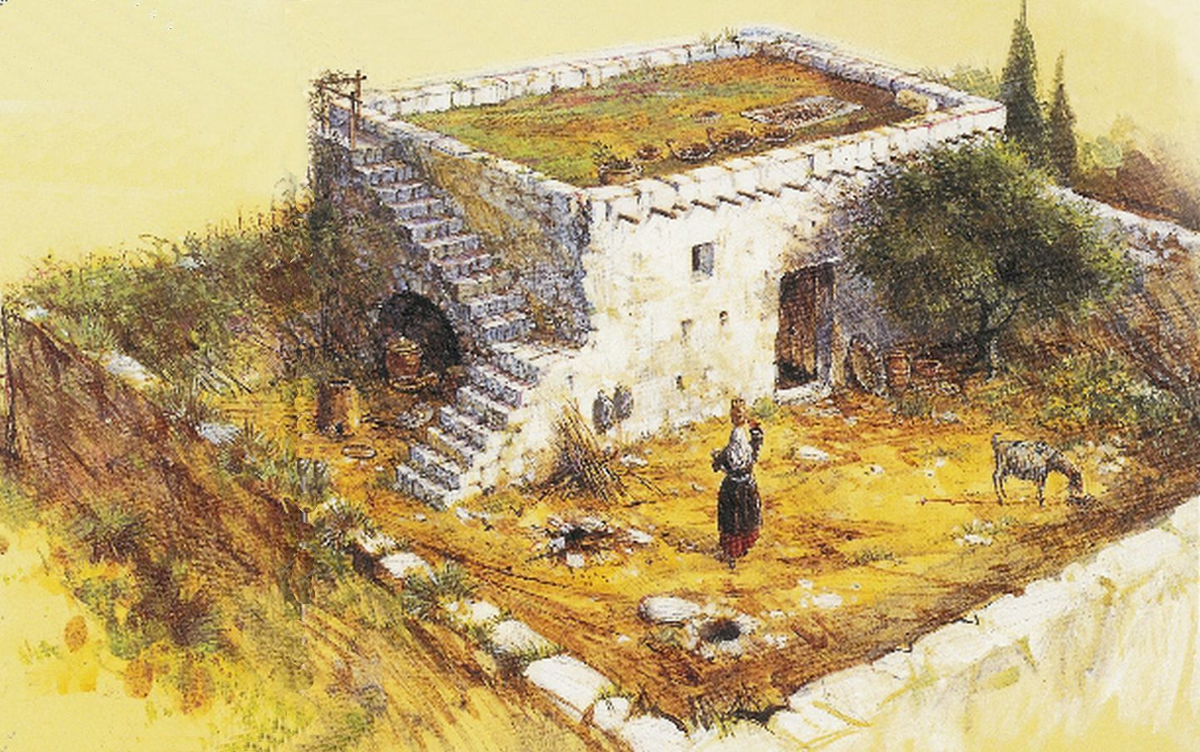

Slide 9
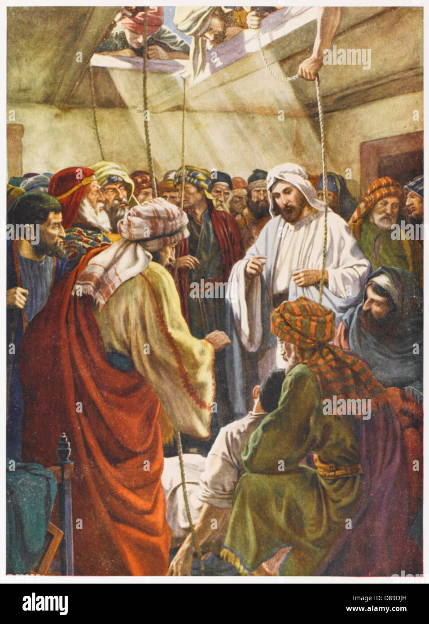

Slide 10
2:1-2 – Jesus has made His home base in Capernaum.
“…He was speaking to them the Word.”
2:3-12 – The miraculous healing of the paralytic.
Key points:
1. Carrying the paralytic (no name) required four men.
2. Jesus healed the paralytic after seeing their faith.
3. Jesus declares Himself the Son of Man.
4. Jesus makes His mission clear: to forgive sins.

Slide 11
2:13-22 – The call of Matthew.
The religious leaders keep asking the question “Why?”
Jesus answers the “Why?” question: things are changing.

Slide 12

You can’t put
new wine into
old wineskins!

Slide 13
2:13-22 – The call of Matthew.
The religious leaders keep asking the question “Why?”
Jesus answers the “Why?” question: things are changing.
2:23-28 – Jesus sets the Pharisees straight on the purpose of the
Sabbath: it was established for man.

