Slide 1
Mark 3
Walk With the Word

Slide 2

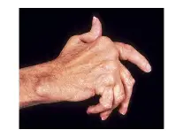

Slide 3
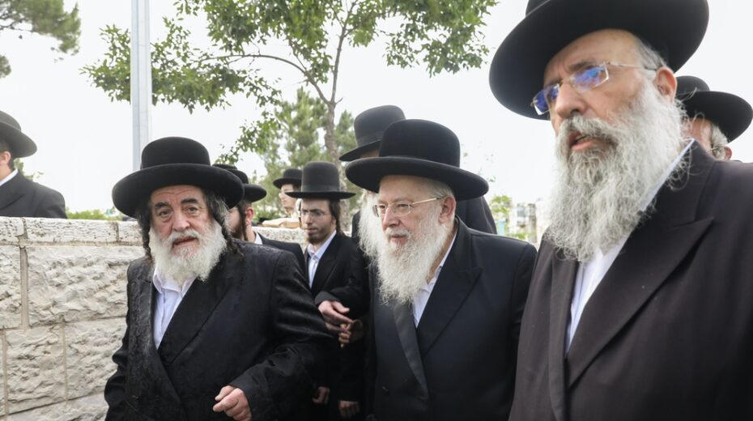

Slide 4
3:1-6 – Jesus heals on the Sabbath: the reaction of the religious leaders is one of the saddest in Scripture and betrays their hardness of heart.
Jesus displays two emotions: anger and grief.
3:7-12 – Sadly, Jesus’ identity is acknowledged even by demons.

Slide 5
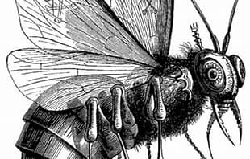
3:13-19 – The twelve apostles are named: (1) they would be “with Him,”’ (2) they would be “sent out” to preach, and (3) they would be given authority to cast out demons.
3:20-30 – Incredibly, Jesus is accused of being possessed by “Beelzebub,” another name for Satan.
Beelzebub
Lord of the Dung Fly

Slide 6
Jesus introduces “the unforgiveable sin”: blasphemy against the Holy Spirit means to deny who Jesus is in spite of all the evidence.
3:31-35 – Those who follow Jesus (in this case, the “will of God,”) have, with Jesus, a unique relationship.

