Slide 1
Walk With the Word
Mark 5

Slide 2
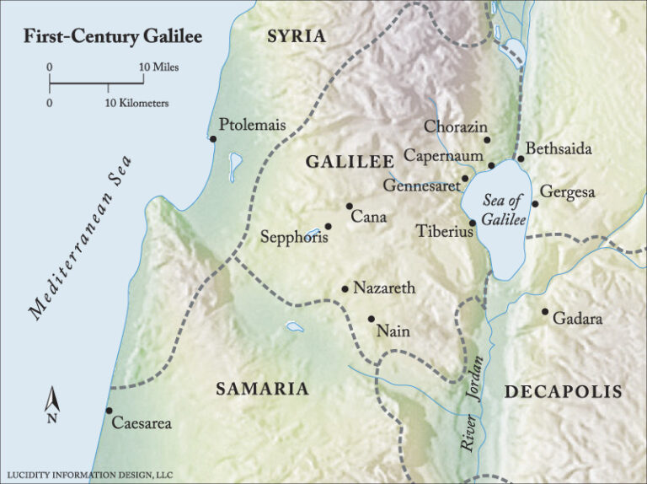




Slide 3
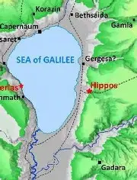
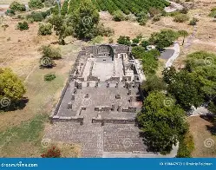

Slide 4
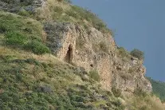
The demoniac’s behavior was out of control.

Slide 5
The demons acknowledge that Jesus is Son of the Most High God.
Note: there was not just one unclean spirit, but many.
On imploring Jesus to leave the region, the people cared more about their livelihood than the man set free.

Slide 6
5:21-24 – Jesus leaves to heal the daughter of the synagogue official; his name was Jairus.
But on His way…
5:25-34 – Jesus heals the woman with the hemorrhage.
This disability made her permanently unclean.
The effects of hemorrhaging for 12 years is catastrophic.

Slide 7
5:35-43 – Jesus continues to the house of Jairus in spite of the fact that Jairus’ daughter has died.
Note: This is the first of Mark’s (indirect) reference to the resurrection.

