Slide 1
Mark 6
Walk With the Word

Slide 2
6:1-6 – The astonishing rejection of Jesus in His hometown.
States specifically here that Jesus had 4 brothers.
Jesus is unable to do miracles because of their unbelief.
6:7-13 – Jesus sends out the twelve for on-the-job training.
They are to preach the need to repent.
They are not to spend energy on those who won’t believe.

Slide 3
6:14-29 – Death of John the Baptist, the last OT prophet.
Herod the Great
(10 wives, 14 sons; murdered a few)
Archaelaus
Ruled 4 BC to AD 6
(born loser)
Philip & Herodias
(Lived in Rome)
Have daughter Salome
Herod Antipas
(In Jerusalem; visits Rome)
Divorces his wife and marries
Herodias, Philip’s wife.
John the Baptist
condemns this union
and is beheaded
at the request of
Herodias

Slide 4
6:14-29 – Death of John the Baptist, the last OT prophet.
6:30-44 – The feeding of the five thousand.
12 baskets full left over: represents the 12 tribes

Slide 5
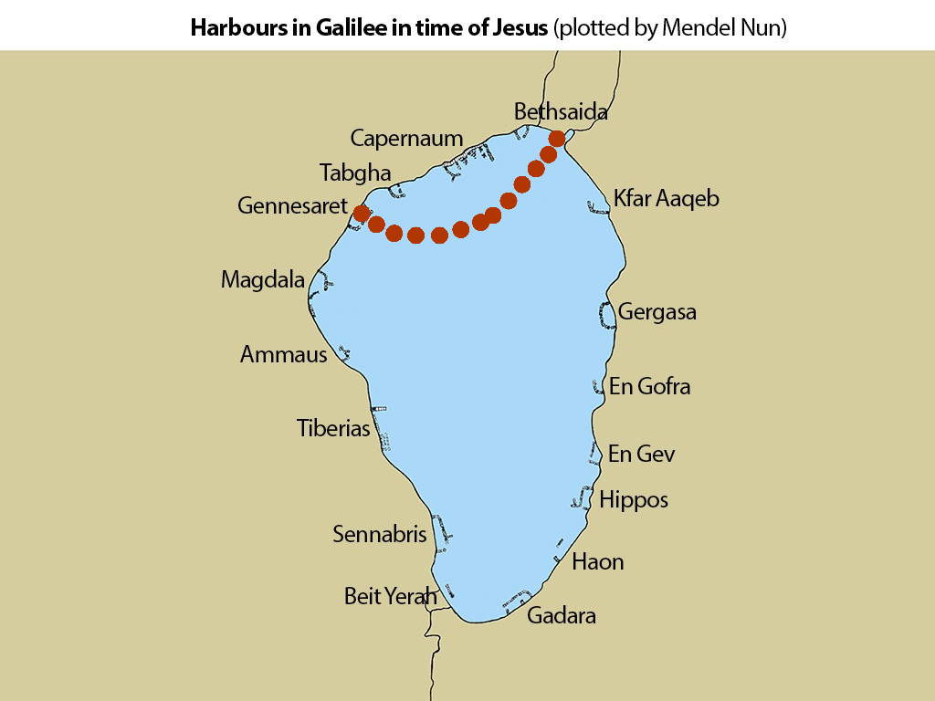
6:45-56 – Jesus walks on water.

Slide 6
6:45-56 – Jesus walks on water.
The storm: a symbol of future persecution.
Key message about the storm: “Do not be afraid.”
The “insight” the disciples were getting: Jesus is God.
Note: The chapter begins with those who do not believe and
ends with those who do believe.

