Slide 1
Walk With the Word Mark 8

Slide 2
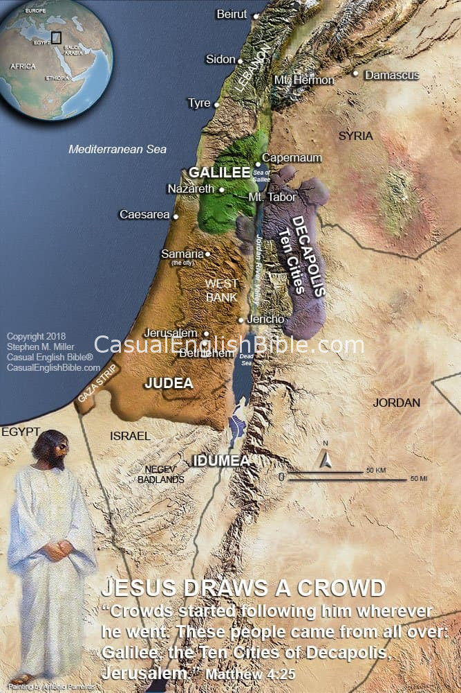
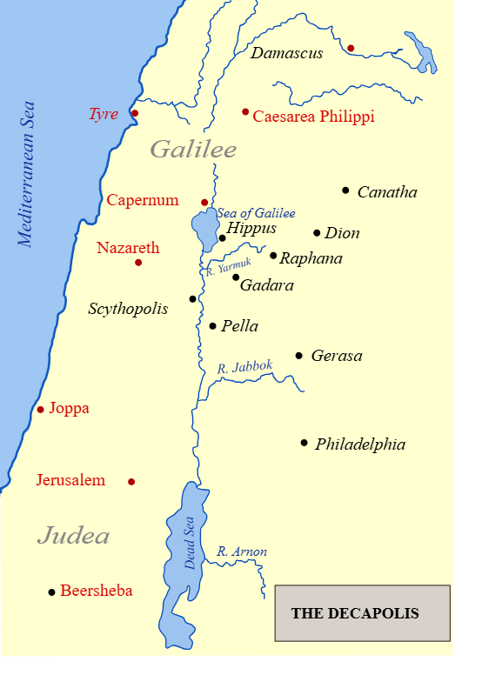

Slide 3
8:1-10 – The feeding of the four thousand.
Symbolic of Jesus’ provision for the Gentiles.

Slide 4
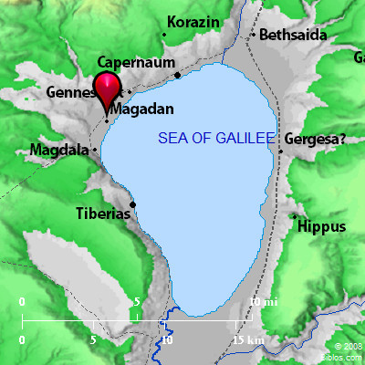
Dalmanutha
(Magadan)
Magdala
8:11-13 – The Pharisaic trap of seeking signs.
What sign? And if a sign, would they believe?

Slide 5
8:14-21 – Jesus explains the blindness of the Pharisees.
The bread is a symbol of the Word.
The bread is enough for the whole world.
The disciples do not yet grasp who Jesus is, the eternal creator and giver of life.
8:22-26 – Healing the blind man: a symbol of spiritual sight.

Slide 6
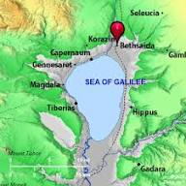

Slide 7


Slide 8
8:27-30 – Peter confesses that Jesus is the Christ, followed immediately by a strong rebuke.
8:31-38 – The key for discipleship: willing to give all.
Point: This means setting your mind, goals, values, interests,
and time on the values that are important to God.

