Slide 1
Walk With the Word Mark 9

Slide 2
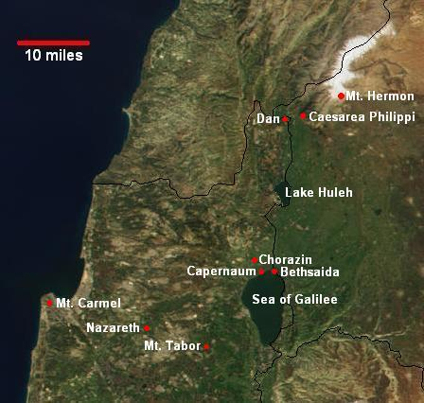
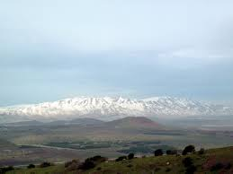
9:1-13 – The “Transfiguration”: a preview of the kingdom of God.

Slide 3
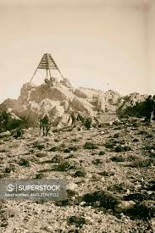
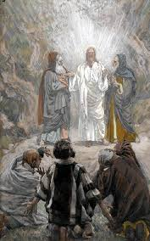
9:1-13 – The “Transfiguration”: a preview of the kingdom of God.

Slide 4
9:1-13 – The “Transfiguration”: a preview of the kingdom of God.
The teaching of “Elijah must come first”: John the Baptist.
Foreshadowing the truth that Jesus must suffer.
9:14-29 – Healing the child who is deaf and mute.
The cause: an unclean spirit.
Two lessons: (1) some afflictions may be caused by an unclean spirit, and (2) some spirits come out only by prayer.

Slide 5
9:30-37 – Jesus’ death and resurrection foretold, but the disciples are anticipating a kingdom of glory.
They still don’t get it that the Messiah must first suffer.
9:38-50 – Warnings to those who destroy faith.
To “stumble” here refers to losing faith in Jesus.
For those who cause stumbling, there are consequences.

