Slide 1
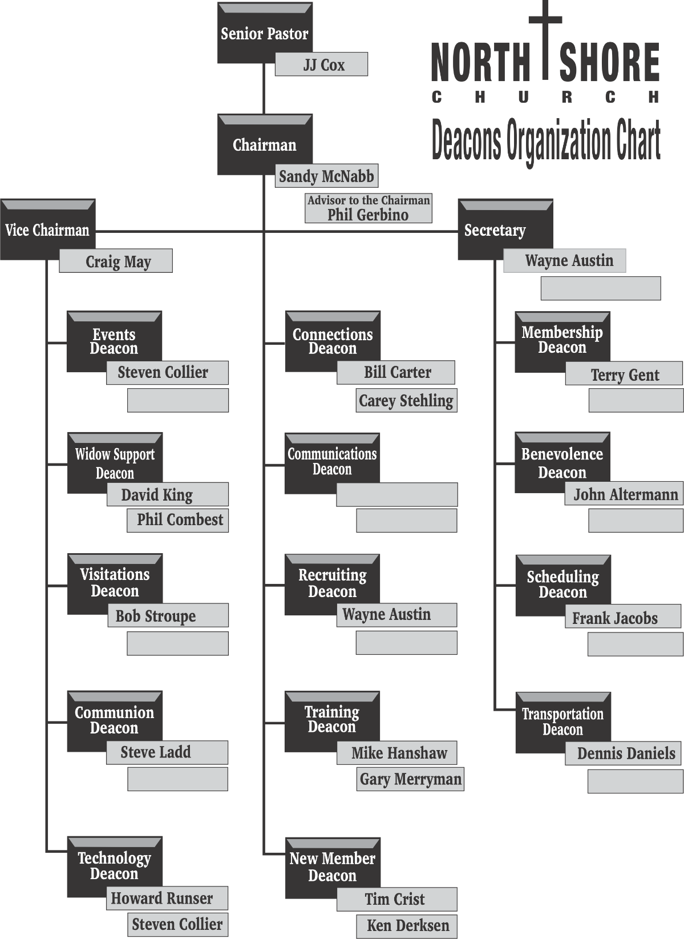
NSC Deacon Organization - Current

