Slide 1


E-zekiel Software Installation
What is it?
  Church management software for computers and phones
  Pictures and information on every church member
    Pictures so you can recognize your sub-flock
    Birthdays, addresses, email, phone numbers
  Deacon groups
  Any many other features

Slide 2
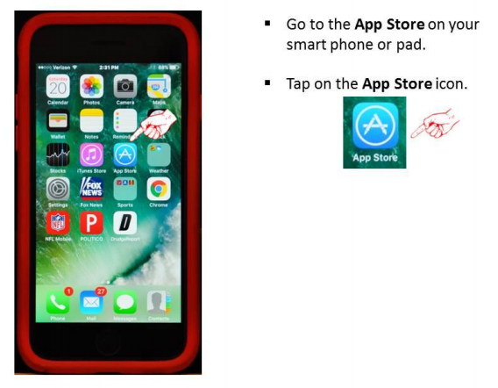
E-zekiel Software Installation – Con’t…

Slide 3
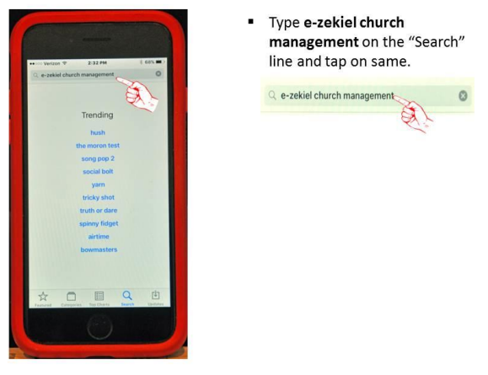
E-zekiel Software Installation – Con’t…

Slide 4
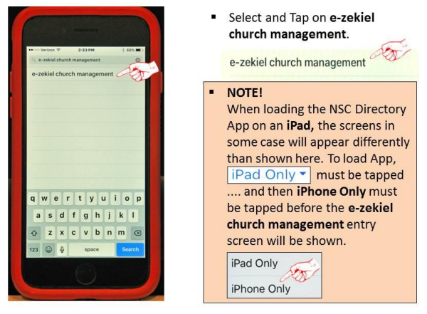
E-zekiel Software Installation – Con’t…

Slide 5
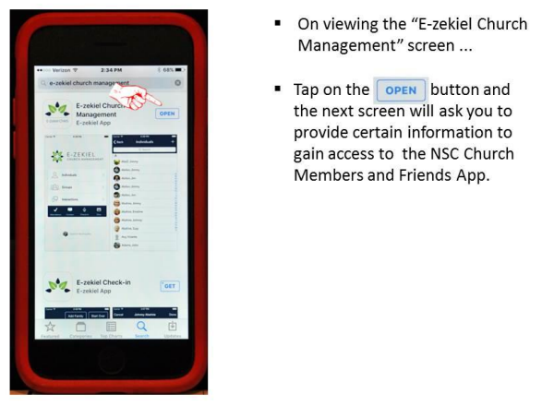
E-zekiel Software Installation – Con’t…

Slide 6
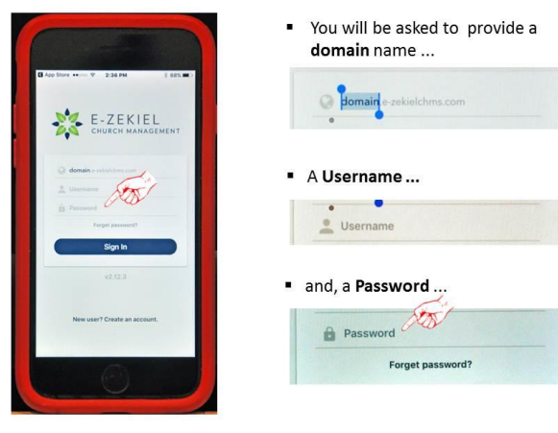
E-zekiel Software Installation – Con’t…

Slide 7
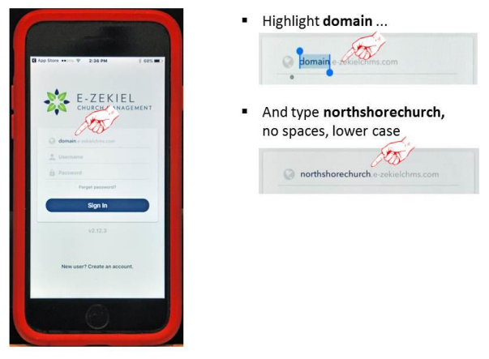
E-zekiel Software Installation – Con’t…

Slide 8
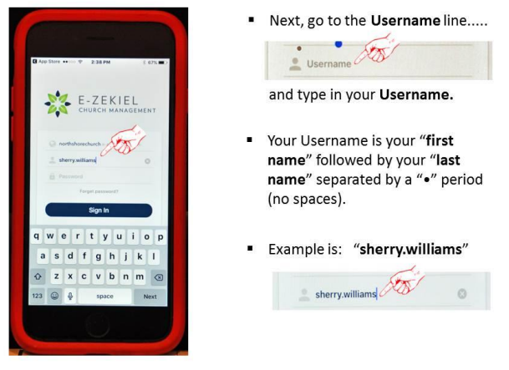
E-zekiel Software Installation – Con’t…

Slide 9
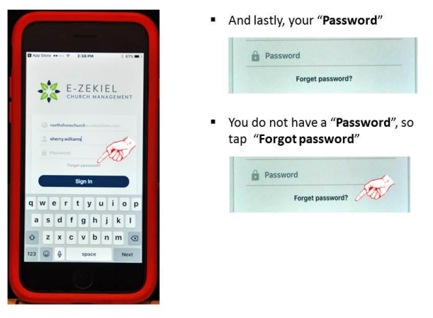
E-zekiel Software Installation – Con’t…

Slide 10
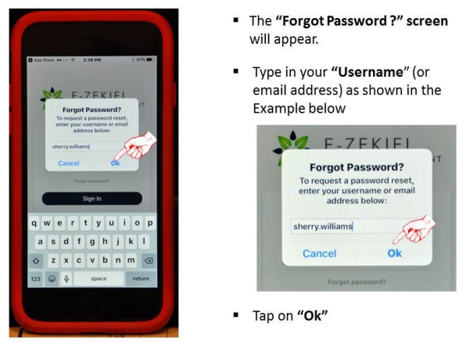
E-zekiel Software Installation – Con’t…

Slide 11
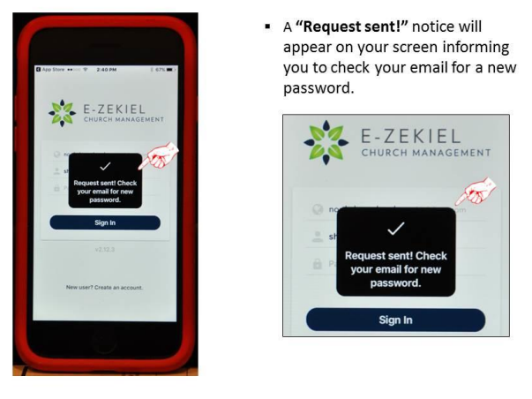
E-zekiel Software Installation – Con’t…

Slide 12
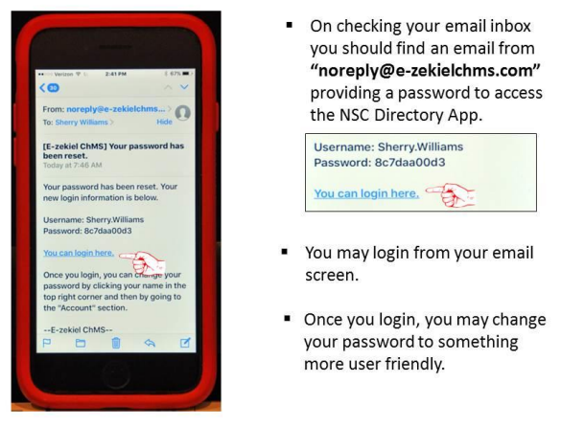
E-zekiel Software Installation – Con’t…

Slide 13
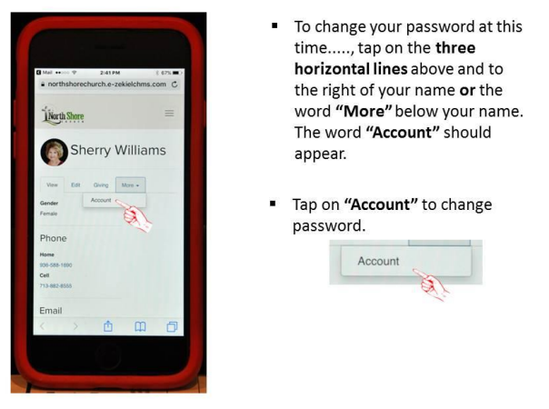
E-zekiel Software Installation – Con’t…

Slide 14
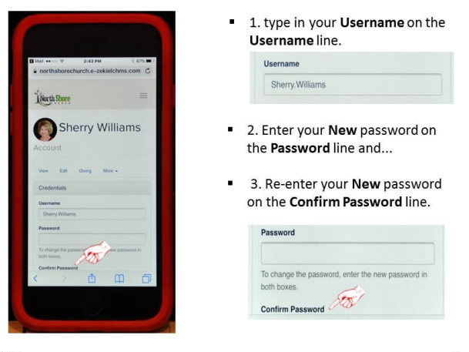
E-zekiel Software Installation – Con’t…

Slide 15
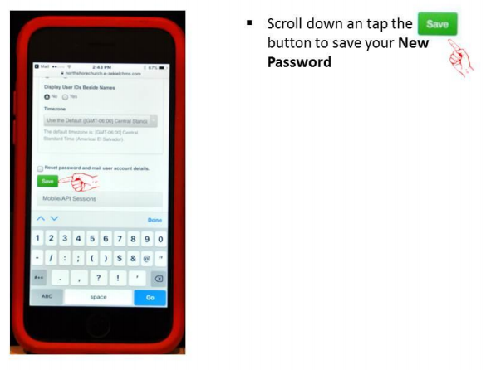
E-zekiel Software Installation – Con’t…

Slide 16
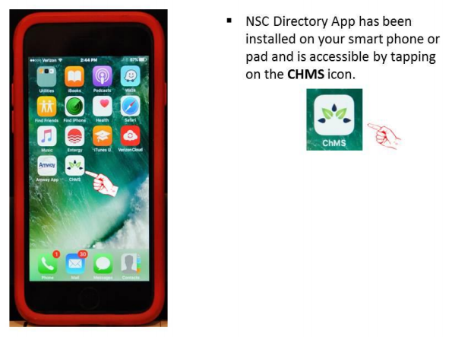
E-zekiel Software Installation – Con’t…

Slide 17
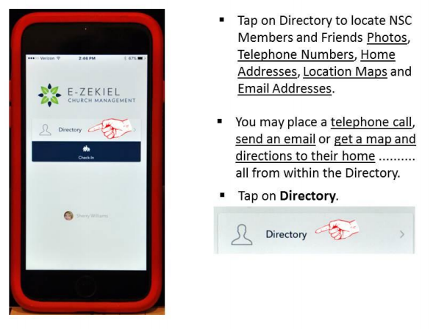
E-zekiel Software Installation – Con’t…

Slide 18
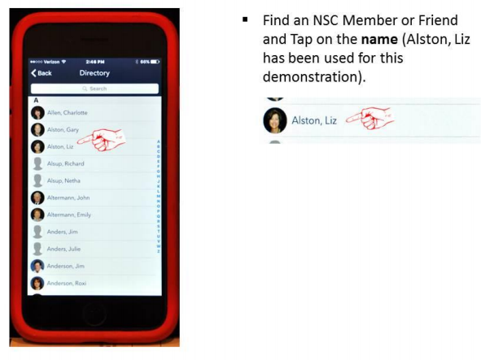
E-zekiel Software Installation – Con’t…

Slide 19
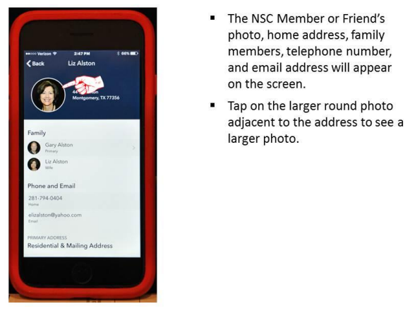
E-zekiel Software Installation – Con’t…

Slide 20
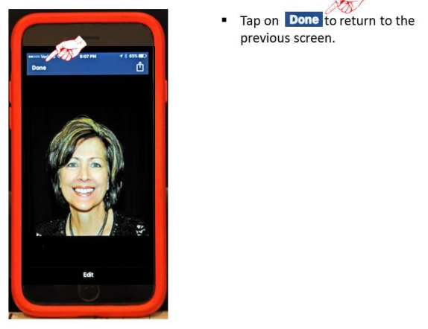
E-zekiel Software Installation – Con’t…

Slide 21
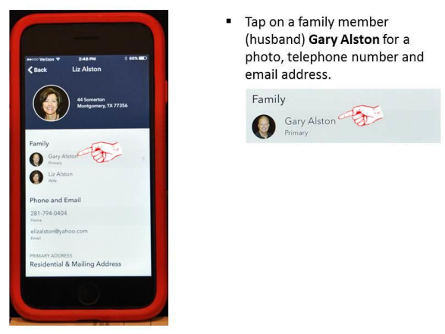
E-zekiel Software Installation – Con’t…

Slide 22
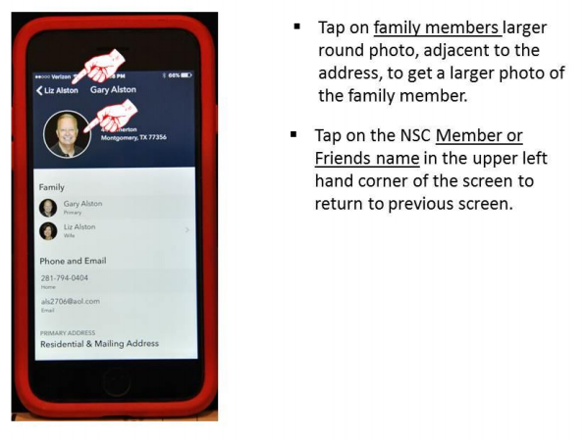
E-zekiel Software Installation – Con’t…

Slide 23
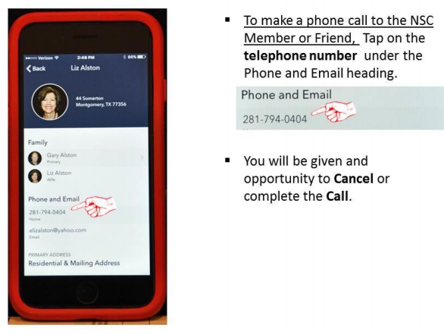
E-zekiel Software Installation – Con’t…

Slide 24
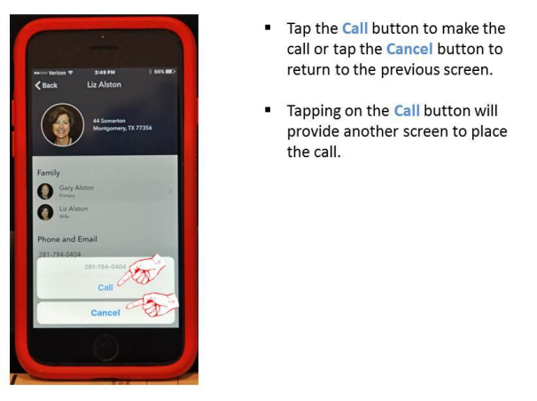
E-zekiel Software Installation – Con’t…

Slide 25
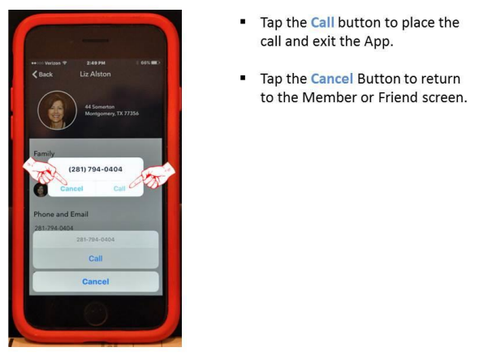
E-zekiel Software Installation – Con’t…

Slide 26
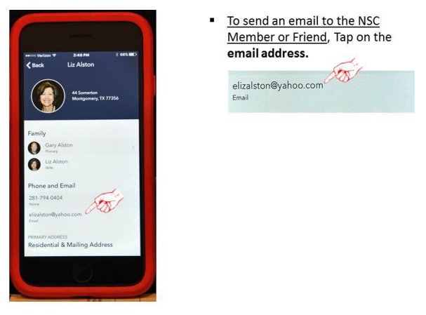
E-zekiel Software Installation – Con’t…

Slide 27
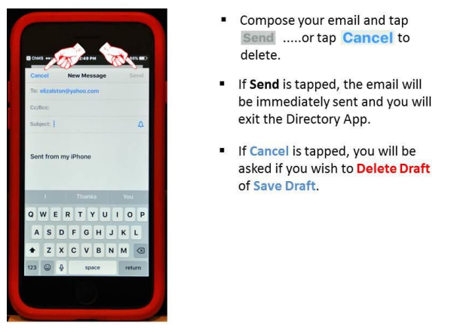
E-zekiel Software Installation – Con’t…

Slide 28
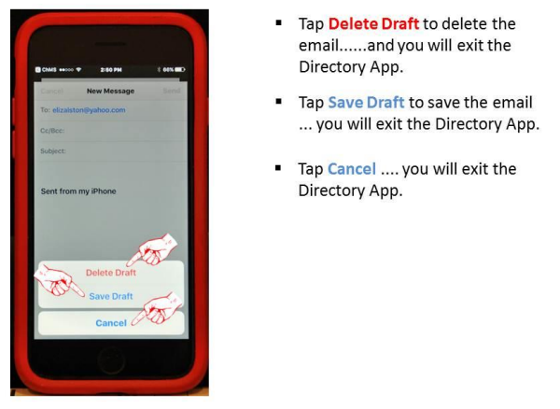
E-zekiel Software Installation – Con’t…

Slide 29
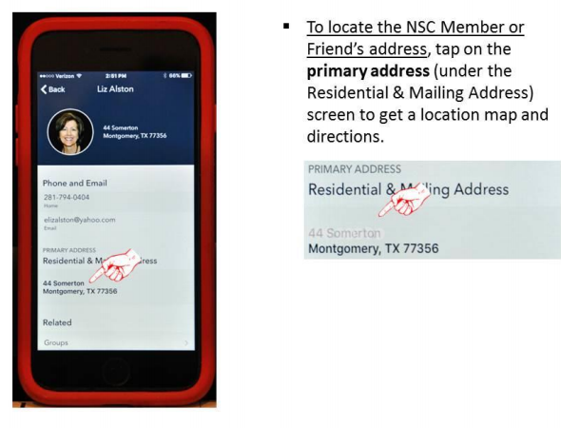
E-zekiel Software Installation – Con’t…

Slide 30
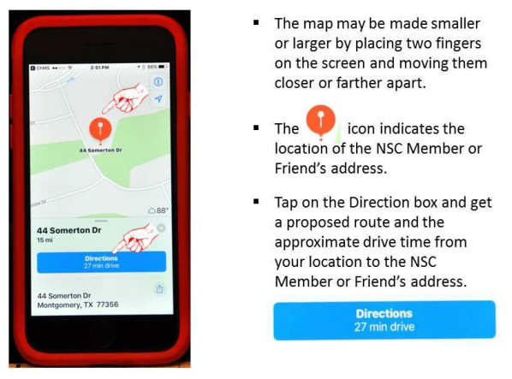
E-zekiel Software Installation – Con’t…

Slide 31
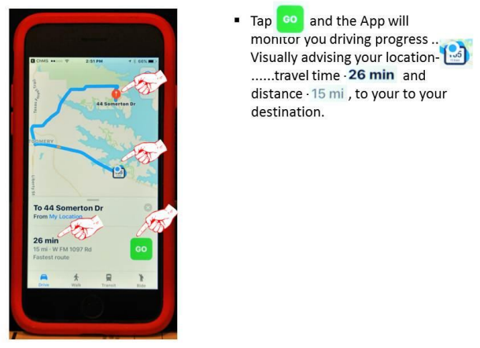
E-zekiel Software Installation – Con’t…

Slide 32
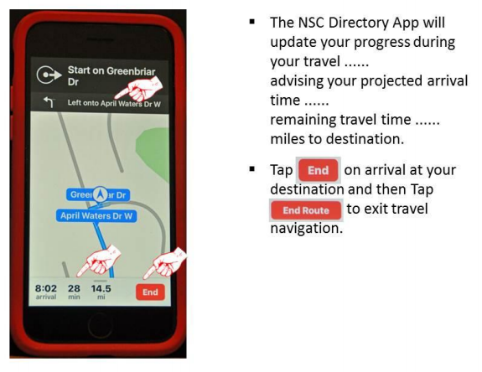
E-zekiel Software Installation – Con’t…

Slide 33
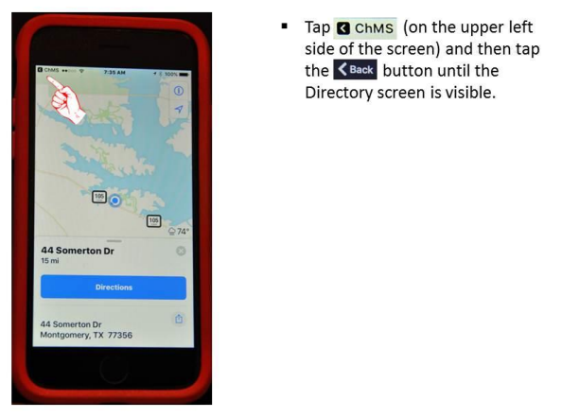
E-zekiel Software Installation – Con’t…

Slide 34
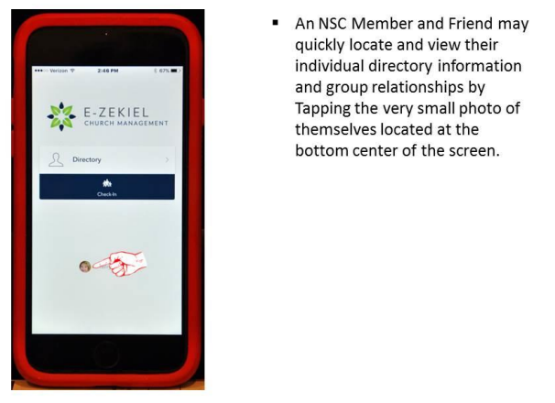
E-zekiel Software Installation – Con’t…

Slide 35
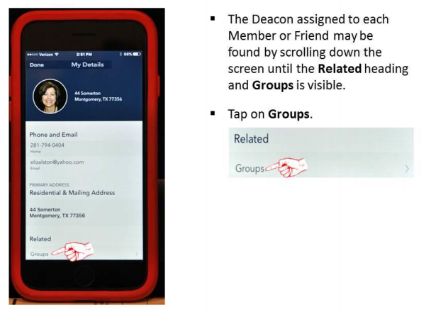
E-zekiel Software Installation – Con’t…

Slide 36
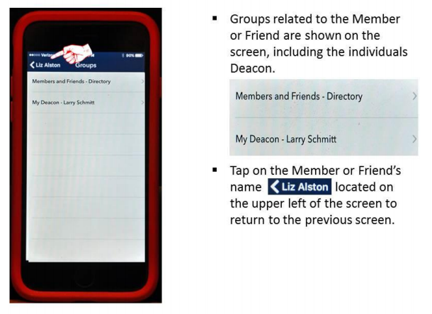
E-zekiel Software Installation – Con’t…

Slide 37
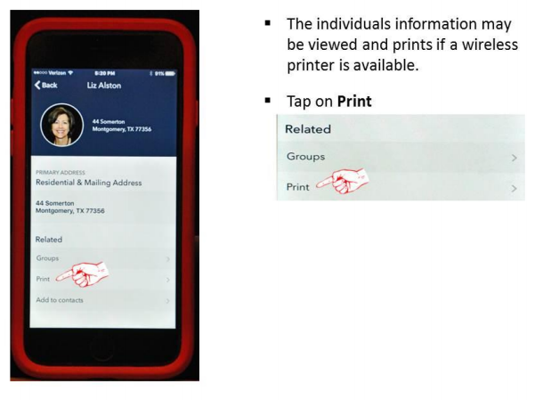
E-zekiel Software Installation – Con’t…

Slide 38
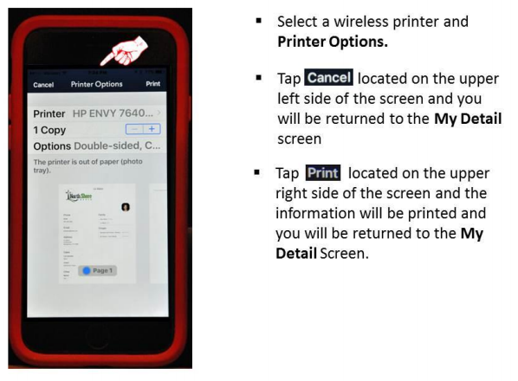
E-zekiel Software Installation – Con’t…

Slide 39
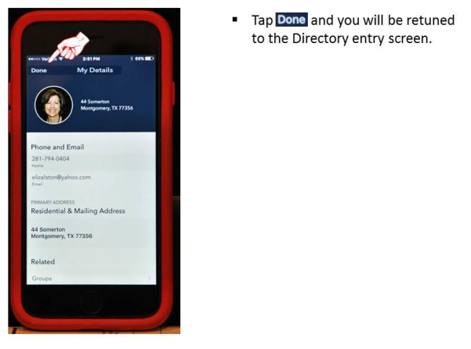
E-zekiel Software Installation – Con’t…

Slide 40
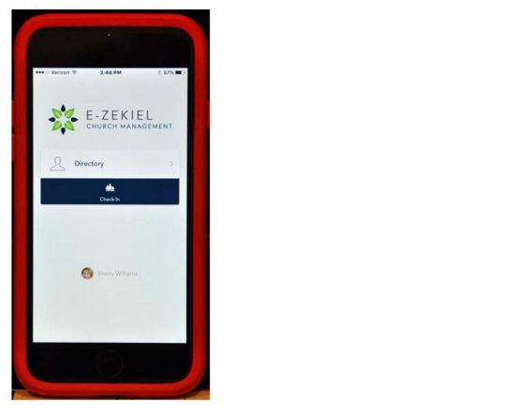
E-zekiel Software Installation – Con’t…

Slide 41
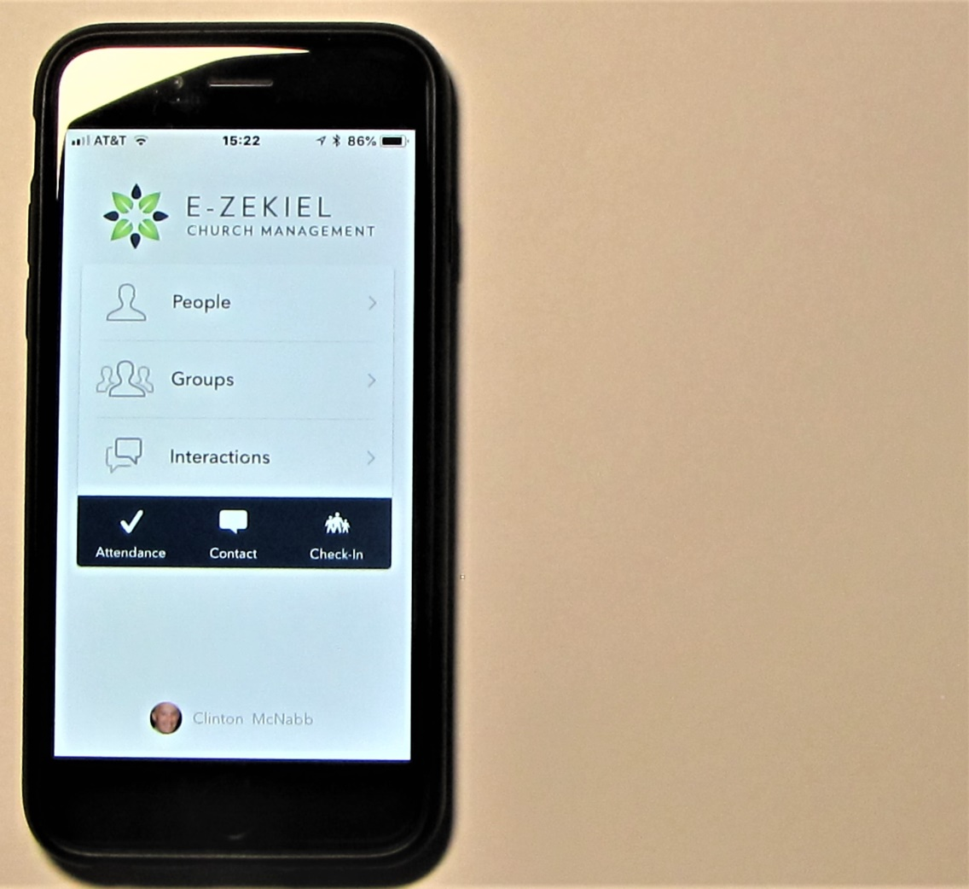
E-zekiel Software Installation – Con’t…

Slide 42
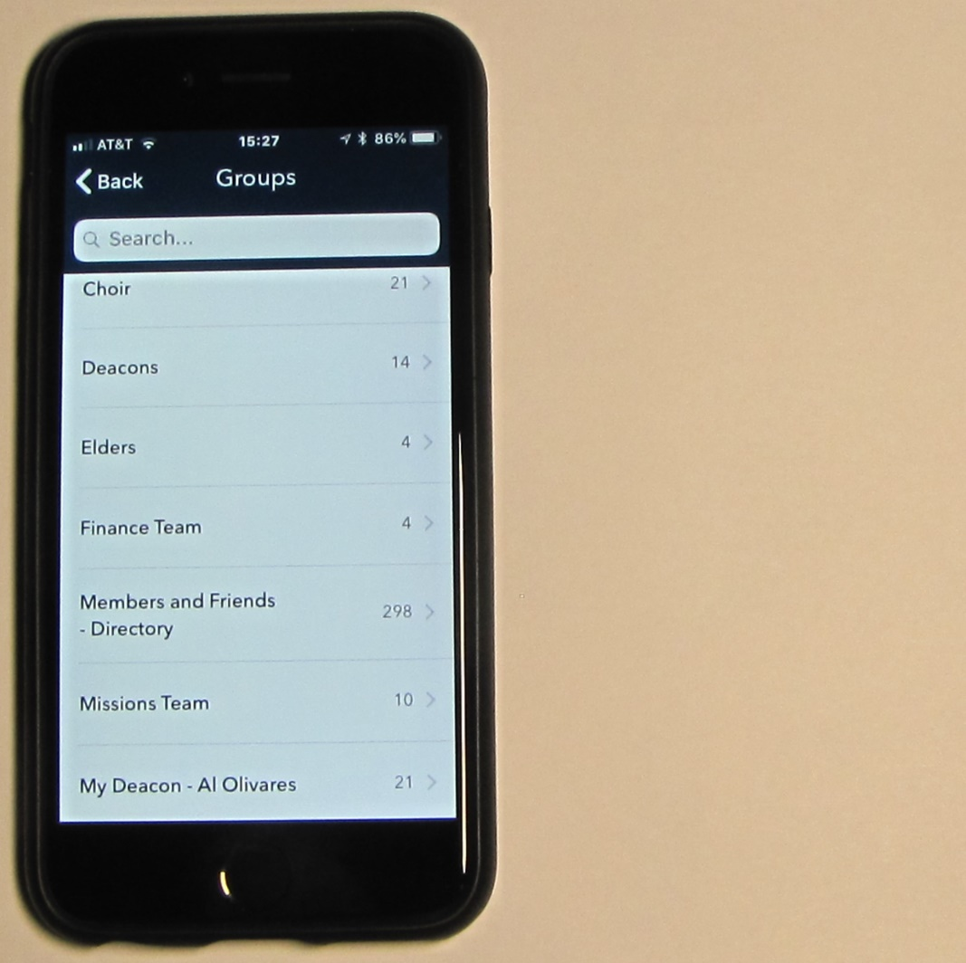
E-zekiel Software Installation – Con’t…

Slide 43
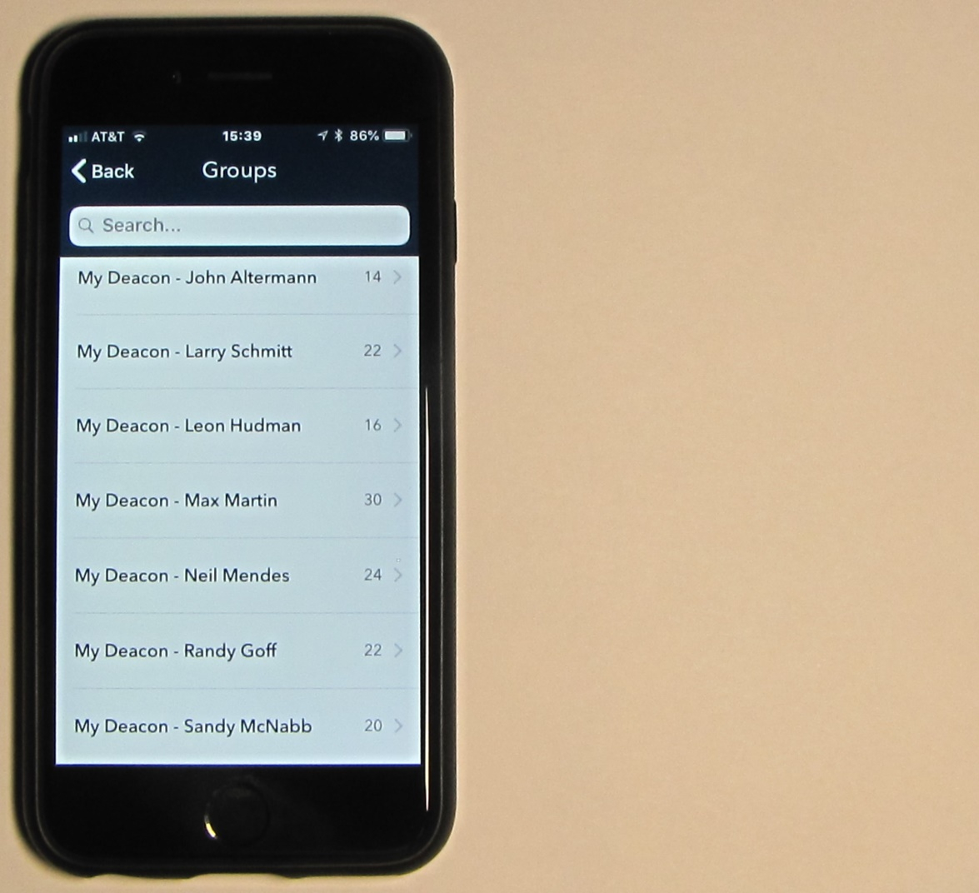
E-zekiel Software Installation – Con’t…

Slide 44
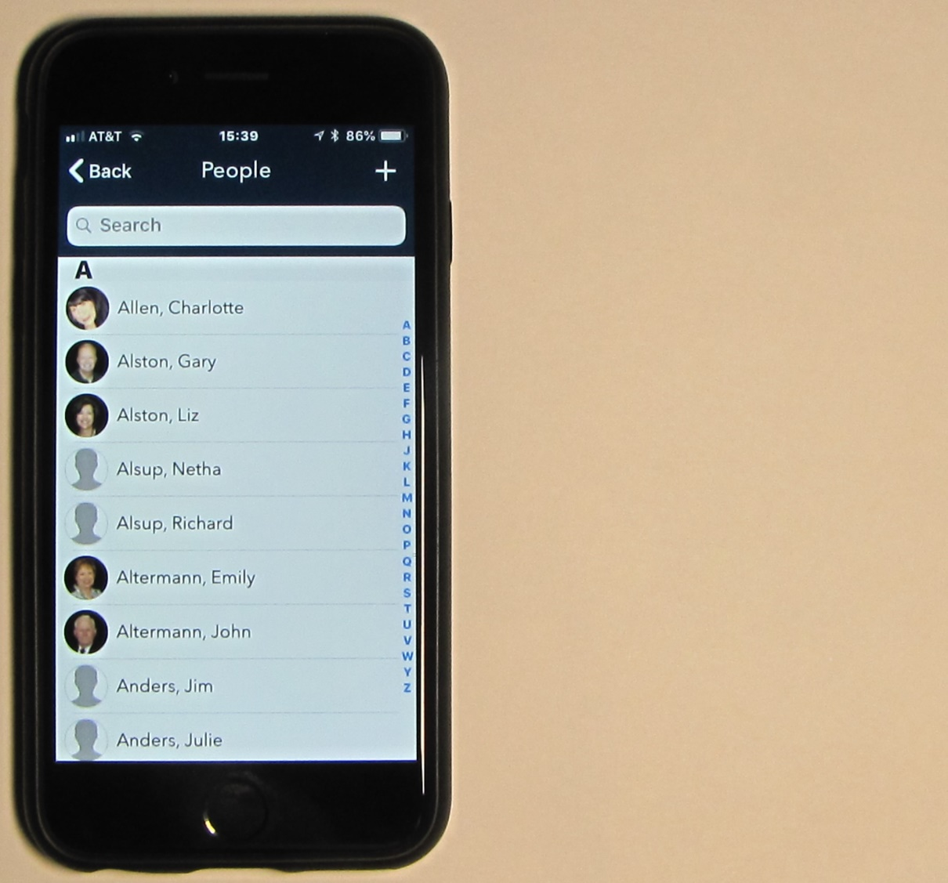
E-zekiel Software Installation – Con’t…

Slide 45
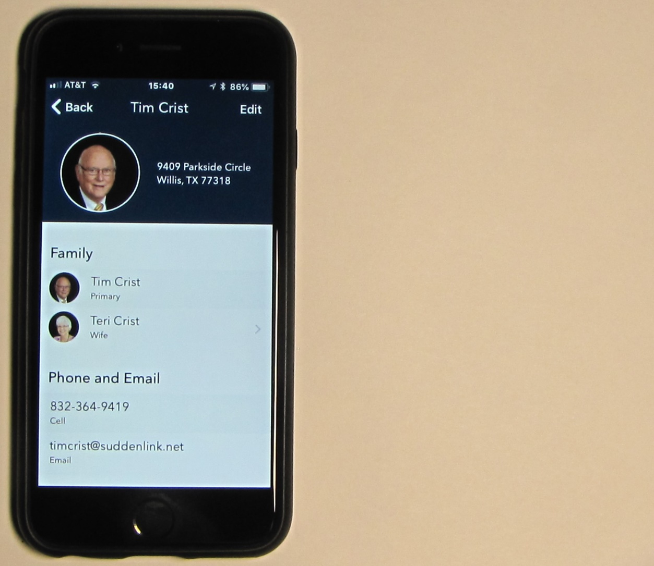
E-zekiel Software Installation – Con’t…

Slide 46
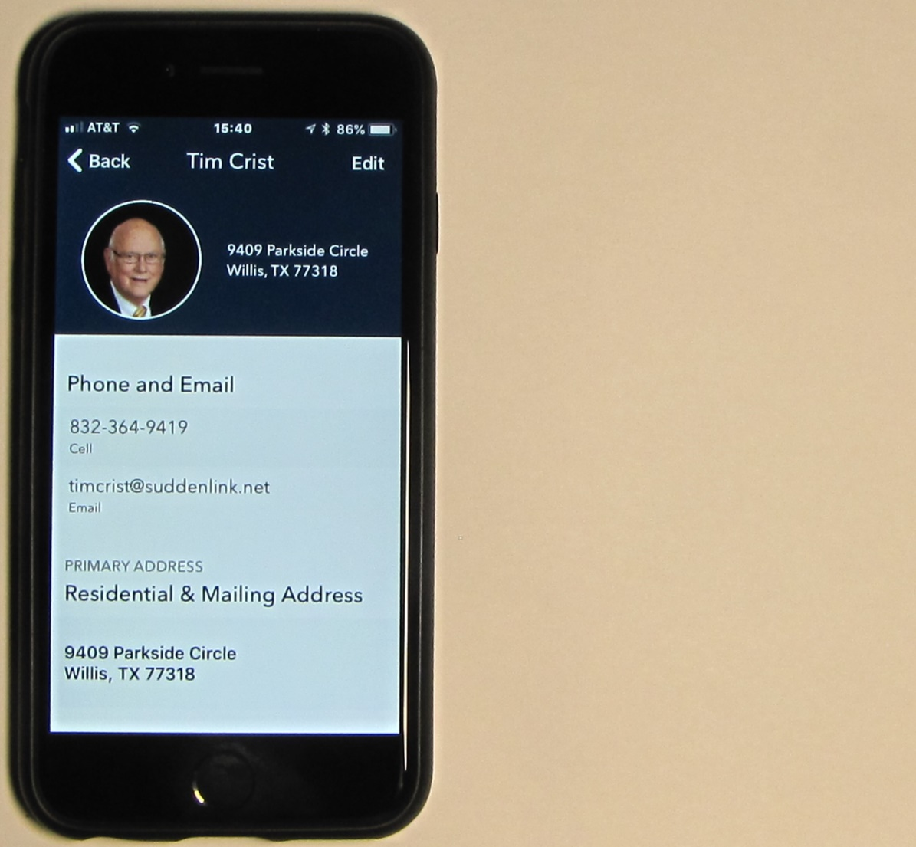
E-zekiel Software Installation – Con’t…

Slide 47
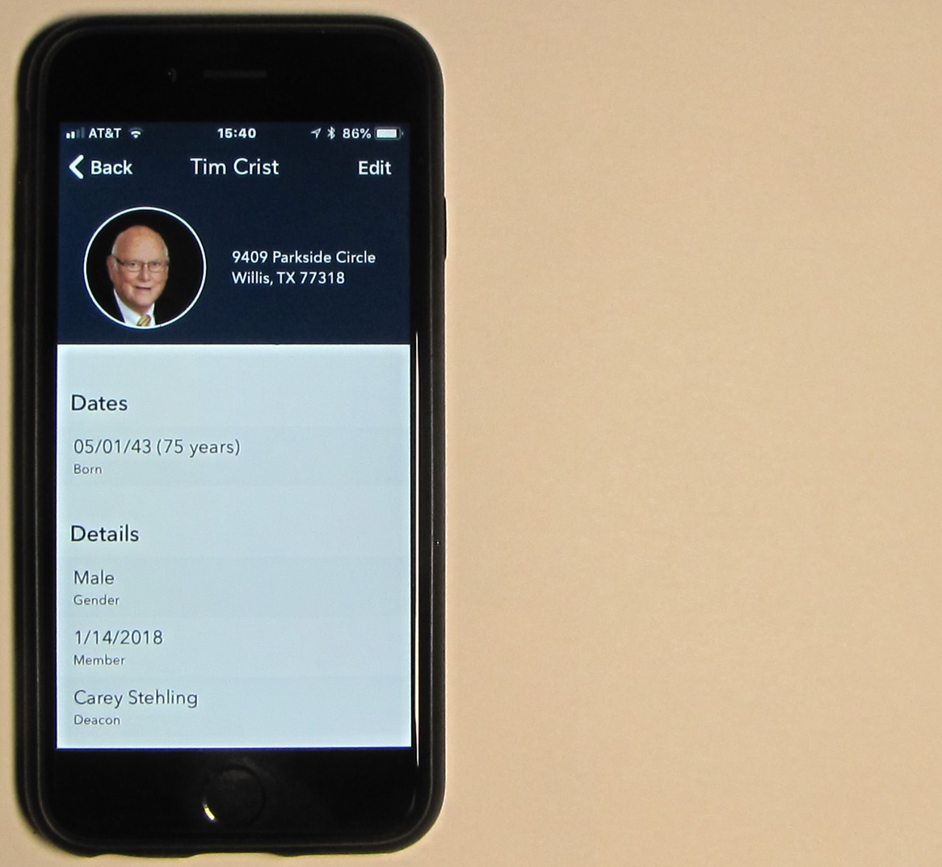
E-zekiel Software Installation – Con’t…

Slide 48
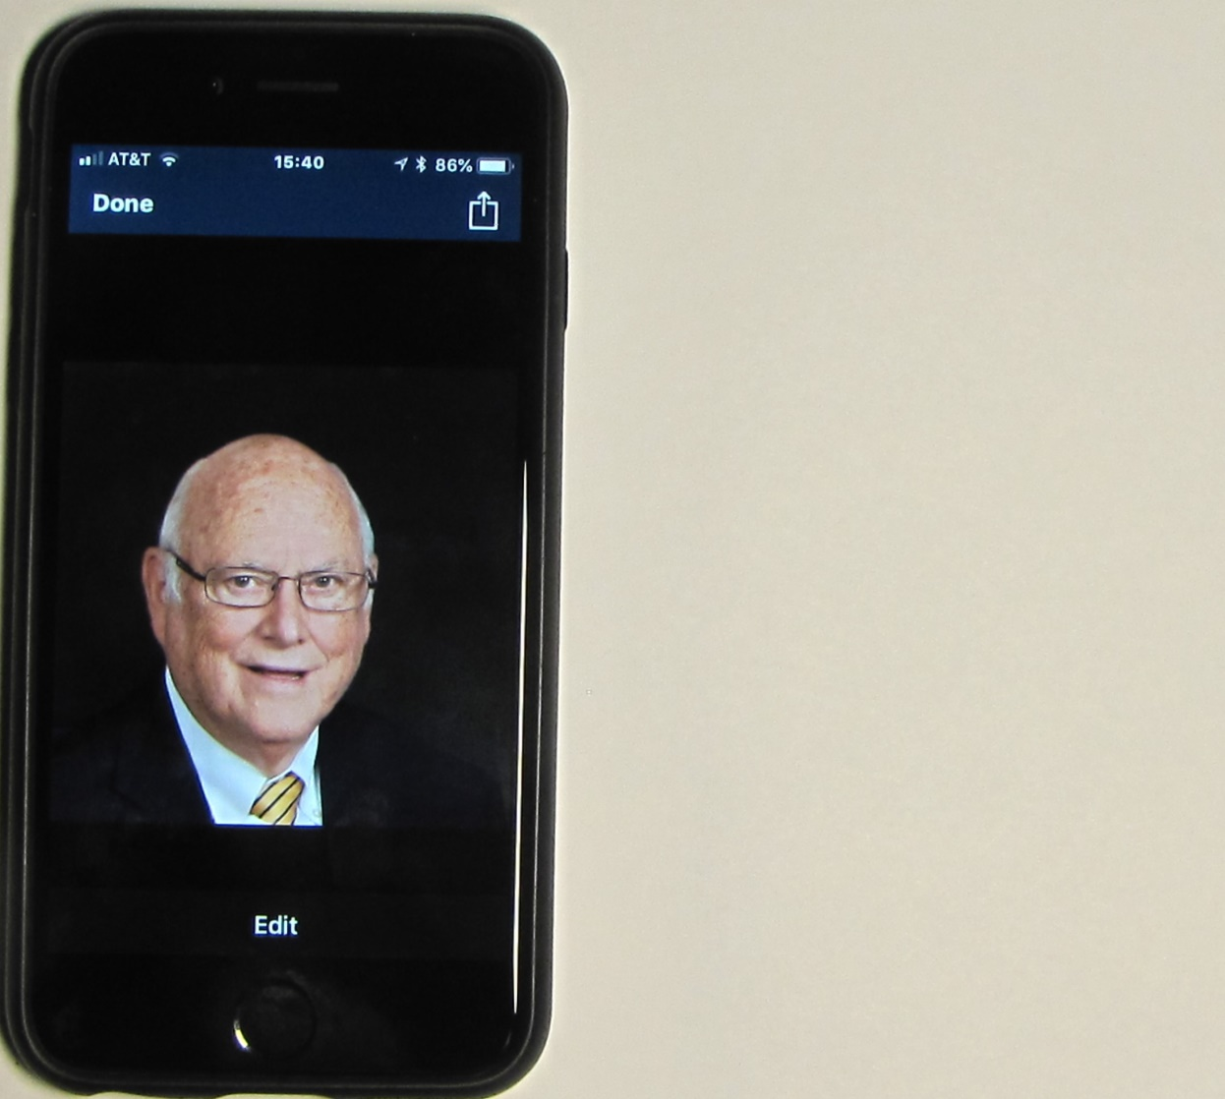
E-zekiel Software Installation – Con’t…

Slide 49
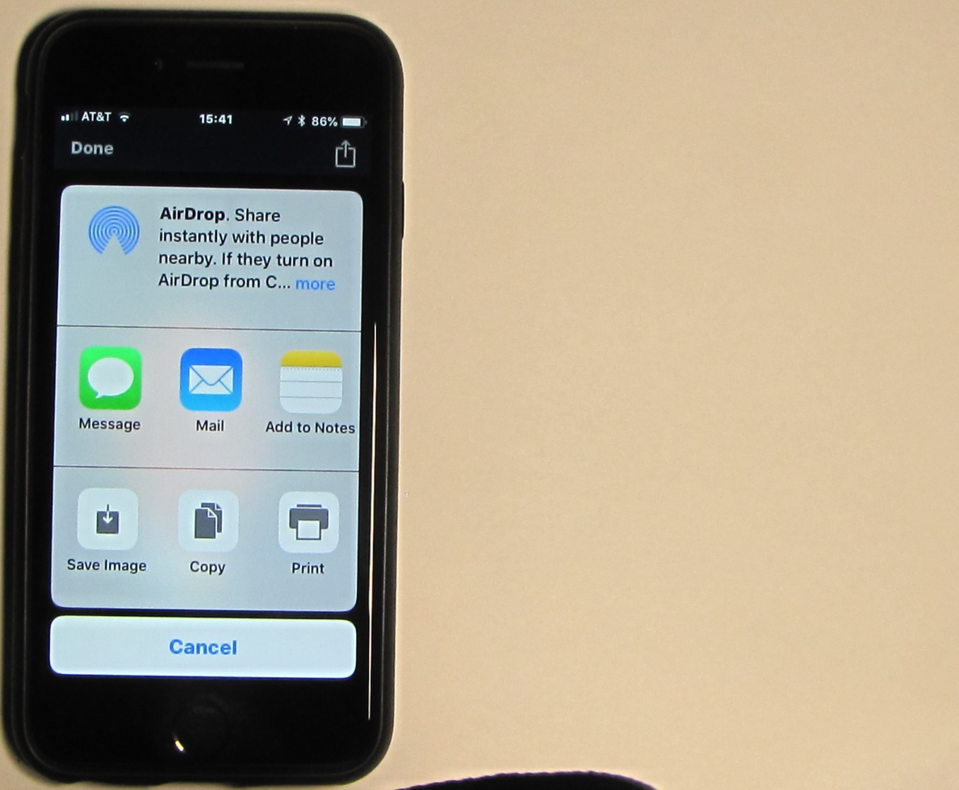
E-zekiel Software Installation – Con’t…

Slide 50
Keys and Codes – Cyndie Sells
Your key fits everything
Your code is your particular code

