Slide 1
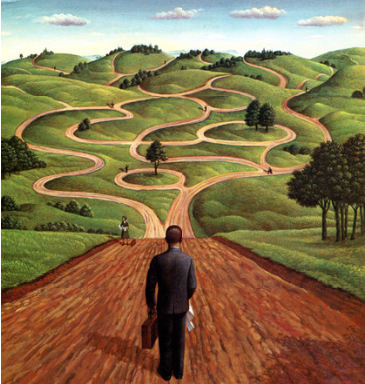

My Faith,
My Life
By Ashley Watson
Director of Youth Ministry
Genesis 50:19-21
November 2022

Slide 2
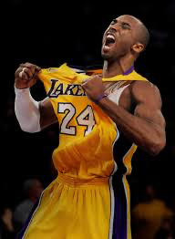

Mamba Mentality
A constant quest to be the best version of oneself.
Connecting with God Growing Together Changing the World

Slide 3
Spiritual Journey
The road that we take to be the best me that God has called me to be.
Connecting with God Growing Together Changing the World

Slide 4
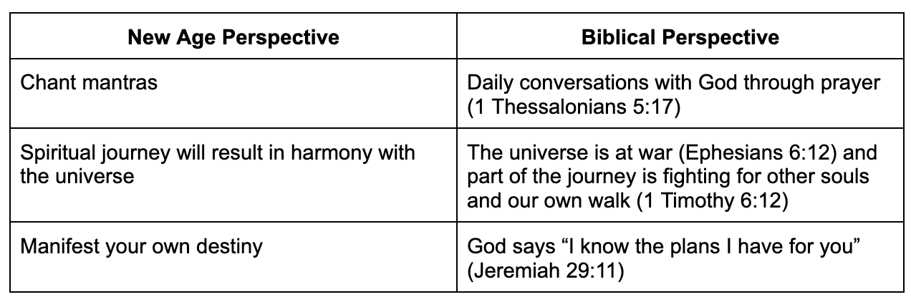
Connecting with God Growing Together Changing the World

Slide 5
Spiritual Journey Spectrum
Searchers
Not interested
Curiously Seeking
Searching assertively
Followers
Lordship Decision
Natural Promotion
Valley of Dependence
Preparation
Valley of Wholeness
Releasing
Valley of Identity
Fulfillment
Connecting with God Growing Together Changing the World

Slide 6
Calling Journey Model
Call Definition: embodying a unique facet of Christ’s character through the channel of your role or task
Connecting with God Growing Together Changing the World

Slide 7
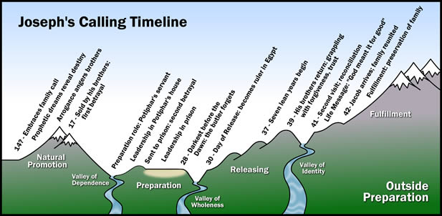
Connecting with God Growing Together Changing the World

Slide 8
Natural Promotion
We have innate abilities but not the character
Joseph has prophetic dreams
Joseph is arrogant
Honeymoon phase
Connecting with God Growing Together Changing the World

Slide 9
Valley of Dependence
Joseph’s brothers sold him into slavery
External events cause a plummet
Learn to rely on God
Connecting with God Growing Together Changing the World

Slide 10
Preparation
Joseph manages Potiphar’s house
Experience and skills are gained
Connecting with God Growing Together Changing the World

Slide 11
Valley of Wholeness
Cup-bearer forgets to tell Pharaoh about Joseph
Joseph is here for 2 years
Connecting with God Growing Together Changing the World

Slide 12
Day of Release
Cup-bearer remembers Joseph
Joseph is promoted to be the ruler of Egypt
Connecting with God Growing Together Changing the World

Slide 13
Valley of Identity
Transformed from doing to being
Your own accomplishments don’t matter
Joseph had to forget about the betrayal his brothers did
Connecting with God Growing Together Changing the World

Slide 14
Fulfillment
Genesis 50:19-21 “You intended to harm me, but God intended it for good. He brought me to this position so I could save the lives of many people.”
Connecting with God Growing Together Changing the World

Slide 15
3 Actions
Map out your and journey and identify where you are now
Empathy for others
Find somebody to journey with
Connecting with God Growing Together Changing the World

Slide 16
Questions
What have life experiences prepared you for?
What have your failures and missteps qualified you to do?
What has God revealed too you about your sense of purpose for your life?
How has family, community, culture shaped and impacted your personal sense of destiny?
Connecting with God Growing Together Changing the World

