Slide 1


Slide 2


Slide 3
Scripture
Acts 22:14-15; 26:16; 20:24; 2 Cor 4:1,16, 5:5-10
Remember your leaders, who spoke the word of God to you. Consider the outcome of their way of life and imitate their faith
(Heb 13:7, NIV)

Slide 4
The Apostle Paul
10 years of service - Travelled 9950 miles
Wrote 13 Books of the New Testament
Planted 14 Churches, 4 Mission Trips
Revival in Ephesus, Mentored 32 people
Unsure of future, circumstances, trials

Slide 5
Trouble, Trials, Temptation, Tribulation
2 Cor 1:8, 2:4, 5:5, 6:4, 7:5, 11:23-33, 12:7
Whatever - Phil 1:12, 19, 27, 2:23, 3:1, 4:11
1 year after Church plant – Acts 18, no unity,
False teachers, dysfunctional and immorality

Slide 6
Therefore, we not lose heart (4:1,16)
Therefore, we are always confident (5:6,9)
Confidence(Ekkakeo) – lose heart, give up

Slide 7
When we do not pray (Luke 18:1)
When experience persecution (Eph 3:13)
When we try to do good (2 Thes 3:13, Gal 6:9)
When we serve (2 Cor 4:1)

Slide 8
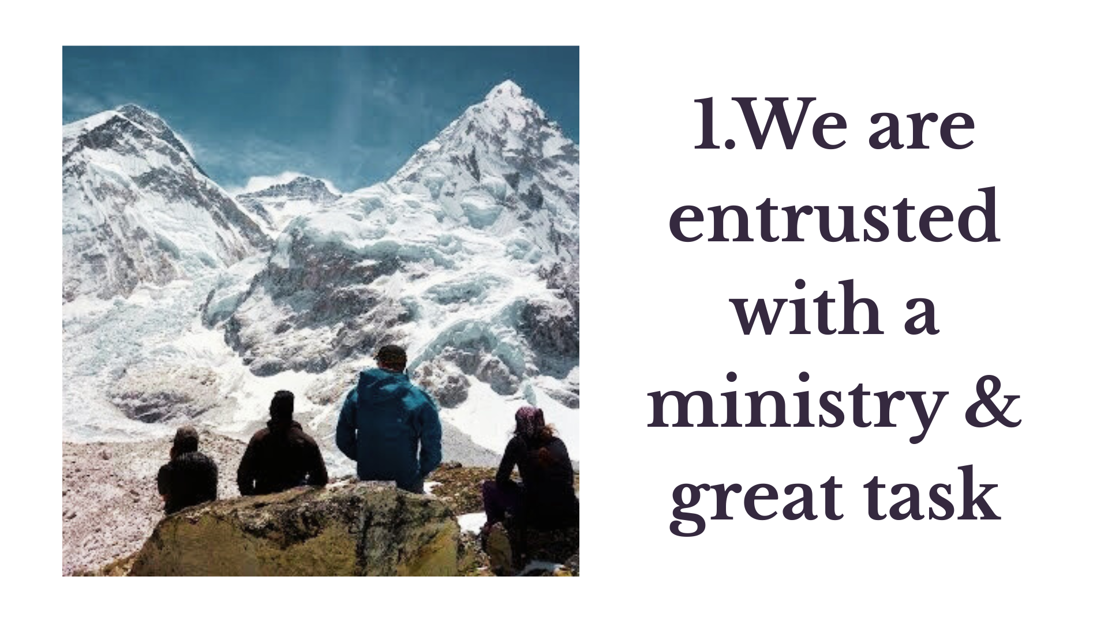

Slide 9
2 Cor 3:17-18, Exodus 34
God’s Glory
Takes time to change and transform
It is the look that saves but the gazing that changes – Robert Murray Mc Cheynne

Slide 10
Paul say – Therefore 2 Cor 4:1
We are entrusted with a special ministry
Ministry – 32 times, 7 in Corinthians
God has saved me
God has blessed me
God has given me the opportunity to join Him

Slide 11
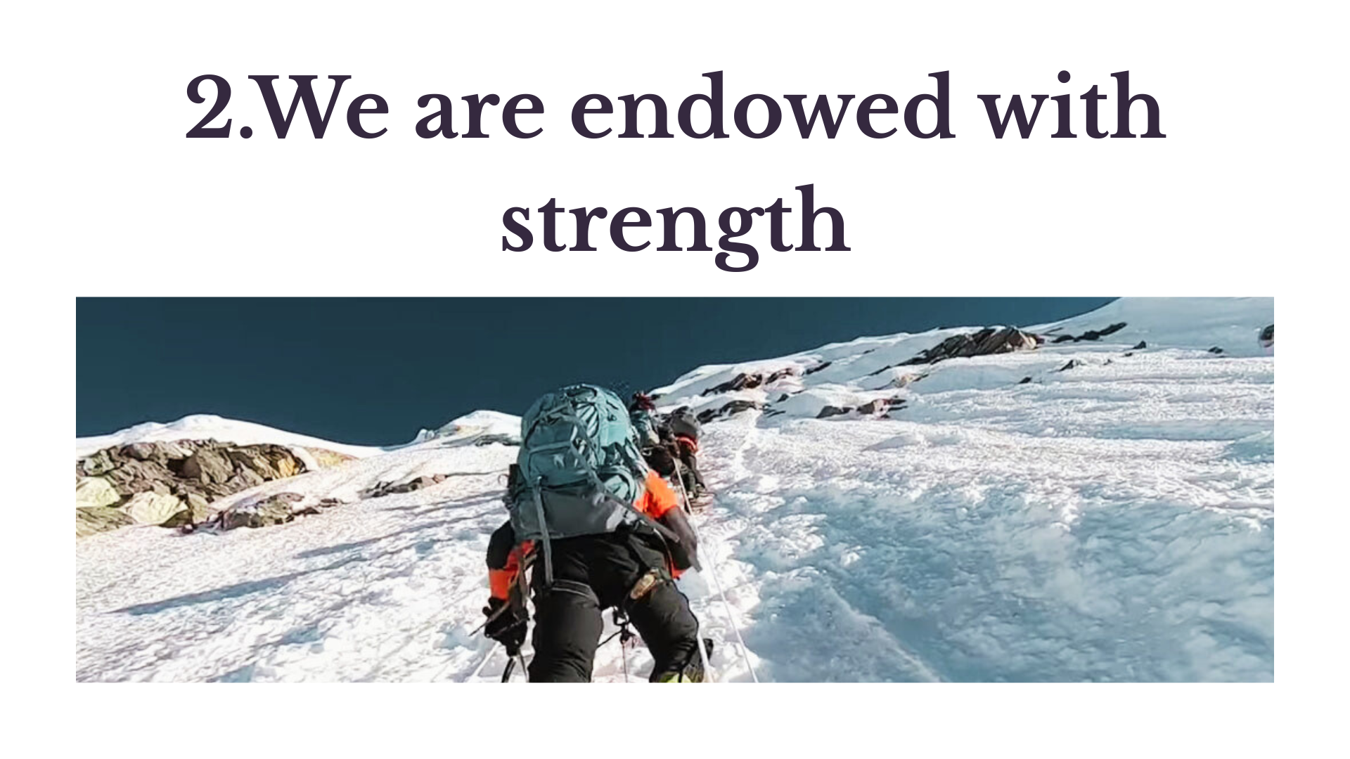

Slide 12
Why?
God’s presence and power v7-9
The spirit of our faith v13
The hope of resurrection v14
The needs of the people and glory of God v15

Slide 13
Paul say – Therefore 2 Cor 4:16
We are endowed with strength
We are naturally given, provided with,
or equipped with a specific quality,
ability, or right

Slide 14
2 Our outer bodies perish
Jar of Clay v 7; Human body v 10
Mortal body v 11; Earthly tent 5:1
Wasting away – age, wear out, decay, die
Body in process of perishing/dying

Slide 15
3 Inner self – renewed day by day
Human Spirit – born again (Jn 3:3, 3-5)
Made alive by Jesus (Eph 2:2, 4-5)
“New Creation” (2 Cor 5:17)
“New Self” (Eph 4:24, Col 3:12)
“Hidden person in us” (1 Pet 3:4) – Spirit

Slide 16
What about you?
I am getting older but actually getting younger and more like Jesus.
Am I not supposed to be closer to God now than last year this time?

Slide 17
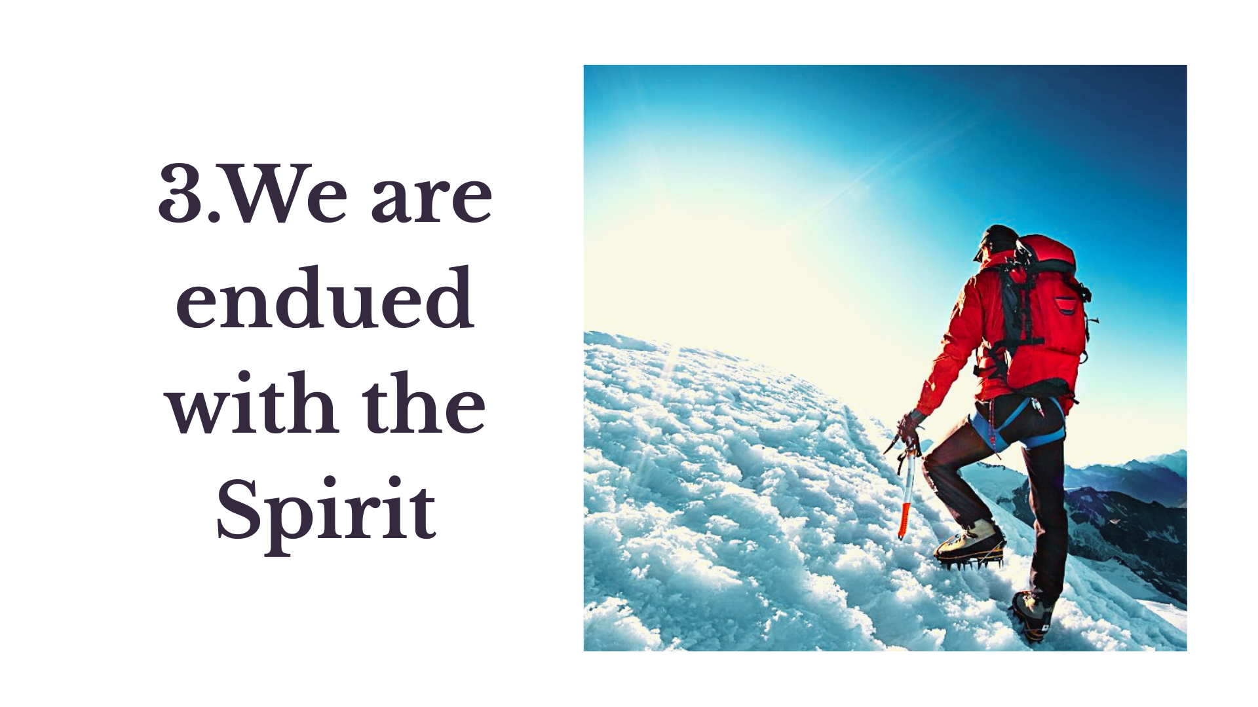

Slide 18
We are endued with the Spirit
5:1-4 - Personal Conviction – we know
5:5 - He guarantees the hope of the Spirit
5:5-8 - He enhances the hope of the Spirit
5:9-10 - He stirs the hope of Resurrection

Slide 19
Paul say – Therefore 2 Cor 5:5-6
2 Cor 5:5 - We are endued with the Spirit
Endued - To be clothed, invested, equipped with divine power, wisdom or abilities by God
To put on like a cloth

Slide 20
Holy Spirit
Active in Jesus life – Birth (Lu 1:35), Baptism (Lu 3:25), Ministry (Lu 4:14), Death (He 9:14) and Resurrection (Rom 8:11)
Led by Spirit (Lu 4:1-2), Empowered by the Spirit (Matt 12:28)

Slide 21
Holy Spirit
35 Miracles (23 Healings, 9 power over nature, 3 people raising from the dead)
The Holy Spirit – the source of His life
He insisted that we wait on Promise – Lu 24:49,

Slide 22
Holy Spirit
God – Attributes
Personality (Will, Emotion, Intellect
Fruit (1/9); Gift (1/21); Deeds (25)
Working (2); Office (2), Baptism

Slide 23


Holy spirit
Attributes
Person
Eternal (Heb 9:14)
Will (1 Cor 12:11),
Emotions (Eph 4:30),
Knowledge ( 1 Cor 2:11)

Slide 24
Holy spirit
Attributes
Person
Fruit
Gifts
Acts/Deeds
Working
Office
Baptism
Eternal (He 9:14)
Will, Emotions, Knowledge
Gal 5
1 Co 12, 1 Pe 4, Rom 12
He leads ( Acts 8:24)
John 16 and 2 Co 3:18
Advocate, Comforter
Acts 1

Slide 25
1, 2
5
Speak (Acts) – Hitpallel
Peace (Fruit)
Convict (Working)
Speak (Acts) – Hitpallel
Peace (Fruit)
3, 4

Slide 27

1, 2
6
Speak (Acts) – Hitpallel
Peace (Fruit)
Convict (Working)
Speak (Acts) – Hitpallel
1st & 2nd Witness
Peace (Fruit)
3, 4
5
?
3, 4

Slide 28
To be Sensitive
He lives within us, who fills us, empower, enlighten, energize, encourages us
The Dove
Are you sensitive for and to the Holy Spirit?

Slide 29
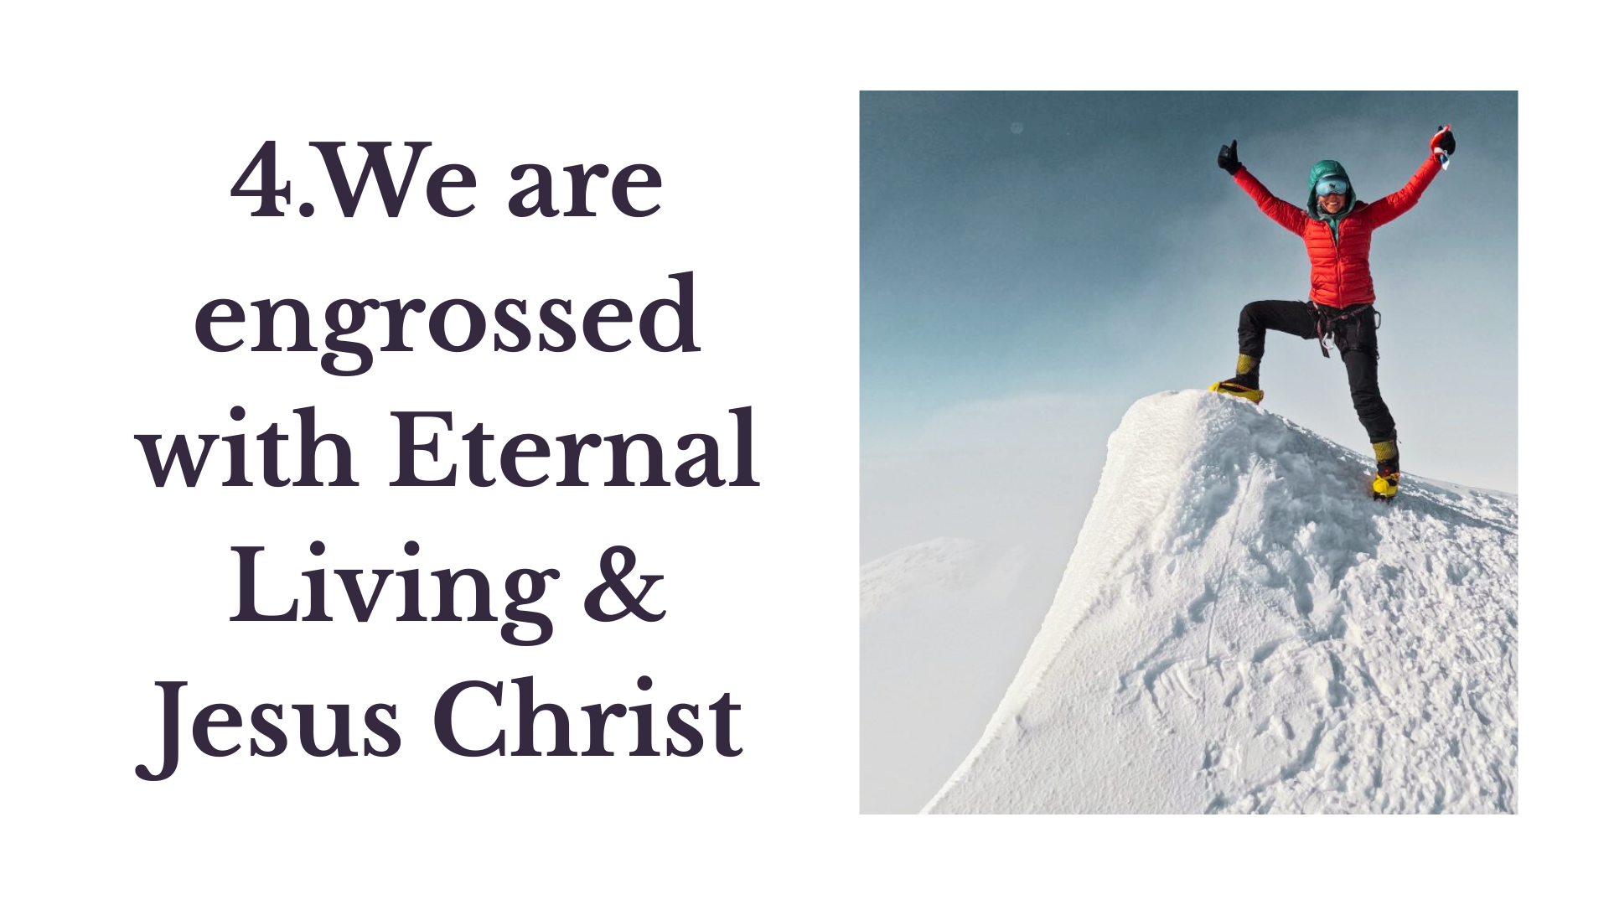

Slide 30
We are engrossed with Jesus
V6 - Gives courage to face the Present
V7 - Stirs to walk by faith
v8 – Therefore, we have confidence and a longing to be with Him

Slide 31
Paul say – Therefore 2 Cor 5:9
v9 – to be pleasing to Him
v10 – Judgement Seat
Jesus engrossed (completely absorbed, preoccupied, wrapped up)
– John 8:29, 4:34, 6:38)

Slide 32
What about you?
No hope or fruit
Do not give up hope
Be faithful
Ask God to empower you (2 Cor 4:1,16)
God works everything out in His time (Gal 6:9)
Stay in/live from His presence (2 Cor 3:18)
Be prepared to serve

