Slide 1



TRAUMA RESPONSE HELPERS

Slide 2
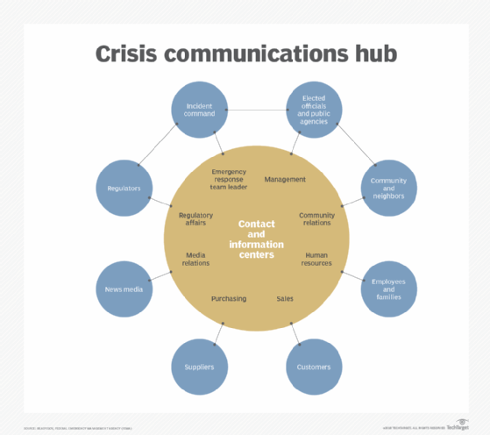

Slide 3


WHO ARE WE?

Slide 4


How Can We Do What Is Asked?
Notes:
Matthew 25:35

Slide 5
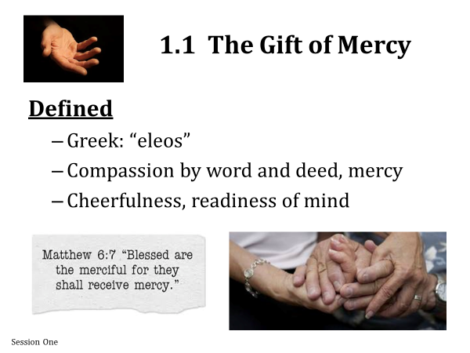

Slide 6
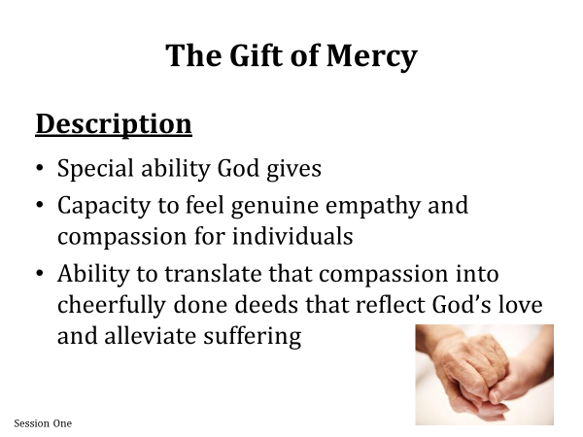

Slide 7
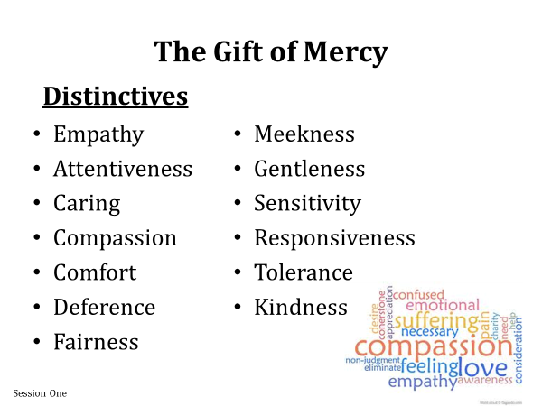

Slide 8
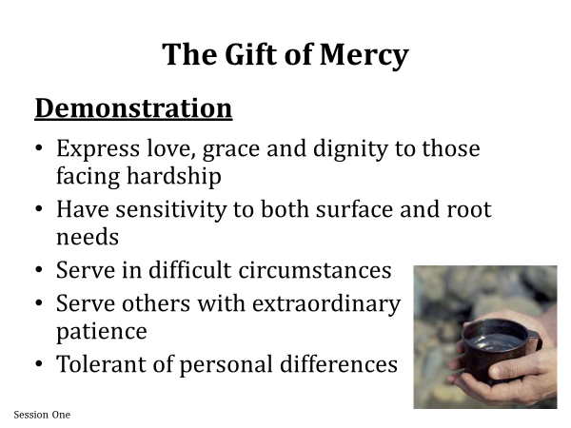

Slide 9
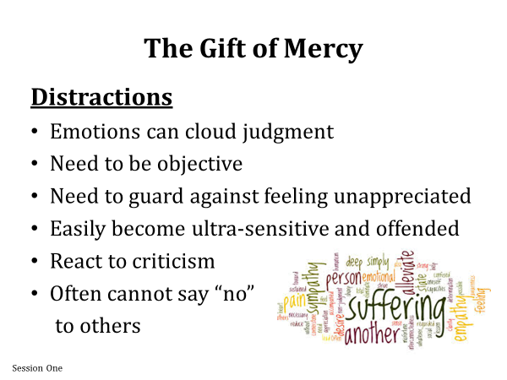

Slide 10
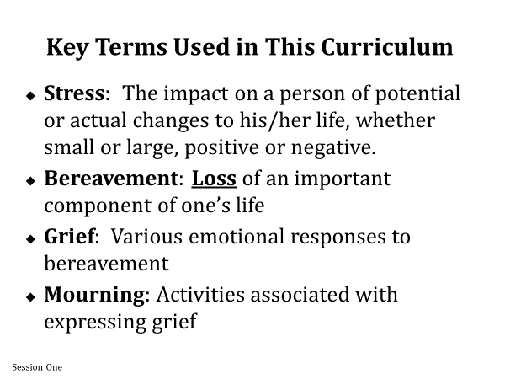

Slide 11
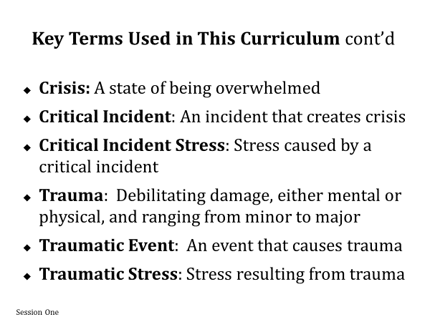

Slide 12
WHAT ARE TRAUMATIC EVENTS?
Render victims helpless by overwhelming force
Involve threats to life or a close encounter with violence or death
Disrupts a sense of control. Connection, or meaning
Confront human beings with the extremities of hopelessness' and terror
Evoke responses of catastrophe
Personal fragility prior to event
Weakness of personal support system
Something becomes “traumatic” by the individual’s perception of the event or situation
*No one decides for someone else whether an event or experience is traumatic to them

Slide 13
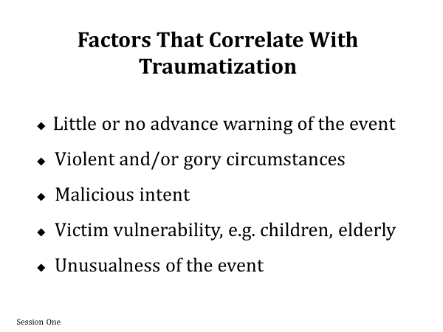
The more of your senses (sight, smell, taste, touch, hearing) impacted, the more traumatic it will be

Slide 14
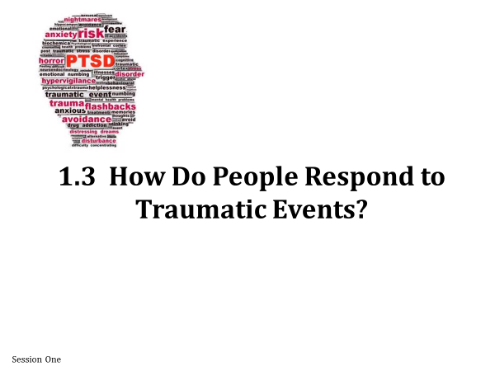

Slide 15
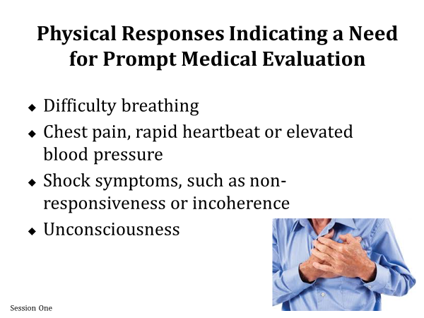

Slide 16
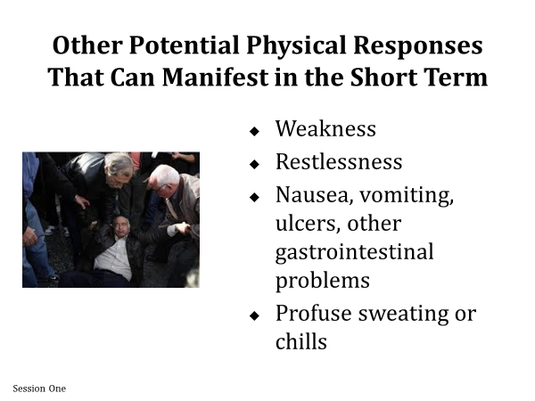

Slide 17
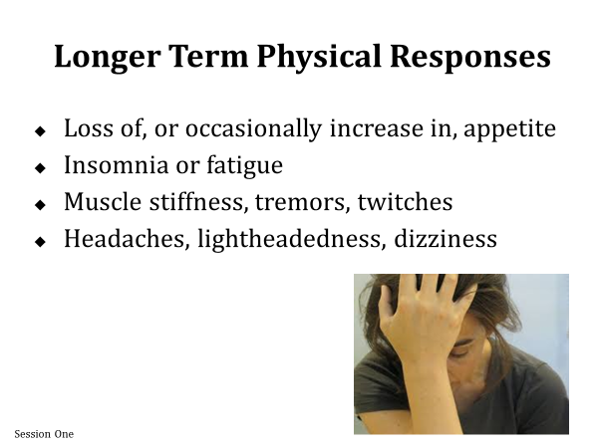

Slide 18
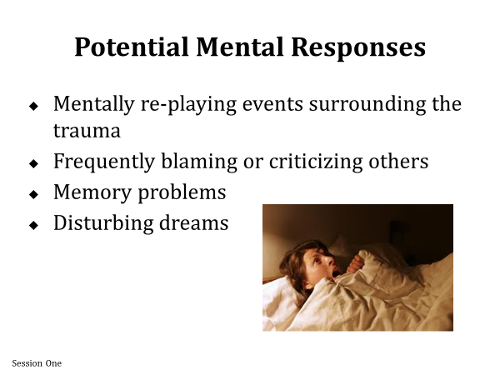

Slide 19
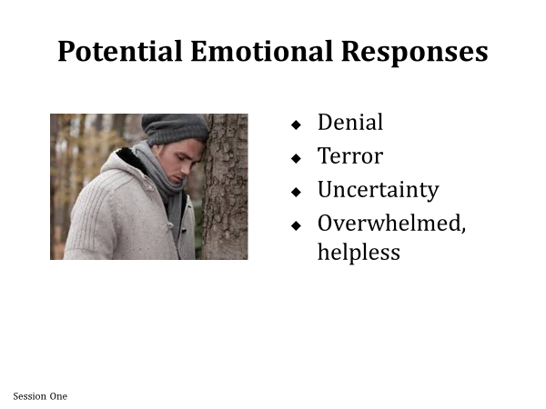

Slide 20
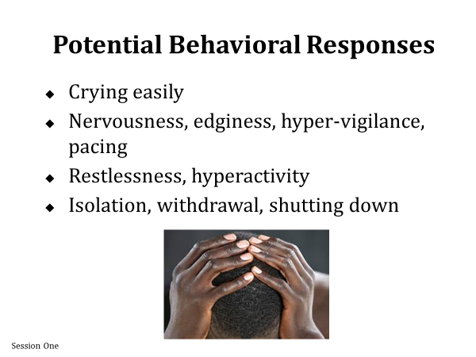

Slide 21
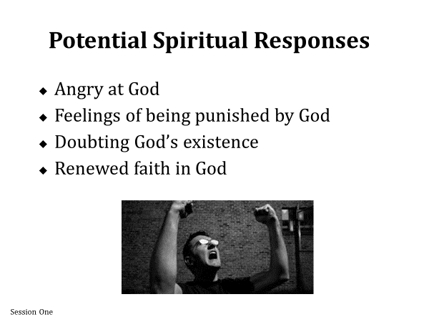

Slide 22
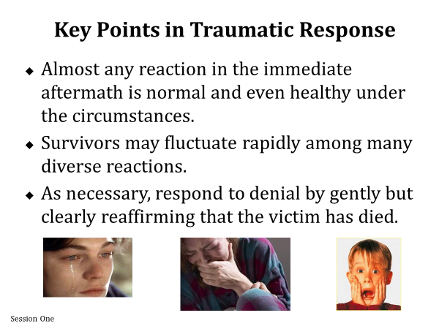

Slide 23
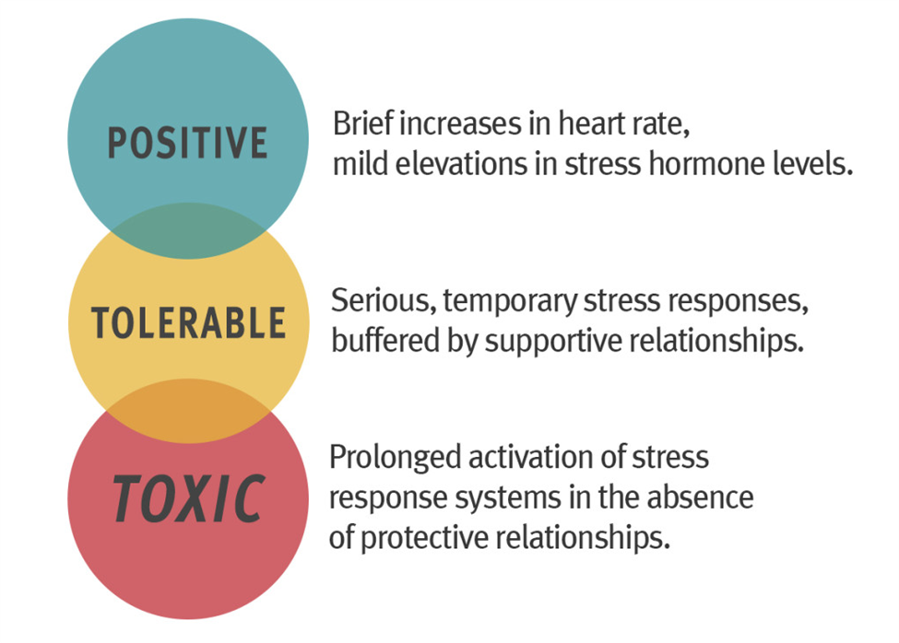

Slide 24
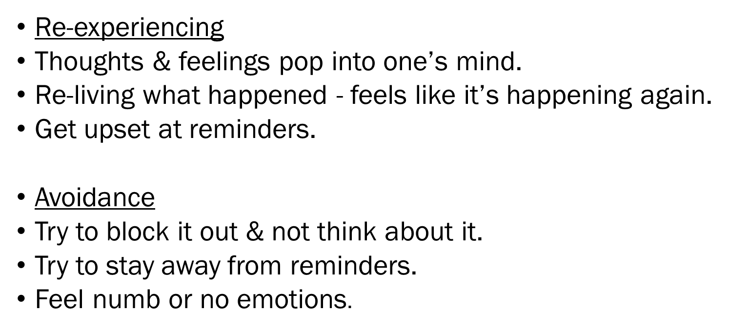
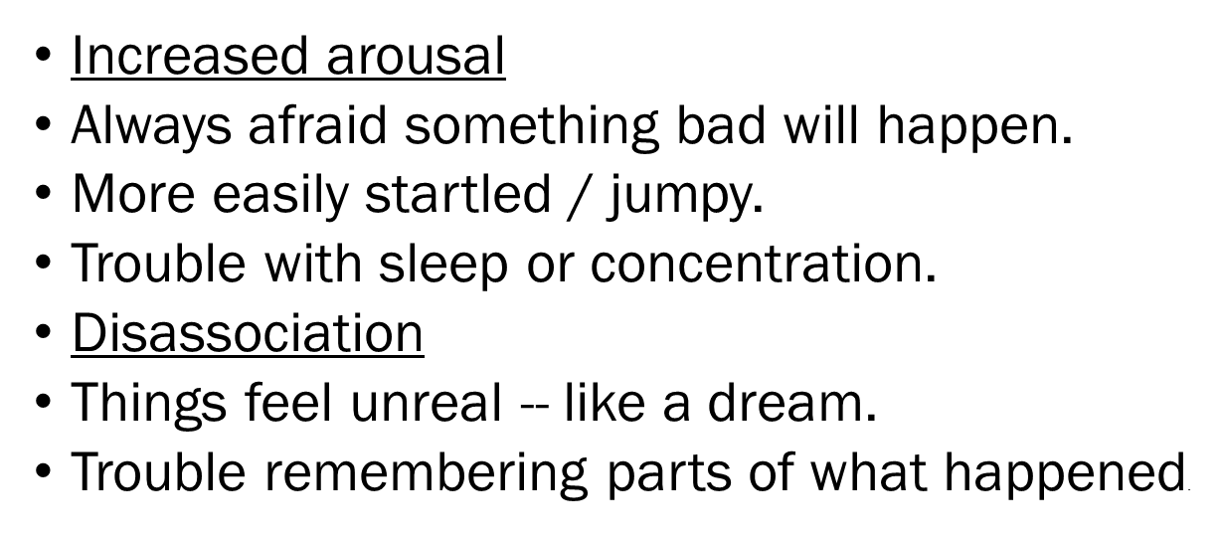
Traumatic Stress Symptoms

Slide 25
CLASS DISCUSSION:
Trauma is irreversible.
Trauma creates changes.
Healing is about creating change that you do choose.
How it shapes us is our choice.

Slide 26
Opportunities to rebuild control and empowerment:
Because control is often taken away in traumatic situations, the importance of choice and empowerment for survivors is to create a predictable environment that re-builds a sense of personal control over their lives.

Slide 27


Slide 28

PRACTICAL ASSISTANCE
What Survivors Want & Need
Notes:
Most survivors typically express a common set of desires. These include:
A desire for a sense of personal safety,
Someone to compassionately listen to them express their reactions,
As much accurate and consistent information as is available,
practical assistance with tasks that need to be performed
justice (or to be treated “fairly”; being afforded dignity and respect)
Tissues,
Blanket
Practical Assistance
water, water, water,
tissues, water, warmth, touch with permission
Power of 3-deep breaths
“I need” write down-VISUALLY need to see what they are thinking/feeling

Slide 29

JUSTICE
FAIR
NO ATTITUDE
NO BIAS
Notes:
Justice / Fair
-no judgment,
-no should have,
-why didn’t you, instead of “clarification” sounds like criticism
- bias,
-attitude
e alright”
-You have a future
-50/50 Hindsight is powerful and damaging-tell truth.
“TELL YOURSELF THE TRUTH” 50 -50 CAUSES ANOTHER TRAUMA WHEN YOUR PERCEPTION AND FACTS-COLLIDE AND TRUTH IS DIFFERENT

Slide 30

SAFETY
Notes:
Safety-environment:
trauma affects/impacts the whole person-sound, smell, sight, hear, feel- YOU
-Minimize pain
-Reassure
-Not happening now
-Safe
-Not in danger
When you talk you are repeating what you already know, listening, you might learn something new

Slide 31

TRUTH
INFORMATION
HONESTY
Truth/Honesty-
pes,
-no opinions,
no speaking for authority
-You are good, ok instead of “everything is going to be alright”
-You have a future
-50/50 Hindsight is powerful and damaging-tell truth.
Notes:
Truth/Honesty-
-no false hopes,
-no opinions,
no speaking for authority
-You are good, ok instead of “everything is going to be alright”
-You have a future
-50/50 Hindsight is powerful and damaging-tell truth.

Slide 32

COMPASSION
IN
ACTION
Notes:
and Compassion-Empathy,
“
I Got You”
not pity “At least”….
COMPASSION IN ACTION
LISTENING WITH FULL ATTENTION
HELPING THEM TELL THEIR STORY

Slide 33
RESPONDER’S ROLE
The Ministry of Presence
The Ministry of Purpose
The Ministry of Permission
The Ministry of Peace
Notes:
Trauma responders serve in a ministry of presence, meaning that the care and concern conveyed by their very presence benefits the survivors.
When you are listening, do it authentically and with full attention. Work to care about what is being said, remain engaged throughout the conversation, and focus on understanding rather than fixing.
Have students describe understanding of and events where they have used it.
Thus, the over-whelming majority of the trauma responder’s time should be spent listening rather than talking.
Trauma responders rely extensively on brief non-word vocalizations to affirm and acknowledge that they have heard the speaker, and to encourage them to continue talking. In the hours immediately following a traumatic events, survivors want someone to share their sorrow and can move towards healthy recovery by moving through their trauma, not becoming stuck in one segment of the crisis. Have them continue through telling the trauma until they can come to a better ending; when help arrived, realization they did all they could depending on the situation.
The “first impression” of how the victim perceives the Chaplain will influence whether that victim feels “safe” and free to speak without fear of judgment, minimizing, or being criticized. As always, attempt to build a connection with the victim by being as empathic as possible, without doing a lot of speaking.
You begin to affect a change in attitude. When you listen to someone they feel valued and respected, and they see the benefit as the way to begin healing. When people who may not have been formerly listen to or valued experience it, this change in action reflects a change in attitude for them.
Long periods of silence are normal. Fight the urge to fill that silence. Use compassion as your intention to relieve the suffering of others.
The key to effective crisis response is to connect with others who will be supportive and empathetic listeners. No one can fix their situation. Rather listen completely, without any motive, because a motive in listening is a distraction.
Do not self-disclose about your own life, similar experiences or related circumstances. Display sincere compassion.
Explain how this can alter a situation, prevent victims from moving forward.
The Chaplain can provide organization to the victim. "How did it start?" "What happened next?" “Then what did you do?" "How were your thoughts at the time?" "What happened next?" Essentially, Chaplains’ are providing the frame within which the victim can tell his/her story. You are also breaking the story up
into small components, which are easier to handle than the whole massive experience. By allowing them to step through the situation, you can guide them to a better ending than where they may be stuck. You may have to hear their initial version a few times before you can determine the best way to guide them to reframe their experience…it will come to you!

Slide 34
HOW TO HELP
1. Understand the Signs & Symptoms
2. Minimize Pain
3. Provide Safety
4. Reassure
5. Be Clear about Your Role
6. Reassure

Slide 35
Key Messages for
Trauma Recovery
1. It is not happening now.
The trauma is over. It is in the past. You are here in the present.
2. You are safe.
The adults here are responsible for your safety and you are worthy of care and protection.
3. You are not inherently dangerous/toxic.
What is inside you (thoughts, feelings, dreams, impulses, etc.) cannot hurt you or others.
Notes:
. It is not happening now.
The trauma is over. It is in the past. You are here in the present.
2. You are safe.
The adults here are responsible for your safety and you are worthy of care and protection.
3. You are not inherently dangerous/toxic.
What is inside you (thoughts, feelings, dreams, impulses, etc.) cannot hurt you or others.
4. You are good.
Whatever you have experienced and whatever you have had to do to survive, you are a good, strong person who can contribute to your community.
5. You have a future.

Slide 36
Key Messages for Trauma Recovery (continued)
4. You are good.
Whatever you have experienced and whatever you have had to do to survive, you are a good, strong person who can contribute to your community.
5. You have a future.
Notes:
“Trauma-informed” refers to all of the ways in which a service system is influenced by having an understanding of trauma, and the ways in which it is modified to be responsive to the impact of traumatic stress. A program that is “trauma-informed” operates within a model or framework that incorporates an understanding of the ways in which trauma impacts an individual’s socio-emotional health. This framework should, theoretically, decrease the risk of retraumatization, as well as contribute more generally to recovery from traumatic stress. (Harris & Fallot, 2001)
Emphasis on safety:
Because trauma survivors are often sensitized to potential danger, trauma-informed service systems work towards building physical and emotional safety for consumers and providers. The system should be aware of potential triggers for consumers and strive to avoid retraumatization. Because interpersonal trauma often involves boundary violations and abuse of power, systems that are aware of trauma dynamics establish clear roles and boundaries developed within a collaborative decision-making process. Privacy, confidentiality, and mutual respect are also important aspects of developing an emotionally safe atmosphere. Diversity is accepted and respected within trauma-informed settings, including differences in gender, ethnicity, sexual orientation, and so on.

Slide 37
Trauma Listening
1. SLO-LO: Slow down, relax, breathe
2. Body language-theirs and yours
Encouraging sounds
Keep the ball rolling-”tell me more” “then what”
Useful questions-open ended
The here and now-”in the moment”
No self disclosure
Do not be the “hero” in their story, help them be their own hero
Let them tell their story, and tell their story well

Slide 38
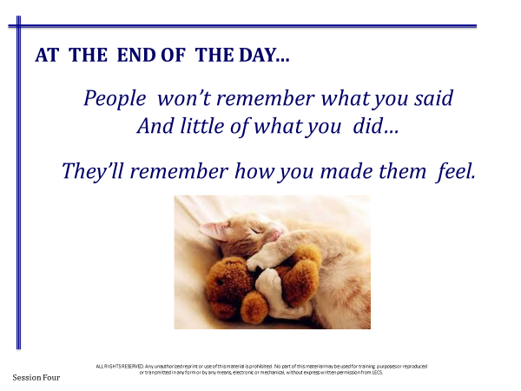

Slide 39



Slide 40

What’s in Your
“Emotional”
Go Bag?

Slide 41
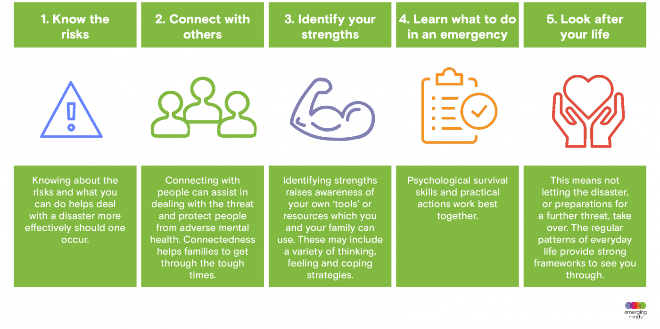

Slide 42
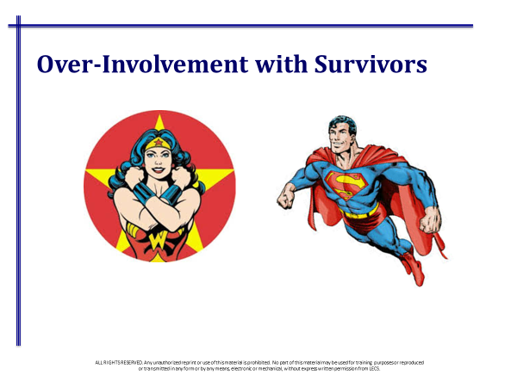

Slide 43
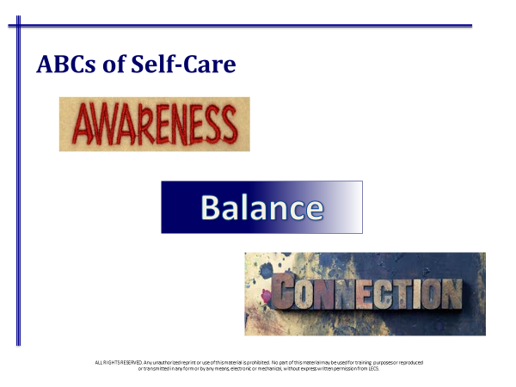

Slide 44


Slide 45
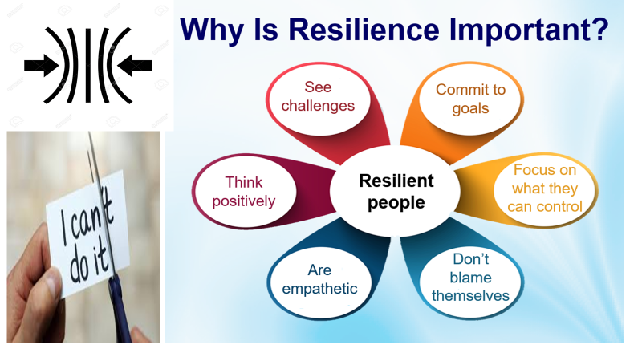

Slide 46


Slide 47


Slide 48
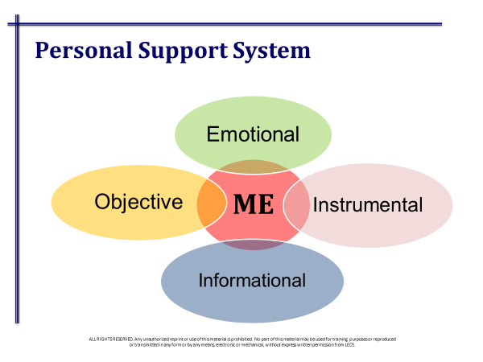

Slide 49


PRAY

Slide 50


Slide 51
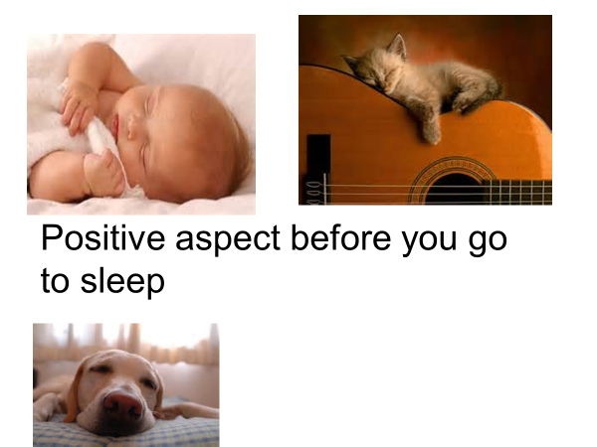

Slide 52



Slide 53


