Slide 1

EVENTS AND ANNOUNCEMENTS

Slide 2
PRE-TEEN CAMP
2026
“Survivor: Overcoming Obstacles & Growing in the Faith”
March 27-28 (no overnight)
Ages 8 – 12 (Grades 3-6)
Cost $30 - Sponsorships available
Registration forms are in foyer
Questions: Contact Joann Penney 254.205.2544

Slide 3

Men’s Ministry
Prayer Group
Tuesday
6:00 pm

Slide 4

Women’s Bible Study
Respectable Sins by Jerry Bridges
Next Study: February 17, 2026 6:30 pm
@ home of Grace Callaway
Please plan to join us in this study that will draw us nearer to the Lord as we evaluate the seemingly “smaller” sins in our lives.

Slide 5
Men’s Meeting –
AUTHENTIC MANHOOD
Who God called you to be
What God requires of you
Encouragement
Accountability
11th grade and up
Every 4th Sunday evening
NEXT STUDY:
February 22
@ 5pm
Location: FLC
We will continue a journey together through the Scriptures of what it means to live out authentic, biblical manhood.

Slide 6

Men’s Ministry
2026 Retreat
March 13-15
Riverbend Retreat Center
Glen Rose, TX
Sign up in foyer

Slide 7

GAME NIGHT / Dinner
Saturday, February 14
6:00 pm
Hosted by Tim & Codi Couch-Thompson
160 HCR 1759A, Whitney

Slide 8


Slide 9

VBS 2026
Emerald Crossing—
An Irish Adventure Through Psalms 23
July 19 - 23

Slide 10
Meal Train Ministry
Something anyone can do
The Meal Train Ministry, headed up by Bekah Hogan, schedules meal deliveries to the ill, grieving, injured or overwhelmed and provides a reprieve from having to worry about the grocery store, restaurant or cooking during difficult times. Families know when and what is being delivered. Just sign up, take the meal to our beloved brothers on the day and time that you signed up for.
This ministry needs commitment by enough people so those involved are not overwhelmed to provide so many meals. And the more people involved, the more people will be blessed.
PLEASE CONSIDER JOINING THIS MINISTRY. Contact via Facebook at BekahBrandonHogan or call her at 972-365-3290 with questions or to sign up.
We need you!

Slide 11





Hire a Youth!
Youth Group Year-round Fundraiser
You name it. There is a good chance one of the youth can do it.
All donations go into the church youth account for that youth.
Contact Chris Eller, Youth and Families Director, to hire a youth.
Chris Eller 817-880-5980

Slide 12
Church Tithes and Offerings
Three ways to give:
  Online at prairievalleybaptist.org
  Online Giving tab (top right)
  Donation box in foyer.
  By mail – PVBC, 741 HCR 2101, Whitney, TX 76692

Slide 13

February Birthdays
February 1 David Penney
February 13 Isabella Eby
February 13 Kate Burkett Eller
February 14 Susan Schultz

Slide 14

February Anniversaries
February 17 Fisher & Abby Hennig
February 23 Kevin & Tracy Eby
February 26 Chris & Devon Eller

Slide 15
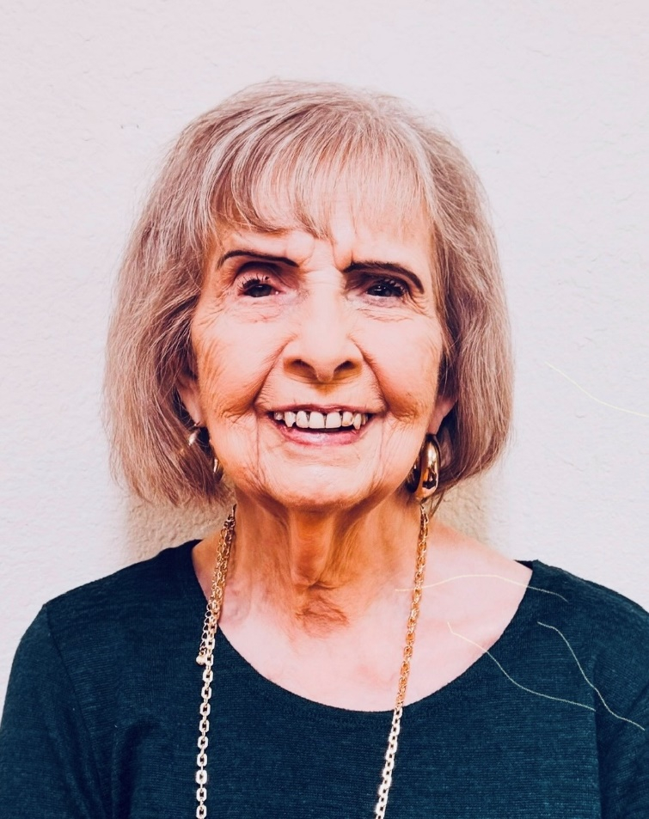
Carolyn Waldrop, Tammy Hein, Jeffrey and Kyla Hester
- Missionaries
Texas Mexico Border
PO Box 440030
Laredo, TX 78044
rgmhl@juno.com
(956) 744-3563

Slide 16
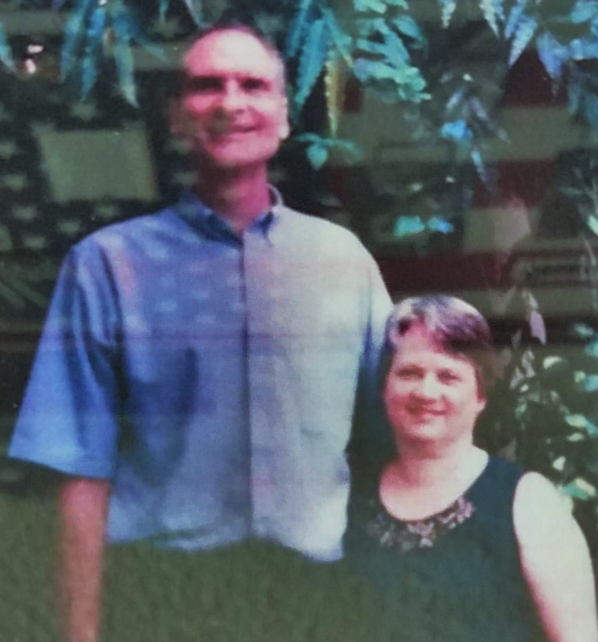
Walter & Cheryl Spicer
- missionaries
Ethnos 360
Faith Academy
Philippines
MC PO Box 2016
0706 Makati City
Philippines
walter_spicer@ntm.org
Birthdays:
Walter- March 23
Cheryl – November 21
Anniversary: June 15

Slide 17
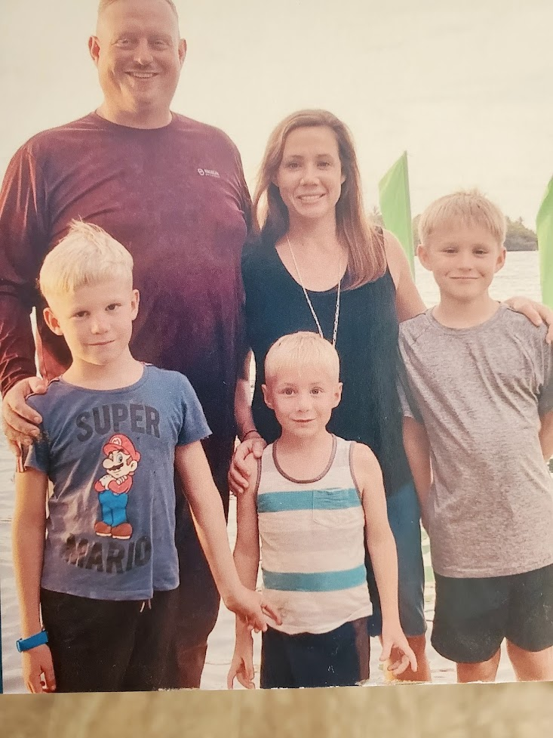
Sean & Jinny Richards
- missionaries
Zeke, Gabe, Ash
Manam, Papua New Guinea
New Tribes Mission
PO Box 1079
Papua New Guinea
sean_Richards@ntm.org
therichardsresponse@gmail.com
Birthdays:
Sean Apr 22; Jinny Nov 15; Zeke Dec 13; Ash Sept 9; Gabe June 25
Anniversary: June 18

Slide 18
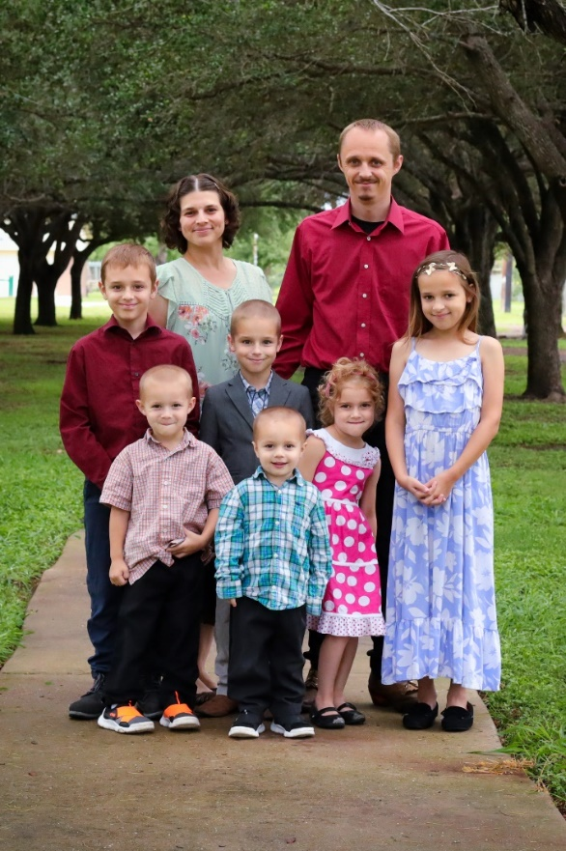
Elijah & Jessica Windle
- missionaries
James, Abigail, Samuel, Naomi, Benjamin & Caleb
Rio Grande Bible Institute
4300 S US Hwy 281
Edinburg, TX 78539
(956) 429-9357
windle87@gmail.com
Birthdays:
Elijah June 12; Jessica Apr 25; James Apr 1; Naomi Apr 18; Abigail Oct 7; Benjamin Aug 14; Samuel June 30; Caleb Apr 22
Anniversary: May 27

Slide 19
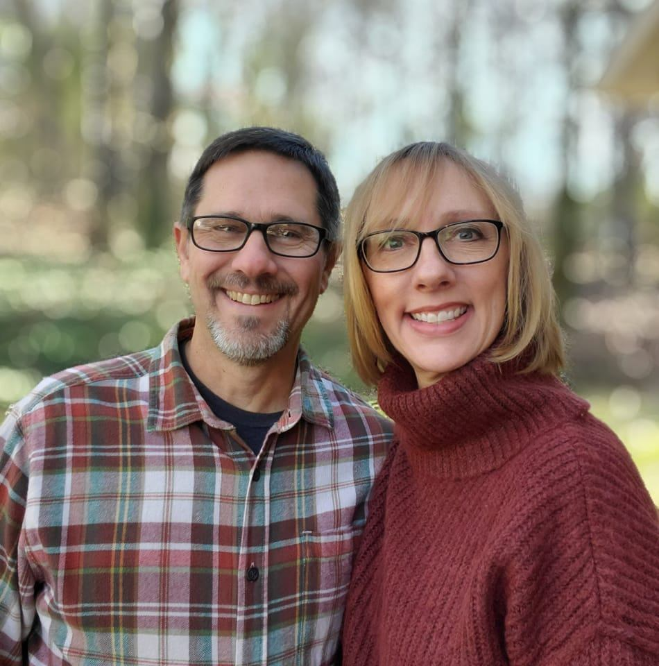
Steve & Becky Cochrane
- missionaries
Echo Ranch Bible Camp
1038 Independence Ct.
Alabaster, AL 35007
(205) 567-4575
scochrane@avmi.org
sbcochrane@avmi.org
Birthdays:
Steve – March 13
Becky – November 7
Anniversary: April 14

Slide 20

Hebron Seminary, Bolivia
Scholarship Fund

Slide 21


PVBC is involved in training Pastors, Missionaries & Sunday School Teachers all over south America

Slide 22


Wall of Honor
*service members’ name
*branch of service
*dates of service
*rank
*where they served
*and, if Navy, name of ship
Military Liaison:
Karen Lair
(254) 405-3183

Slide 23
Additions/Corrections
To: Calendar, Military Address List,
Membership Directory, and/or Prayer List
Contact:
Office hours: Tues & Thurs, 9am to 1pm
Phone Number: (254)694-2056
Email: pvbc2011@gmail.com

Slide 24

Please silence your cell phone
Enjoy
the service

