Slide 2

I. M. Haldeman
The life of Moses presents a series of striking antitheses. He was the child of a slave, and the son of a queen. He was born in a hut and lived in a palace. He inherited poverty and enjoyed unlimited wealth. He was the leader of armies, and the keeper of flocks. He was the mightiest
of warriors, and the meekest of men. He was educated in the court and dwelt in the desert. He had the wisdom of Egypt, and the faith of a child. He was fitted for the city and wandered in the wilderness. He was tempted with the pleasures of sin and endured the hardships of virtue. He was backward in speech and talked with God. He had the rod of a shepherd, and the power of the Infinite. He was a fugitive from Pharaoh, and an ambassador from Heaven. He was the giver of the Law, and the forerunner of grace. He died alone on Mount Moab and appeared with Christ in Judea. No man assisted at his funeral, yet God buried him.

Slide 4
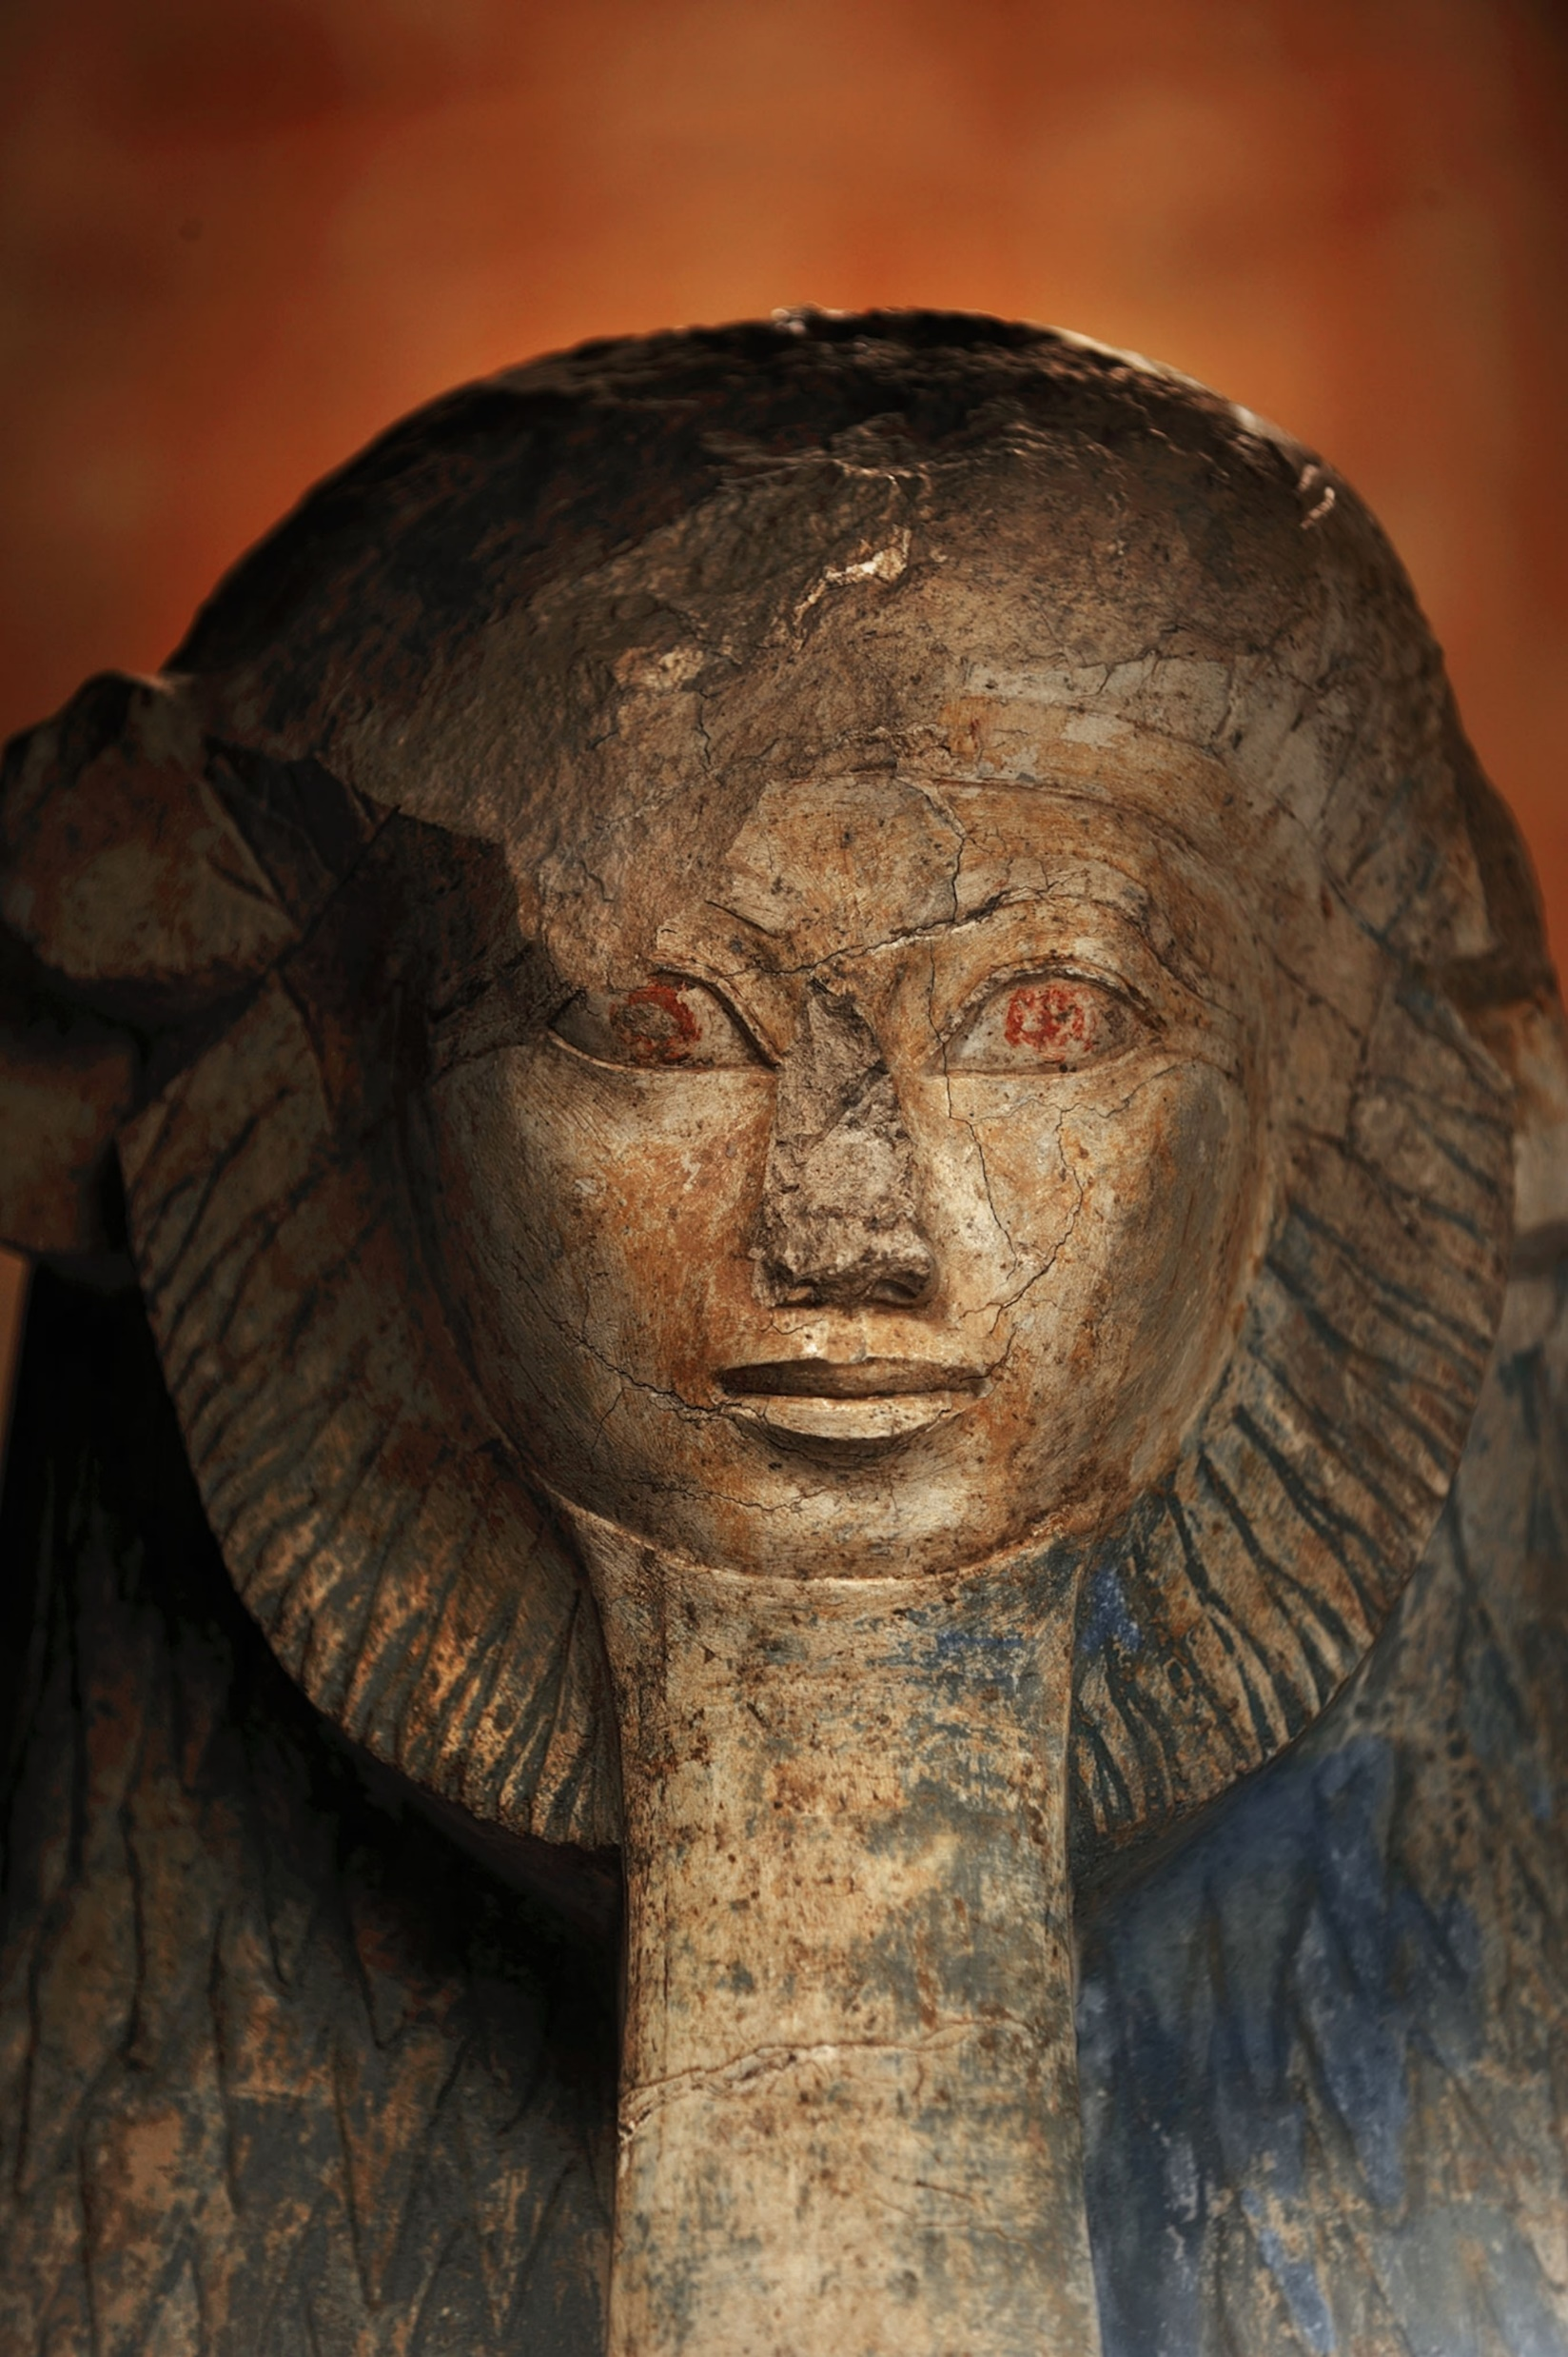
Pharaoh Hatshepsut

Slide 5
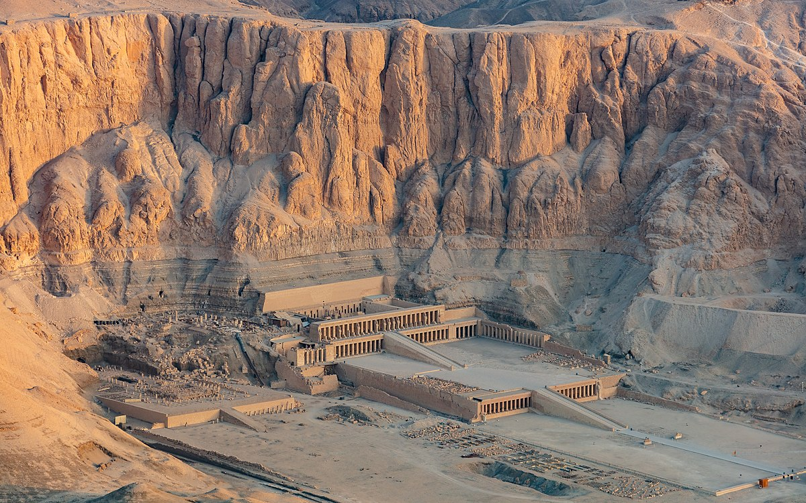

Slide 6
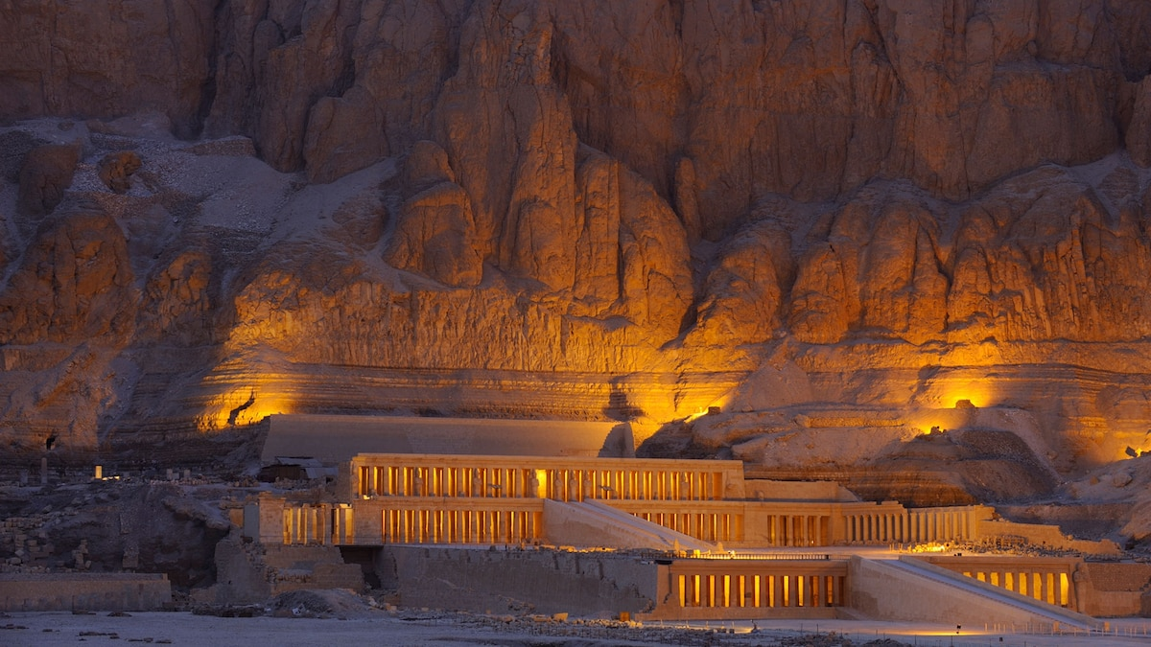

Slide 7
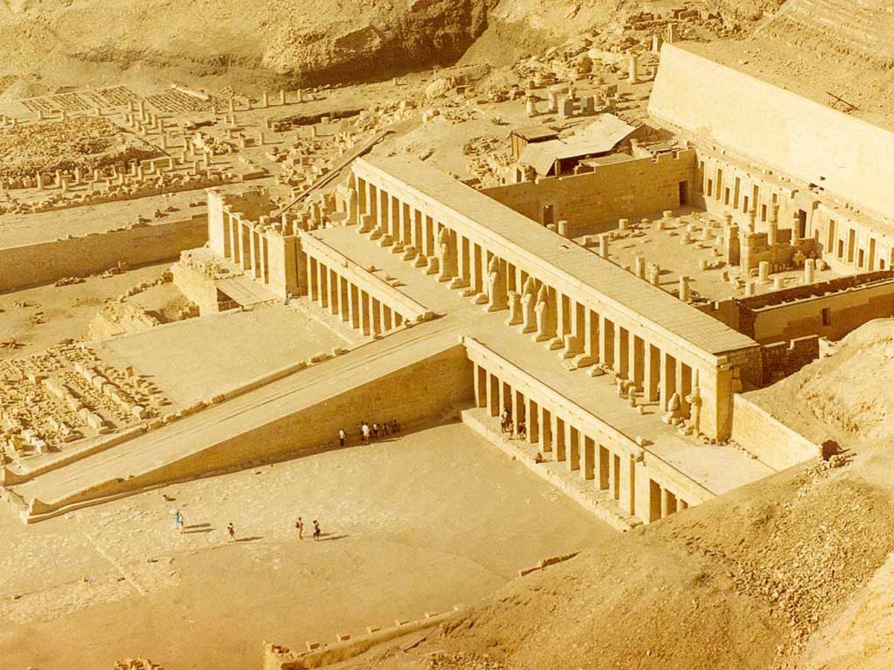

Slide 8
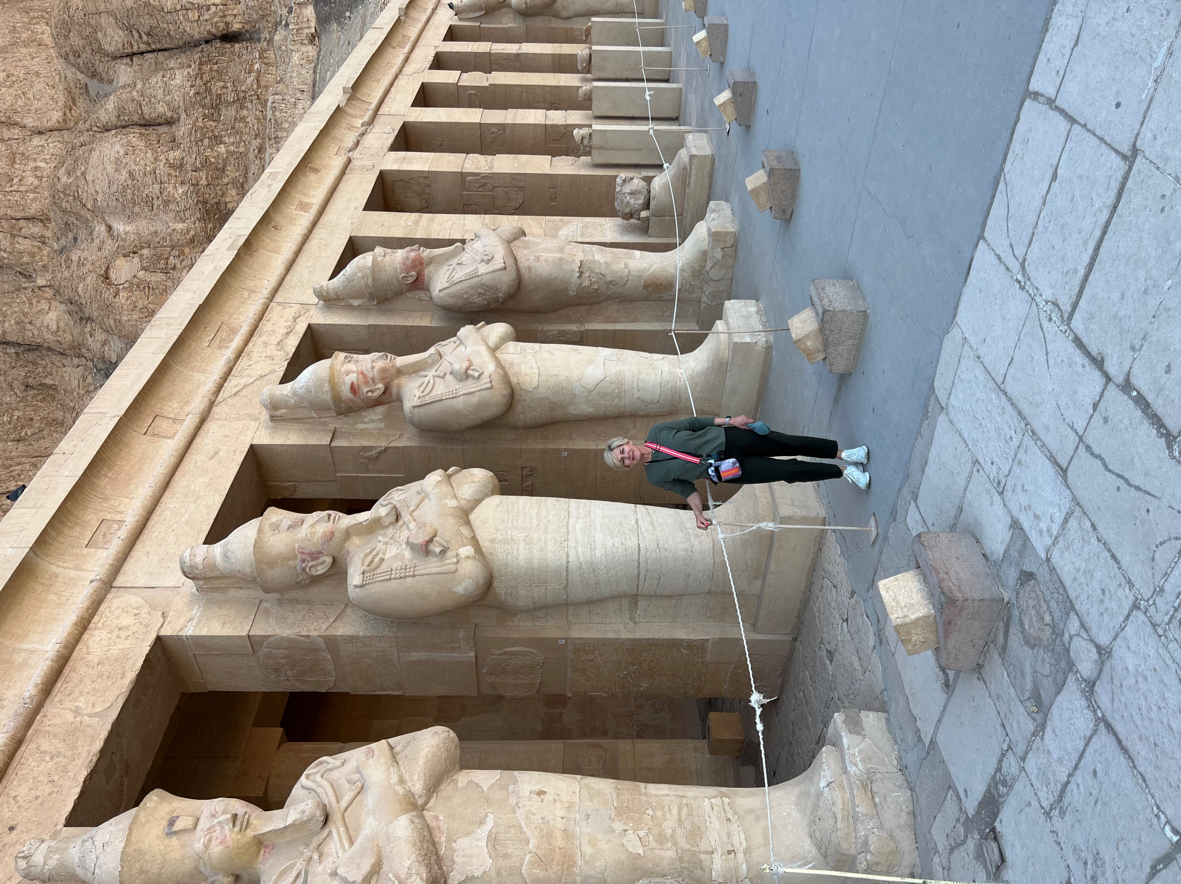

Slide 9
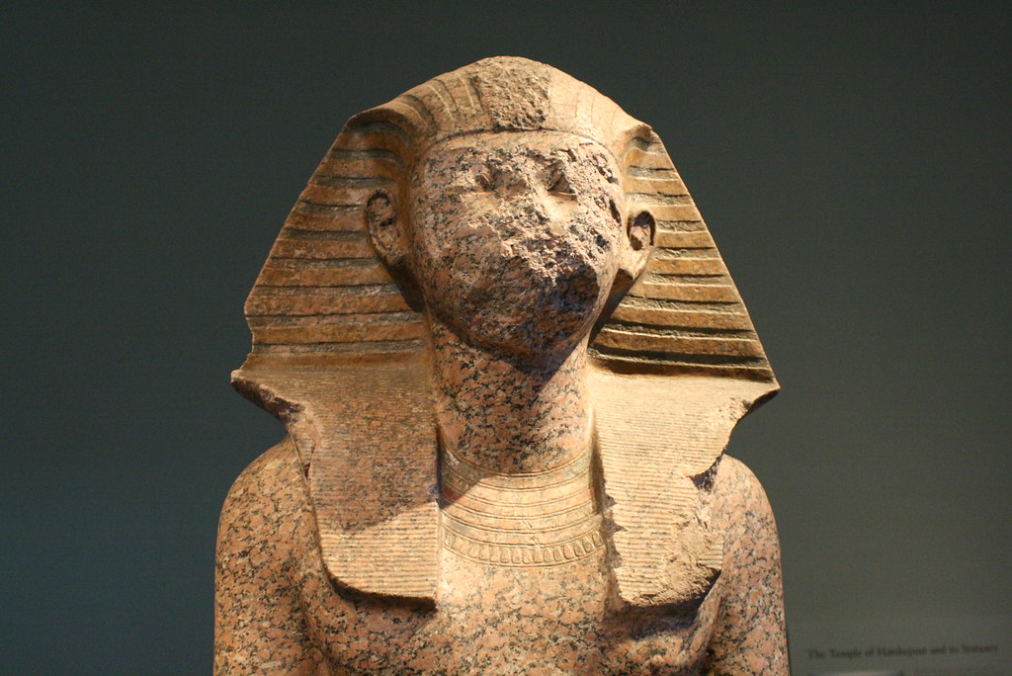

Slide 10
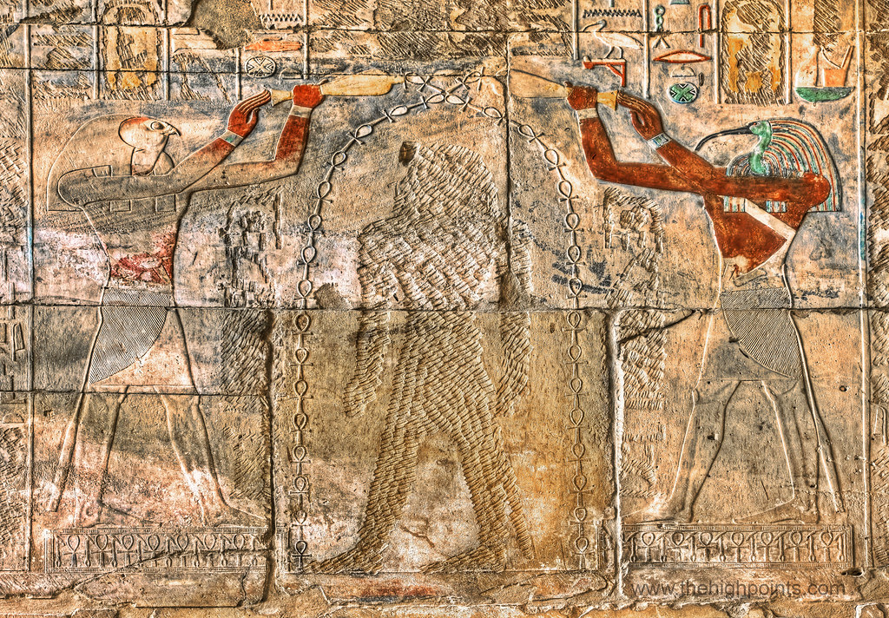

Slide 11
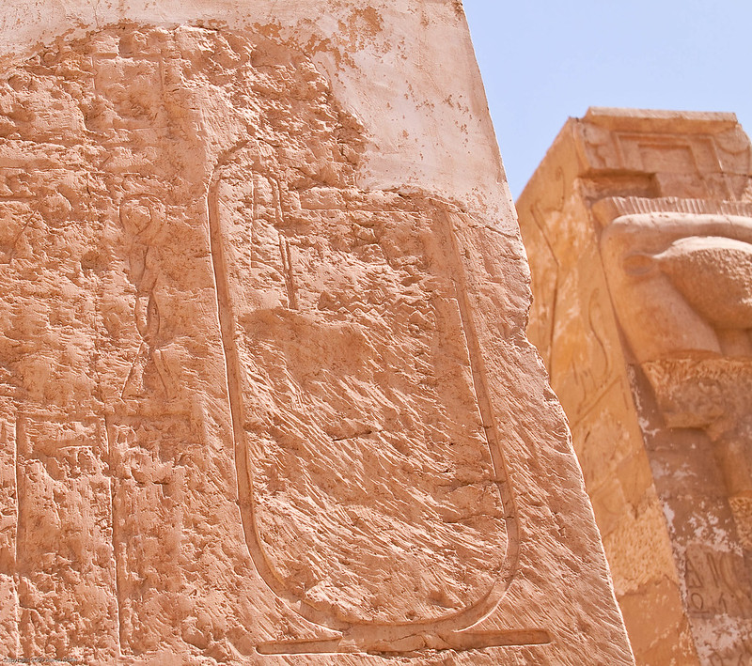

Slide 12
Hatshepsut married her half-brother Thutmose II.
Thutmose II died, and she became Pharaoh and ruled as co-regent with her stepson Thutmose III for some time.
Thutmose III died, and his son Amenhotep II became Pharaoh. He was the Pharaoh of the plagues. He defaced and demolished every memory of Hatshepsut after the Israelites escaped Egypt. This was probably due to his burning anger that she was the mother of Moses.

Slide 14
Moses & Jesus
Born to be Saviors in time of oppression
Rescued from enemies at birth [Pharaoh / Herod]
Visited by royalty as a child
Spent time in Egypt
Passed through waters
Wandered in the desert [Moses 40 yrs. / Jesus 40 days]
Went up to the mountain to give the law

