Slide 2

J. I. Packer (Knowing God)
“What were we made for? What aim should we set ourselves in life? What is the best thing in life, bringing more joy, delight, and contentment than anything else? The answer to all these questions is the same: Knowing God!”

Slide 3
Charles Spurgeon
“The highest science, the loftiest speculation, the mightiest philosophy, which can ever engage the attention of a child of God, is the name, the nature, the person, the work, the doings, and the existence of the great God whom he calls his Father. There is something exceedingly improving to the mind in a contemplation of the Divinity. It is a subject so vast, that all our thoughts are lost in its immensity; so deep, that our pride is drowned in its infinity. No subject of contemplation will tend more to humble the mind, than thoughts of God. … But while the subject humbles the mind it also expands it . . . . Nothing will so enlarge the intellect, nothing so magnify the whole soul of man, as a devout, earnest, continued investigation of the great subject of the Deity.”

Slide 4
W. Tozer (The Knowledge of the Holy)
“What comes into our minds when we think about God is the most important thing about us. . . . The man who comes to a right belief about God is relieved of ten thousand temporal problems.”

Slide 6


Slide 7


Slide 8


Slide 9
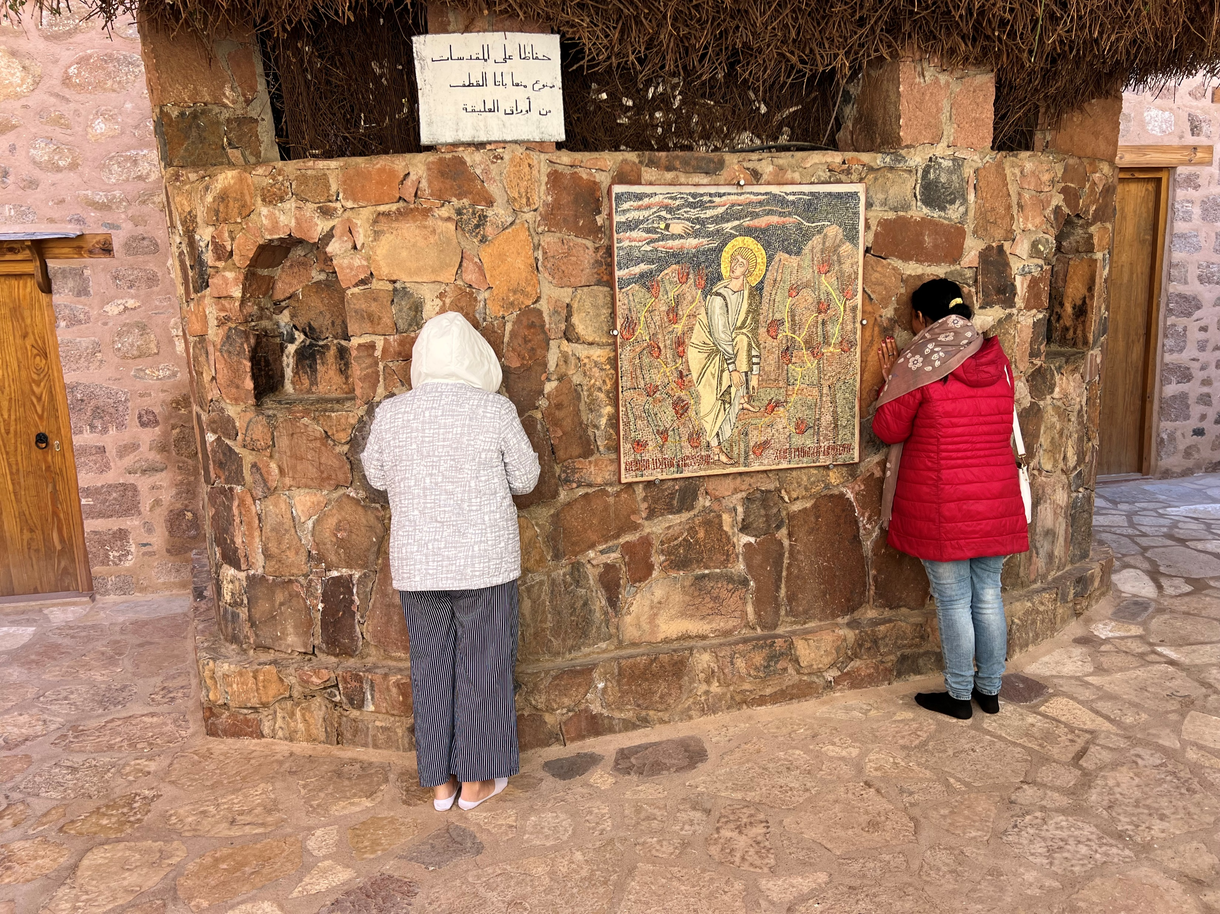

Slide 10


Slide 12
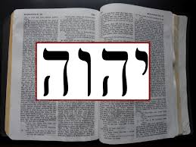
Tetragrammaton (the four letters)
Yahweh

