Slide 2
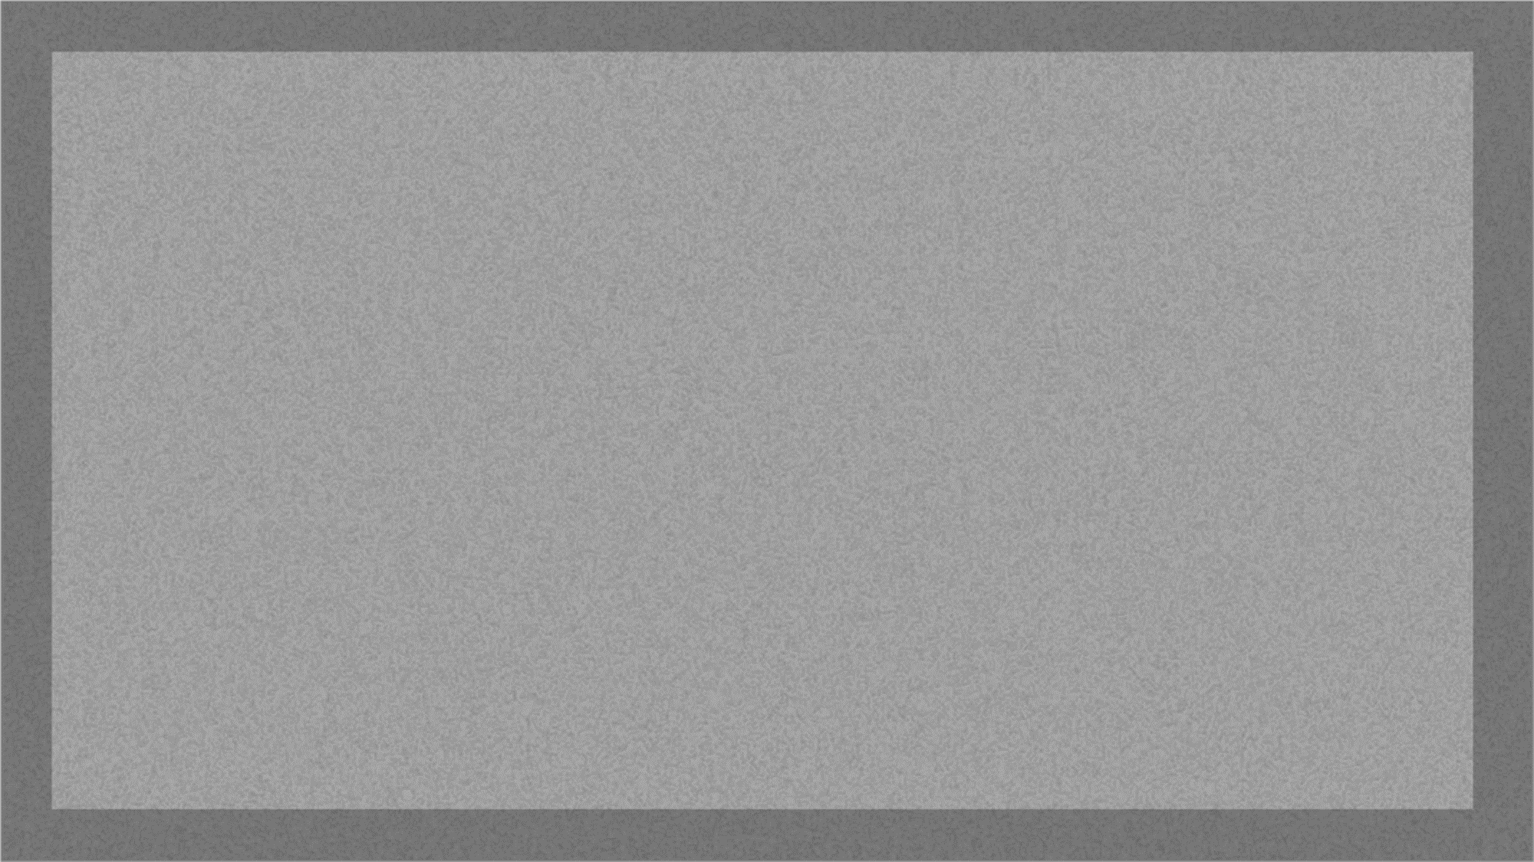
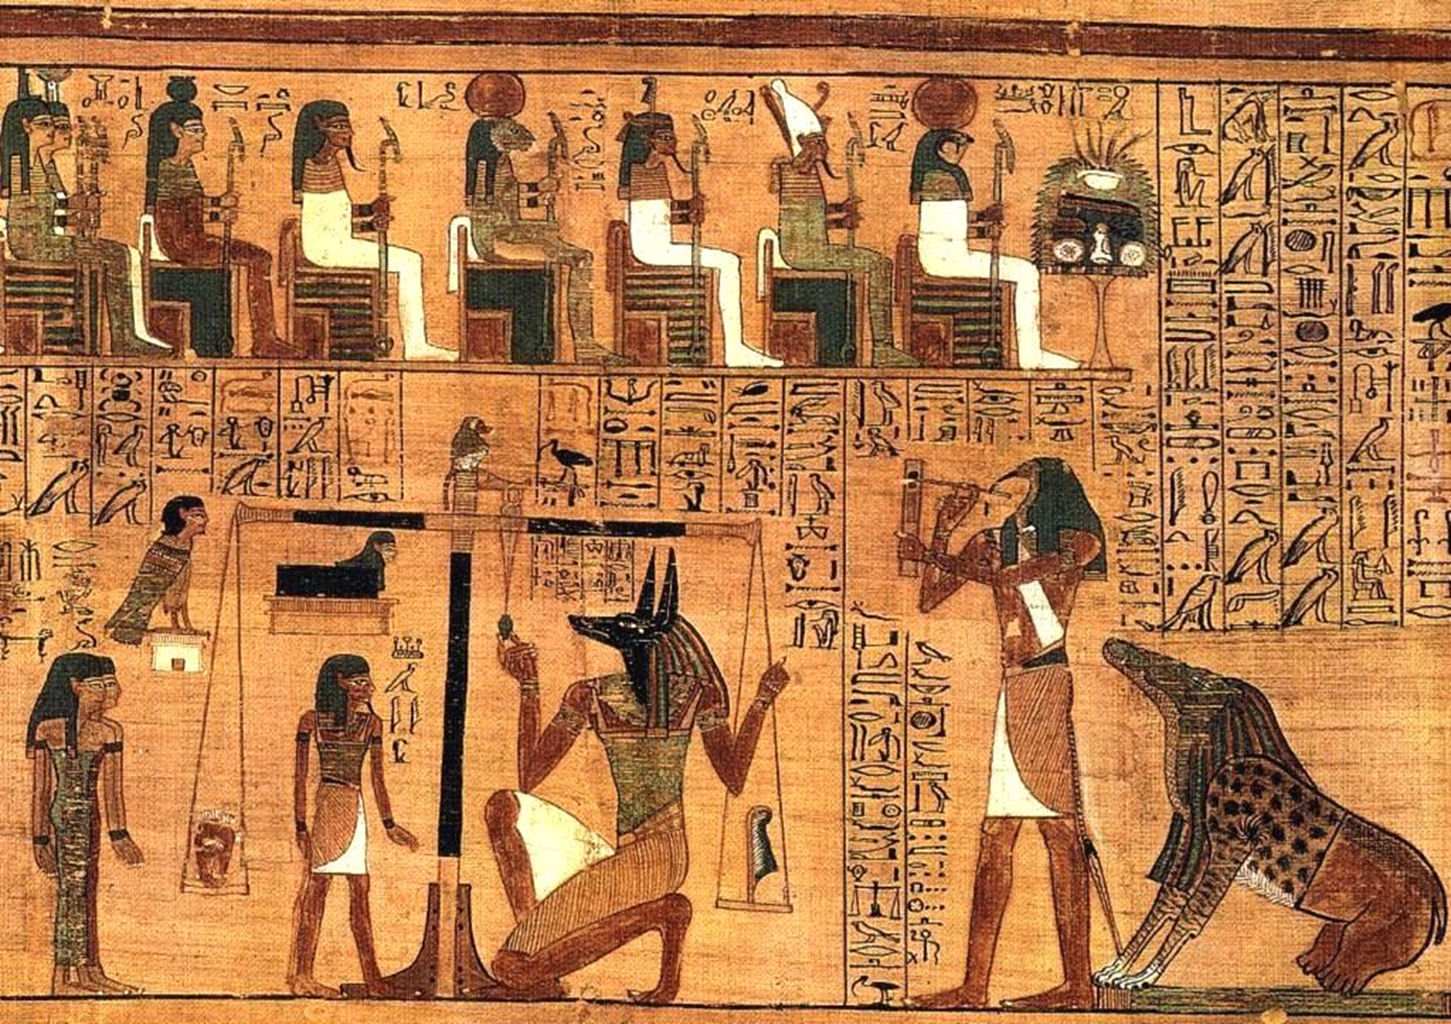
The Weighing of the Heart
The Book of the Dead

Slide 3
The Weighing of the Heart ceremony in ancient Egypt was a procedure that the Egyptians believed occurred after death in the underworld to judge if the person was allowed to pass to paradise.
The individual’s heart would be placed on scales opposite maʾat, the Egyptian personification of truth, justice, social order, and harmony, pictured as a feather.

Slide 4
If the heart was found to be lighter than maʾat, the judged was shown to be righteous and would be allowed into the afterlife. If, however, the heart was heavy and outweighed maʾat, the heart would be devoured by a monster, and the person cast to oblivion.
Egyptians believed that the heart was made “heavy” with sin. This is why the heart was left in mummified bodies, while the other organs were removed.

