Slide 2

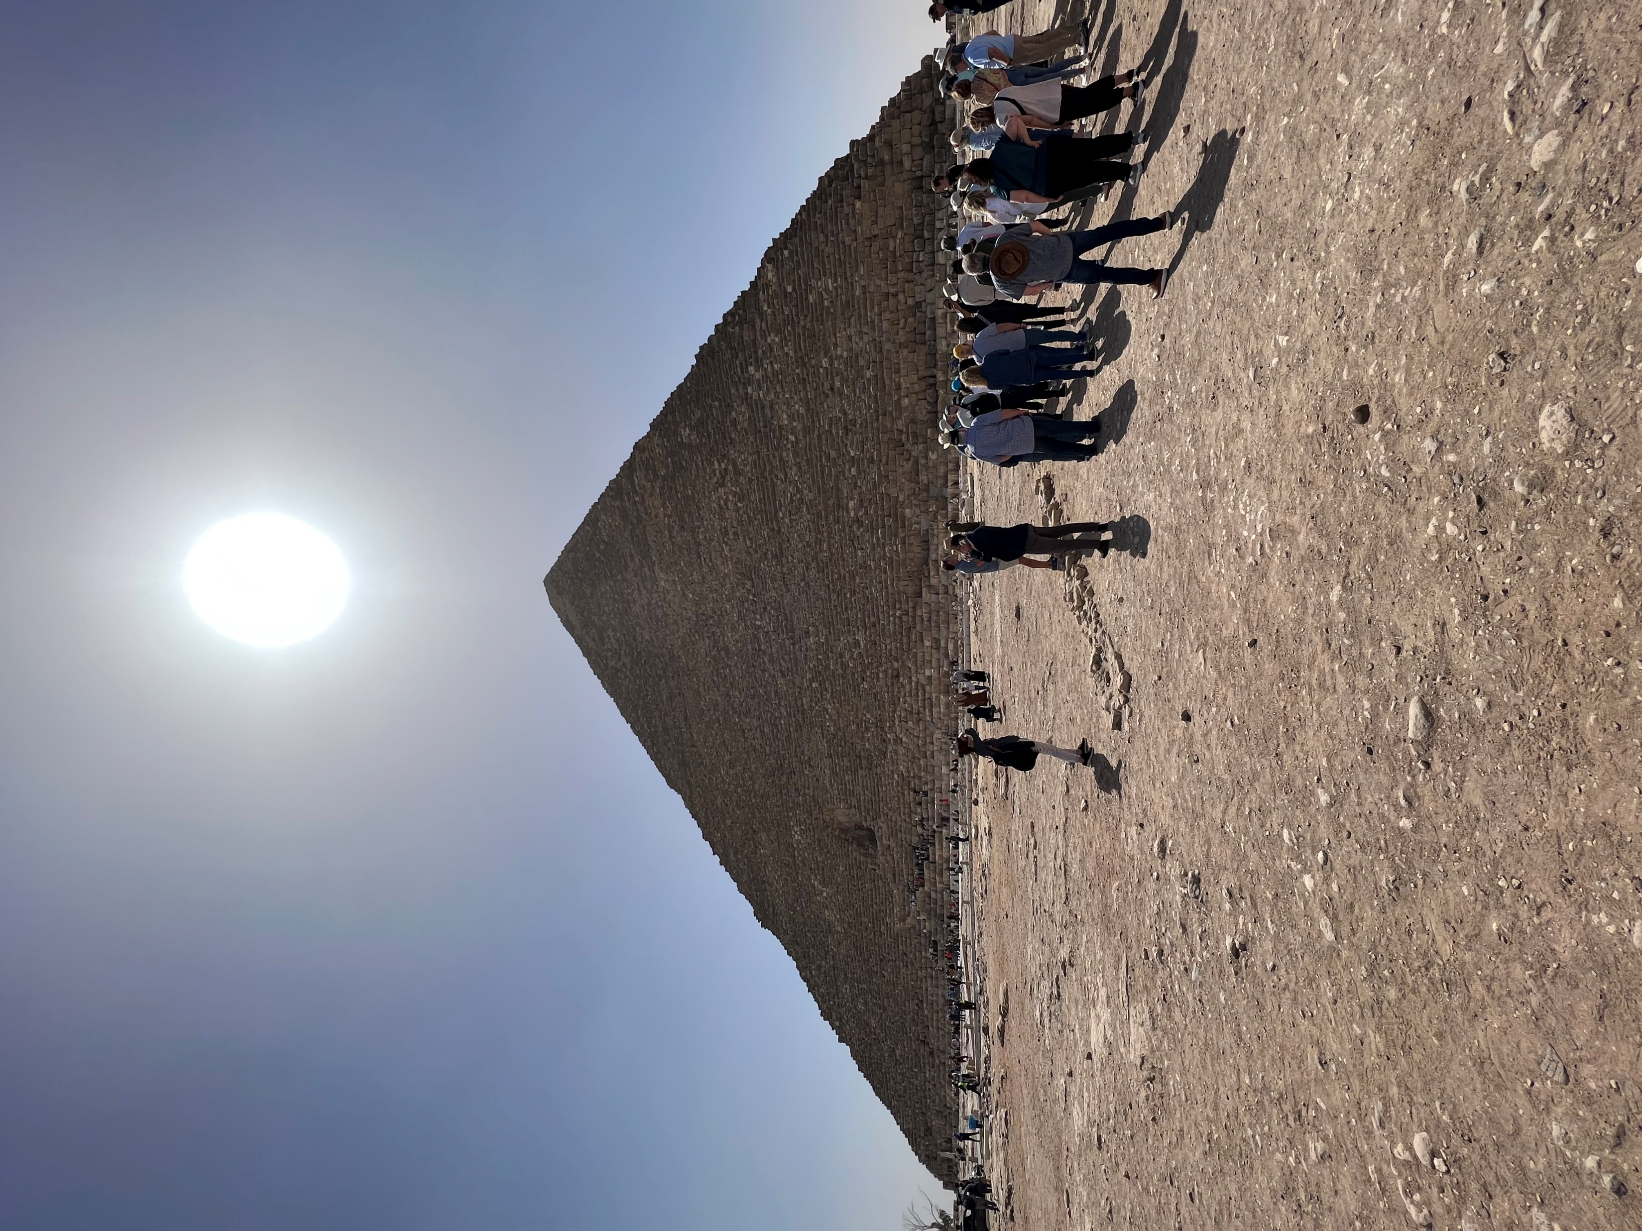
Great Pyramid of Giza
2.3 million stones with an average weight of 15 tons.
460 feet tall

Slide 3
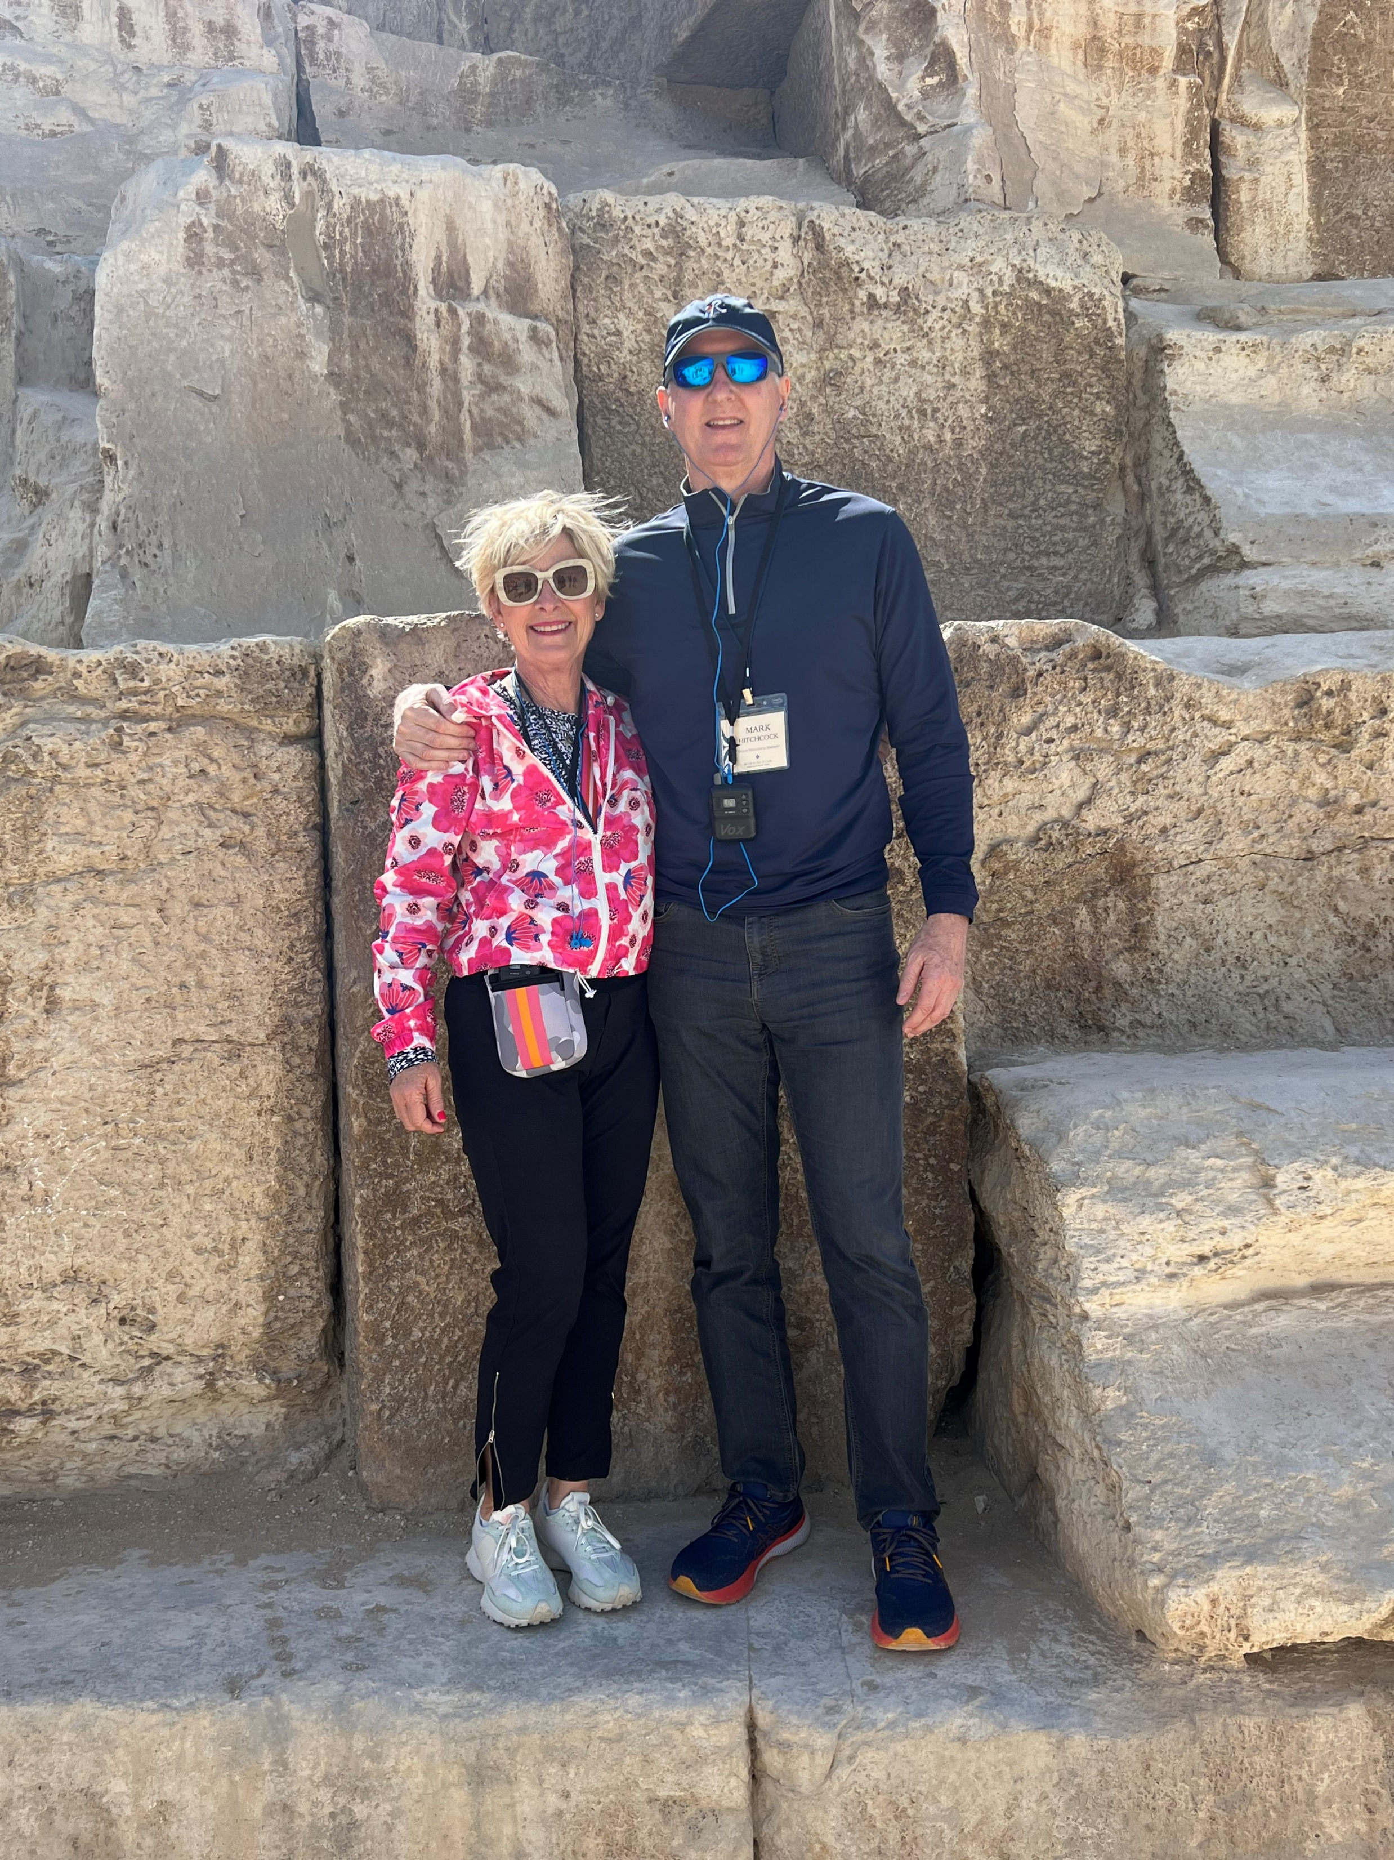

Slide 4
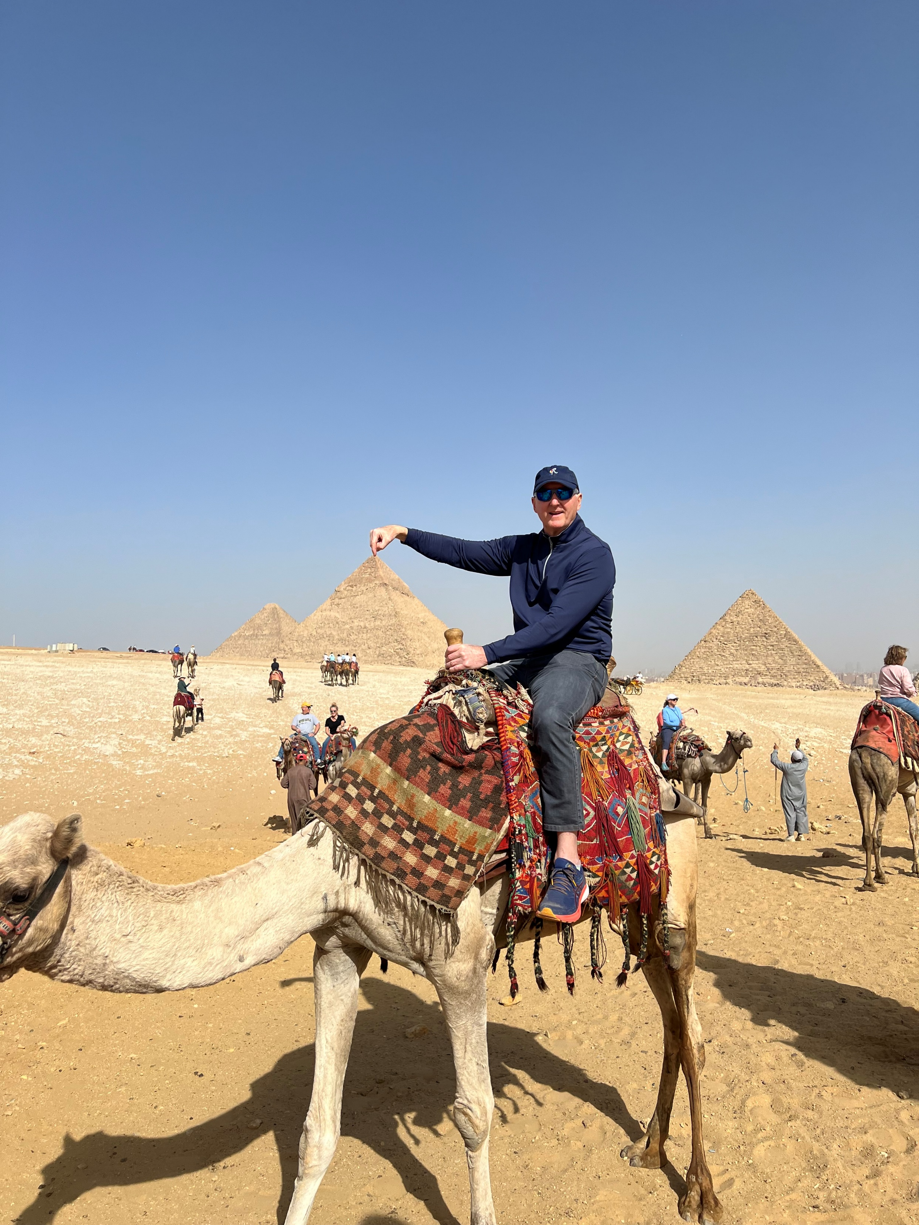

Slide 5
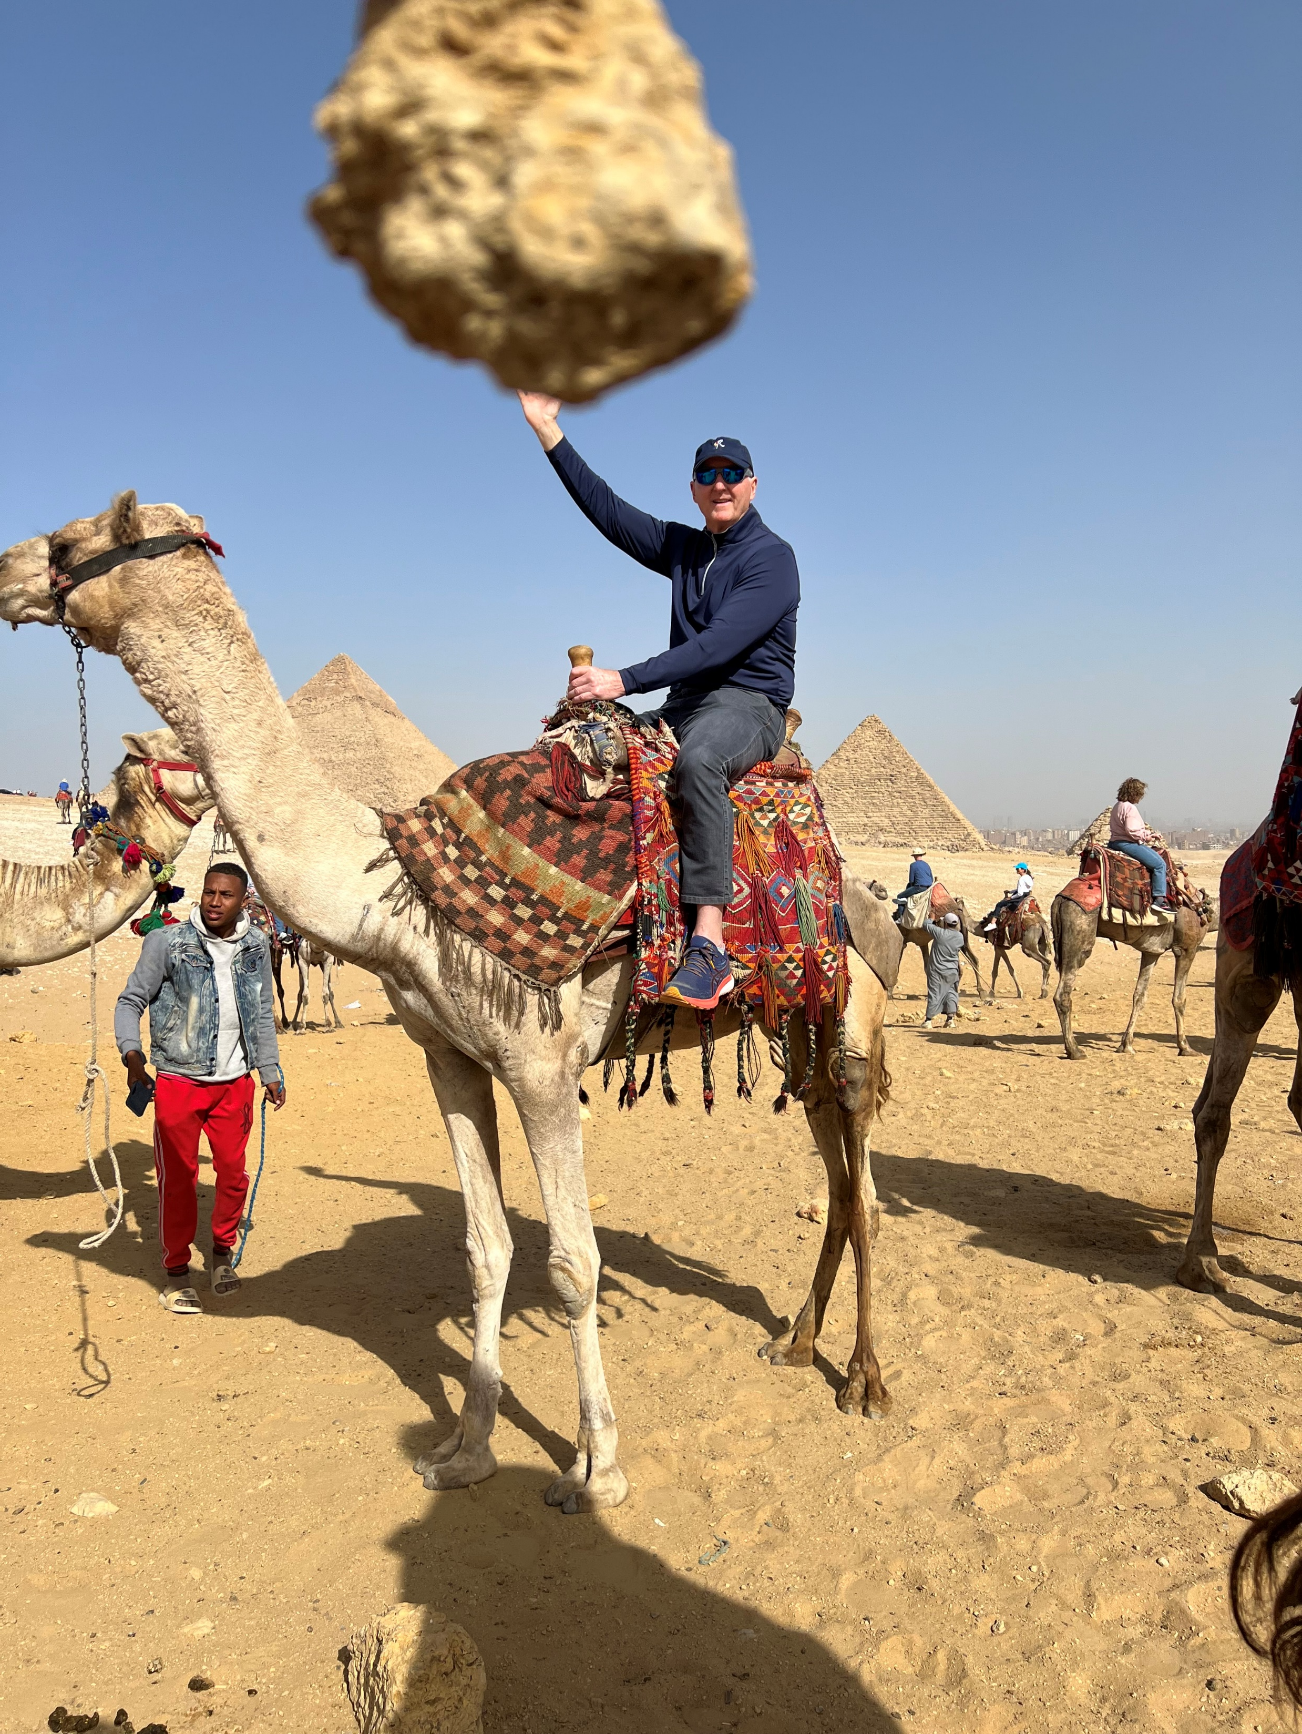

Slide 6
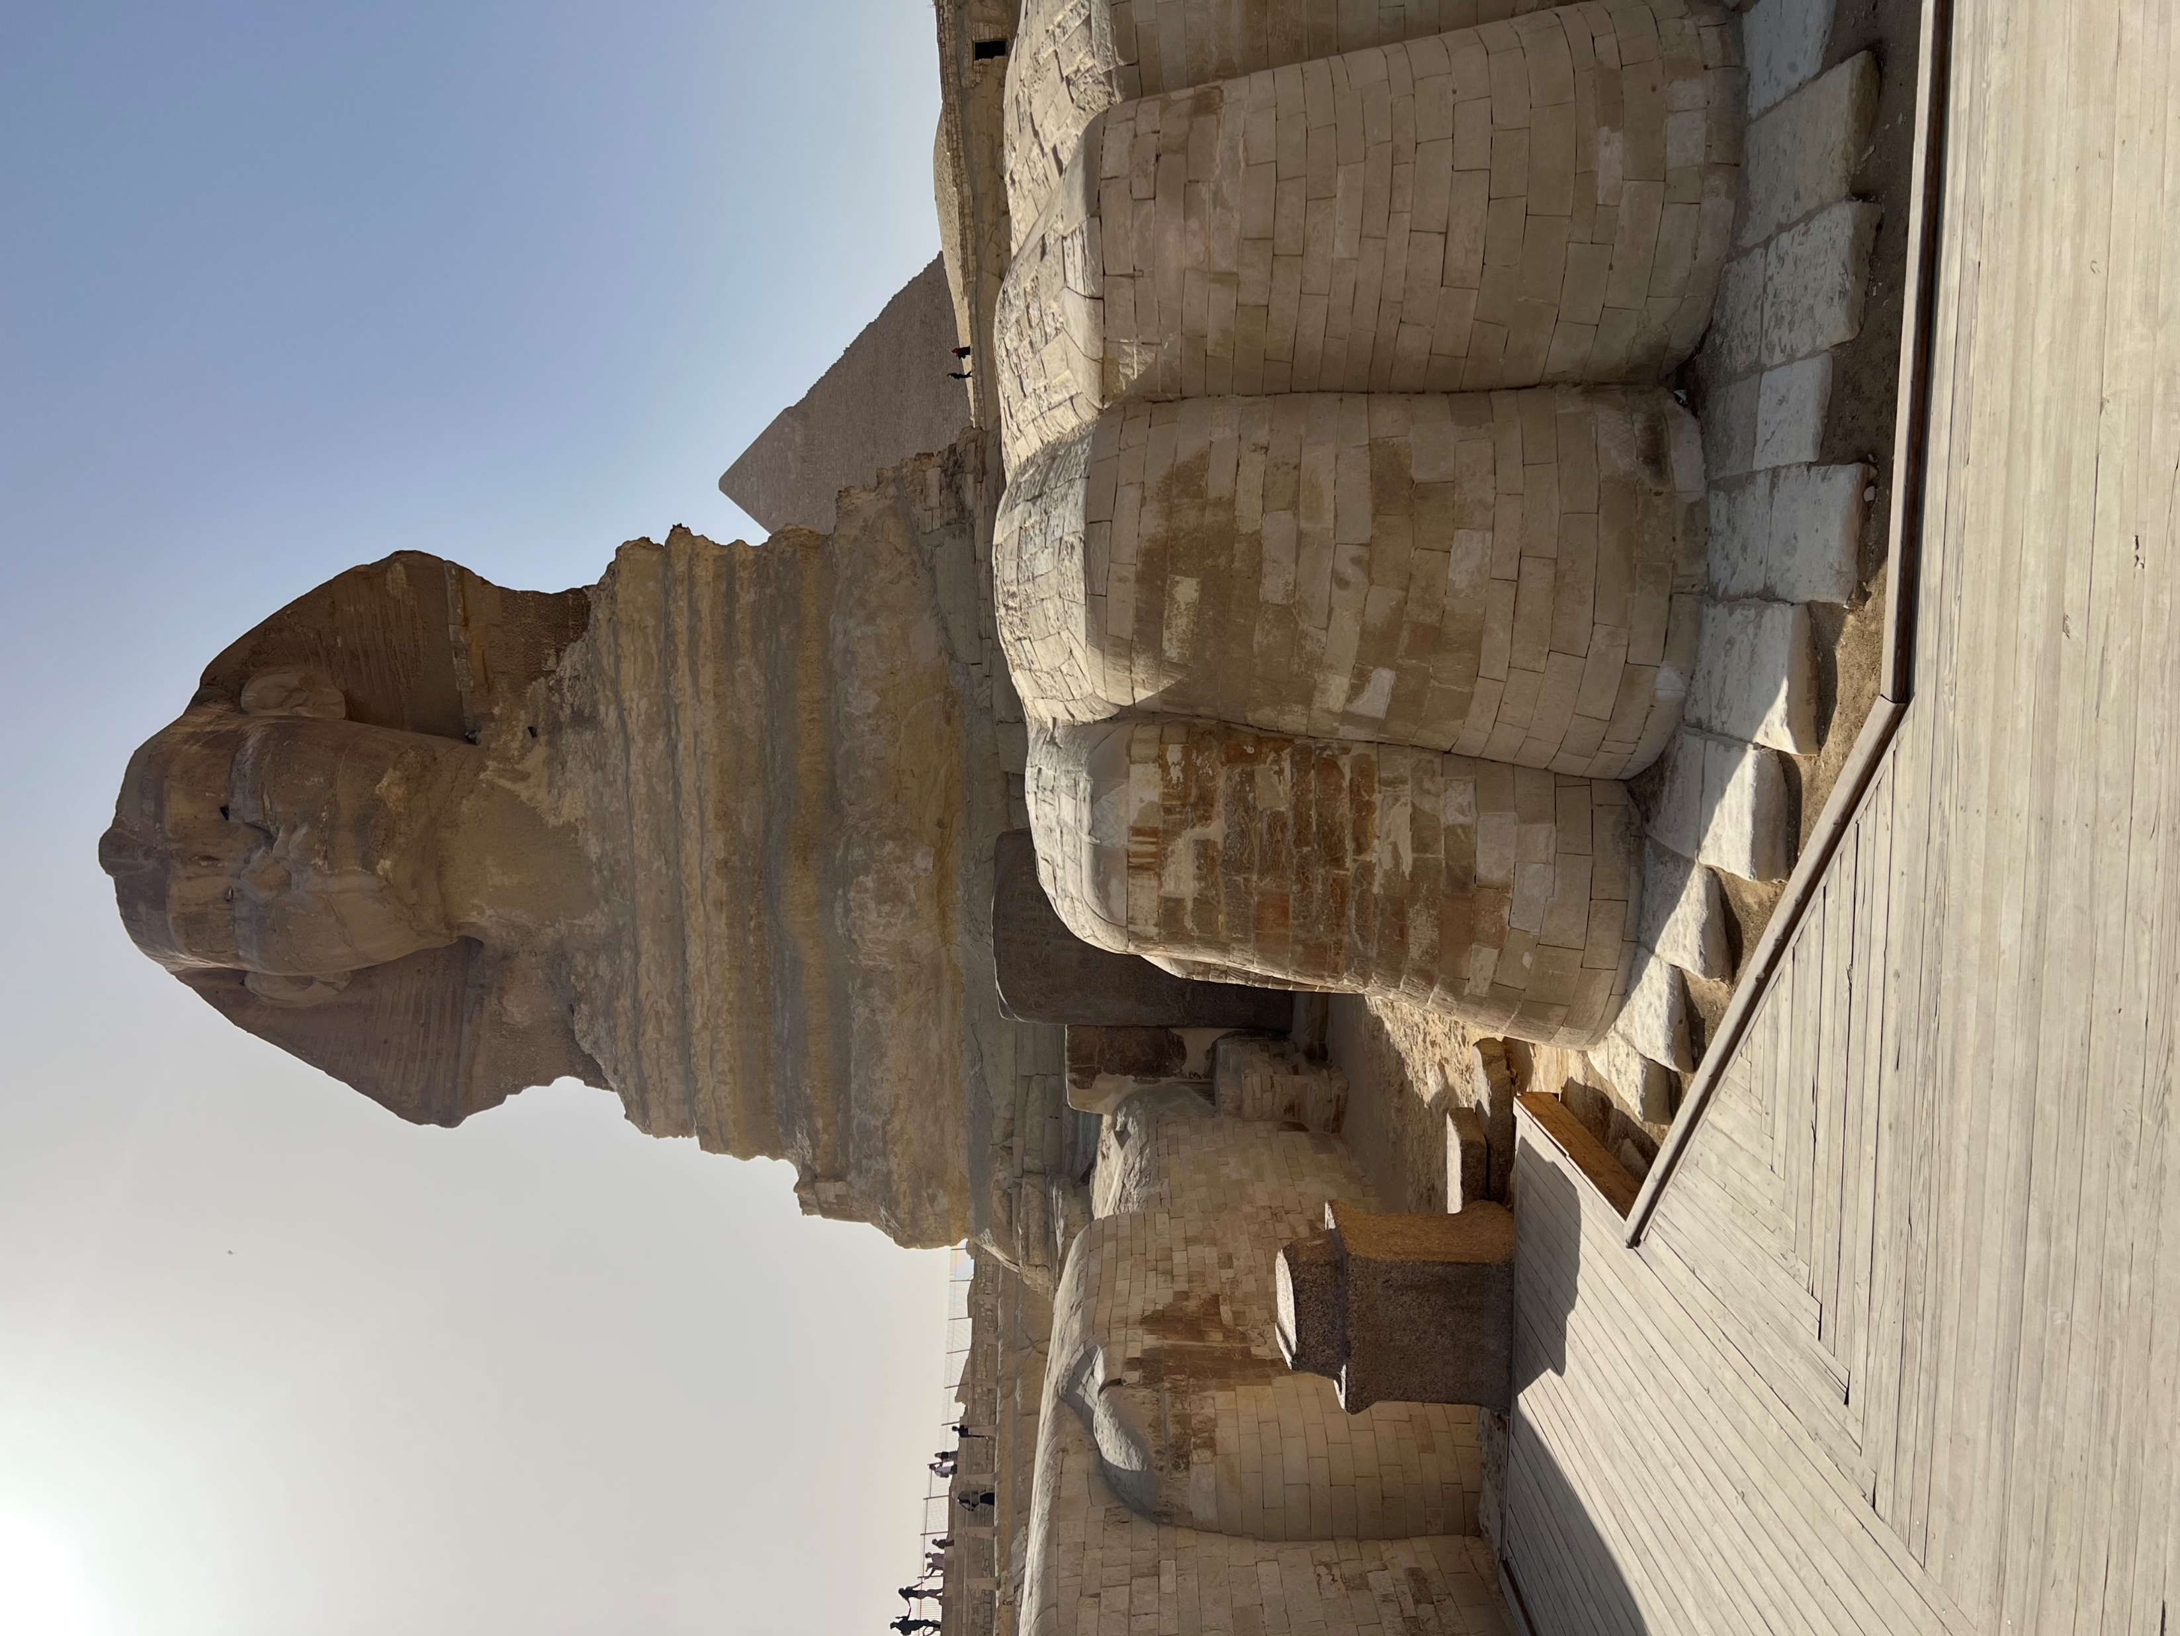

Slide 7
Hebrew title—“These are the names”
English title—From the Greek word exodus (“way out” “departure”)
Author—Moses (Ex 34:27)
Audience—the Hebrew people in the wilderness

Slide 8
Aim / Message—God makes His glory, holiness, and faithfulness known by freeing the Hebrew people from Egypt and forming them into a holy nation.
Where did we come from?
How did we get here?
Where are we going?
Who is Yahweh?

Slide 9
Arrangement
Exodus 1—18 Exodus 19—40 Redemption from Egypt Revelation from God
Narration Legislation
Getting Israel out of Egypt Getting Egypt out of Israel
1—12 Egypt (430 yrs.) Mt. Sinai (1 yr.)
13—18 Traveling (2 mos.)

Slide 10
From Bondage to Blessing
From Captivity to Covenant
1—2 Captivity
3—5 Calling
6—13 Conflict
14—15 Crossing
16—18 Complaints
19—40 Covenant

Slide 11
Tony Merida
“God’s desire extended beyond liberating Israel from political, economic, and social slavery. He desired worshipers. He wanted Israel to know
and worship Him. Further, He wanted to use
Israel to make worshipers from all nations.”

Slide 13
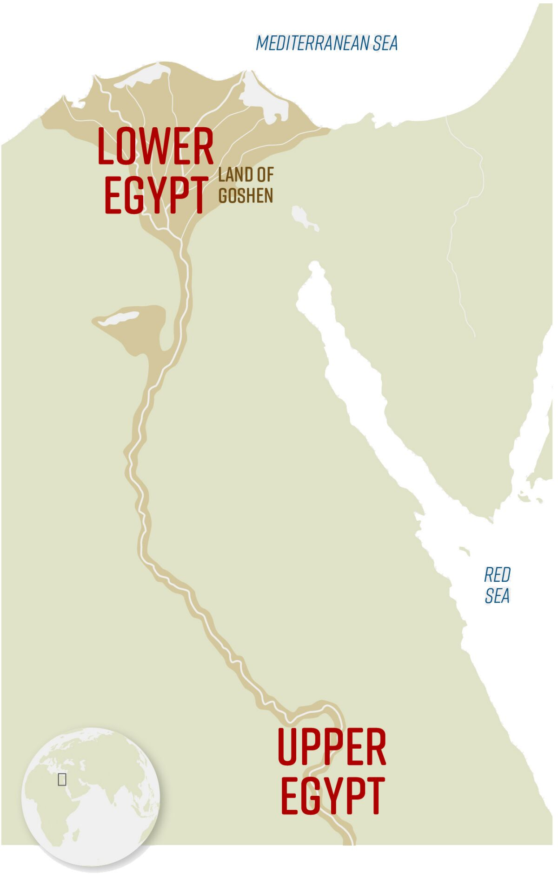

Slide 15
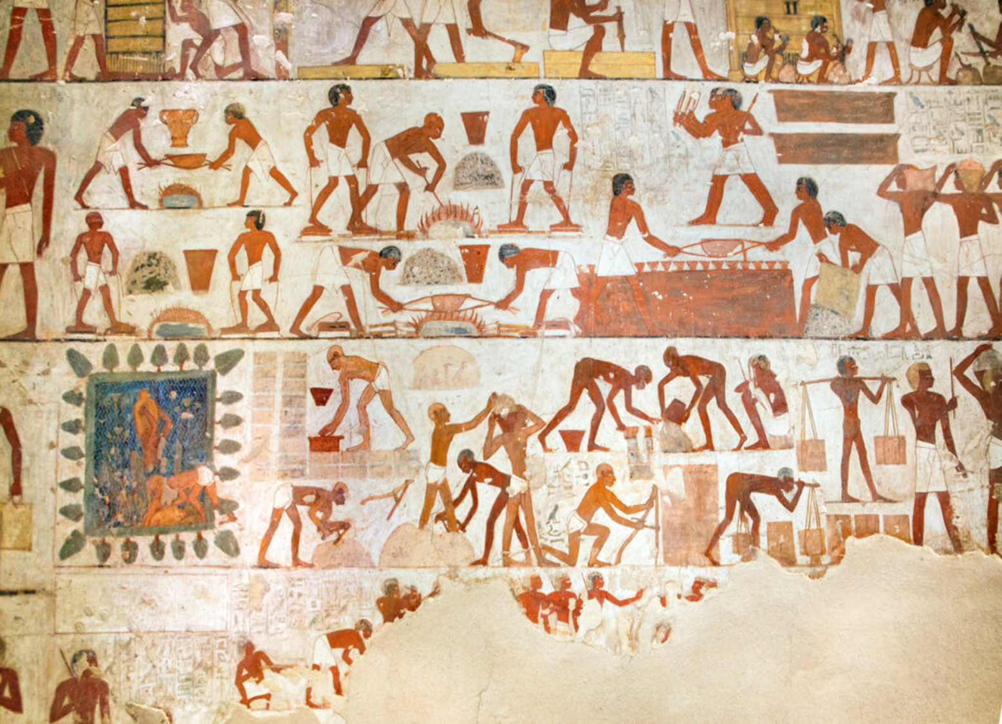
Brickmaking Slaves in Egypt (Tomb of Rekmire)
Tomb mural from the time of Pharaoh Thutmose III

