Slide 1
Campbell Street Church of Christ
September 21, 2024

Slide 2
Should We Talk about
Sex at Church?

Slide 3
Should We Talk about
Sex at Church?
What Is Going On?
And WHY?

Slide 4
Scripture’s Positive Thesis
Marriage should be honored by all, and the marriage bed kept pure . . .
Hebrews 13:4a (NIV)

Slide 5
The Negative Implication
Marriage should be honored by all, and the marriage bed kept pure, for God will judge the adulterer and all the sexually immoral.
Hebrews 13:4 (NIV)

Slide 6
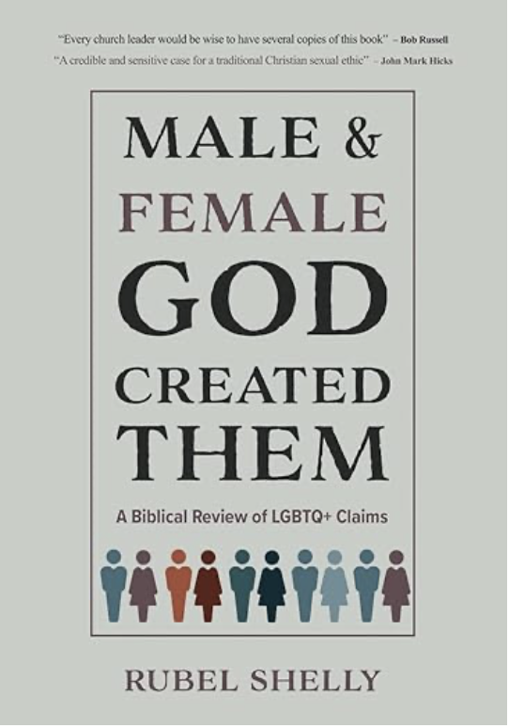
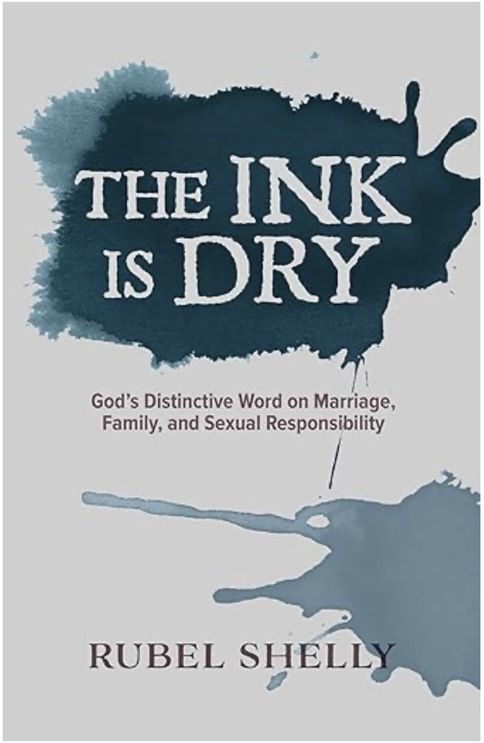
A Disclaimer
I never wanted to present these lectures, hold seminars on “LGBTQ+ issues,” or write Male and Female God Created Them and The Ink Is Dry – or imagined the need for doing so.
Notes:
NOTE: Division within the United Methodist Church / get current figures
NOTE Church of England and “trial service” for blessing same-sex couples

Slide 7
A Disclaimer
I never wanted to present these lectures, hold seminars on “LGBTQ+ issues,” or write Male and Female God Created Them and The Ink Is Dry – or imagined the need for doing so.
I had lived with the naïve assumption that Jesus-confessing, Bible-believing churches held a consistent doctrine of ethical behavior as articulated in the Holy Scriptures – certainly all the churches within my heritage in Churches of Christ.
Then things began to change!
Notes:
NOTE: Division within the United Methodist Church / get current figures
NOTE Church of England and “trial service” for blessing same-sex couples

Slide 8
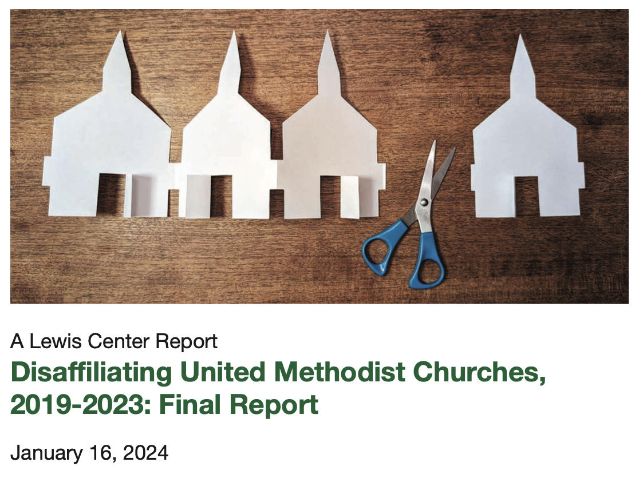

Slide 9
Case Study: David Gushee
Stassen & Gushee, Kingdom Ethics (2003), 310-311
Gushee, Changing Our Mind (2014-2017), 176-177
Gushee, After Evangelicalism: The Path to a New Christianity (2020), 41, 130-131

Slide 10
Gushee’s “Post-Evangelical Sexual Ethic”
Step One: There are “other ways of knowing [than Scripture] – indeed, other ways of hearing God address us. These include tradition, science, reason, experience, intuition, community, and relationships. The power of a narrow evangelical biblicism must be broken, but you can’t replace something with nothing. We need to open ourselves to other ways of discerning truth.” (p.41)

Slide 11
Gushee’s “Post-Evangelical Sexual Ethic”
Step Two: He proposes a two-tiered sexual ethic in which (a) there is a “bare minimum” or “baseline of mutual enthusiastic consent and noncoercive, nonexploitative sex, as well as other dimensions of sexual responsibility” and (b) a “renewed vision of the concept of covenantal marriage, applied to all followers of Jesus.” (pp.130-131)
Notes:
[from Highfield, “The Choice”] The career of David P. Gushee provides another striking example of the lure progressive logic has for evangelicals who cross the Rubicon of LGBTQ+ affirmation. In his 2015 book Changing our Minds, Gushee could still be described as an evangelical leader. The titles of his 2017 book Still Christian: Following Jesus Out of American Evangelicalism and his 2022 book After Evangelicalism: The Path to a New Christianity tell a story of change in the direction of progressive theology toward a perspective Gushee calls “post-evangelicalism.” In After Evangelicalism, Gushee proposes a two-tiered sexual ethic. Covenant marriage should be the aspirational norm by which every other use of sex is measured. In covenant marriage, people pledge to take care of each other through thick and thin. For all the reasons cultures down through the ages have encouraged it, marriage is still the best place to direct sexual energy toward personal and social wellbeing. Although Gushee does not mention gay marriage in this immediate context, it is clear that he includes these marriages within his category of covenant marriage. He says,
I personally affirm that full acceptance of LGBTQ people is a nonnegotiable dimension of post-evangelical Christianity, and most others in this terrain seem to feel the same way (p. 130).

Slide 12
Gushee’s Assertion
“We need to accept that for something like 3 to 5 percent of the population, their given version of sexuality is lesbian, gay, or bisexual. It is past time to drop all stigma associated with this natural variation in the human family, which our faith has done so much to worsen. I personally affirm that full acceptance of LGBTQ people is a nonnegotiable dimension of postevangelical Christianity, and most others in this terrain seem to feel the same way.” (p.130)
Notes:
[from Highfield, “The Choice”] The career of David P. Gushee provides another striking example of the lure progressive logic has for evangelicals who cross the Rubicon of LGBTQ+ affirmation. In his 2015 book Changing our Minds, Gushee could still be described as an evangelical leader. The titles of his 2017 book Still Christian: Following Jesus Out of American Evangelicalism and his 2022 book After Evangelicalism: The Path to a New Christianity tell a story of change in the direction of progressive theology toward a perspective Gushee calls “post-evangelicalism.” In After Evangelicalism, Gushee proposes a two-tiered sexual ethic. Covenant marriage should be the aspirational norm by which every other use of sex is measured. In covenant marriage, people pledge to take care of each other through thick and thin. For all the reasons cultures down through the ages have encouraged it, marriage is still the best place to direct sexual energy toward personal and social wellbeing. Although Gushee does not mention gay marriage in this immediate context, it is clear that he includes these marriages within his category of covenant marriage. He says,
I personally affirm that full acceptance of LGBTQ people is a nonnegotiable dimension of post-evangelical Christianity, and most others in this terrain seem to feel the same way (p. 130).

Slide 13
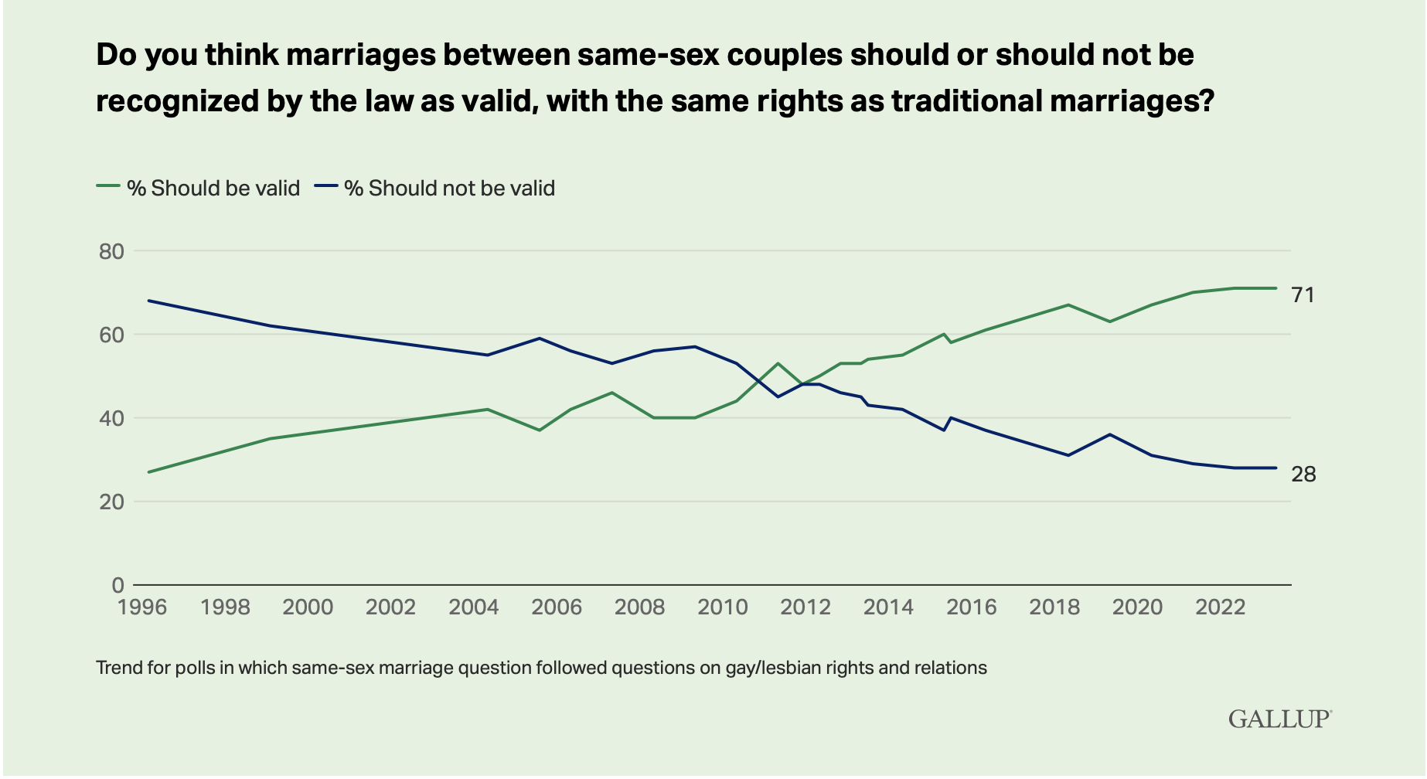
The Shift!
Notes:
In 1996 / 27% Approve / 68% Disapprove
In May 2023 / 71% Approve / 28% Disapprove

Slide 14
So RAPID a Shift!
Researchers have expressed shock that so radical a cultural shift could have taken place so quickly!
“You can’t find another issue where attitudes have shifted so rapidly.”
  Don Haider-Markel, Prof of Political Science, Univ of Kansas
How to account for it?

Slide 15
The “Culture Wars” Are Over
Western Culture has an ethical posture that is non-Christian.
  Three Values: (1) autonomy, (2) self-interest / pleasure, and (3) mutuality / consent
  These values have created a Sexual Ethic that permeates Western culture
Autonomy = It is my life / body, and nobody has the right to tell me what I cannot do; I alone am the “master of my fate” and I can do as I please.
Self-Interest = I must find my true self and be who I am meant to be; my physical and emotional satisfaction are primary in all things.
Mutuality = My autonomy and self-interest are limited chiefly by those same rights for others; among consenting partners, all things are permitted.

Slide 16
Autonomy = my life, my body, do as I please.
  “You are not your own; you were bought at a price. Therefore honor God with your bodies” (1 Cor 6:19b-20; see 6:12ff).
  What a radically opposite point of departure for sexual ethics!

Slide 17
Autonomy = my life, my body, do as I please.
  “You are not your own; you were bought at a price. Therefore honor God with your bodies” (1 Cor 6:19b-20; see 6:12ff).
  What a radically opposite point of departure for sexual ethics!
Self-Interest / pleasure = find my authentic self and experience satisfaction.
  For Christians, our life goal is “to be conformed to the image of [God’s] Son” (Rom 8:29) and to live to the Spirit rather than to the flesh (Rom 8:12-13).
  In a fallen world, we are broken people whose instinctual drives are to the flesh.

Slide 18
Autonomy = my life, my body, do as I please.
  “You are not your own; you were bought at a price. Therefore honor God with your bodies” (1 Cor 6:19b-20; see 6:12ff).
  What a radically opposite point of departure for sexual ethics!
Self-Interest / pleasure = find my authentic self and experience satisfaction.
  For Christians, our life goal is “to be conformed to the image of [God’s] Son” (Rom 8:29) and to live to the Spirit rather than to the flesh (Rom 8:12-13).
  In a fallen world, we are broken people whose instinctual drives are to the flesh.
Mutuality / consent = anything is permitted that is not forced on another.
  Nonconsensual acts are wrong (e.g., rape), but that hardly justifies all that one’s partner consents to share (e.g., fornication, adultery).
  “Consent” merely allows the morally permissible but cannot purify what is forbidden in itself.
  I will defend one’s legal/civil right to do things that are not morally right.

Slide 19
Moralistic Therapeutic Deism the remnant of Christian faith in American culture
A god exists who created and ordered the world and watches over human life.
People should be good, nice, and fair (i.e., moral) in dealing with each other.
The central goal of life is to be happy and to feel good about oneself.
There are no absolute moral truths for a human life.
God does not need to be particularly involved in one's life, except when needed to resolve a problem.
Good people go to heaven when they die.
Smith and Denton, Soul Searching (2005)
Notes:
America is now a post-Christian culture where much of what survives as religion is a remix made up of a little Bible, a larger dash of pop psychology, and defining quantities of self-validating egoism. Thus some of the strongest of “faith statements” from people I have met lately take some form resembling this: “I could never believe in a God who x!” – where x is in disagreement with the speaker’s view or makes an unwanted and unwelcomed demand on that person’s life choices.
Two sociologists have given us what has become a widely used name for this vague and undemanding disposition. Christian Smith and Melinda Lundquist Denton have dubbed it “Moralistic Therapeutic Deism.” Their research focused on the core religious beliefs of American teenagers at the turn of the century, but their findings have come to be regarded by many as the general state of cultural beliefs in our country.
[[Christian Smith and Melinda Lundquist Denton, Soul Searching: The Religious and Spiritual Lives of American Teenagers (New York: Oxford University Press, 2005). ]]

Slide 20
Five Cultural Shifts
Postmodernity

Slide 21
“Truthless” Culture
Postmodernity: Western culture since late 20th century
  Facts-out-there have given way to facts-in-me/us
  Autobiography has become argument
Postmodern Theology: Scripture is true and authoritative when confirmed by (soft) sciences and personal experience
Relativism Rules!

Slide 22
Five Cultural Shifts
Postmodernity
A Strategy for Normalization
Notes:
AFTER THE BALL: How America Will Conquer Its Fear and Hatred of Gays in the 90s (New York: Doubleday, 1989).
Hunter Madsen was a bright, Harvard-educated student of persuasion, psychology, and
propaganda. He met Marshall Kirk during his Harvard years, where Kirk was studying
psychology. The two became a formidable pair in their After the Ball: How America Will
Conquer Its Fear of Gays in the ’90s.11 Using the term “propaganda” of their project, the book
proposed a Waging Peace Campaign designed to persuade the American public not only to
accept same-sex relationships as normal but to portray gay persons as society’s victims and to
invite straights to be their protectors. The authors’ candor is quite forthright:
“The campaign we outline in this book, though complex, depends centrally upon a program of unabashed
propaganda, firmly grounded in long-established principles of psychology and advertising.”12
The campaign outlined in After the Ball rests on the three pillars Kirk and Madsen termed
desensitization, jamming, and conversion. Desensitization occurs when repeated exposure to
something that has previously caused discomfort diminishes the discomfort – like exposure to
certain animals or allergy treatments that reduce a body’s sensitivity to ragweed pollen. This
first move is designed to convince people that “gays are just like everybody else” and not
abnormal. Like left-handed or red-haired people, they are just a minority. Jamming seeks to
create a sense of shame in non-affirming people by making them attach their feelings of
aversion and rejection based on biblical teaching to postures of bigotry, small-mindedness, and
intolerance. “All normal persons feel shame when they perceive they are not thinking, feeling,
or acting like one of the pack,” they write. “It [a gay-normalizing ad] can depict gays
experiencing horrific suffering as the direct result of homohatred – suffering of which even
most bigots would be ashamed to cause.”13 Then conversion occurs when aversion gives way to
increased likability and even affirmation of persons who cannot be seen as other than
warmhearted and decent who are involved in same-sex relationships.
How this blueprint has worked can be documented from novels and movies, TV shows and
their stars, athletes and musicians, or even advertisements for automobiles and vacation
homes. There are very few TV sitcoms, for example, that do not have at least one comedic or
heroic lead character whose is openly lesbian or gay – perhaps with the show built around
them. The result has been a wholesale shift of attitude toward same-sex partnerships and
behaviors among young people. They have only seen gay and lesbian persons portrayed
83
sympathetically – either as heroic in character or victimized by bigoted (usually super-religious!)
villains whose behavior nobody would want to imitate.

Slide 23
Five Cultural Shifts
Postmodernity
A Strategy for Normalization
Changed Legal Status
Notes:
As recently as 1996 and precisely because of the social debates going on about the status
of these and related issues, the United States Congress passed the Defense of Marriage Act
(DOMA). DOMA specifically defined marriage as the union of one man and one woman and
explicitly said “the word ‘spouse’ refers only to a person of the opposite sex who is a husband
or a wife.”15
In 2013, the Supreme Court struck down the law’s definition of marriage as the union of
one man and one woman. Then, two years later, the court followed up by striking down
another provision of the law that allowed individual states to deny recognition of same-sex
marriages that had been performed legally in other states. The result of these two court actions
was that the right for same-sex couples to marry was declared to be a constitutional right. On
December 13, 2022, President Joe Biden signed the Respect for Marriage Act into law. Its
bipartisan proponents argued it was needed to guarantee that a future Supreme Court would
not invalidate the 2013 and 2015 court decisions. The Respect for Marriage Act specifically
mandates federal recognition for same-sex marriage. . . .
What even many Christians seem not to appreciate is that changes in American law do not
alter biblical teachings. Churches, parachurch ministries, Christian schools, and the like feel
cultural pressures at various points. But the ink is still dry on what the Bible says to believers
and what the church must teach and live by as an alternate community of faith in a post-
Christian time. To whatever degree the laws protect LGBTQ+ persons from bigotry, unfair
treatment, and violence, they are only doing what Christians should have pressed for already.

Slide 24
Five Cultural Shifts
Postmodernity
A Strategy for Normalization
Changed Legal Status
“Progressive Christianity”
Notes:
Figures such as Brian McLaren, Andy Stanley, and David Gushee – who gained followings
from their conservative starting points – have gone on record to reject their roots for a new
alternative. McLaren describes himself as “a passionate advocate for ‘a new kind of Christianity’
– just, generous, and working with people of all faiths for the common good.” Stanley has
revived the second-century Marcionite heresy already described in Chapter Four with his
declaration that the twenty-first century church must “unhitch” from the Old Testament.
Gushee has marked what he terms “the path to a New Christianity” that is animated by a spirit
of Christian humanism.
These three have gained both attention and credibility by hammering the failings of
twentieth-century fundamentalism. Pointing to the racist, sexist, and homophobic predilections
of today’s Evangelicalism that morphed into a hateful more-political-than-theological Christian
Nationalism, they have convinced many that their rejection of those views forces them to
embrace a restructured version of Christianity. And there is not enough biblical knowledge or
theological sophistication in the general church population to sense where all this leads. In a
word, the social sciences of Sociology and Psychology now count for more than Scripture. . . .
As Ron Highfield has noted:
Hence the church’s traditional teaching that the Bible alone is the ultimate norm of Christian faith and morals must be rejected. To defend their progressive views, progressives reinterpret, correct, reject, or even condemn the teaching of Scripture. God’s “voice” in personal experience, political movements, culture, and psychology in certain cases trumps Scripture. Apparently the “progress” of progressive Christianity depends on a constant flow of new divine revelations. It should not escape notice that these new revelations track almost perfectly, albeit a few months behind, with advances in secular culture and politics.19
Highfield also provides a helpful distinction between what it is to “interpret” versus
“reinterpret” a biblical text. The legitimate task of literate Bible students is to interpret the
original language and historical setting of a text in order “to unite the mind of the listener with
the original meaning of the text along with its full implications and applications.” On the other
hand, to reinterpret “usually means not merely to challenge older, established interpretations
but to read an alien meaning into the text with as much plausibility as one can create. It is to
hijack the accrued authority of a text and place it in service of a meaning more acceptable to
the interpreter.”20

Slide 25
Five Cultural Shifts
Postmodernity
A Strategy for Normalization
Changed Legal Status
“Progressive Christianity”
“But it is someone I know/love!”
Notes:
Jesus said it would happen: “If anyone comes to me and does not hate father and mother, wife and children, brothers and sisters – yes, even their own life – such a person cannot be my disciple” (Luke 14:26). He knew that some of his would-be followers would have to make terribly hard choices to be his disciple. Our generation has found a way to dismiss this tough demand rather than have to accept it.
The key to resolving the dilemma, of course, is neither to deny the power of romantic human love nor to minimize the demands of true discipleship. It is to realize that love for God is more fundamental and precious than love for family, friends, nation, or even life itself. “We should seek to reconcile love of God and love of others whenever they appear to conflict,” Tushnet continues. “But we can’t simply assume that such a conflict never exists – or that, if a conflict seems to arise, God couldn’t possibly be asking us to sacrifice a human relationship.”
Jesus used the metaphors of gouging out an eye or cutting off a hand to help his disciples understand just how costly discipleship could be (Matt 5:29-30). It is not insignificant that he was discussing personal relationships when he used that language. When power, money, or a human relationship takes priority over someone’s love for and devotion to God, it becomes his or her god and turns the person into what the Bible calls an idolator. Perhaps that is precisely why Paul used male-with-male and female-with-female love as examples of what happens when a culture exchanges the truth it can know about God for an idol.

Slide 26
A Final Word: God Loves Gay People
LGBTQ+ persons are my “neighbors” in God’s world – not my enemies.
Notes:
LGBTQ+ persons are my “neighbors” in God’s world, and lesbians are not my enemies.
BUT this does not make them exceptions to the Bible’s judgment of same-sex conduct.
The church cannot love God and be homophobic and unwelcoming to gay people.
In Christ and by the power of the Spirit, no one is locked in psychological or biological determinism.
We must do a better job helping people deal with this issue!
“Attraction” is not “action” – and reflects our common fallenness in a fallen world.
Singleness is not a curse, and marriage/family must not be the church’s idol.
“Welcoming” and “affirming” are no different for persons who teach, practice, or otherwise affirm any other category of misbehavior in Scripture’s list of vices.
We “welcome” greedy, adulterous, addicted, drunk, gossiping, proud, self-righteous, lesbian, gay, bisexual, transgender, queer, and questioning people in the hope that the Holy Spirit will convict, bring to repentance, save them, and empower righteous new behavior – with the rest of us sinners.
We do not and cannot “affirm” any one of these behaviors that remains un-repented.
Persons who advocate any of these actions as moral and/or defend them are not only non-traditional and unorthodox, but heretical.

Slide 27
A Final Word: God Loves Gay People
LGBTQ+ persons are my “neighbors” in God’s world – not my enemies.
The church cannot love God and be homophobic and unwelcoming to gay people.
Notes:
LGBTQ+ persons are my “neighbors” in God’s world, and lesbians are not my enemies.
BUT this does not make them exceptions to the Bible’s judgment of same-sex conduct.
The church cannot love God and be homophobic and unwelcoming to gay people.
In Christ and by the power of the Spirit, no one is locked in psychological or biological determinism.
We must do a better job helping people deal with this issue!
“Attraction” is not “action” – and reflects our common fallenness in a fallen world.
Singleness is not a curse, and marriage/family must not be the church’s idol.
“Welcoming” and “affirming” are no different for persons who teach, practice, or otherwise affirm any other category of misbehavior in Scripture’s list of vices.
We “welcome” greedy, adulterous, addicted, drunk, gossiping, proud, self-righteous, lesbian, gay, bisexual, transgender, queer, and questioning people in the hope that the Holy Spirit will convict, bring to repentance, save them, and empower righteous new behavior – with the rest of us sinners.
We do not and cannot “affirm” any one of these behaviors that remains un-repented.
Persons who advocate any of these actions as moral and/or defend them are not only non-traditional and unorthodox, but heretical.

Slide 28
A Final Word: God Loves Gay People
LGBTQ+ persons are my “neighbors” in God’s world – not my enemies.
The church cannot love God and be homophobic and unwelcoming to gay people.
We must do a better job helping people deal with this issue!
Notes:
LGBTQ+ persons are my “neighbors” in God’s world, and lesbians are not my enemies.
BUT this does not make them exceptions to the Bible’s judgment of same-sex conduct.
The church cannot love God and be homophobic and unwelcoming to gay people.
In Christ and by the power of the Spirit, no one is locked in psychological or biological determinism.
We must do a better job helping people deal with this issue!
“Attraction” is not “action” – and reflects our common fallenness in a fallen world.
Singleness is not a curse, and marriage/family must not be the church’s idol.
“Welcoming” and “affirming” are no different for persons who teach, practice, or otherwise affirm any other category of misbehavior in Scripture’s list of vices.
We “welcome” greedy, adulterous, addicted, drunk, gossiping, proud, self-righteous, lesbian, gay, bisexual, transgender, queer, and questioning people in the hope that the Holy Spirit will convict, bring to repentance, save them, and empower righteous new behavior – with the rest of us sinners.
We do not and cannot “affirm” any one of these behaviors that remains un-repented.
Persons who advocate any of these actions as moral and/or defend them are not only non-traditional and unorthodox, but heretical.

Slide 29
A Final Word: God Loves Gay People
LGBTQ+ persons are my “neighbors” in God’s world – not my enemies.
The church cannot love God and be homophobic and unwelcoming to gay people.
We must do a better job helping people deal with this issue!
“Welcoming” and “affirming” are no different for persons who teach, practice, or otherwise affirm any other category of misbehavior in Scripture’s list of vices.
Notes:
LGBTQ+ persons are my “neighbors” in God’s world, and lesbians are not my enemies.
BUT this does not make them exceptions to the Bible’s judgment of same-sex conduct.
The church cannot love God and be homophobic and unwelcoming to gay people.
In Christ and by the power of the Spirit, no one is locked in psychological or biological determinism.
We must do a better job helping people deal with this issue!
“Attraction” is not “action” – and reflects our common fallenness in a fallen world.
Singleness is not a curse, and marriage/family must not be the church’s idol.
“Welcoming” and “affirming” are no different for persons who teach, practice, or otherwise affirm any other category of misbehavior in Scripture’s list of vices.
We “welcome” greedy, adulterous, addicted, drunk, gossiping, proud, self-righteous, lesbian, gay, bisexual, transgender, queer, and questioning people in the hope that the Holy Spirit will convict, bring to repentance, save them, and empower righteous new behavior – with the rest of us sinners.
We do not and cannot “affirm” any one of these behaviors that remains un-repented.
Persons who advocate any of these actions as moral and/or defend them are not only non-traditional and unorthodox, but heretical.

Slide 30


