Slide 1
Campbell Street Church of Christ
September 21, 2024

Slide 2
Should We Talk about
Sex at Church?
The Bible in
Historical Context

Slide 3
Dare We Be “Judgmental”?
Is Matthew 7:1 the Bible’s “most misinterpreted and misused text”?
Jesus’ own language . . .
Some religionists were a “brood of vipers” / Matt 12:34
Herod Antipas is “that fox” / Luke 13:32
He called some children of the devil / John 8:44
Jesus’ clarification about “judging”: “Stop judging by mere appearances, but instead judge correctly” / John 7:24.
No one can escape the duty of making ethical judgments

Slide 4
The Importance of Historical Context
LGBTQ+ issues are neither “new” nor
“unique” to our time in history

Slide 5
“In the beginning . . .”
“So God created mankind in his own image, in the image of God he created them; male and female he created them” (Gen 1:27)
This wide-angle shot of creation sets the stage and assigns the human mission
Mission: Be fruitful and rule wisely! (Gen 1:28)
“This is now bone of my bones and flesh of my flesh; she shall be called ‘woman,’ for she was taken out of man” (Gen 2:23)
In the close-up shot, “not good” that the male is alone
He needs a “suitable helper” to fulfill his mission
Thus woman (Heb, ishah) is created from man (Heb, ish)
Result: “That is why a man leaves his father and mother and is united to his wife, and they become one flesh” (Gen 2:24)

Slide 6
The Genesis Norm
Male-Female union is not about fixing human psychological loneliness but enabling the human mission: (a) fill the Earth and (b) rule it wisely
Adam sees: image-of-God sameness (“bone of my bones”)
Adam sees: sex/gendered difference (“ishah” is from “ish”)
Males and Females are both “complete persons,” and single or married state is a choice for each to make
Male-Female complementarity (binary as m/f) was God’s choice for the race
Descriptive or Prescriptive?

Slide 7
The Importance of Genesis
“Mankind” (NIV) or “humans (NRSVue) are MALE and FEMALE
The Bible affirms what science says: there are two and only two sexes
One’s sex is defined by the type gamete (sperm or ova) it functions to produce
Sex is binary, and there is no third gamete type
Excursus: gender spectrum / gender fluidity / transgender
Hard sciences: there are two sexes (obj. category)
Soft sciences: sex can be redefined along a gender spectrum (self-perception)
Facebook / passports / gov’t documents / athletics / etc.
“Feelings” and secondary traits don’t change “facts” and primary traits!

Slide 8
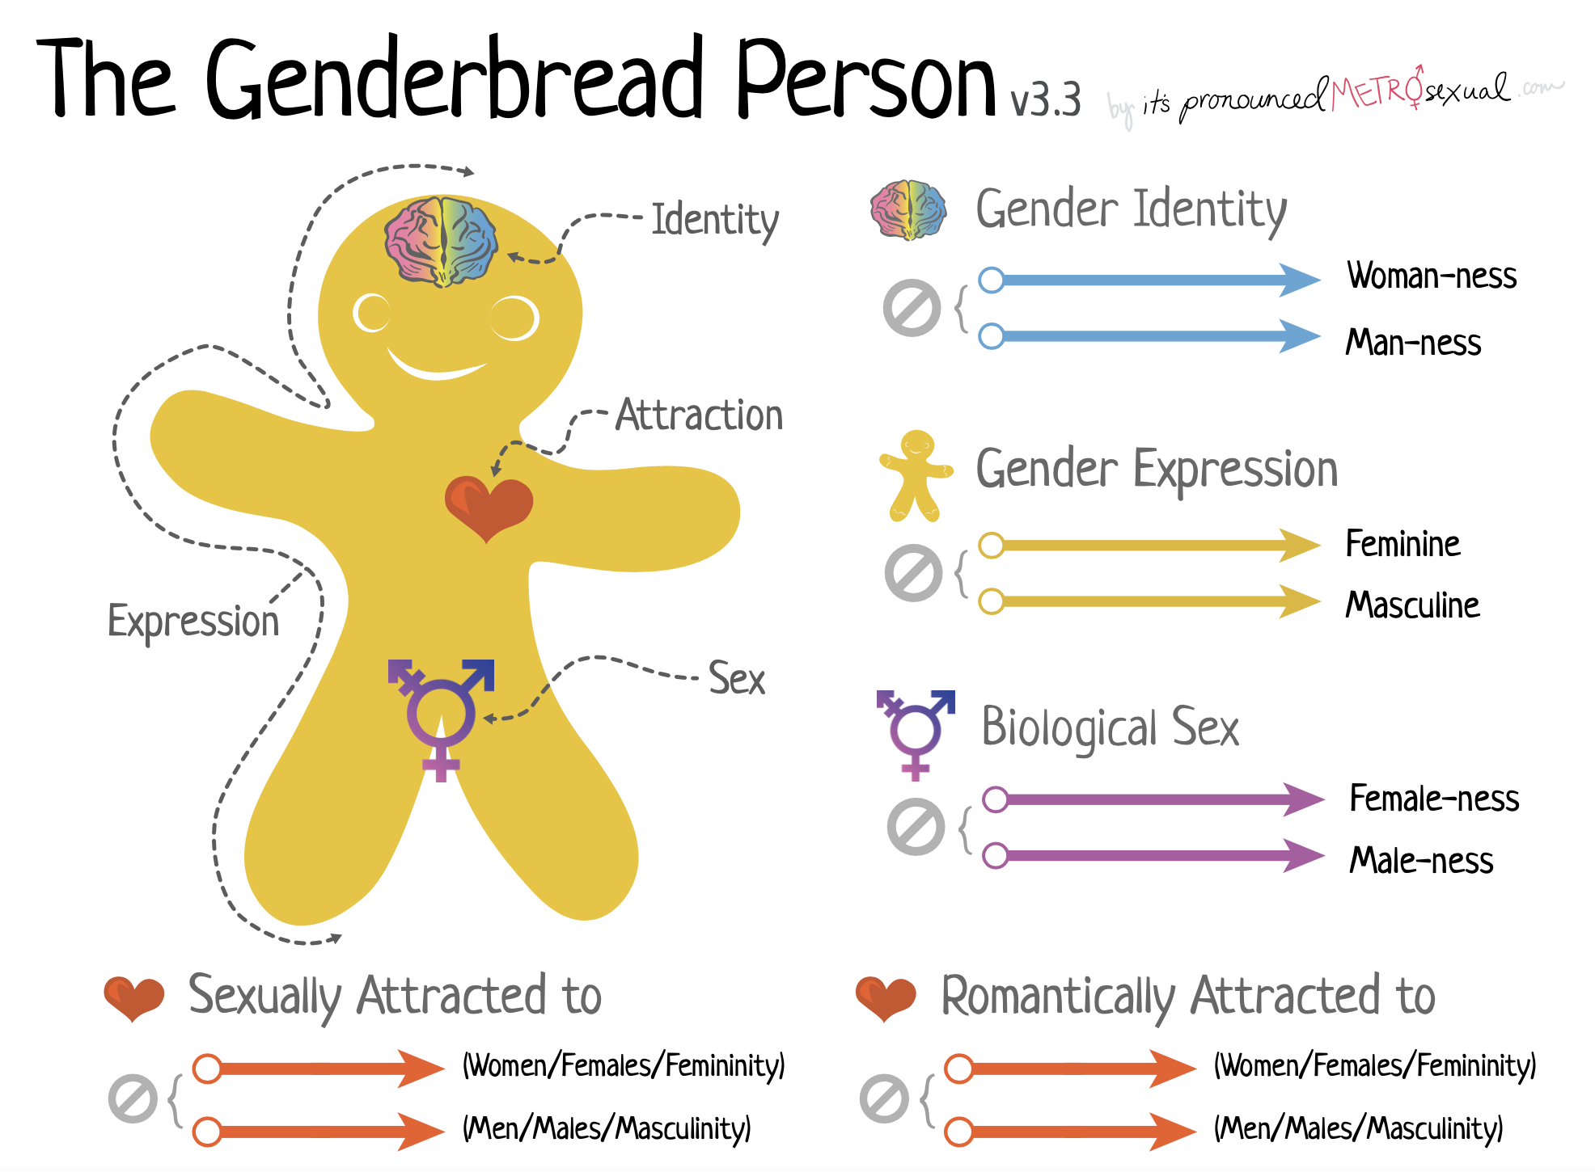

Slide 9
Jesus Saw Genesis as Prescriptive Matthew 19:1ff
We find the following key aspects of marriage in Genesis 2 and Jesus’ interpretation of Genesis:
companionship (not good to be alone)
mutual support of a strong ally (ezer ; not unilateral since Adam is by definition a counterpart [kenegdo]; as counterparts they mirror each other)
commonality and similarity
human spouse (bestiality ruled out; animals are too “other”)
establishment of “flesh of my flesh” kinship tie (no incest because it’s redundant; one does not need to form a kinship bond with someone who is already kin; one must leave family of origin to find a spouse [Gen.2:24])
faithfulness (no adultery or divorce)
a pair (no polygamous relationships)
— Karen Keen,
Scripture, Ethics, & the Possibility of
Same-Sex Relationships, 32-33

Slide 10
Jesus Saw Genesis as Prescriptive Matthew 19:1ff
We find the following key aspects of marriage in Genesis 2 and Jesus’ interpretation of Genesis:
companionship (not good to be alone)
mutual support of a strong ally (ezer ; not unilateral since Adam is by definition a counterpart [kenegdo]; as counterparts they mirror each other)
commonality and similarity
human spouse (bestiality ruled out; animals are too “other”)
establishment of “flesh of my flesh” kinship tie (no incest because it’s redundant; one does not need to form a kinship bond with someone who is already kin; one must leave family of origin to find a spouse [Gen.2:24])
faithfulness (no adultery or divorce)
a pair (no polygamous relationships)
— Karen Keen,
Scripture, Ethics, & the Possibility of
Same-Sex Relationships, 32-33
sex/gender differentiation ? (1:27b; 2:22; 2:23; 2:25; 2:25)

Slide 11
Same-Sex Relationships in Non-Biblical Literature
It is generally known that “ethical” sexual behavior in antiquity permitted much of what modern law codes prohibit
Premarital sex / common for fathers to “educate” sons in sexual behaviors
Prostitution / sometimes as actions of “religious devotion”
Exploitation of slaves / both male and female
Acts of war & conquest / rape of male combatants and innocents
Pederasty / institutionalized “mentorship” in Greece (note: Athens & Sparta vs Roman attitude)
NOTE: In patriarchal cultures males had “sexual privilege” denied to females

Slide 12
A Background Note
The historical argument around same-sex behaviors has changed rather dramatically in recent years
A twentieth-century case (e.g., Boswell, Crompton) argued that the frequency of documented and sanctioned same-sex coupling should override modern hesitation about same-sex marriage
“A work of paramount significance, Same-Sex Unions in Premodern Europe irrefutably demonstrates that same-sex relationships have been sanctioned and even idealized in Western societies for over two thousand years” (Dust jacket of Same-Sex Unions)
John Boswell (Professor of History, Yale Univ) gives documentation – both citation and text – for a number of public and normalized same-sex relationships
Louis Crompton (Univ of Nebraska) – The major source of prestige for male-male love was “its contribution to military morale” that led to Sacred Band of Thebes
Notes:
Boswell, dust jacket
Crompton, p.69

Slide 13
The More Recent Form of Argument
Robin Scroggs: “The only model of male homosexuality [in Paul’s day] was pederasty . . .”; “It is certain that pederasty was the only model in existence in the world of this time. That proposed by twentieth-century gay liberation movements was, without question, entirely absent.”
James Brownson: “In the ancient world, such ongoing permanent relationships between persons of the same sex are never documented in the extant literature of the period.”
David Gushee: “The context is so different that Paul’s words are of little relevance to the question of covenanted same-sex relations among devoted Christians.”
Mark Achtemeier: “The world of the biblical writers had nothing that remotely resembles the loving, egalitarian, committed gay marriages and partnerships we know today.”
Karen Keen: “But the biblical authors don’t write about the morality of consensual same-sex relationships as we know them today.”
Notes:
Scroggs, The New Testament and Homosexuality: Contextual Background for Contemporary Debate (Philadelphia: Fortress Press, 1983), 130, 139
Brownson, Bible, Gender, Sexuality: Reframing the Church’s Debate on Same-Sex Relationships (Grand Rapids: Eerdmans Publishing Co., 2013), 107.
Gushee, Changing Our Mind (Canton, MI: Read the Spirit Books, 2017), 89.
Achtemeier, The Bible’s Yes to Same-Sex Marriage, new edition (Louisville: Westminster John Knox
Press, 2015), 82.
Keen, Scripture, Ethics, and the Possibility of Same-Sex Relationships (Grand Rapids: Eerdmans,
2018), 20.

Slide 14
Correction of a Common Claim
Affirming writers often claim that only pederasty and other exploitative and/or non-consensual unions were known in ancient times (thus, only they are referred to/condemned in Scripture)
Thus, the claim is that Scripture nowhere condemns loving, consensual, covenanted, and monogamous same-sex unions
If these were not known in antiquity, they could not be rebuked
The claim is false and the conclusion from it is wrong

Slide 15
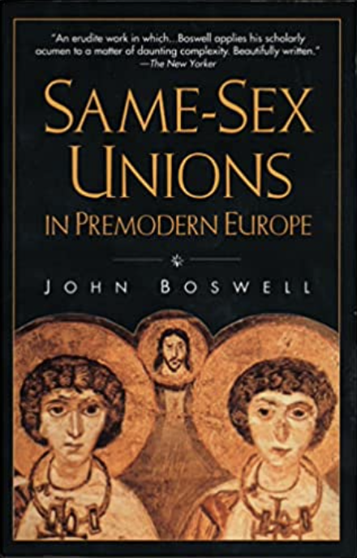
Yale Historian / Gay Activist
A fourth type of homosexual relationship known in the ancient world consisted of formal unions – i.e., publicly recognized relationships entailing some change in status for one or both parties, comparable in this sense to heterosexual marriage.
Cicero, though notoriously straightlaced, persuaded Curio the Elder to honor the debt his son had incurred on behalf of Antonius, to whom the younger Curio was, in Cicero’s words, “united in a stable and permanent marriage, just as if he had given him a matron’s stola.” [The stola was the distinctive attire to identify a married Roman woman.]
— John Boswell (p.80)
Notes:
Boswell, Same-Sex Unions in Premodern Europe (New York: Villard Books, 1994), 80. NOTE: Cicero quote is from Philippic 2.18.45

Slide 16
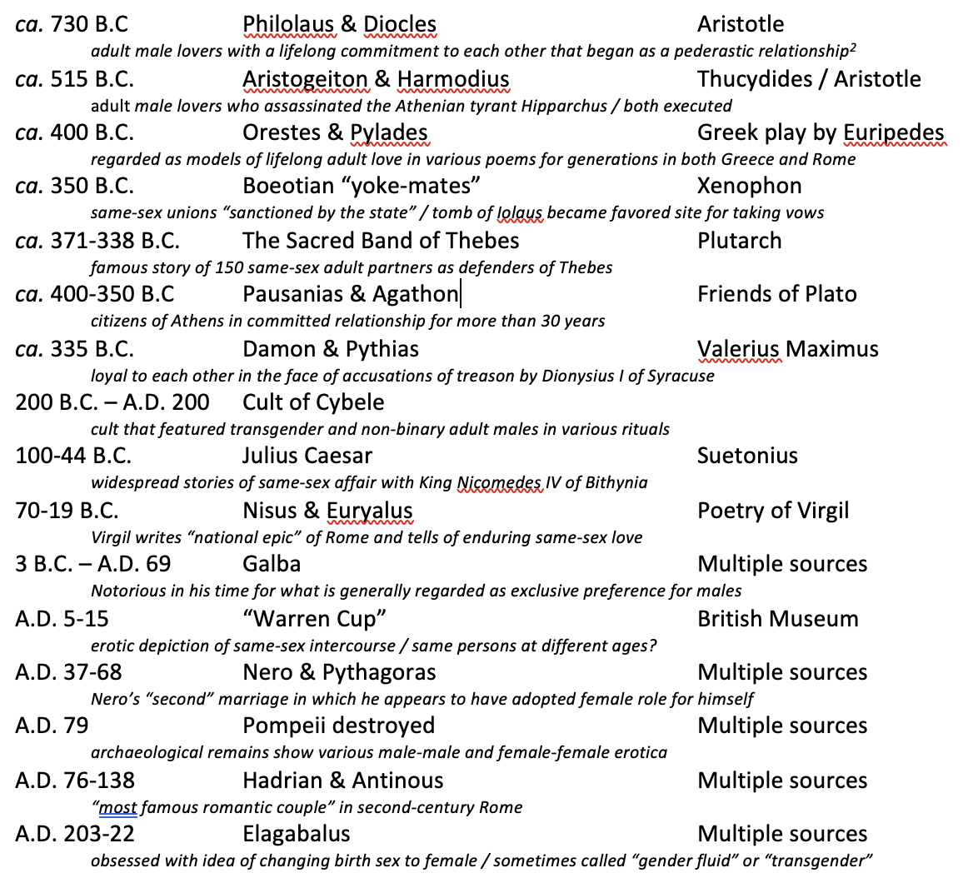
Notes:
Documented References to
LGBTQ+ Activities in Greco-Roman Period
Some of these are names of gods and/or public legends. Others are historic characters. They illustrate widespread public awareness of same-sex liaisons, partnerships, and “pseudo-marriages” in Greek and Roman cultures. Collectively, they prove the claim that ancient Greco-Roman culture neither knew nor approved consensual same-sex partnerships of the sort we know today is false. Further, that some of these are accounts of “gods” or “heroes” rather than common people or citizens does not diminish their relevance to the topic: myths were central to the educational process that taught Greeks and Romans what behaviors were acceptable for them as honorable persons.¹⁸ Quite clearly, consensual same-sex love over time was endorsed by these common stories, poems, plays, etc. They were known, documented, and talked about in the New Testament era.

Slide 17
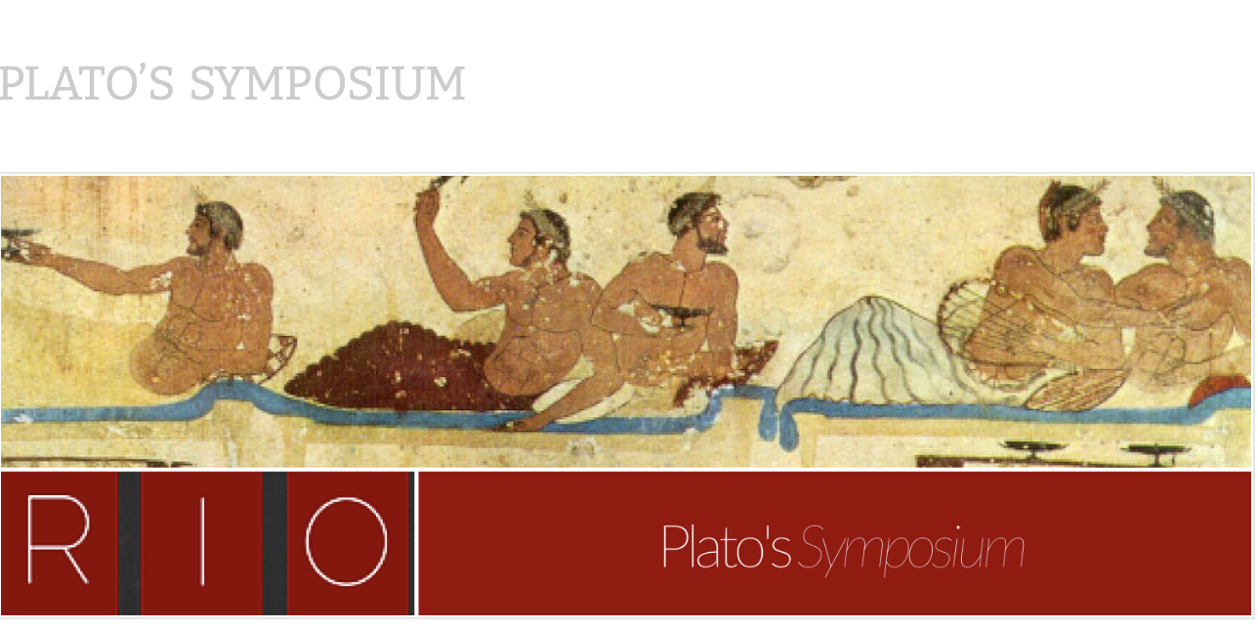

Slide 18
Plato’s Symposium
Symposia were regular features of sophisticated Greek life
Six speeches / three pair of male-male lovers / topic: Erōs
Pausanias & Agathon
Their committed and exclusive relationship was over 30 years old at the time
Pausanias’ speech is on-point for our issue

Slide 19
Pausanias’ Speech on Erōs/Love
Pausanias scorns the “vile man” and “vulgar lover” who is only interested in his own sensual satisfaction and moves from one young man to another. On the other hand, the erastēs with the “right sort of character” honors his words of love by remaining true to his beloved (erōmenos) “for life.”
To give oneself to a vile man in a vile way is truly disgraceful behavior; by contrast, it is perfectly honorable to give oneself honorably to the right man. Now you may want to know who counts as vile in this context. I’ll tell you: it is the common, vulgar lover, who loves the body rather than the soul, the man whose love is bound to be inconstant, since what he loves is itself mutable and unstable. The moment the body is no longer in bloom, “he flies off and away,” his promises and vows in tatters behind him. How different from this is a man who loves the right sort of character, and who remains its lover for life, attached as he is to something that is permanent. (Symposium 183d-e).

Slide 20
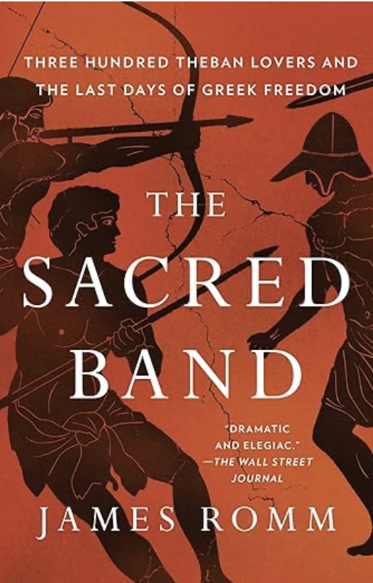
History of Thebes
“The tomb of Iolaus [in Thebes] became a pilgrimage site for male couples. According to Plutarch, who cites Aristotle as his source, men pledged their love for one another beside that tomb, as if the bond between Heracles and Iolaus were their model.
“In no other Greek city do we hear of such vows, but then, Thebes was unique in how it regarded erōs, sexual love, between men. Male erōs took many forms across the Greek world, as Plato attests in his meditation on the subject, Symposium. In Athens and Sparta, male erōs was “complicated,” as Plato has one of his speakers, Pausanias, declare.
Notes:
James Romm, The Sacred Band (New York: Simon and Schuster, 2021), 11-12.

Slide 21
History of Thebes
“… But among the Boeotians, Pausanias claims – referring principally to the Thebans – male pair bonding was embraced and even encouraged by law. ‘No one there, neither young nor old, would say it is shameful,’ Pausanias says, adding that this cheerful acceptance was also seen in Elis, in the Peloponnese. Two other Greek writers, our principal sources for classical Thebes, confirm this phenomenon. Xenophon, a contemporary of Plato’s, claims that ‘among the Boeotians, a man and a youth live together suzugentes—’yoked together,’ a word that elsewhere refers to a bond of lifelong marriage.“ (pp.11-12).
Notes:
James Romm, The Sacred Band (New York: Simon and Schuster, 2021), 11-12.

Slide 22
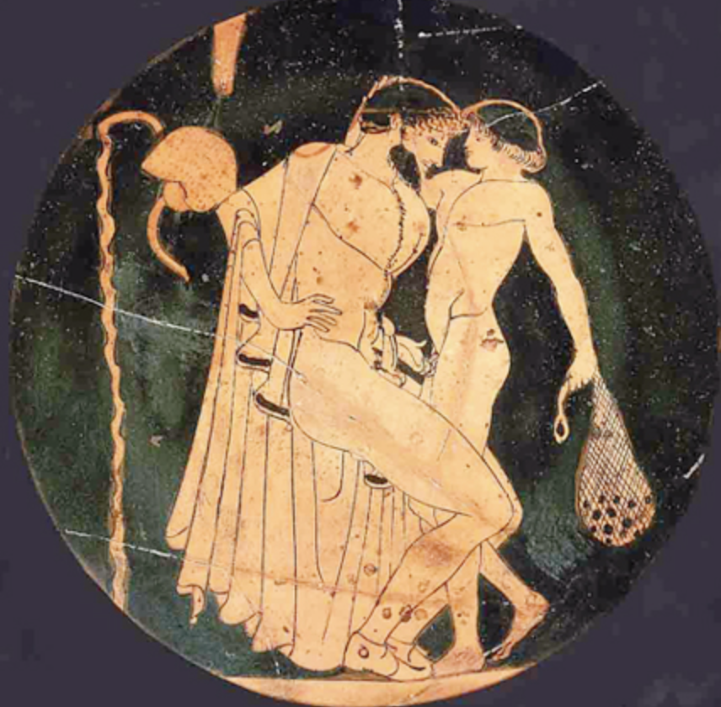
Evidence in Art
“Greek homosexual activity, despite popular misconceptions, was not restricted to man-boy pairs. Vase-painting shows numerous scenes where there is little or no apparent difference in age between the young wooer and his object of courtship . . . as well as graphic scenes of sexual experimentation between youths.”
— Thomas Hubbard
Typical Pederastic Plate/Vase Scene
Notes:
Thomas K. Hubbard, Homosexuality in Greece and Rome: A Sourcebook of Basic Documents (Berkeley, CA: University of California Press, 2003), 5.
PLATE / 450 BC / Ashmolean Museum / Oxford University // Hubbard calls it a “popular misconception” that Greek same-sex coupling was restricted to older-with-younger men.
“Vase painting shows numerous scenes where there is little or no apparent difference between the young wooer and his object of courtship, as well as graphic scenes of sexual experimentation between youths. . . . Although a youth’s attractiveness was thought by many to cease with the growth of his beard and body hair, the window of attraction varied to some degree by individual preferences. . . . In the Hellenistic period, some lovers swore continued attraction even well into their loved one’s adulthood . . . In Roman times, we have more than one account of soldiers being the object of sexual attention by superior officers; the elderly emperor Galba is said to have preferred mature and masculine men, and Nero supposedly ‘married’ a freedman named Doryphorus.” Thomas K. Hubbard, Homosexuality in Greece and Rome: A Sourcebook of Basic Documents (Berkeley, CA: University of California Press, 2003), 5-6.

Slide 23
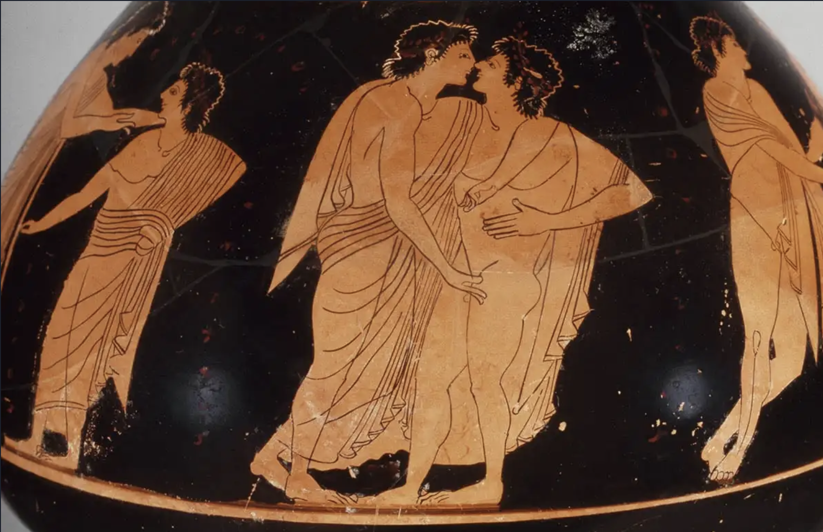
Scene of Two Young Men in Same-Sex Exchange
Notes:
Attic Red-Figure Psykter (vessel for cooling wine, set into large bowl of cold water) / ca. 500 B.C. / Getty Museum

Slide 24
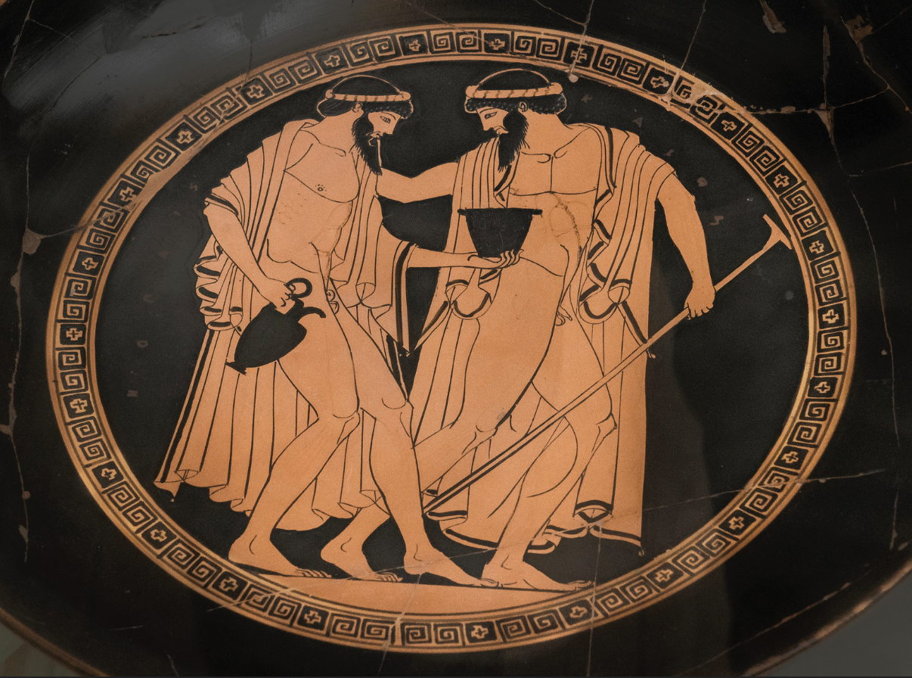
Scene of Two Older Men in Same-Sex Exchange
Notes:
Attic Red-Figure Psykter (vessel for cooling wine, set into large bowl of cold water) / ca. 500 B.C. / London / British Museum
NOTE: In Roman times, we have more than one account of soldiers being the object of sexual attention by superior officers. (Hubbard, 6)

Slide 25
Cult of Cybele
One of several “mystery religions” of the Roman Empire
Some contemporary non-binary and transgender persons claim historical precedent and/or identify with them
“Cybele’s priests were known as the Galli ; these men wore yellow or multi-colored robes with a tiara, and ‘adorned [themselves] with ornaments,’ rings, and earrings; they wore white make-up and curled their long hair.” (Clark, A History of European Sexuality, 28)
Note: Possible background to Paul’s comments in 1 Cor 11:14 (cf. 11:2-16)

Slide 26
Pompeii as Witness
“Gay Sex in Bi and Straight Company” (Clarke, Roman Sex, 78-92)
Clarke is a “revisionist” of a different order – claiming that Roman same-sex culture has been given too little attention because of 19th/20th-century prudishness
“Scholars could not bring themselves to believe that such hardcore images of gay sex could have existed in ancient Rome.” (Specific comment on “Warren Cup”)
“It did not take much sleuthing to find many male-male sex scenes that I could date to the same period as the Warren Cup, between A.D. 1 and 30. I found a whole range of images of gay sex on a variety of vessels of the period.” (78)
Wider Comment: “These ‘bisexual’ cups and bowls [from 30 B.C. to A.D. 14] helped me to establish that ordinary people prized beautiful images of explicit straight and gay sex.” (78)
“Like all Romans, [the ancient Roman man] worshiped beauty in both male and female bodies – and strove to have sex with beauties of both sexes.” (87)

Slide 27
“But did they really have ‘same-sex marriages’ in those cultures?”

Slide 28
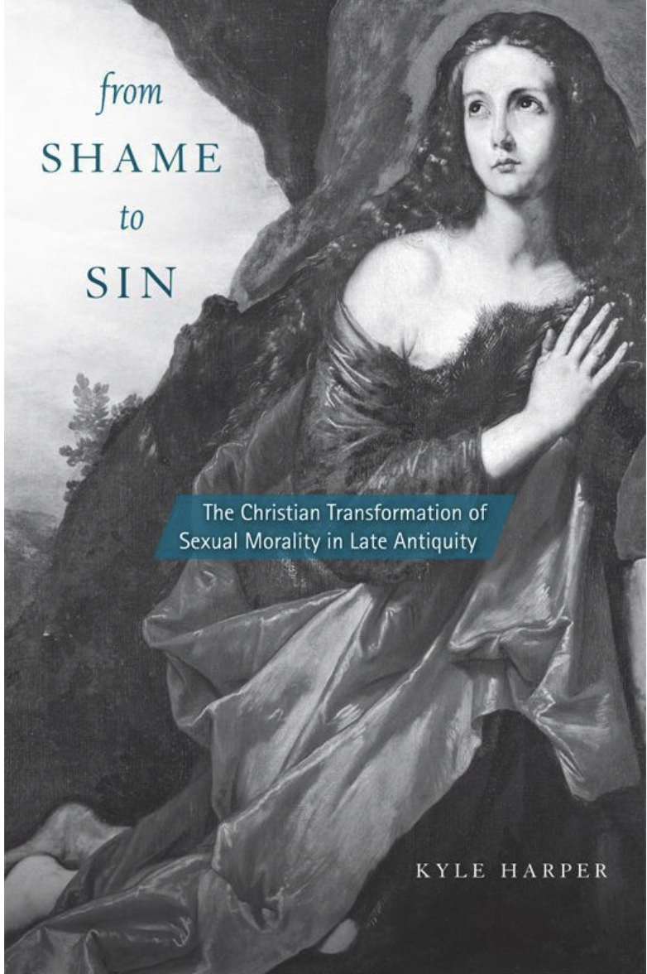
Classics Professor / Univ of Oklahoma
But the most intriguing novelty, by far, is the evidence for male-male marriage in the early empire. If we had only the extravagant reports about Nero or Heliogabulus marrying their favorites, we might ascribe it to conventional senatorial animus, although the extreme and unnecessary level of detail about the ceremonies would be striking. But there is plenty of evidence besides. . . . Juvenal’s second satire, written sometime in the early second century . . . claims that recently a man of wealth and status was given away in marriage to a man; he imagines that the day is near when male-male marriages will take place publicly and be recorded in the state’s registers.
— Kyle Harper
Notes:
Harper, From Shame to Sin, 35.
Kyle Harper is Professor of Classics at University of Oklahoma. This book received 2014 Award for Excellence from the American Academy of Religion and was published by Harvard University Press as a volume in its “Revealing Antiquity” series

Slide 29


