Slide 1
Sexual Stewardship

Slide 2
Are persons who violate God’s will about sex guilty of sin?
The LOVING response is “Yes, and God’s call to repentance offers grace and healing that Christ-followers are authorized to offer them.”
HOWEVER, have gay, lesbian, transgender persons – and/or heterosexual fornicators, prostitutes, “johns” – been sinned against?
The TRUTHFUL response is “Yes, and the church must stop hurting, demeaning, and driving people away because of sexual sins.”
All sexual sin is the distortion of our Creator’s intention and design for sexual fulfillment and the sabotage of human shalom.

Slide 3
Homophobia
hate speech, derogatory slurs, demeaning jokes, threats, violence directed at LGBTQ+ persons

Slide 4
An Important Clarification!
What business is it of mine to judge those outside the church? Are you not to judge those inside? God will judge those outside. “Expel the wicked person from among you.”
— Paul / 1 Cor 5:12-13 (NIV)

Slide 5
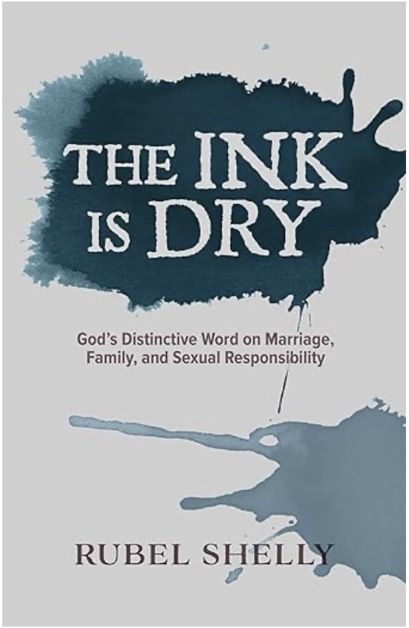
The Ink Is Dry is not a political appeal to bind Christian morality through law. It is an appeal, instead, for Christians to live the distinctive life to which God has called us in Christ Jesus.
Paul’s rhetorical question still rings in our ears: “While we are not responsible for what outsiders to the faith may do with their lives, do we not have a duty to those people who are members of our congregations of believers?”

Slide 6
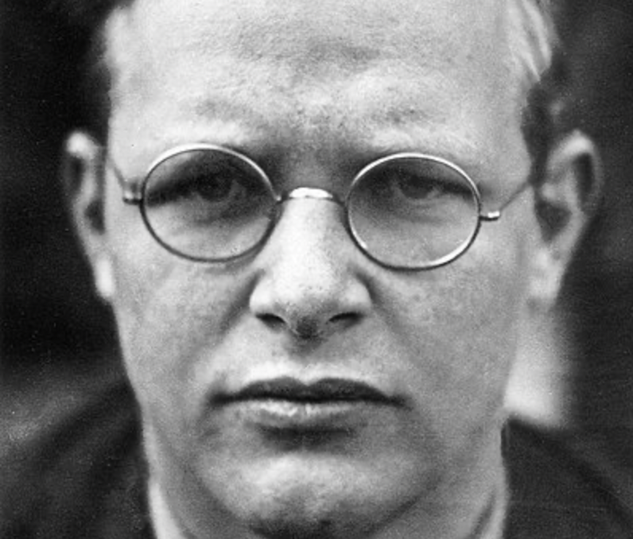
Cheap grace is the deadly enemy of our Church. We are fighting today for costly grace. . . . Cheap grace means grace as a doctrine, a principle, a system. . . . Cheap grace means the justification of sin without the justification of the sinner . . . [but] what has cost God much cannot be cheap for us.
— Dietrich Bonhoeffer (1906-1945)

Slide 7
From Genesis . . .
a HUMAN BEING is . . .
a “living soul” – unique in both spirit and body
neither “assigned” nor “gender fluid” in nature
“in God’s image” and responsible to him

Slide 8
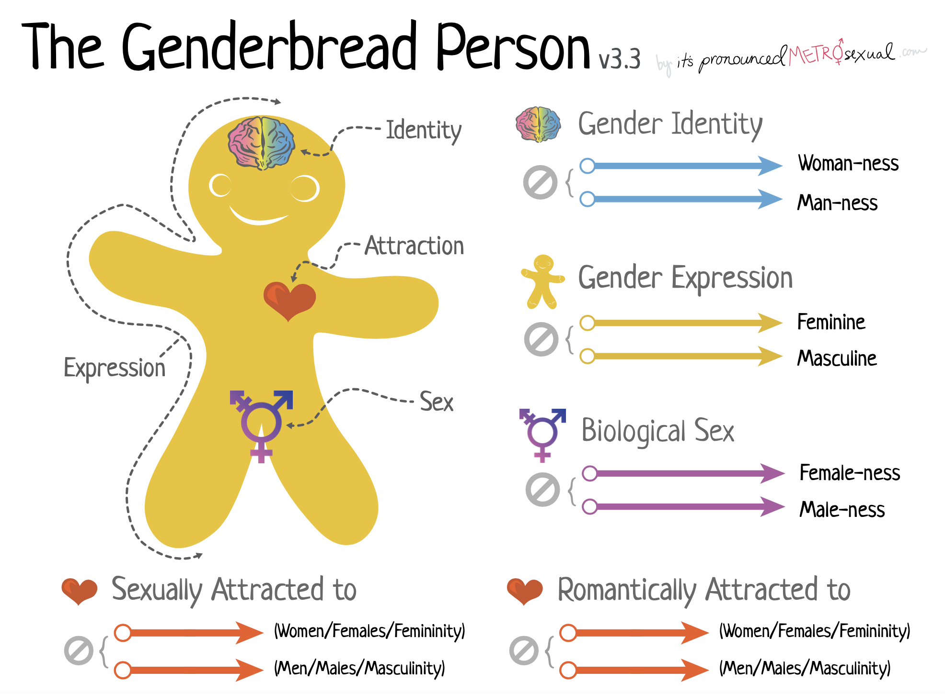

Slide 9
From Genesis . . .
our HUMAN SEXUAL EXPRESSION is . . .
for help and partnership in the human mission
for procreation and nurture of children
for protection from all illicit sexual unions
Book of Common Prayer

Slide 10
From Genesis . . .
our HUMAN SEXUAL INTEGRITY is . . .
found, affirmed, and lived in monogamous marriage
always and only in male-female union
protected by divine prohibitions against various departures from God’s will in the Torah

Slide 11
“Do not have sexual relations with a man as one does with a woman; that is detestable.”
— Leviticus 18:22 (NIV)

Slide 12
“If a man has sexual relations with a man as one does with a woman, both of them have done what is detestable. They are to be put to death; their blood will be on their own heads.”
— Leviticus 20:13 (NIV)

Slide 13
All cultures must answer to God’s moral laws
“You must not do as they do in Egypt, where you used to live, and you must not do as they do in the land of Canaan, where I am bringing you. Do not follow their practices. You must obey my laws and be careful to follow my decrees. I am the Lord your God.”
— Leviticus 18:3

Slide 14
EXCURSUS: Acts 15:28-29
The four prohibitions to Gentile Christians are the same ones imposed on non-Israelites in the Old Testament
meat offered to idols / Lev 17:1-9
blood offered to idols / Lev 17:10-12
improperly slaughtered animals / Lev 17:13-16
sexual immorality (porneia) / Lev 18:1-23
The word porneia embraces incest, rape, gay sex, prostitution, bestiality, and the other illicit sexual contacts of Leviticus

Slide 15
Asked about marriage, Jesus spoke of EDEN
He gave two options . . .
1. Monogamous male-female marriage
2. A chaste and celibate single life
3. No “third option” is offered

Slide 16
Sex / Gender / Marriage
The relational nature of marriage is defined as
male / female
man / woman
husband / wife

Slide 17
Marriage should be honored by all, and the marriage bed kept pure, for God will judge the adulterer and all the sexually immoral.
— Hebrews 13:4

Slide 18
The Ancients Knew . . .
Writing to the Christians at Rome, the apostle had identified as the surest and most terrifying measure of humanity’s alienation from God’s love the sexual depravity of gentile society. One aspect of it more than any other had disgusted him. ’Men committed indecent acts with other men.’ Here, in Paul’s formulation, was a perspective that Roman men would barely have recognized. The key to their erotic sense of themselves was not the gender of the people they slept with, but whether, in the course of having sex, they took the active or passive role. Deviancy, to the Romans, was preeminently a male allowing himself to be used as though he were a female. Paul, by condemning the master who casually spent himself inside a slaveboy no less than the man who offered himself up to oral or anal penetration, had imposed on the patterns of Roman sexuality a thoroughly alien paradigm: one derived, in large part, from his upbringing as a Jew. Paul had been steeped in Torah. Twice the Law of Moses prohibited the lying of men with other men ‘as one lies with a woman.’
— Tom Holland
Reproductive Sex
Recreational Sex
Experimentation
Brothels
Prostitution
Pederasty
Slavery
Long-term same-sex commitments
Notes:
Holland, Dominion: How the Christian Revolution Remade the World (New York: Basic Books, 2019), 288.

Slide 19
Teachings of Jesus?
Second Temple Judaism
Matthew 5:17-20
Mark 7:20-22

Slide 20
Teachings of Paul?
Apostle to the Gentiles
Could not assume Scripture!
Prohibited “vile and degrading things pagans do with each other’s bodies”

Slide 21
NT use of a term: porneia
Paul: either marriage or porneia
porneia = items of the Holiness Code
“Since sexual immorality (porneia) is occurring, each man should have sexual relations with his own wife, and each women with her own husband” / 1 Cor 7:2

Slide 22
Paul’s message of HOPE
“cleansed … made holy …
put right with God”

