Slide 2
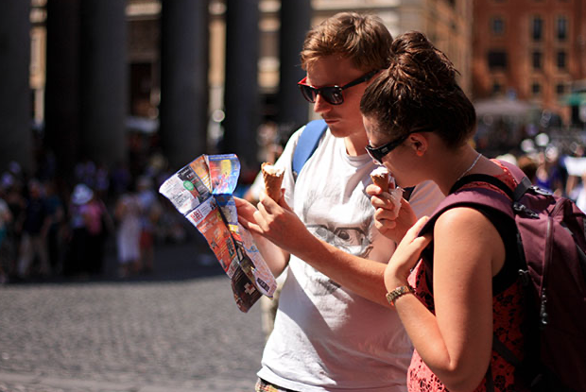

That dISOrI$∃$nTED Feeling of . . . “I’m in a Foreign Culture!”

Slide 3
The Culture of the Roman Empire
Religious Pluralism
There is a place for all religions in your life!
Truth is what you want it to be
No one’s belief can be true for everyone!
Sex is the most popular sport
Pleasure is an ultimate good and sex is the ultimate pleasure!
Violence is accepted as a way of life
Violent entertainments appeal to the masses!

Slide 4
The Culture of the Post-Christian West
Religious Pluralism
There is a place for all religions in your life!
Truth is what you want it to be
No one’s belief can be true for everyone!
Sex is the most popular sport
Pleasure is an ultimate good and sex is the ultimate pleasure!
Violence is accepted as a way of life
Violent entertainments appeal to the masses!

Slide 5
The Culture of the Christian Faith
Religious Pluralism?
Jesus is the only way to God!

Slide 6
The Culture of the Christian Faith
Religious Pluralism?
Jesus is the only way to God!
Truth is what you want it to be?
Scripture is God’s public truth to all humankind!

Slide 7
The Culture of the Christian Faith
Religious Pluralism?
Jesus is the only way to God!
Truth is what you want it to be?
Scripture is God’s public truth to all humankind!
Sex is the most popular sport
Sex is a private sacrament of male-female marriage!

Slide 8
The Culture of the Christian Faith
Religious Pluralism?
Jesus is the only way to God!
Truth is what you want it to be?
Scripture is God’s public truth to all humankind!
Sex is the most popular sport
Sex is a private sacrament of male-female marriage!
Violence is accepted as a way of life
God’s people affirm and pursue peace as their way of life!

Slide 9
“Because modern Western society and its values are growing more and more similar to that of the pagan first-century Roman Empire, the apostolic writings from that time giving instruction on how to live as a Christian in such a time and place grows more and more directly relevant. The apostle Peter’s exhortation to live for Christ faithfully – even when it hurts – is a challenging but necessary message for Christians today who want to be bearers of the gospel in this generation.”
— Karen Jobes

Slide 10
Key Insights We Must Embrace!
Christians are God’s children – exiles in the world’s culture!
Christians are building blocks in God’s temple – and should expect the same rejection Jesus experienced!
Christians cherish a new identity – chosen and holy to God!
Christians are a positive presence in the world’s culture – giving a glimpse of God’s Kingdom to the world!

Slide 11
Don’t leave with a chip on your shoulder!
The earliest Christians didn’t fight “culture wars”!

Slide 12
Don’t leave with a chip on your shoulder!
The earliest Christians didn’t fight “culture wars”!
They put God’s love on display . . .

Slide 13
Don’t leave with a chip on your shoulder!
The earliest Christians didn’t fight “culture wars”!
They put God’s love on display . . .
and it turned the world upside down!

