Slide 1


Slide 2
Rom 12
² Do not conform to the pattern of this world, but be transformed by the renewing of your mind. Then you will be able to test and approve what God’s will is—his good, pleasing and perfect will.

Slide 3


Slide 4
I Do……………….………Be with Jesus
We Do………….…Live Life With Jesus
You Do………………….. Live for Jesus

Slide 5
I Do……………….………Be with Jesus
We Do………….…Live Life With Jesus
You Do………………….. Live for Jesus

Slide 6
John 15:4
Abide in me, and I in you

Slide 7
John 15:1-2
I am the true vine, and my Father is the vinedresser. Every branch in me that does not bear fruit he takes away, and every branch that does bear fruit he prunes, that it may bear more fruit.

Slide 8
John 15:5
⁵ I am the vine; you are the branches. Whoever abides in me and I in him, he it is that bears much fruit, for apart from me you can do nothing.

Slide 9
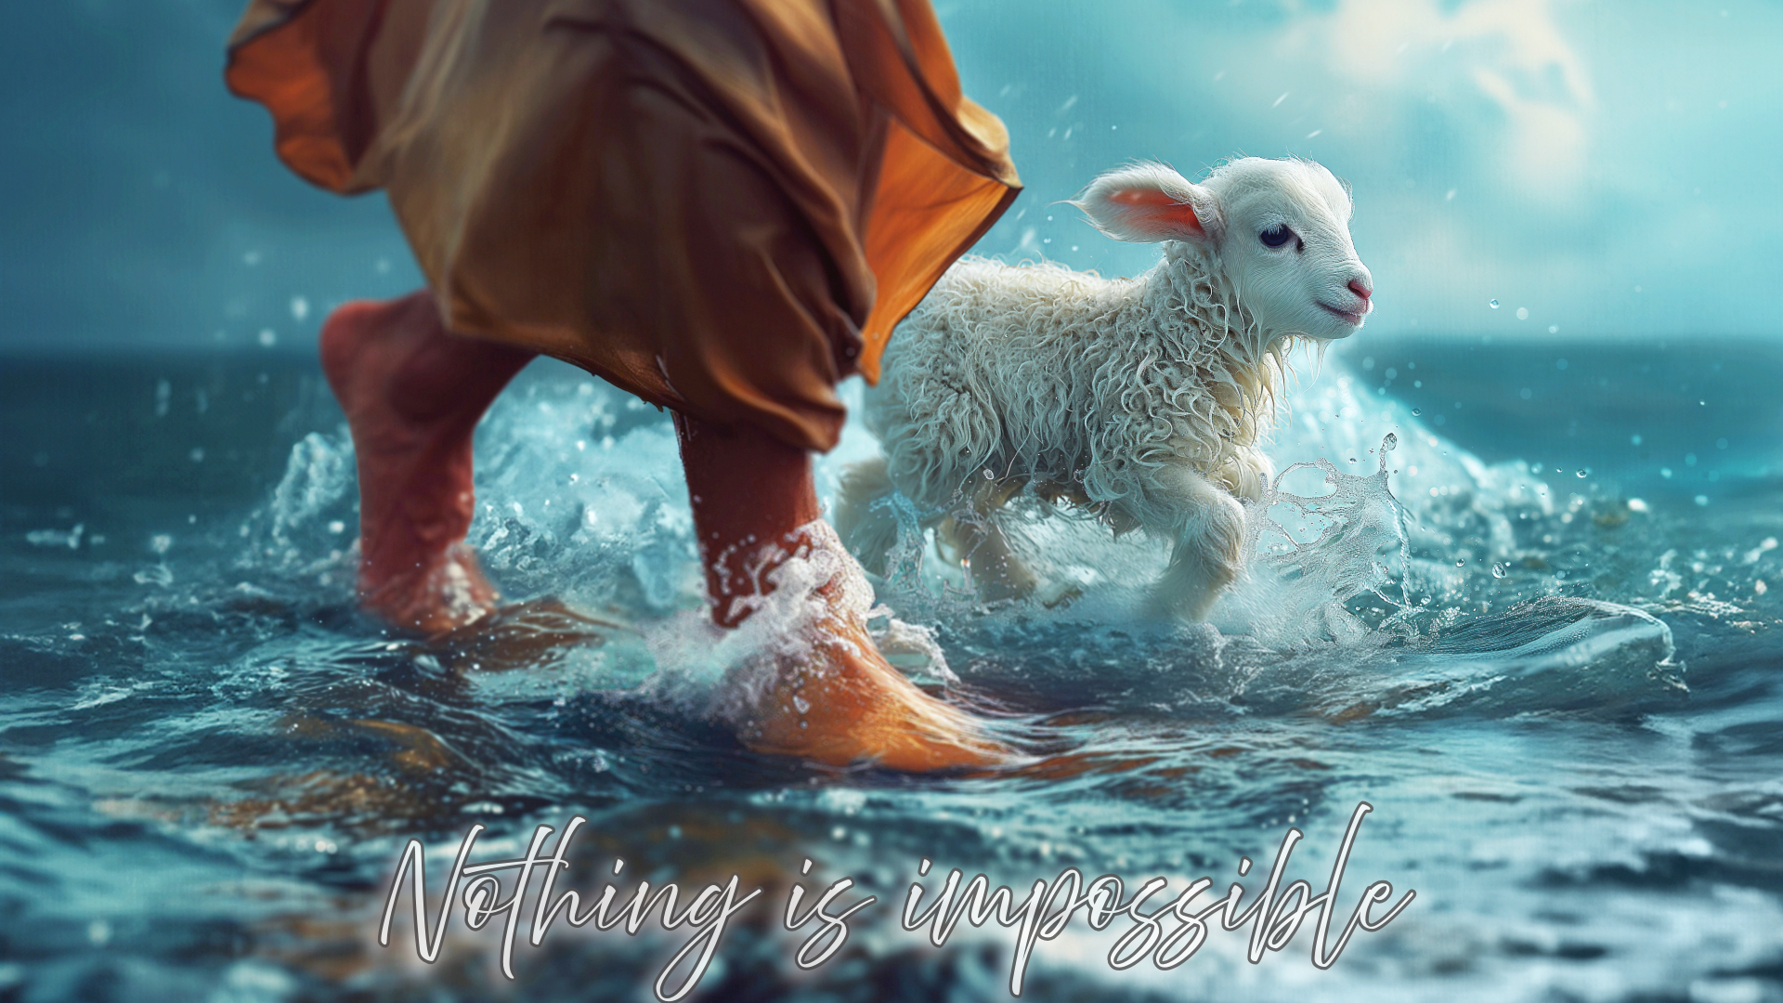

Slide 10
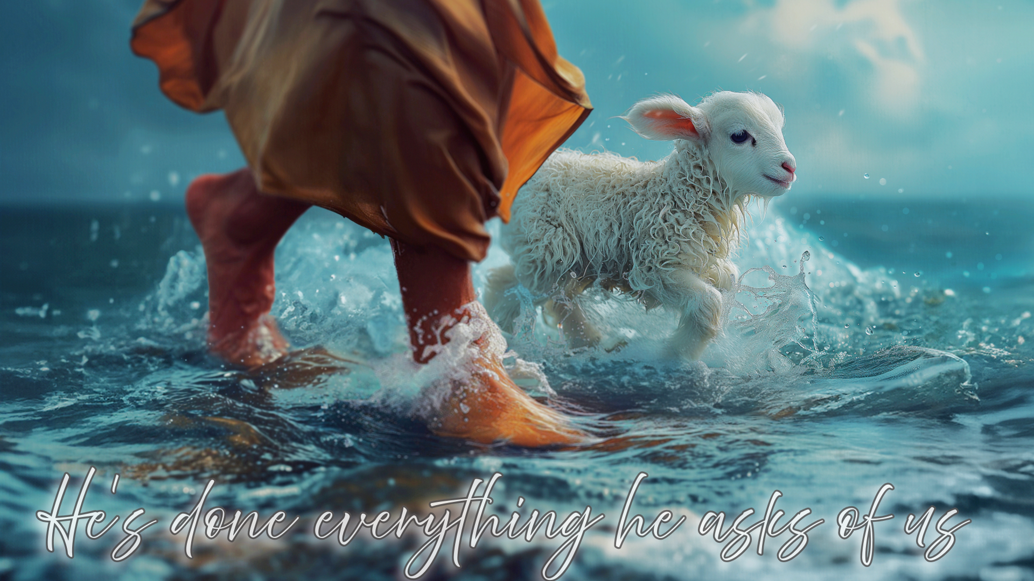

Slide 11
Reward
Psalm 23
The Lord is my shepherd, I lack nothing.
He makes me lie down in green pastures, he leads me beside quiet waters, he refreshes my soul.

Slide 12
2 Corinthians 5:17
Therefore, if anyone is in Christ, he is a new creation; old things have passed away; behold, all things have become new.

Slide 13
John 10:27-28
²⁷ My sheep listen to my voice; I know them, and they follow me. ²⁸ I give them eternal life, and they shall never perish; no one will snatch them out of my hand.

