Slide 1
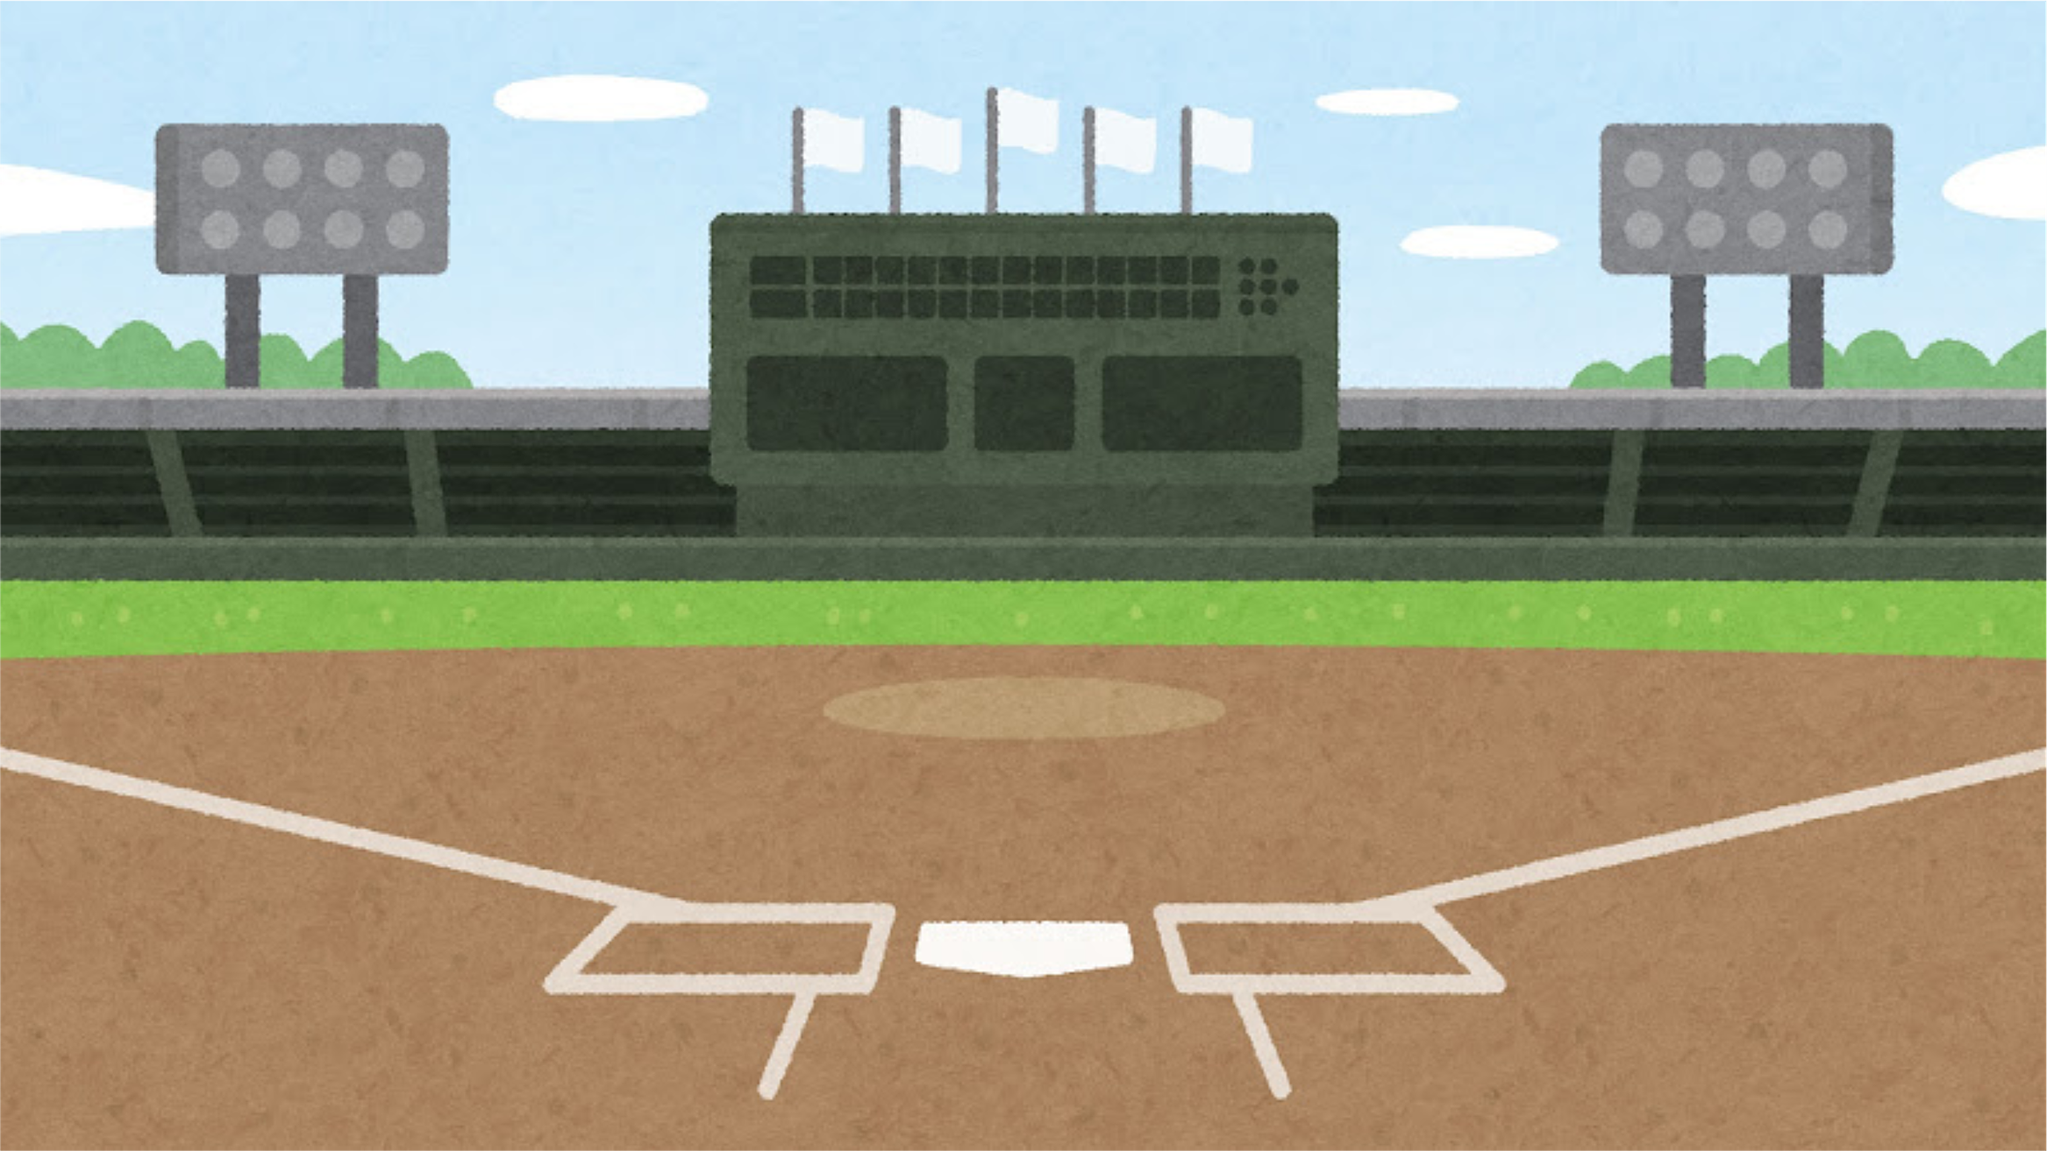

STEP UP TO THE PLATE
AUGUST 11
5:30 - 7:30 PM
Family Dinner & School Kickoff!

Slide 2

Build Your Winning Team: Healthy Habits and Routines
for a Championship Season
Laura Reinke, Licensed Marriage & Family Therapist, Associate Lecturer, Wisconsin Lutheran College

Slide 3
Objectives:
Create a winning team by:
  Building healthy habits and routines to support your child’s success at school and home.
  Create a family "Game Plan" for the first month of school.

Slide 4
Table Activity: With your team answer the following:
  Think about your favorite sports team.
Make a list of what makes them successful.

Slide 5
Why Healthy Habits are Important:
Bible Truth: Whatever you do, work at it with all your heart, as working for the Lord, not for human masters.
Col. 3:23
  Healthy habits help children thrive academically, socially, and emotionally.
  Family routines help decrease stress, improve communication and build family resilience.

Slide 6


First Base: Fuel Up
  You are what you eat!
Who do you think would be able to run faster to first base?

Slide 7
First Base Training
  Prepare meals together
  Make ahead meals for busy nights
  Healthy snack options

Slide 8
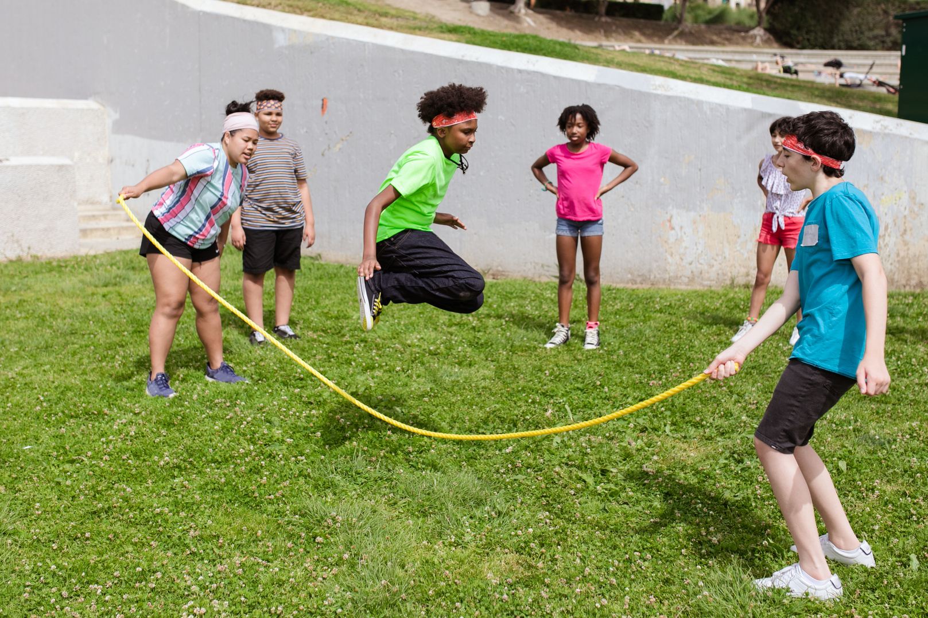

Second Base: Stay Active
  And let us run with perseverance the race marked out for us, fixing our eyes on Jesus, the pioneer and perfecter of faith. Hebrews 12: 1b-2
Who do you think would be able to steal second base?

Slide 9
Second Base Training
  Daily physical activity
  Family Walks
  Limit screentime

Slide 10
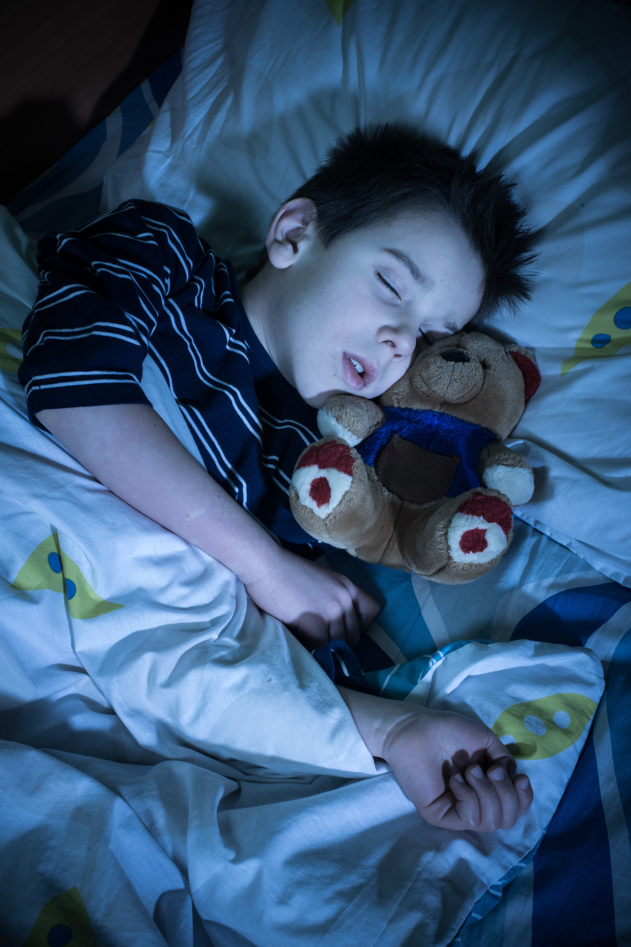

Third Base: Rest and Recover
Psalm 4:8 In peace I will lie down and sleep, for you alone, Lord, make me dwell in safety.
Who do you think would be ready for the game the next day?

Slide 11
Third Base Training
Recommended hours of sleep by age level
  3-5 years: 10-13 hours
  6-12 years: 9-12 hours
  13-18 years 8-10 hours

Slide 12
Third Base Training
Keys to success
  Consistent bedtime
  Sleep routines
  Screen-free evenings

Slide 13

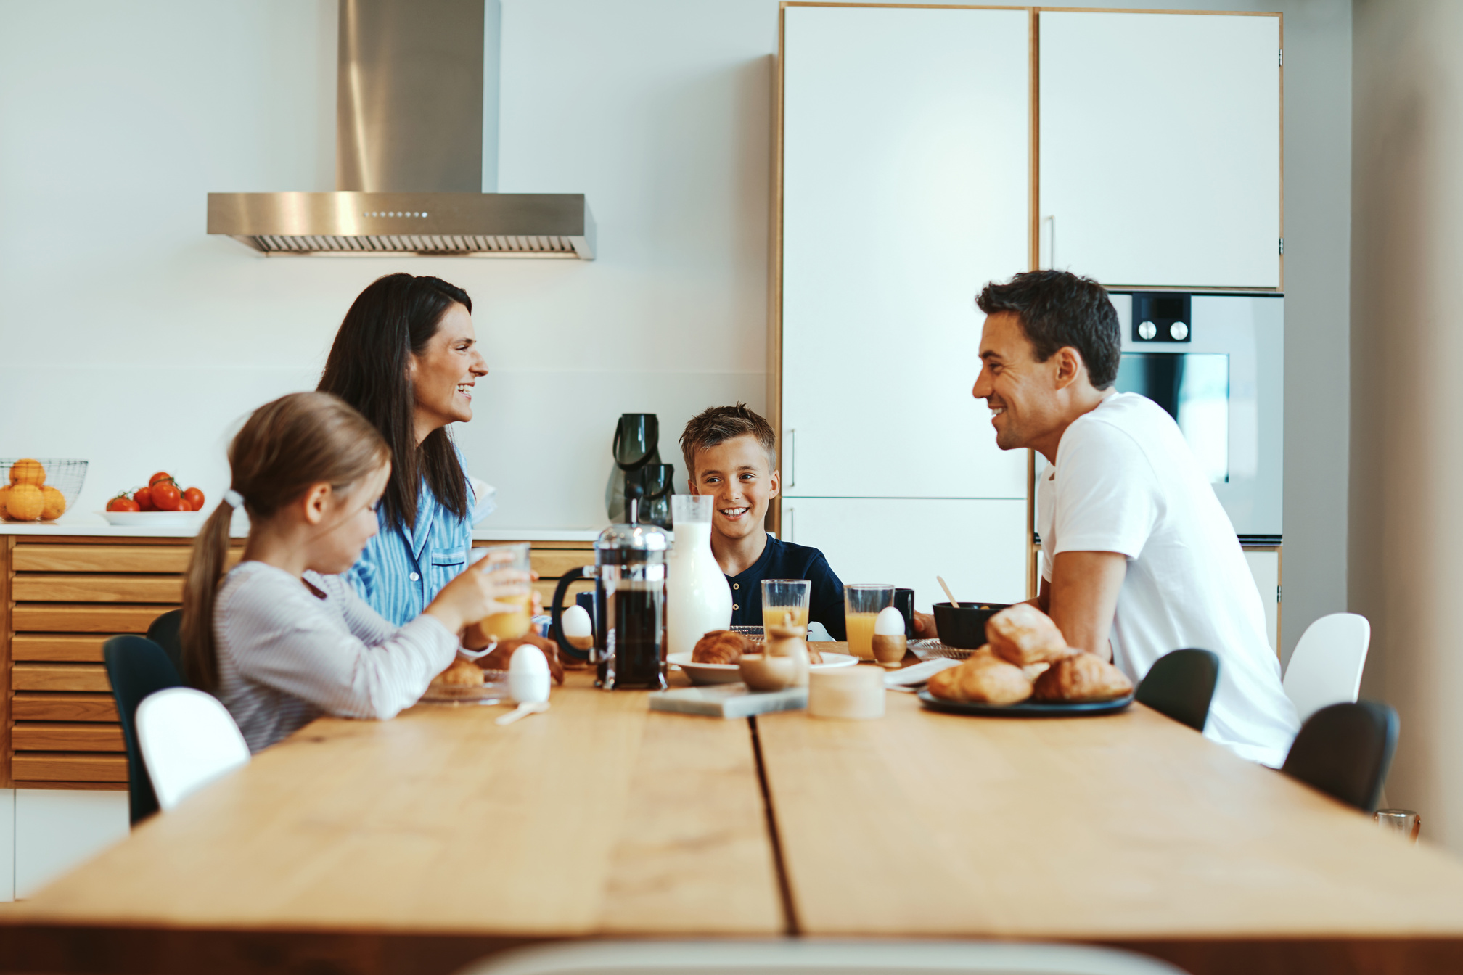
Home Plate: Winning Team
Which family looks like they have a solid game plan?

Slide 14
Home Plate: Winning Team Training
  Communication
  Emotion Regulation
  Routines + Predictability = Safety/Growth

Slide 15
Create Your Own Game Plan
Take Home Challenge: Each week you get a chance to complete these 4 bases activities. A Google form (put out each week like we did with the summer activities)will be available to track your activities.
  First base (Fuel Up):
  Second base (Stay Active):
  Third base (Rest and Recover):
  Run into Home Strategy (Winning Team):

Slide 16
Each week, fill out the form with how your family reached each base (even if you only hit one goal). Every completed activity counts as a hit! Families with the most hits will receive prizes at our next two dinners, with the World Series Grand Prize awarded at our final dinner in November.

Slide 17
EXAMPLE:
  First Base (Fuel Up): We planned healthy
after school snacks together
  Second Base (Stay Active): We went for a bike ride after dinner
  Third Base (Rest and Recover): We hit our goal of being in bed by “X” time 4 of the 7 nights this week.
  Run into Home Strategy (Winning Team): We all shared our favorite thing that happened each day at dinner.

Slide 18
Join Us for our next two dinners (RSVP through the App):
All Star Check In
Sunday | September 20 | 11:30 AM
(Immediately Following the Sunday School Hour)
World Series Championship
Tuesday | October 27 | 5:30 PM

Slide 19
“Every day is a new opportunity. You can build on yesterday’s success or put its failures behind and start over again. That’s the way life is, with a new game every day, and that’s the way baseball is.”
– Bob Feller

