Slide 1
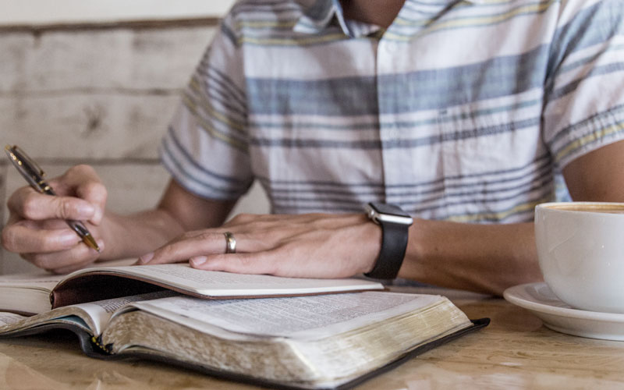
Bible Study Methods
Week 1 - Class Introduction

Slide 2
Introduction
Bible Study Methods
Teachers
Tim Oakleaf
Bo Spires

Slide 3
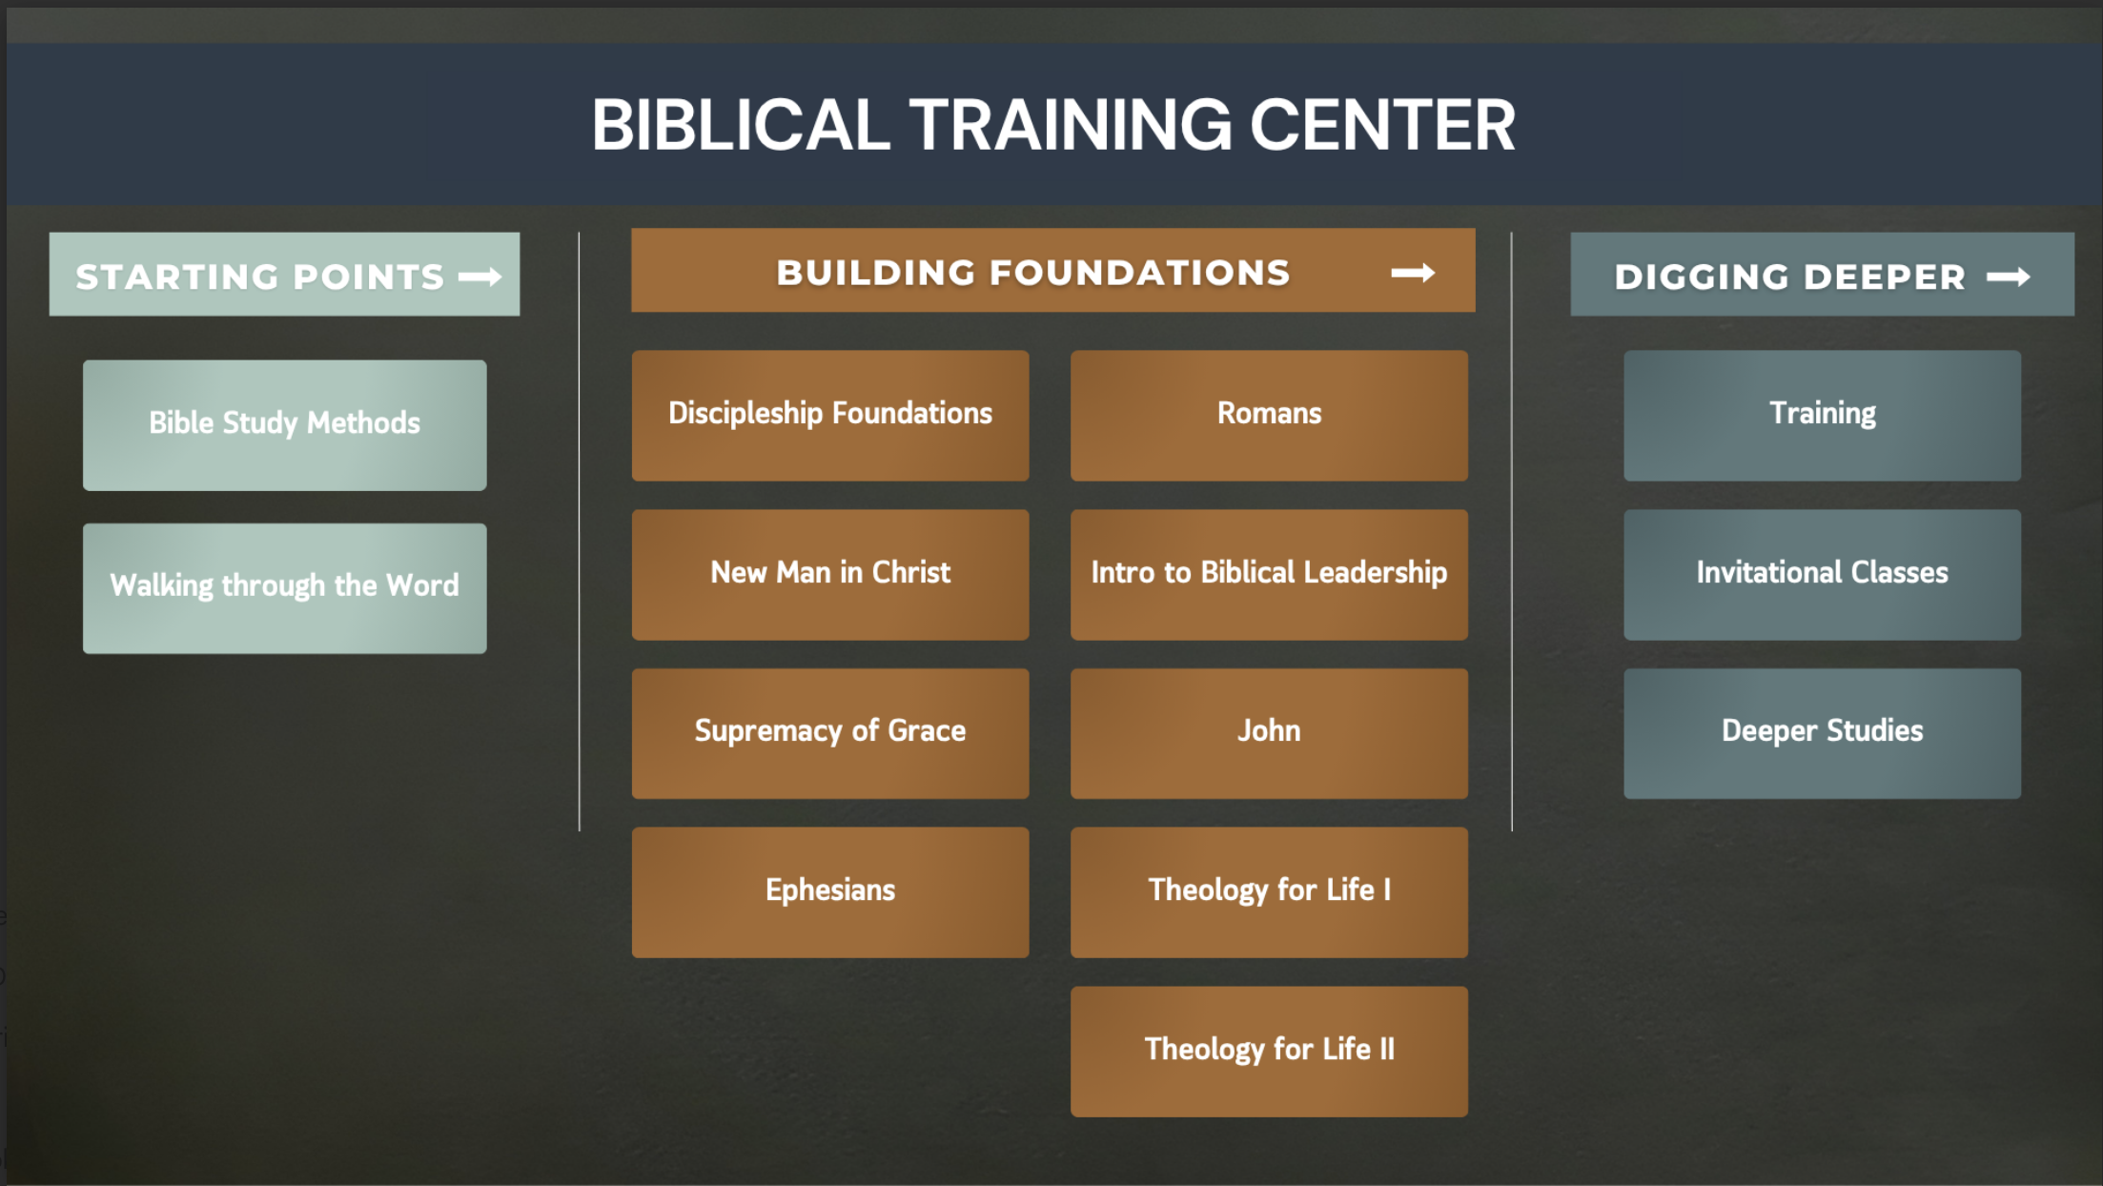
Biblical Training Center Revamp

Slide 4
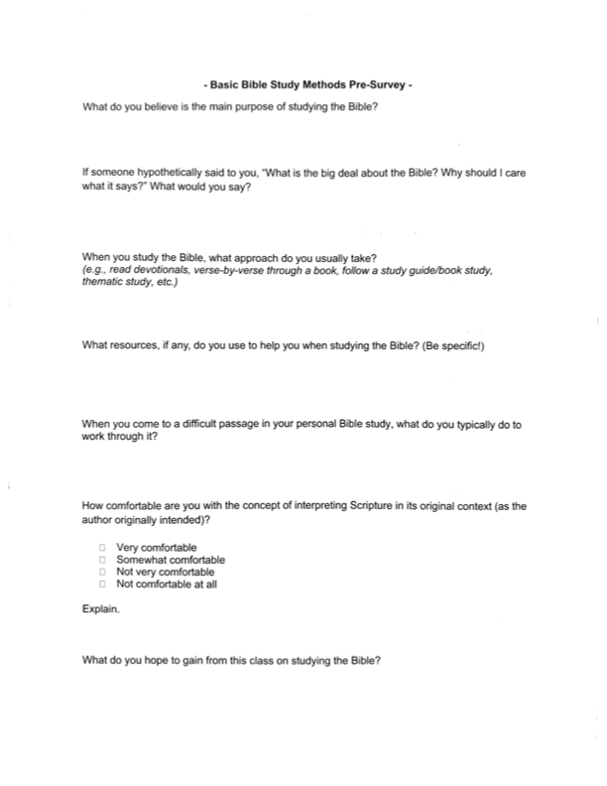
Bible Study Methods Pre-Survey

Slide 5
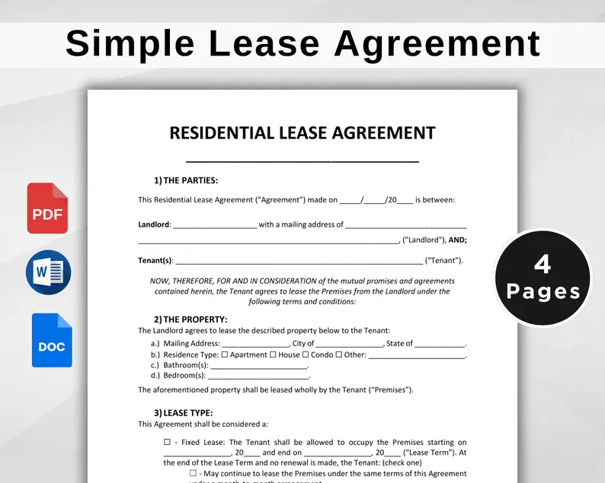

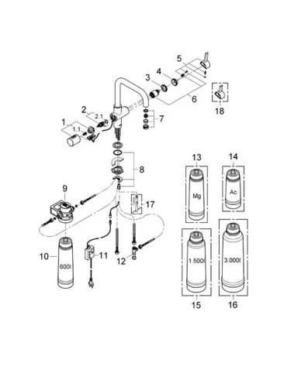

Game Time

Slide 6
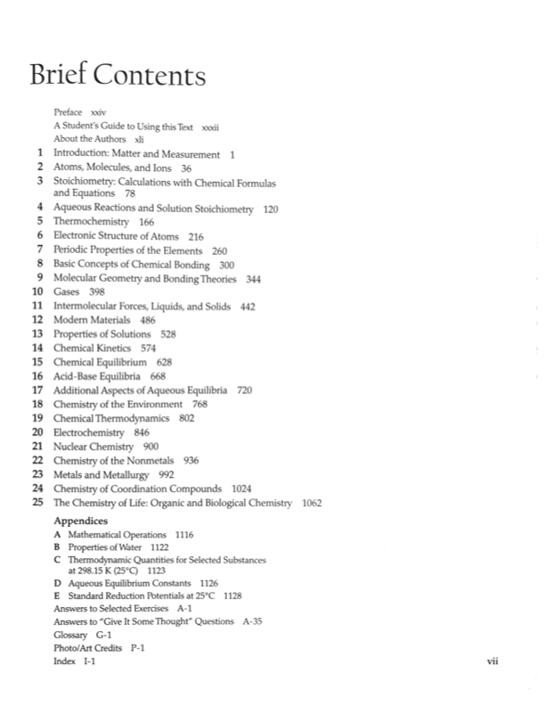
Game Time

Slide 7
Game Time
Which One Is It?
  Tie
  Wave
  Watch
  Right
  Run

Slide 8
Game Time
Excerpt from Bo’s Journal
  Yesterday was very busy. I had a million things to get done, so I jumped out of bed and got hopping! I put on my running shoes and went for a quick run to get the juices flowing. Then I took a shower and ran to the store to pick up some groceries. While I was in the store I ran into a lady, knocking her grocery basket onto the floor. Her groceries went everywhere. I was so embarrassed I wanted to run and hide. After helping her, I ran into a good friend from church, and we talked for a least fifteen minutes. I told him I needed to run because I needed to get to Staples and run off some copies of fliers, I was putting around town for a friend who was running for mayor. On the way to make copies I had to call a friend to come and pick me up because I ran out of gas. This was such a crazy day. I need to rest tomorrow because today has run me ragged.

Slide 9
Game Time
To My Dearest Wife,
There are so many things that I want to say, so many thoughts of you that fill my mind, but words feel too small to hold them all. So, let me begin with a simple truth: loving you has changed my world for the better in every imaginable way.
I still remember the first time I saw you. The way you laughed has stayed with me ever since. Little moments like that are woven throughout our story and have shaped my life more than you know.
I love the person you are, from the core of your being to all the little things that make you uniquely you. I love the strength you show in the face of challenges, and the kindness you extend to everyone around you. I love the sound of your laugh and the feeling of your hand in mine. You are, and have always been, my safe place.
With you, the truest self is felt. You inspire to be better, and you support through everything. The life is richer, a more joyful one for having you in it.
I look forward to our future together, to all the new memories we'll create, and to the quiet, everyday moments we'll share. Whatever comes, it can be faced together.
Yours forever,
Charles

Slide 10
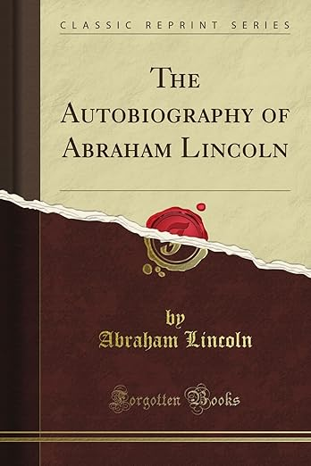
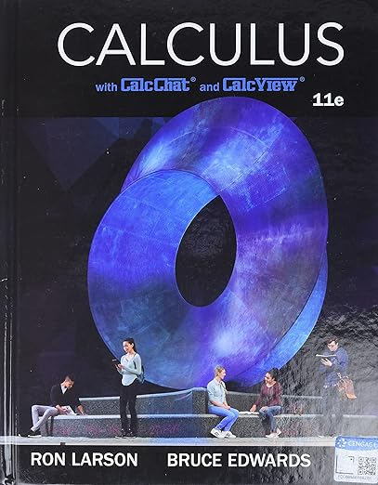


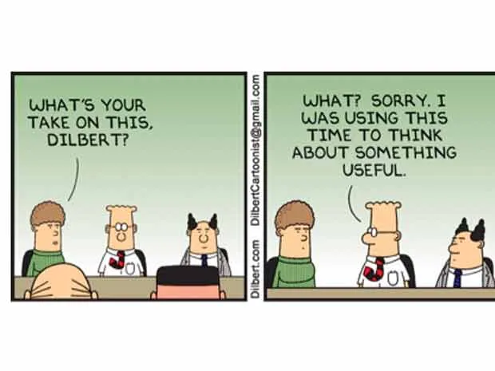
Game Time

Slide 11
Game Time
When Beka came home today she told me her day was rough. She said, “her classroom was a zoo, and her kids acting like wild animals.”
The ancient trees whispered secrets
I am so hungry I could eat a horse
Someone tells you a secret and then begs you, “Please don’t let the cat out of the bag.”
These are all types of what?

Slide 12

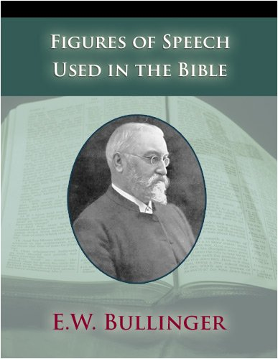
Game Time

Slide 13
Purpose for the Game
You have been doing “Bible Study Methods” your whole life
Being a better Bible Student is hard work, but IT IS WORTH IT!

Slide 14
Final Thoughts
What this class IS NOT!
What this class IS!
Initial Assumptions about the Students in this class
My Initial Assumptions
The Goal(s) of this Class

