Slide 1


Slide 2

WELCOME TO WORSHIP
Take a few moments to meditate on this Scripture as you prepare for worship with the Body of Christ at Mt. Sinai today.
Let the nations be aroused
And come up to the valley of Jehoshaphat,
For there I will sit to judge
All the surrounding nations.
Put in the sickle, for the harvest is ripe.
Come, tread, for the wine press is full;
The vats overflow, for their wickedness is great.
Joel 3:12-13

Slide 3

Matters of Praise
Operation B.L.E.S.S. week contacts and outreach into the Crowd; Ron Grigg Community Group fish fry outreach; Harvest Seeds Ministries and Mission; Senior Saints Lake Lure trip and fellowship; Wednesday Night Community Groups, Bible Studies for all ages, and fellowship meal; recent visitors and guests; wedding of Zane Putnam and Allie Cook; wedding of Alex Edwards and Ellen Winkle; “R3 Investments” New Believer’s Discipler’s Training Saturday; In what ways are you rejoicing in the Lord?

Slide 4
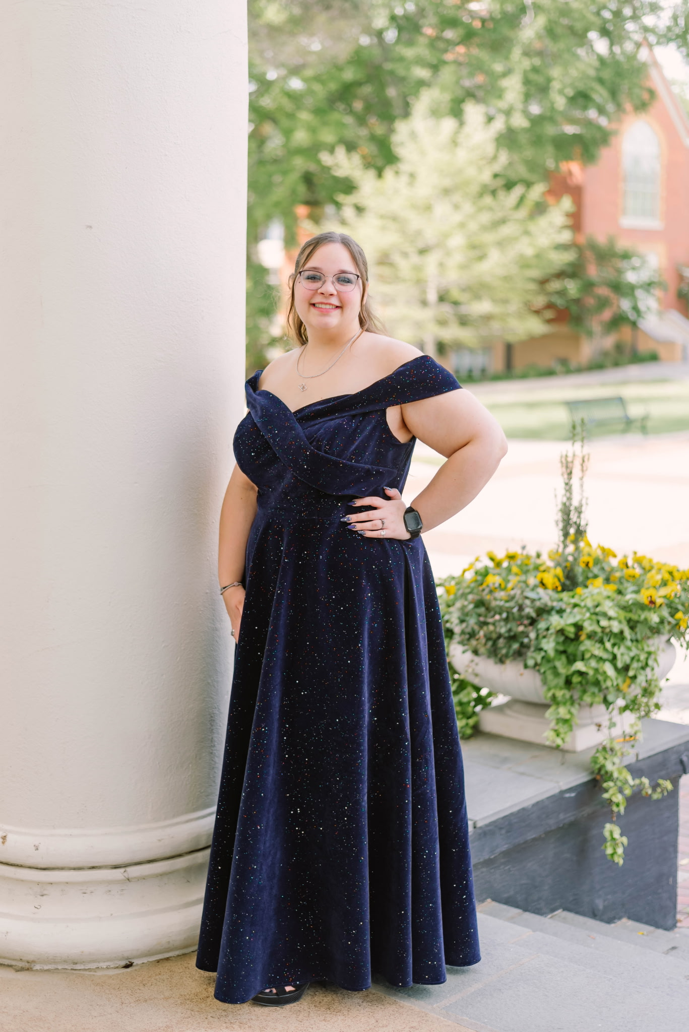
Young Adult of the Week
Essie Bridges
245 Memorial Drive, Suite #7277
Cullowhee, NC 28723
Attends Western Carolina University, majoring in Forensic Science.
Prayer Requests: Pray that my semester will get better and the work will get easier.

Slide 5


Slide 6


Slide 7


Slide 8


Slide 9

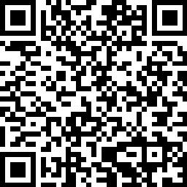
If you are visiting with us today, please scan the QR code and fill out our Connect Card so we will have a record of your visit. Thank You.

