Slide 1


Slide 2

WELCOME TO WORSHIP
Take a few moments to meditate on this Scripture as you prepare for worship with the Body of Christ at Mt. Sinai today.
The Revelation of Jesus Christ, which God gave Him to show to His bond-servants, the things which must soon take place; and He sent and communicated it by His angel to His bond-servant John, who testified to the word of God and to the testimony of Jesus Christ, even to all that he saw. Blessed is he who reads and those who hear the words of the prophecy, and heed the things which are written in it; for the time is near.
Revelation 1:1-3

Slide 3

Matters of Praise
Lord’s Supper observance last Sunday; Choir special preparing us to receive Communion; time of examination and remembrance; first-time Communion partakers; recent visitors and guests; White Bible Service for Joshua King and Caden Gibbs; Wednesday Night outreach, community building, and fellowship at the Shelby Corn Maze; LOL³ ministry to ladies led by Lynn Lavender; Dedication of New Church Year and Responsive Reading of church leaders and members; Gods faithful provision and comfort for His children; In what ways are you rejoicing in the Lord?

Slide 4
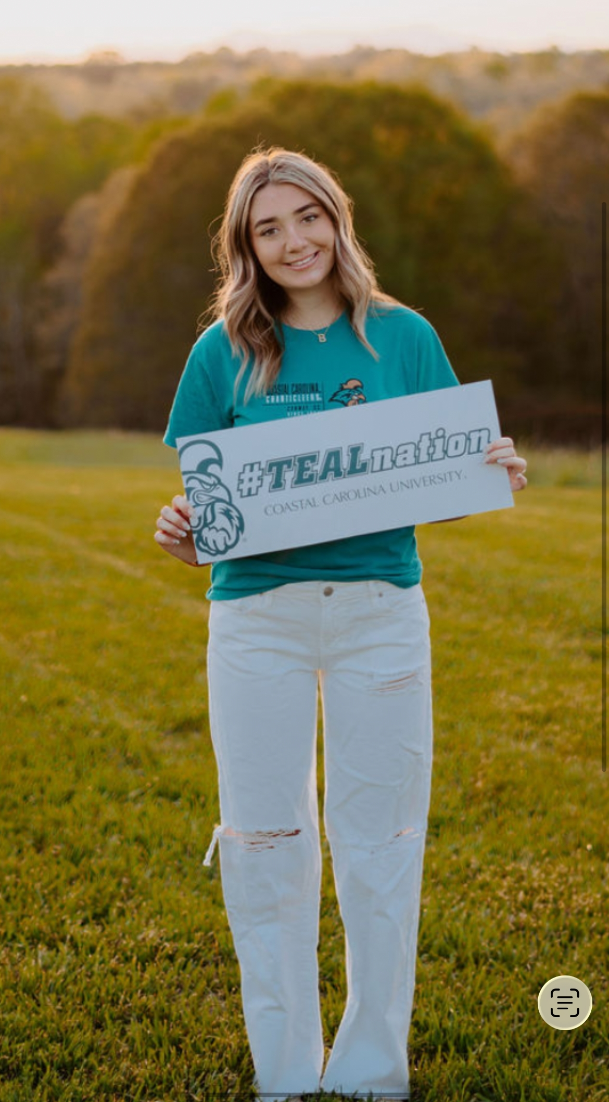
Young Adult of the Week
Baylee Walker
CCU Box 238969
107 Founders Drive
Conway, SC 29526
864-491-2993
Attends Coastal Carolina, majoring in Journalism and Sports Media.
Prayer Requests: Pray that I can make good grades and have a good rest of the year. Also, pray for the family and friends of a girl who was hit by a car on campus and, sadly, didn’t make it.

Slide 5


Slide 6


Slide 7


Slide 8
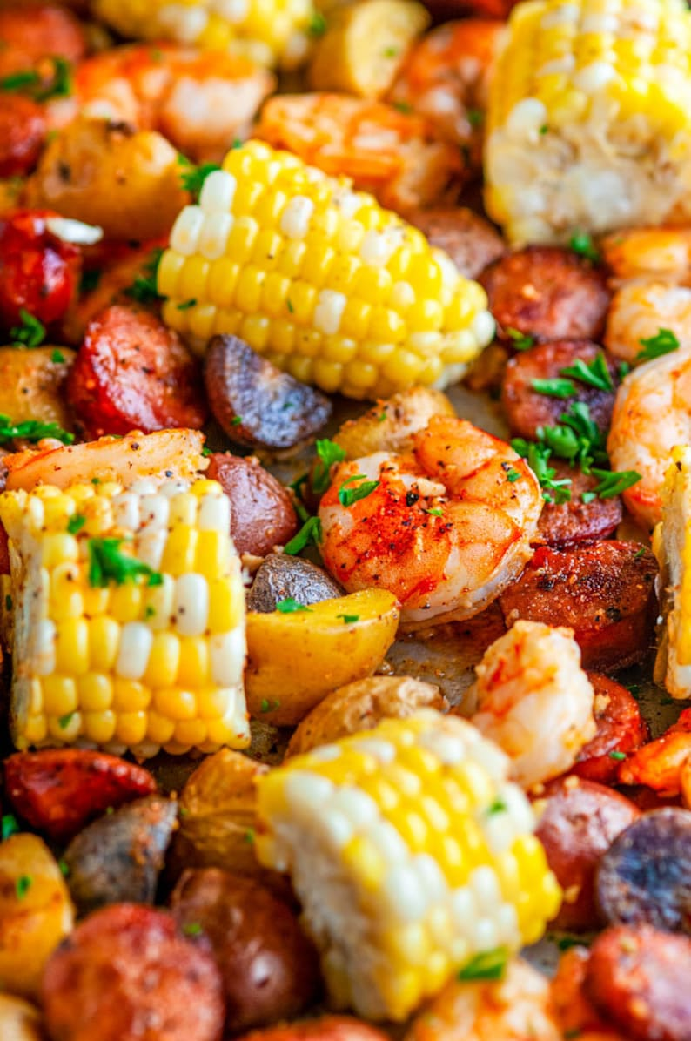
Church-Wide
Low-Country Boil
October 17, 2026
at 5:00pm
(Shrimp, corn, potatoes, sausages)
(Chicken tenders will be served for those
not interested in the Low-Country Boil)
Sign-up sheet in the Vestibule and Education Center. Come and fellowship with us! Bring a friend!
Donations and love offerings will be accepted so we can continue these types of events.
Sponsored by: The Baptist Men
Ladies: Please text Kaye Grigg at
704-473-0325 if you can provide a dessert.

Slide 9


Slide 10

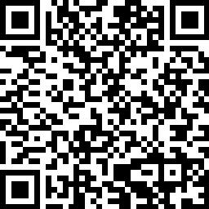
If you are visiting with us today, please scan the QR code and fill out our Connect Card so we will have a record of your visit. Thank You.

