Slide 1


Slide 2
WELCOME TO WORSHIP
Take a few moments to meditate on this Scripture as you prepare for worship with the Body of Christ at Mt. Sinai today.
“Timothy, my dear son, be strong through the grace that God gives you in Christ Jesus. You have heard me teach things that have been confirmed by many reliable witnesses. Now teach these truths to other trustworthy people who will be able to pass them on to others.”
2 Timothy 2:1–2 • NLT

Slide 3

Matters of Praise
Recent Baptisms, Salvations, and Church Membership decisions; Membership decisions of Thomas, Sharon, William, and Bethany Andrews, Salvation and Church Membership decision of Ellen Winkle; Drew and Andy Jolly expecting their first child, a little girl; Deacon Ordination of Matt Doster; recent visitors and guests; Operation B.L.E.S.S. Week contacts and ministry touches; Wednesday Night Community Groups, Bible Studies for all ages, and fellowship meal; Growth in our Student Ministry and Wednesday’s Parent’s meeting with Pastor Andrew; Start back of the Young Adult of the Week ministry; Today’s R3 Investment opportunities

Slide 4

Connect and Care @ 6:30
All are welcome to attend our first Connect and Care Service of the New Church Year. All leaders are expected to attend as we “hold fast” to the confession of our hope (vs. 23), stir one another up to love and do good deeds (vs. 24), and encourage one another in ministry and mission (vs. 24). (Hebrews 10:23-24) The night will be spent connecting with God through the Scriptures and with one another as we share, plan, and care for the needs of others. We will hear from ministry leaders and workers about how God is working and ways we can join in. Come and learn ways you can “invest” in God’s Kingdom agenda at MSBC.

Slide 5
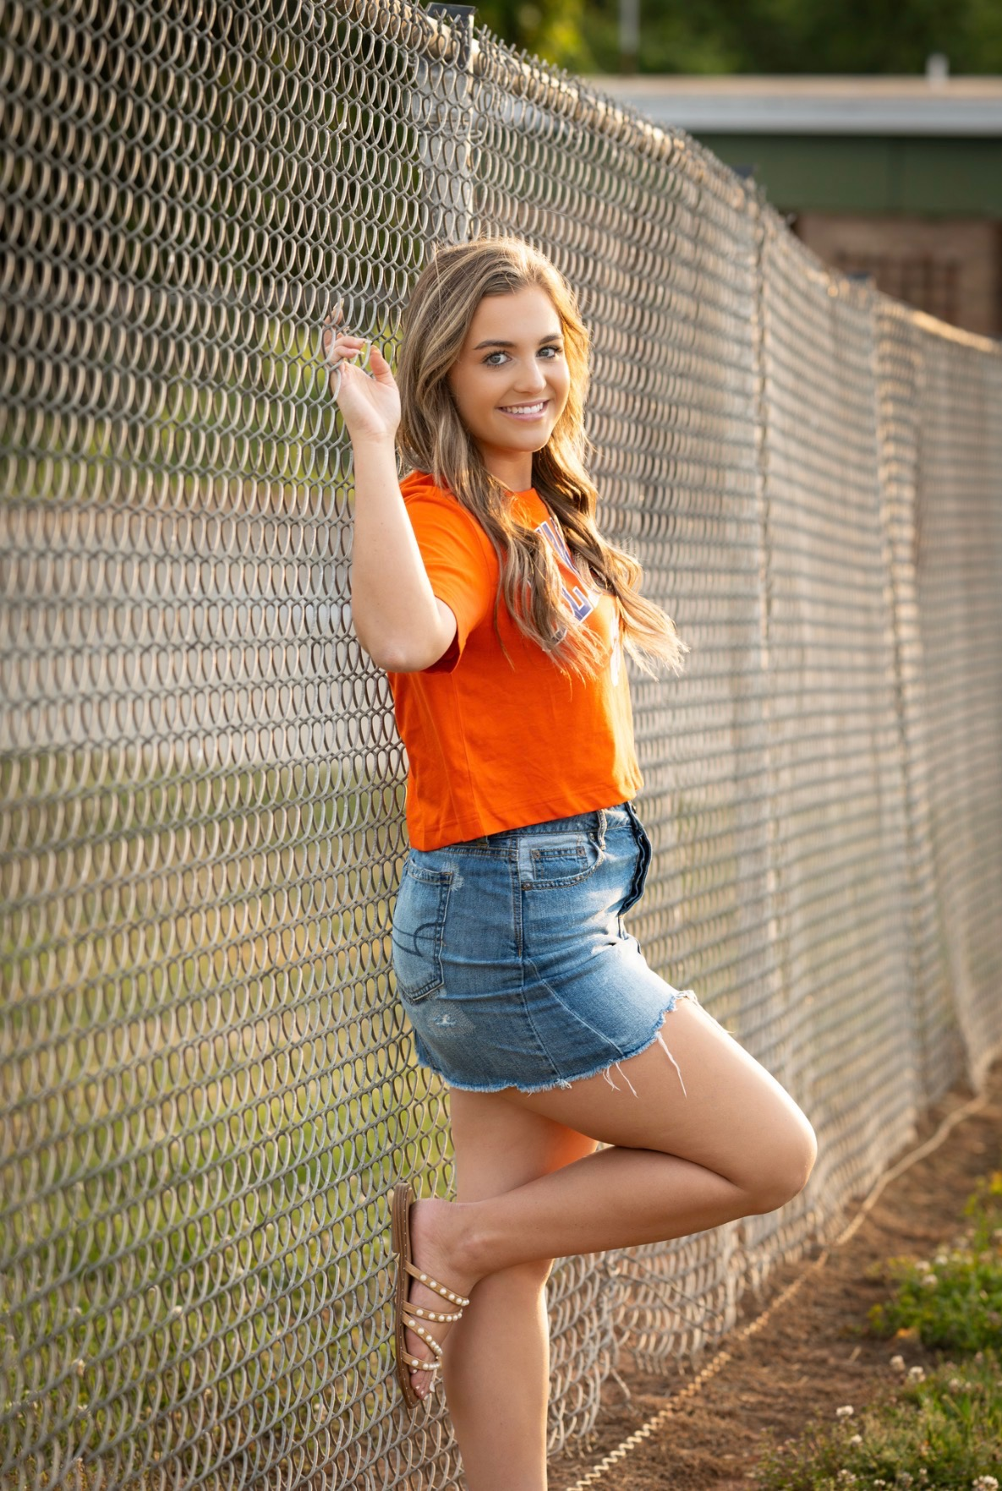
YOUNG ADULT OF THE WEEK
Brylee Greene
Attending Clemson University
Major: Health Science
2275 University Station
Douthit 2530
Clemson, SC 29632
704-692-9093
PRAYER REQUEST
Pray that God would calm my anxiety about things I cannot control and give me peace with everything going on with college.

Slide 6


Slide 7


Slide 8


Slide 9


Slide 10


Slide 11
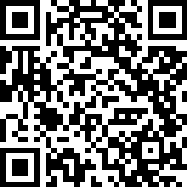
WEDNESDAY NIGHT MEAL
Join us for a delicious meal and fellowship!
MENU
• Spaghetti
• Salad
• Garlic Bread
• Dessert
SCAN TO SIGN UP
Adults: $5 | Children ages 2–10: $4
Families of 4+ in the same household: $20
Or sign up by calling the church office,
filling out the form in your bulletin,
and placing it in the offering plate.
Please sign up by Monday around noon so we can prepare enough food for everyone!

Slide 12

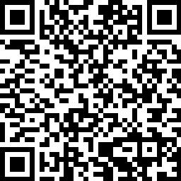
If you are visiting with us today, please scan the QR code and fill out our Connect Card so we will have a record of your visit. Thank You.

Slide 13


Festival of Trees is Back!
Mark your calendars for November 14-15!
We’re excited to announce the return of our Festival of Trees!
This event has been one of our biggest fundraisers in the past, and we can’t wait to bring it back this year. Now is the perfect time to start thinking about the theme or style of tree you’d like to enter. Whether it’s elegant, whimsical, traditional, or completely unique, we’d love to see your creativity on display!
We’re also thrilled to welcome back The Peppermint Perch—our Christmas boutique featuring mostly handmade gifts, home décor, and holiday treasures. It’s the perfect place to get a head start on your Christmas shopping while supporting a great cause!
More details, entry information, and craft day dates will be announced soon, so stay tuned!
We can’t wait to celebrate the Christmas season with you!
Festival of Trees Committee

