Slide 1

God’s Design
For You
Notes:
Welcome to God’s Design for You. During this time, we will examine what the Bible says about spiritual gifts and help you begin the process to discover your spiritual gifts and determine how to use them.
But before we get started, I’d like to pray for our time together that it may be a real opportunity of discovery. (Pray)
Let’s look at our first slide that says, “God’s Design Our Purpose and the scripture verse Eph 2:10.
Ephesians 2:10 says, “For we are His workmanship created in Christ Jesus for good works, which ?god prepared behand that we should walk in them.”

Slide 2
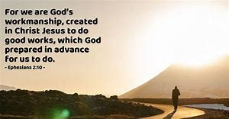
EPHESIANS 2:10
Notes:
This means that because of Jesus’ death on the cross, we as believers have been resurrected to new life, so that there should be an evident change in the kind of life we live due to God being at work in us.
And because God is at work in us, He didn’t merely give a command but He is transforming us, molding us and shaping us into His Image.

Slide 3
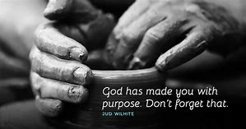
GOD’S DESIGN
God’s design has everything to do with His Purpose, His Plan and His Provision
Regarding His Purpose
Rom 8:28– “For all things work together for our good for those who love God and are called according to His purpose.”

Slide 4
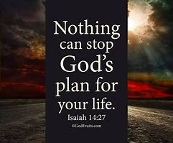
GOD’S DESIGN
God’s design has everything to do with His Purpose, His Plan and His Provision
Regarding His Plans
In Jere 29:11 - God says, “For I know the thoughts I have towards you, plans of peace not evil – to give you a future and a hope.”

Slide 5
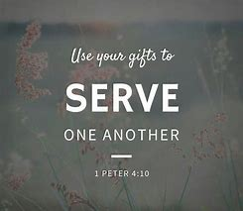
GOD’S DESIGN
God’s design has everything to do with His Purpose, His Plan and His Provision
Regarding His Provision
1 Pet 4:10 – “Just as each one has received a gift – use it to serve one another as good stewards of the grace of God.”

Slide 6

Not because it needs people to fill positions but because YOU ARE IMPORTANT!

Slide 7






PURPOSE OF THE NETWORK MINISTRY IS FOR YOU TO DISCOVER 3 THINGS
How God has placed you in the body of Christ to make a difference.
How to discover what your spiritual gift or gifts are in the body of Christ.
How to find a meaningful place of service.

Slide 8

WHAT IS A SPIRITUAL GIFT?
Spiritual Gifts Are:
  Special abilities given by the Holy Spirit to build up the body of Christ.
  Every believer has at least one spiritual gift.
  You can’t earn them or choose them.
Notes:
Ephesians 4 teaches us that spiritual gifts of God are actually given to His church to help equip the people in the church for the work of service for the building up of the body of Christ.
The ministry gifts serve to reveal the plan of God.

Slide 9
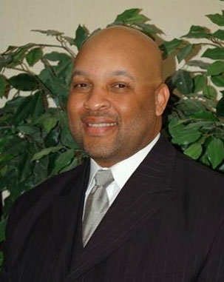
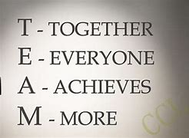

A QUOTE FROM PASTOR CANADY…..
“You Can’t Do A Spiritual Work Without Being Spiritual.”

Slide 10
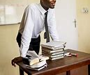


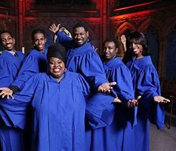
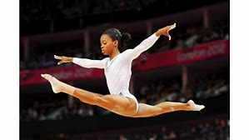
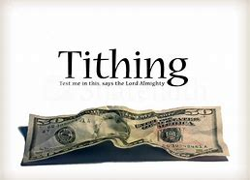
SOME COMMON MISCONCEPTIONS SPIRITUAL GIFTS ARE NOT:
Natural Talents – like cooking, sports, singing, etc.
The Fruit of the Spirit – like love, joy, peace, gentleness, meekness and self-control…
Church positions – like Pastor, Sunday School teacher, small group leader.
Christian disciplines – like fasting, prayer, study, & tithing.

Slide 11

INTRODUCTION TO THE 23 SPIRITUAL GIFTS OF THE HOLY SPIRIT
1 Corinthians 12:4-11 says, “Now to each one the manifestation of the Spirit is given for the common good.
To one there is given through the Spirit a message of wisdom, to another a message of knowledge by means of the same Spirit, to another faith by the same Spirit, to another miraculous powers, to another prophecy, to another distinguishing between spirits, to another speaking in different kinds of tongues, and still to another the interpretation of tongues.
All these are the work of one and the same Spirit, and He distributes them to each one, just as He determines.”
Notes:
In this scripture, the Holy Spirit is seen “deciding” what gifts to give to each person.

Slide 12

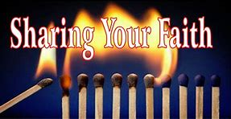

THE SPIRITUAL GIFTS OF COMMUNICATION
God imparts His Word of Consolation and the Gift of Salvation through these Gifts
Encouragement
Evangelism
Intercession
The ability to strengthen and comfort others.
The ability to communicate the gospel to unbelievers.
The ability to pray for others.
1 Thessalonians 5:11 – “Therefore encourage one another and build each other up, just as in fact you are doing.”
Notes:
God imparts his divine encouragement and support through these gifts

Slide 13
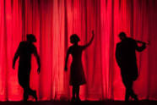

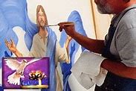



THE SPIRITUAL GIFTS OF DESIGN & THE ARTS
God imparts His Creativity within Us through these Gifts
Creative Communication
Craftmanship
The ability to use your artistic skills thru drama, writing, art and music to inspire others.
The ability to design or construct.
Exodus 35:35 – “He has filled them with skill to do all manner of work of the engraver and the designer and tapestry…..those who do every work and those who design artistic works.”

Slide 14

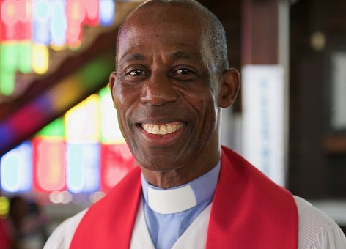

THE SPIRITUAL GIFTS OF EQUIPPING
God Equips and Builds up the Body of Christ for Service through these Gifts
Leadership
Shepherding
Teaching
The ability to cast a vision, to motivate and direct others.
The ability to nurture, care for and guide others.
The ability to communicate, explain and apply God’s word.
Ephesians 4:12 – “For the equipping of the saints for the work of service, to the building up of the body of Christ; For the perfecting of the saints, for the work of the ministry, for the edifying of the body of Christ: so his people would learn to serve and his body would grow strong.”

Slide 15
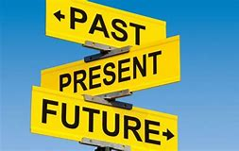

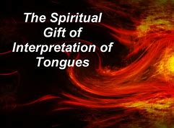
THE SPIRITUAL GIFTS OF INSPIRATION
God reveals secret things by Edification, Exhortation & Comfort through these Gifts
Prophecy
Tongues
The Interpretation of Tongues
The ability to speak a word – to foretell, warn or expose sin.
The ability to speak in an unknown language you have not learned before.
The ability to translate a message to the body of Christ when someone is speaking in tongues.
1 Corinthians 14:39 – “Therefore, my brothers and sisters, be eager to prophesy, and do not forbid speaking in tongues.”
Notes:
God Brings His Anointing and His Blessing to the Church through these Gifts
God brings inspiration of the Spirit through these gifts

Slide 16


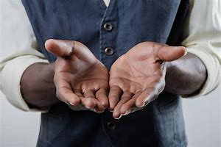
THE SPIRITUAL GIFTS OF OVERSIGHT
God imparts His Guidance So that We Can Advance God’s Kingdom with these Gifts
Administration
Apostleship
Giving
The ability to organize people, tasks or events.
The ability to start and oversee new churches or ministries.
The ability to contribute money and resources for the work of the church.
1 Corinthians 3:13 – “Each one’s work will become clear; for the Day will declare it, because it will be revealed by fire and the fire will test each one’s work, of what sort it is.”

Slide 17
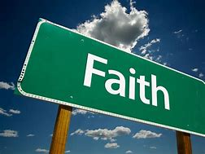

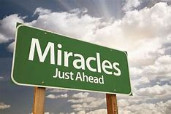
THE SPIRITUAL GIFTS OF POWER
God imparts His own Divine Powers and Abilities to Men and Women through these Gifts
Faith
Healing
The Working of Miracles
The ability to act on God’s promises with confidence – unwaveringly.
The ability to demonstrate the power of God by restoring the sick, (emotionally, physically and spiritually).
The ability to be used supernaturally to glorify God.
John 14:12 –“Verily, verily, I say unto you, He that believeth on me, the works that I do shall he do also; and greater works than these shall he do; because I go unto my Father.”

Slide 18



THE SPIRITUAL GIFTS OF SUPPORT
God’s Purpose is to Make Us People who Enrich the Lives of Others through these Gifts
The ability to free up and support others – one who works behind the scene.
The ability to care for others – by providing fellowship, food and shelter.
The ability to help those who are suffering or in need.
Helps
Hospitality
Mercy
Matt 25:40 –“The King will reply, 'Truly I tell you, whatever you did for one of the least of these brothers and sisters of mine, you did for me.’”

Slide 19
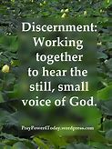


THE SPIRITUAL GIFTS OF REVELATION
God Reveals Information Supernaturally to a Man or Woman through these Gifts
The Discerning of Spirits
The Word of Knowledge
The Word of Wisdom
The ability to discern between truth and error, right or wrong. The ability to discern spirits – good or evil.
The ability to have unusual insight and knowledge about a particular situation or person.
The ability to reveal truth and expose deception.
Proverbs 29:18 – “Where there is no revelation, the people perish; but blessed is the one who heeds wisdom's instruction.”

Slide 20

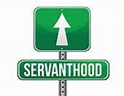
THE GOAL IS SERVANTHOOD
IN ORDER TO GLORIFY GOD
Ephesians 2:10 – For we are God’s workmanship, created in Christ Jesus to do good works, which God prepared in advance for us to do.
Phil 2:13 – For it is God who works in you to will and to act according to His good purpose.
Romans 12:5 – In Christ, we who are many form one body and each member belongs to all the others. (I need u..)
Matt 5:16 – Let your light shine before men, that they may see your good deeds and glorify the Lord!

Slide 21
Q&A

Slide 22
SPIRITUAL GIFTS ASSESSMENT INSTRUCTIONS
You have receive a “Spiritual Gift Assessment document consisting of 64 questions. In addition, you will find two additional documents which are called the Spiritual Gifts Assessment “Score Sheet” and an “Answer Key” Document to help you complete the assessment.
Since you already have your Spiritual Gift Assessment in your packet, you can return your completed Spiritual Gift Score Sheet:
  Via Email
  In Person at Church
  You can submit the completed form into the church’s mailbox. (Attn. Network Ministry)
  If you want to mail your completed form, the church’s address is Rodman Street Missionary Baptist Church, 6111 Rodman Street, Pittsburgh, PA 15206. (Attn. Network Ministry)
Once the New Member Class has been completed, you have five-days to complete the questionnaire.
Once we retrieve your Spiritual Gift Score Sheet, you will be contacted by a facilitator via telephone. We will then review your spiritual gift assessment with you.

Slide 23
SPIRITUAL GIFTS ASSESSMENT INSTRUCTIONS
PART 2
The next step is to visit the Rodman Website to review the Spiritual Gift’s materials under the Resources tab such as:
Note: ***If you have any concerns, please feel free to contact;
Deaconess Melanie Sudduth at 412-812-8242 or melanie.sudduth@aol.com
Sister Edie Smith at 412-412-310-7447 or msedie123@aol.com
Deaconess Beverly Stewart at 412-628-1651 or beverlystewart11@aol.com
Sister Jackie Simmons at 724-594-4685 or jacron_2@msn.com
Sister Jackie Willingham at 724-594-5444 or jan.willingham@icloud.com

