Slide 1
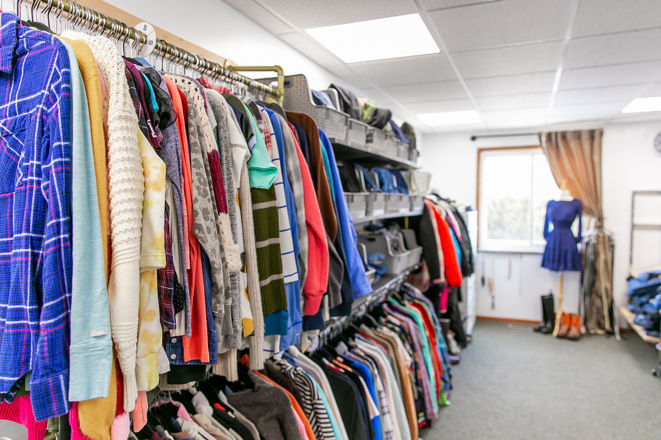

Main Location - 1501 W. Thomas St.
Bay City, MI 48706
Phone: (989) 266-7020
Email: hello@fosterfamiliesnrc.org
Website: fosterfamiliesnrc.org

Slide 2
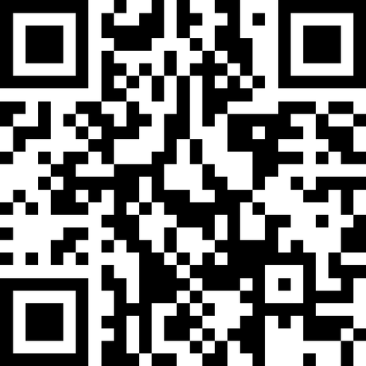
Think of questions during the presentation and afraid you will forget, ask here!
Scan Here!

Slide 3

FFNRC - A History
2023 Haven 127 & Parenting time went live.
2024/25 Program expansion to include Child Welfare Worker Support
2027 + extending services/locations West & North
Founded in 2020
2022 - Moved from Auburn to Bay City
2024 - Bridgeport & Midland Outposts were Born
2026?? looking to reloacte into Saginaw City limits.

Slide 4
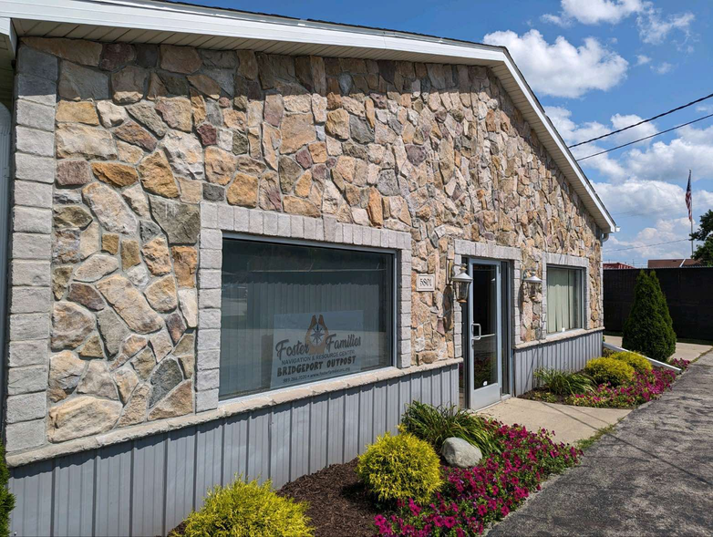

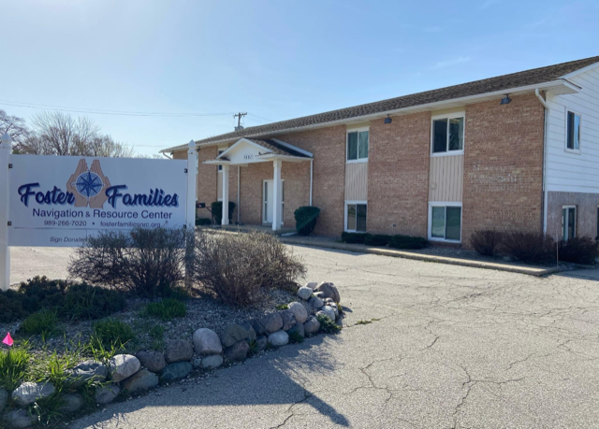
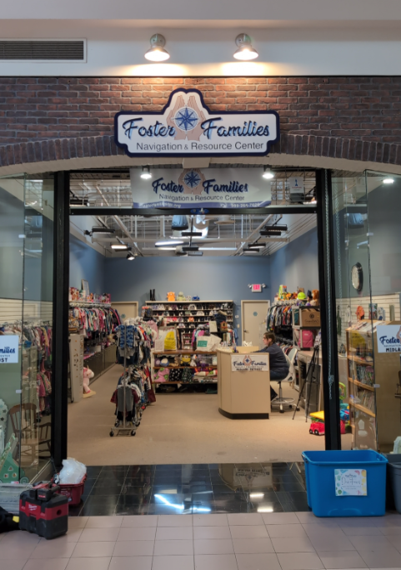
Locations
Midland
Bridgeport
Bay City

Slide 5
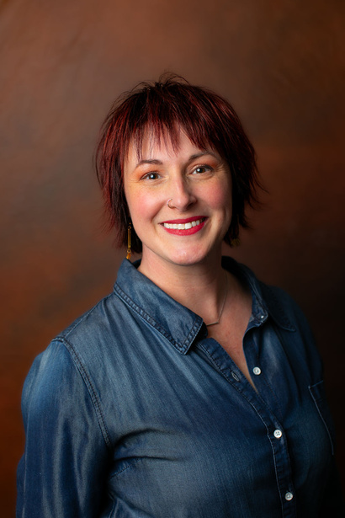
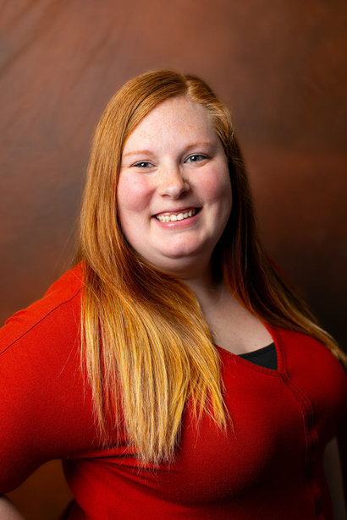
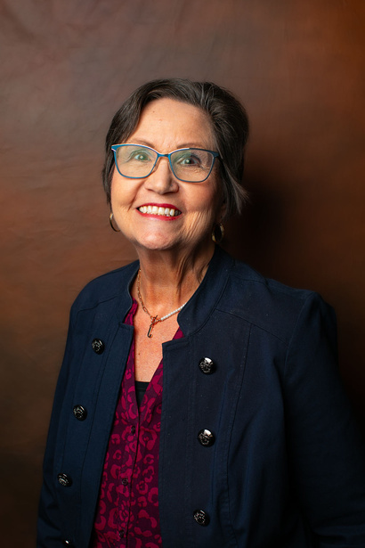
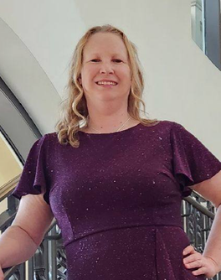

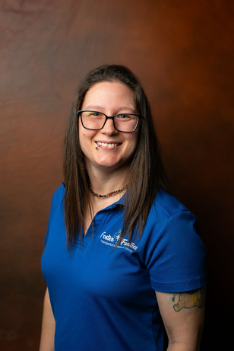
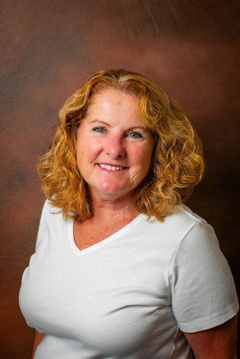
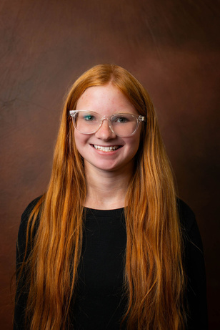
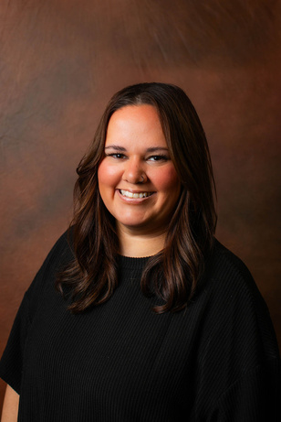

Introductions
Executive Leadership
The Voice of FFNRC
Sarah Humerickhouse
Shaina Parker
Founder/Executive Director
Operations Director
Support Staff

Slide 6
The Real Reason People Visit Us
Pearl
Emotional Support Animal

Slide 7
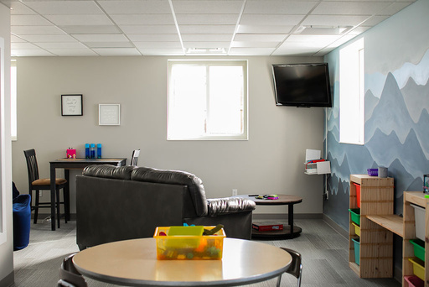
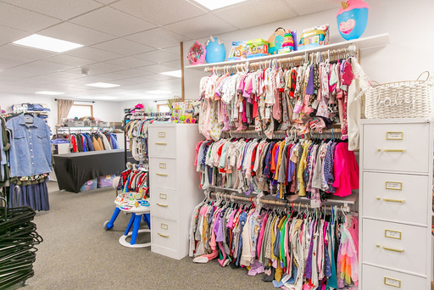
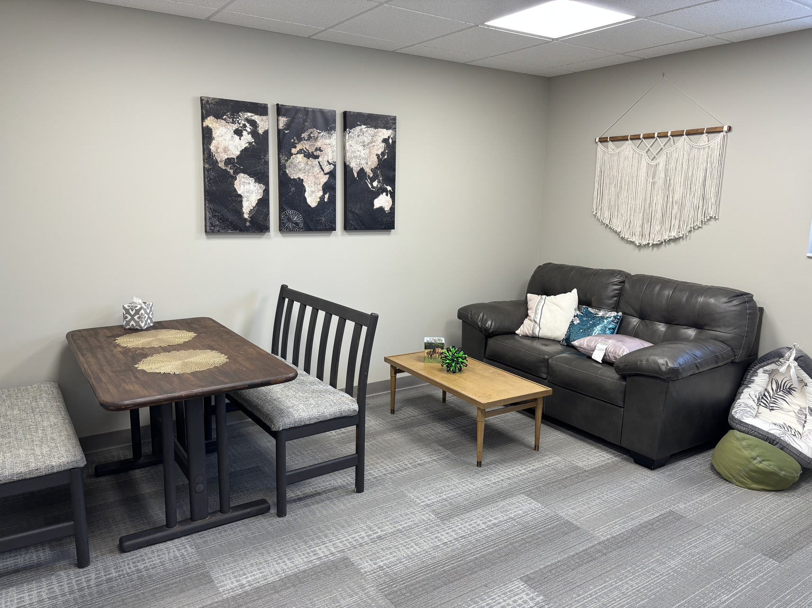
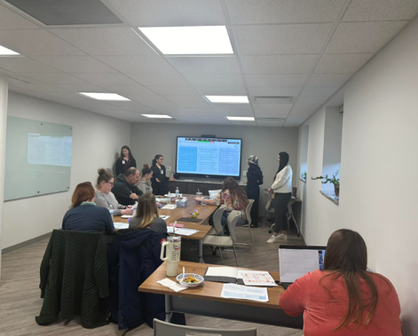
Services Provided:
For Our Families
For Our Workers
  Resource Boutique
  Relevant Trainings
  Family Fellowship Events
  Resource Database
  Worker Support
  Haven 127
  Parenting Time Space

Slide 8
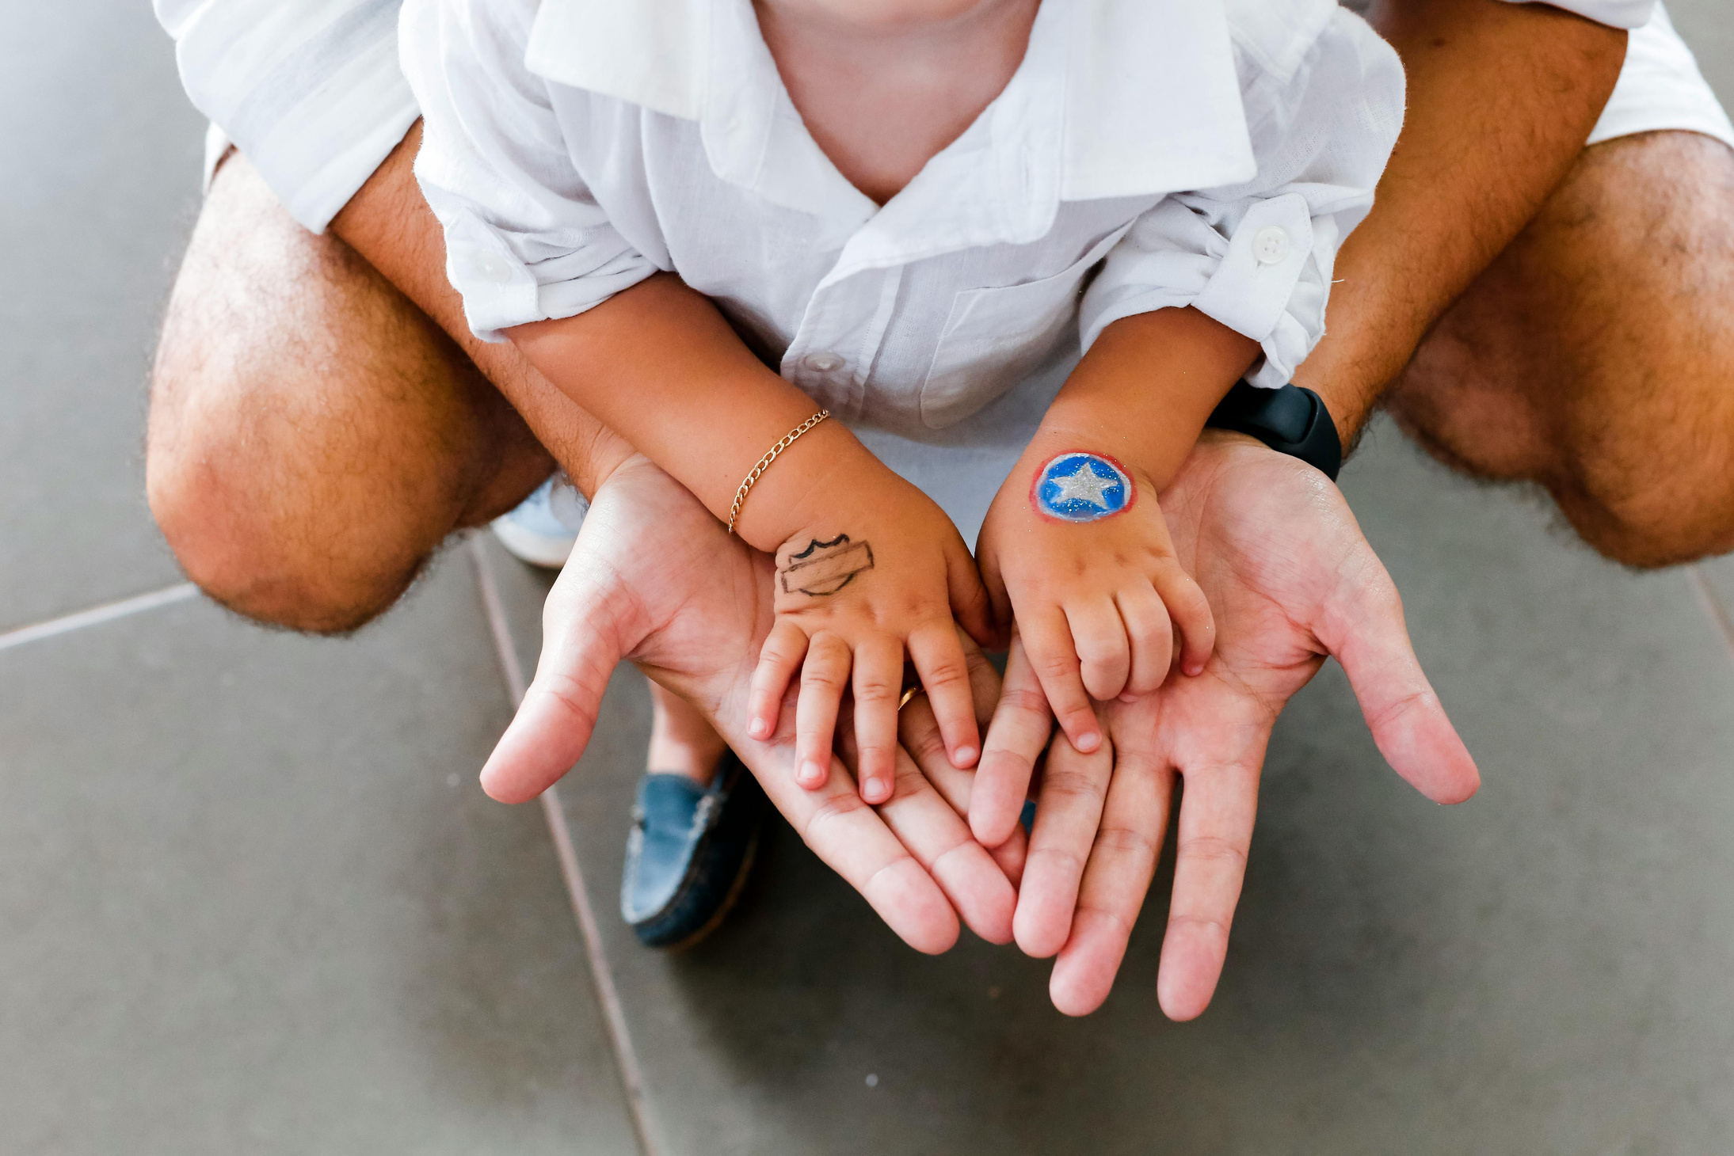
How We Support Your Families?

Slide 9
Who We Serve & How to Access
Resource Boutique & Resource Request
Foster, Adoptive, Kinship Families
  Can shop in our Resource Boutiques with an appointment (preferred) or drop in.
    Bridgeport is always by appointment only.
  Resource Requests can be submitted online and picked up by the families worker or by the families themselves.

Slide 10
Who We Serve & How to Access
Resource Boutique & Resource Request
CPS Involved Families - Prevention & On-Going
  Resource Boutique - for the protection and privacy of all parties, the Resource Boutique is not offered to CPS involved families - no matter the status of their case. These families may not come into our boutiques accompanied by workers.
  Resource Requests - must be submitted and picked up by the worker. No exception. Failure to comply with this will result in services being severed with this family.

Slide 11
Who We Do Not Serve
Resource Boutique & Resource Request
Support People
  We do not provide resources to support people, respite care, etc.
  Resources are provided to those who have legal custody of the children
Formerly CPS Involved Families
  Once the case has ended, services need to be transfered to other local agencies and clothing closets. We cannot continue providing resources at that time.

Slide 12
Completeing Resource Requests
Vital Information
  Sizes MUST be included for any requests for shoes, clothing or sheets. If they are not provided, we cannot fill the request.
  Make sure that your marked requested items match the sizes provided.
Sensitivities and Requests
  Special requests or sensitivities, please include on the resource request, we will do our best to fulfill those needs. These include texture sensitivities, medical modifications, etc.

Slide 13
Completeing Resource Requests
Urgency/Pick Up Date
  If the request(s) needs to be completed for a specific day, please include that in the special considerations.
  If it is urgent, please include that in the special considerations.
      Urgent Requests MUST be picked up in Bay City.

Slide 14
Items We Do Not Provide...
We will refer out any of the requested items
  Anything with an expiration date such as:
    Car Seats - we will get you in contact with someone that does provide them
    Food
    Formula
  Large Furniture Items (beds over toddler size, dressers, etc.

Slide 15
Resource Request Pick Up
  We have pick up locations in Bay City, Midland, Gladwin and Bridgeport, please specify which location you would like to pick up at. (We are working on Clare/Isabella locations)
  We will contact you when your request has been completed Please do not stop by to wait. This causes a distruption to our workflow.
    We prioritize our requests by urgency and then the order in which they have arrived.
    Due to delivery services and finding special requested items, it may take us some time to retrieve special items.

Slide 16
Resource Request Pick Up
  Notifications will be sent when your request has been completed.
  Notifications will include Family Name, Number of Bags, and location for pick up.
  We will send 3 reminders. If there is no communication and/or exceeds 3 weeks on our shelves packed, we will return them to inventory.
  We have every resource request signed out by the person picking up.

Slide 17
Request Question??
If you are unsure about something, if we provide an item, or have a special request please ask. We are happy to answer.
If the question is something that we do not provide, we will do our very best to get you an answer or in connection to a resource.

Slide 18
Other Resources We Provide for Foster, Adoptive & Kinship Families
Family Fellowships - Events held 7 times a year for our families to enjoy with their children and other families walking this journey.
Relevant Trainings - we provide space for relevant trainings. Some trainings qualify for fostering credits. Partnered with other agencies.
Resource Database - on our website we have family type specific resources for quick access. We keep our website up to date with the most accurate information we can provide.

Slide 19
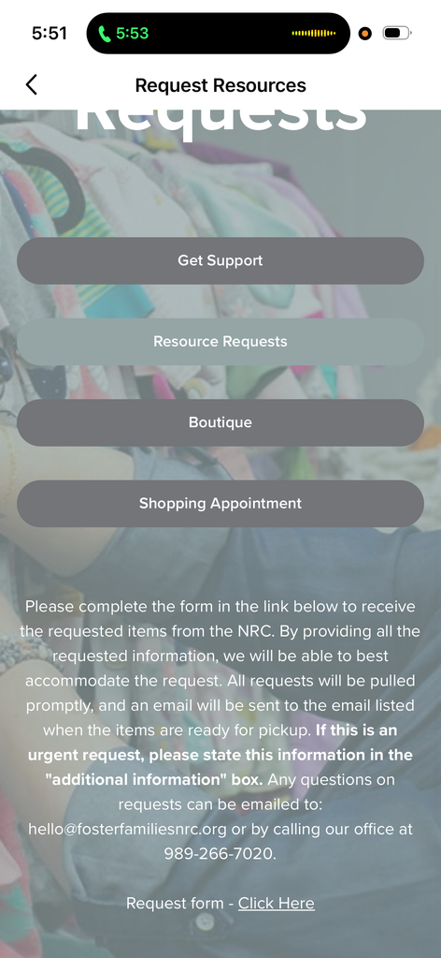
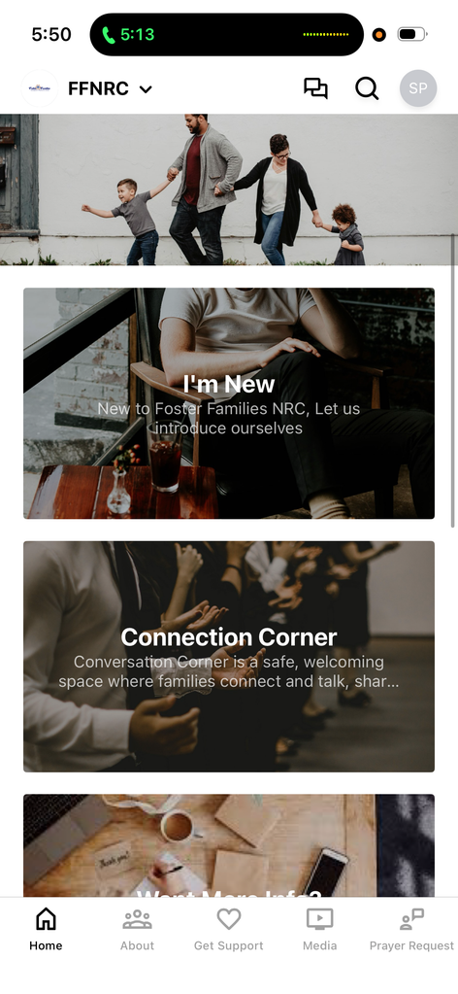
COMING SOON!!!
Foster Families NRC
Mobile APP!
ETA: Summer 2026

Slide 20

How We Support You?

Slide 21
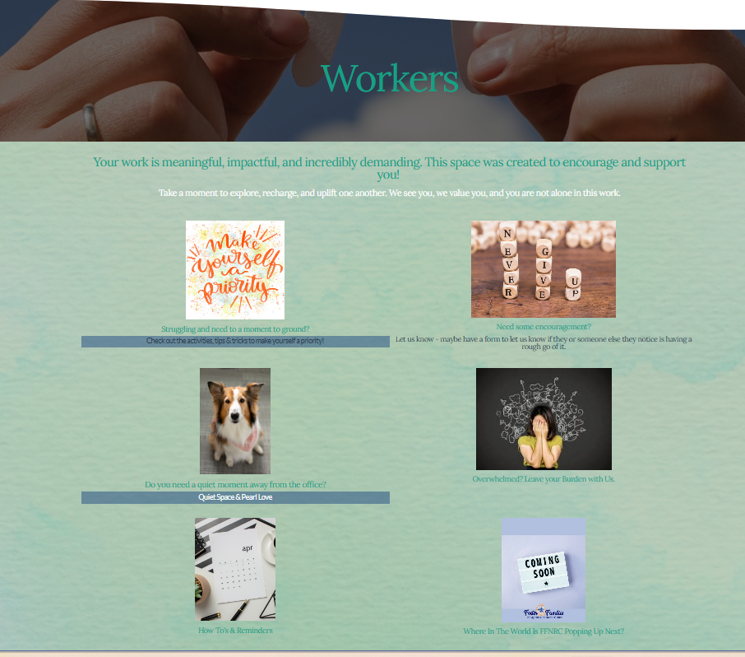
Worker Support
  Encouragement
  Worker Page on the website
  Prayer
  Work Space Away From The Office

Slide 22
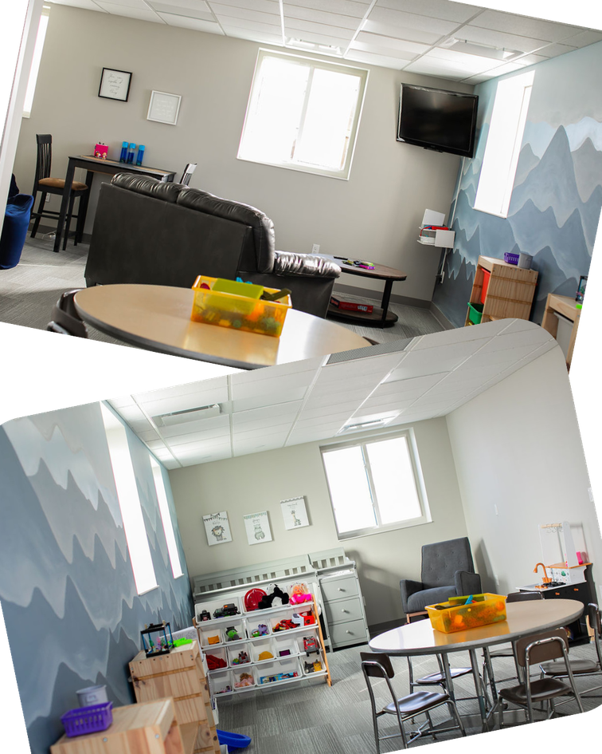
Worker Support
Haven 127
  A space for when removing a child(ren) from unsafe environments
  Trauma-informed space. Calming.
  Contract is required to use.

Slide 23
Worker Support
Parenting Time Space
  A den-style room to hold supervised visits.
  Has microwave & Fridge/Freezer for meals or snacks together
  Has an observation room to give a feeling of privacy while still being safe.
  Requires a contract

Slide 24
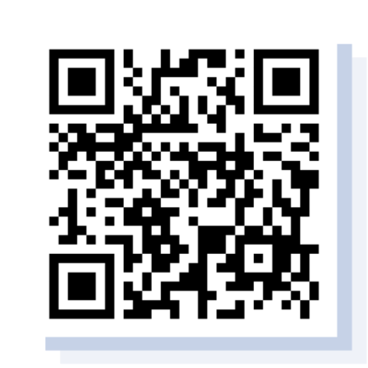
Want to stay up to date on the happenings at Foster Families Navigation & Resource Center?
Scan Here!

Slide 25
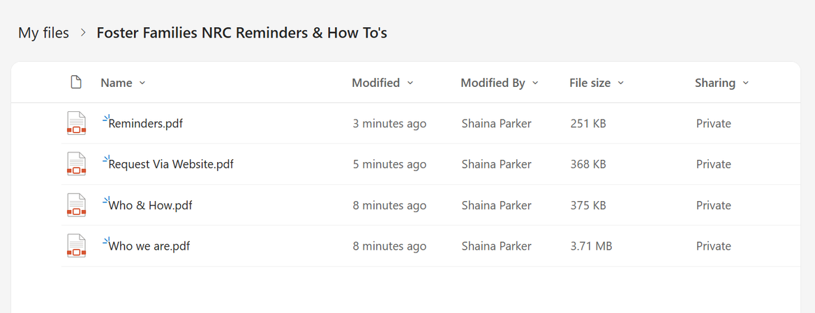
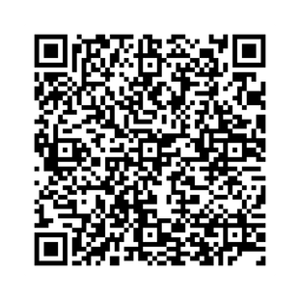
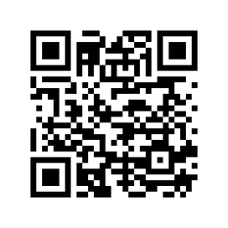
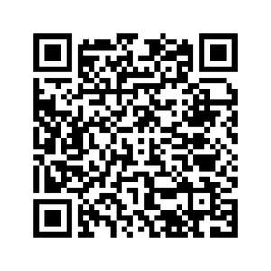
Scan to Access
Foster Families NRC’s Reminders & How To’s
Need a little bit of a mental break or encouragement?
Scan to Access
Foster Families NRC’s Worker Page
Have Questions?
password: ffnrc

Slide 26
Feel free to contact me
shaina.p@fosterfamiliesnrc.org
989.266.7020

