Slide 1
Morning star Baptist Church
Pastoral Search Committee
Information Session
May 16, 2026
“TOGETHER WE CAN, TOGETHER WE WILL”
Notes:
---
Welcome to the update session on the pastoral search process at Morningstar Baptist Church. Today, we will share our progress and next steps as we move closer to presenting a pastoral candidate to the congregation.

Slide 2


session agenda
Direction
Who We Are: Introducing the Pastoral Search Committee
What We Have Done: Progress Since November 2025
What We Will Do: Next Steps Toward Presenting a Candidate
Visualizing the Vetting Process: Five-Stage Candidate Funnel
Congregational Planning
Notes:
We will begin with introductions, then provide an overview of who we are as the Pastoral Search Committee. Next, we'll review what we have accomplished since November 2025 and outline our upcoming plans. We'll also explain the vetting process for candidates and conclude with a Q&A session.

Slide 3
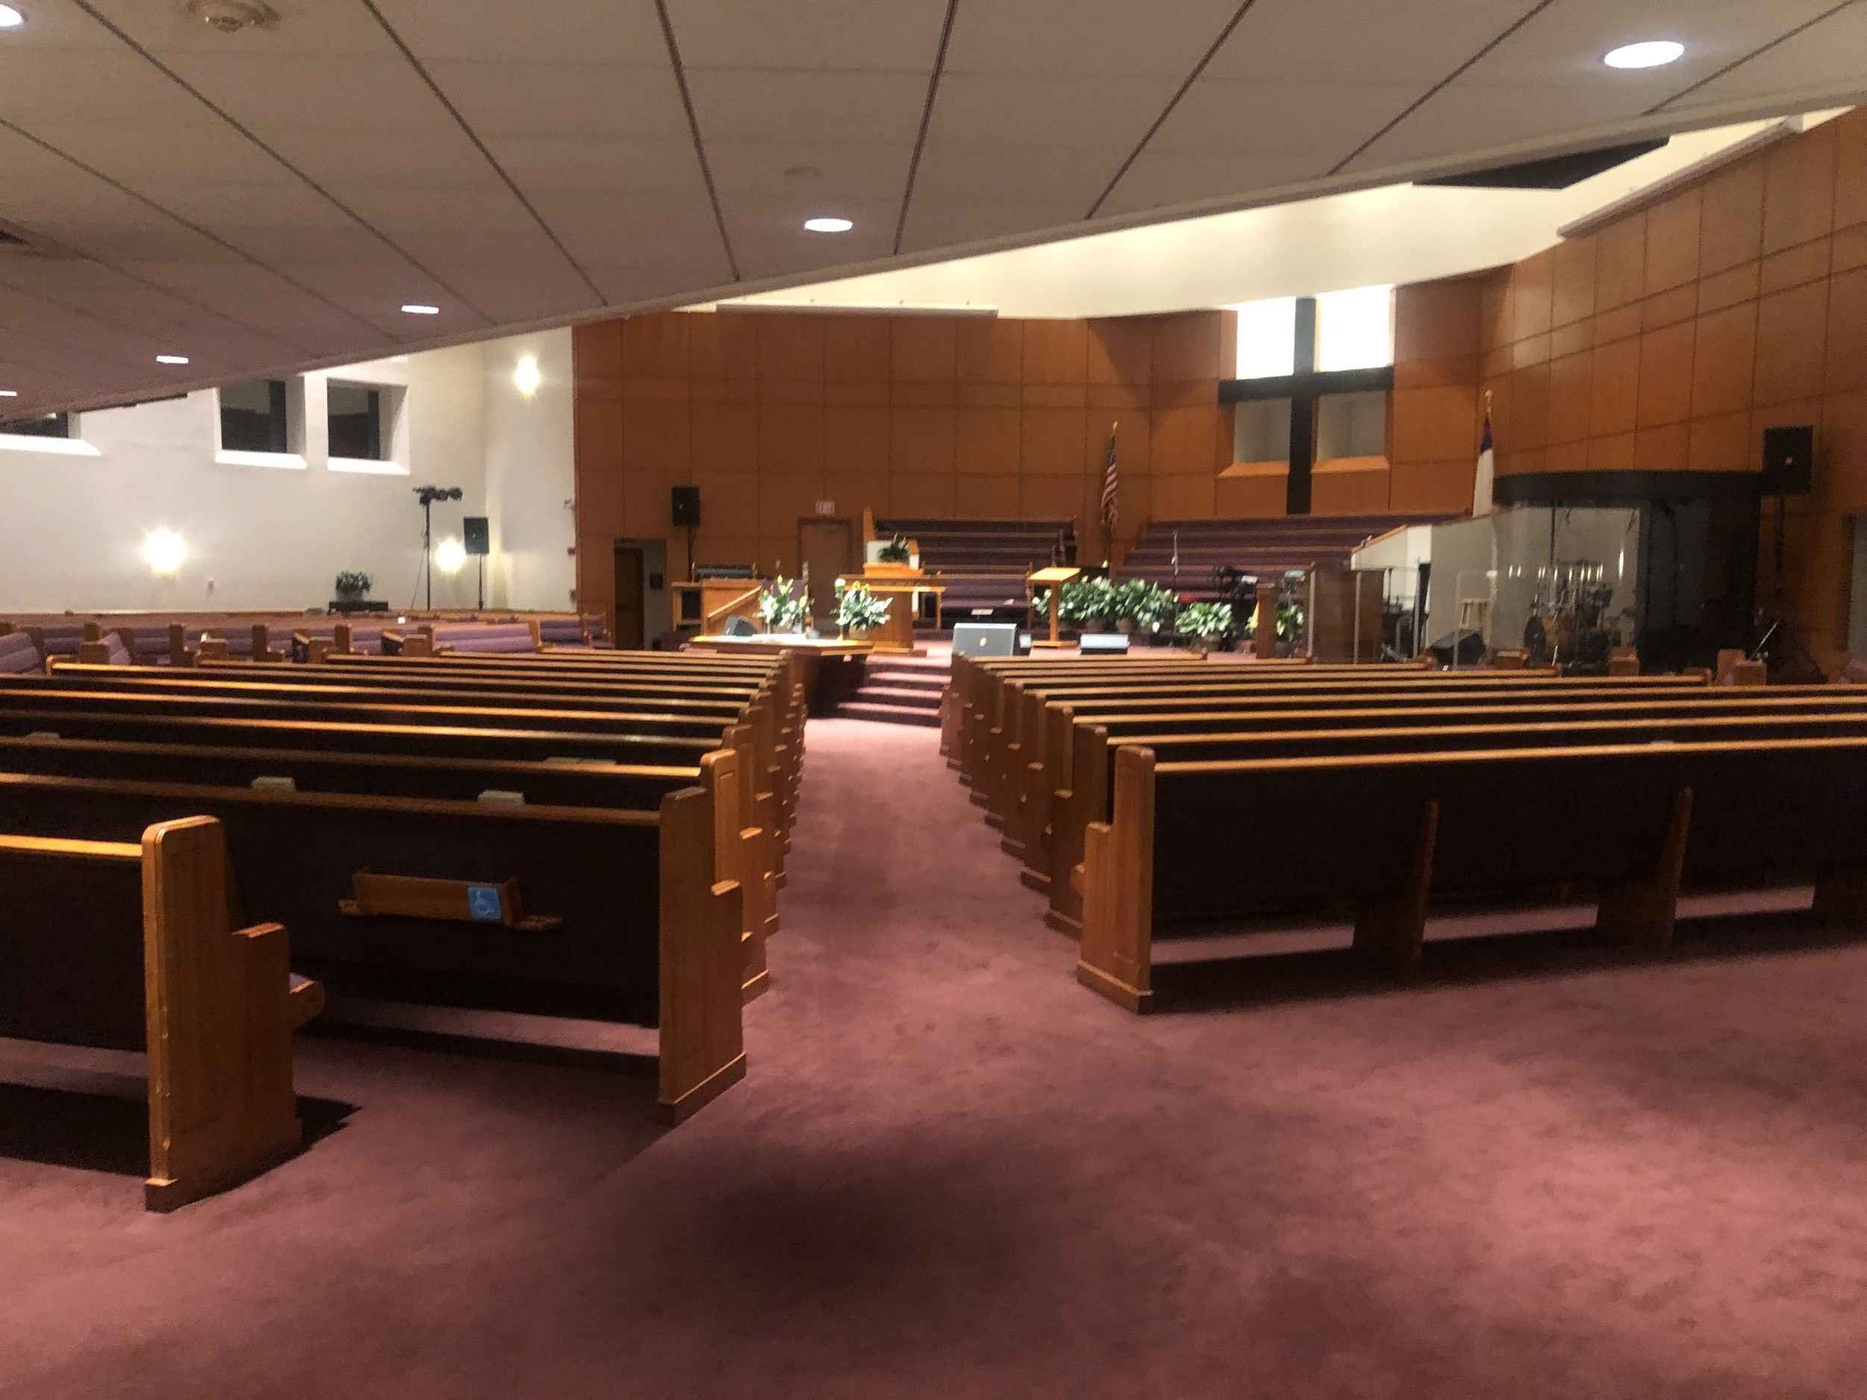
DIRECTION
Notes:
The committee's purpose is to prayerfully and diligently seek a pastoral candidate aligned with our church’s values and vision. Our mission is to support Morningstar Baptist Church by identifying a leader who will guide our spiritual growth.

Slide 4
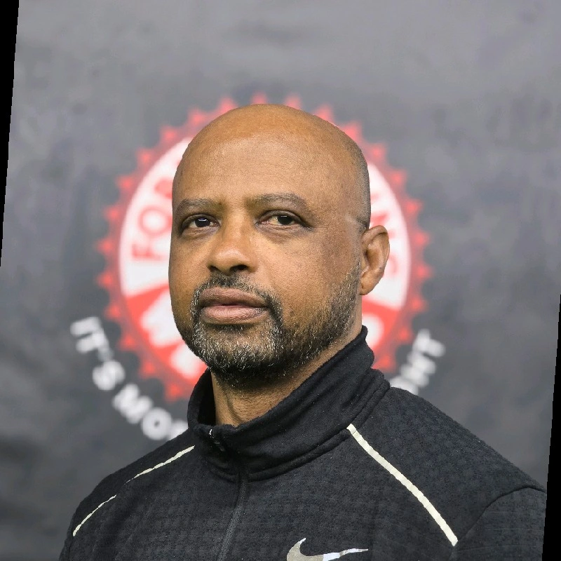
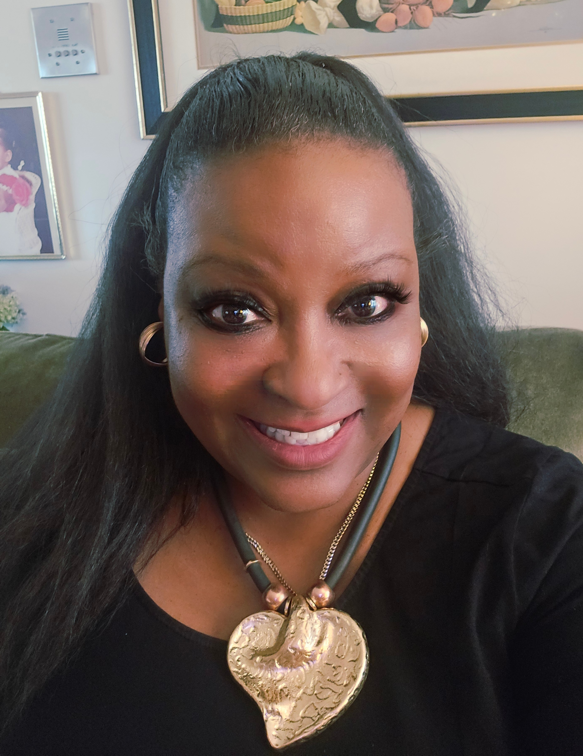
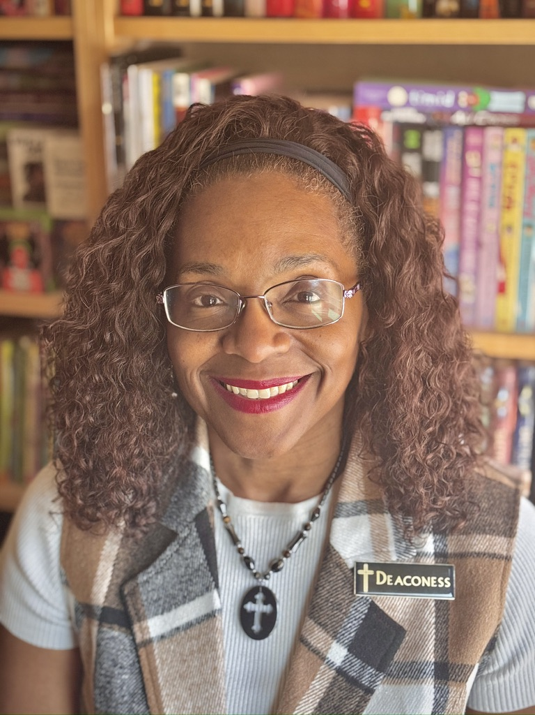
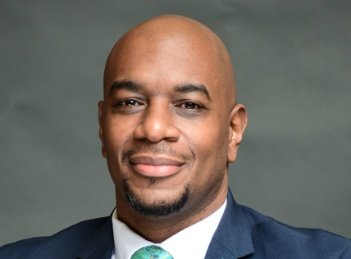
Who We Are:
Meet Our Committee Members
Bro. Larry Young
Member since 2011
Sis. Lisa Cook
Member since 2011
Deaconess Devita McConnell
Member since 1992
Deacon Carl Payne, Jr.
Member since 1986
Notes:
We have assembled a diverse team of church members with various skills and backgrounds. Each member has a clearly defined role, from candidate review to community engagement, ensuring a thorough and balanced search.

Slide 5
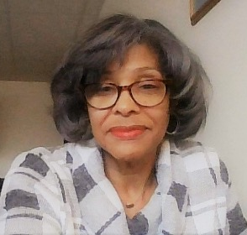
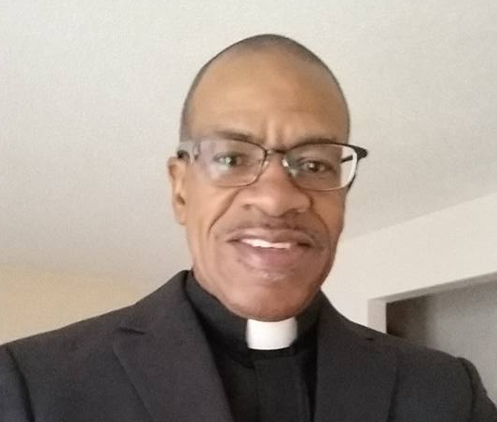
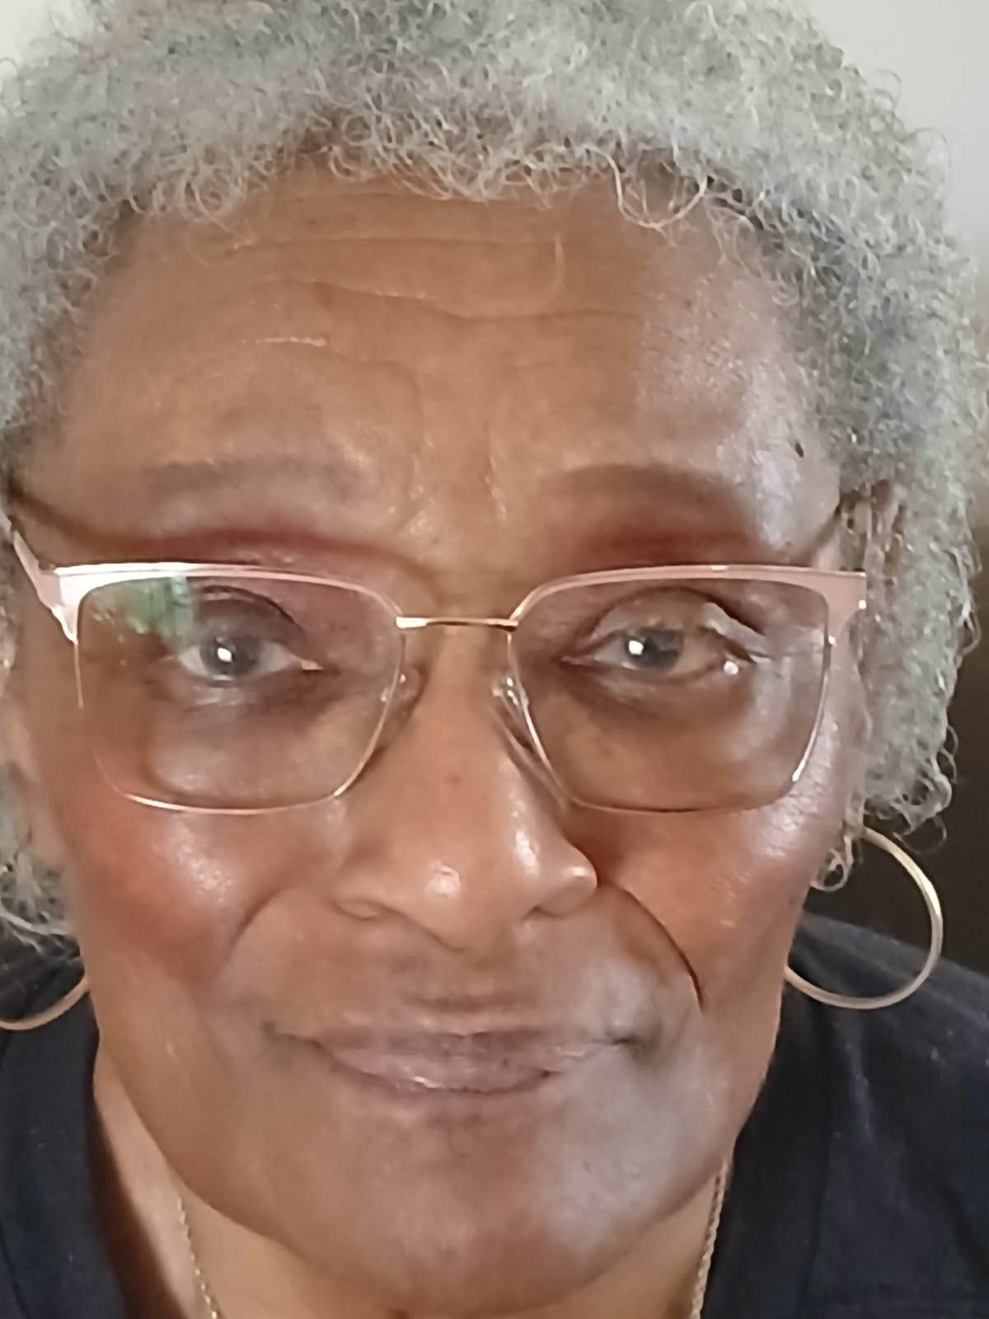
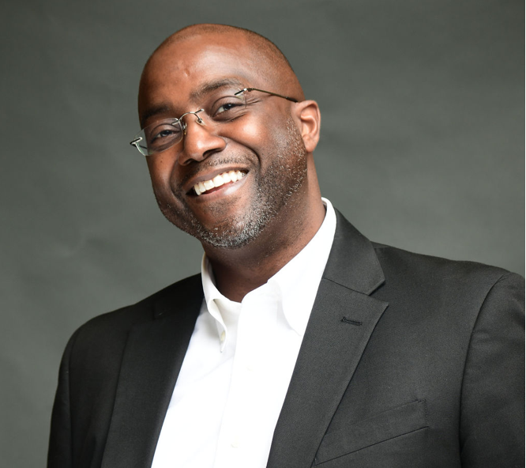
Who We Are:
Meet Our Committee Members
Rev. Dorothy Isles Smith
Member since 1983
Min. Kenneth Kelley
Member since 1990
Deaconess Elaine Maddox
Member since 1983
Deacon Stanley McConnell
Member since 1988
Notes:
We have assembled a diverse team of church members with various skills and backgrounds. Each member has a clearly defined role, from candidate review to community engagement, ensuring a thorough and balanced search.

Slide 6
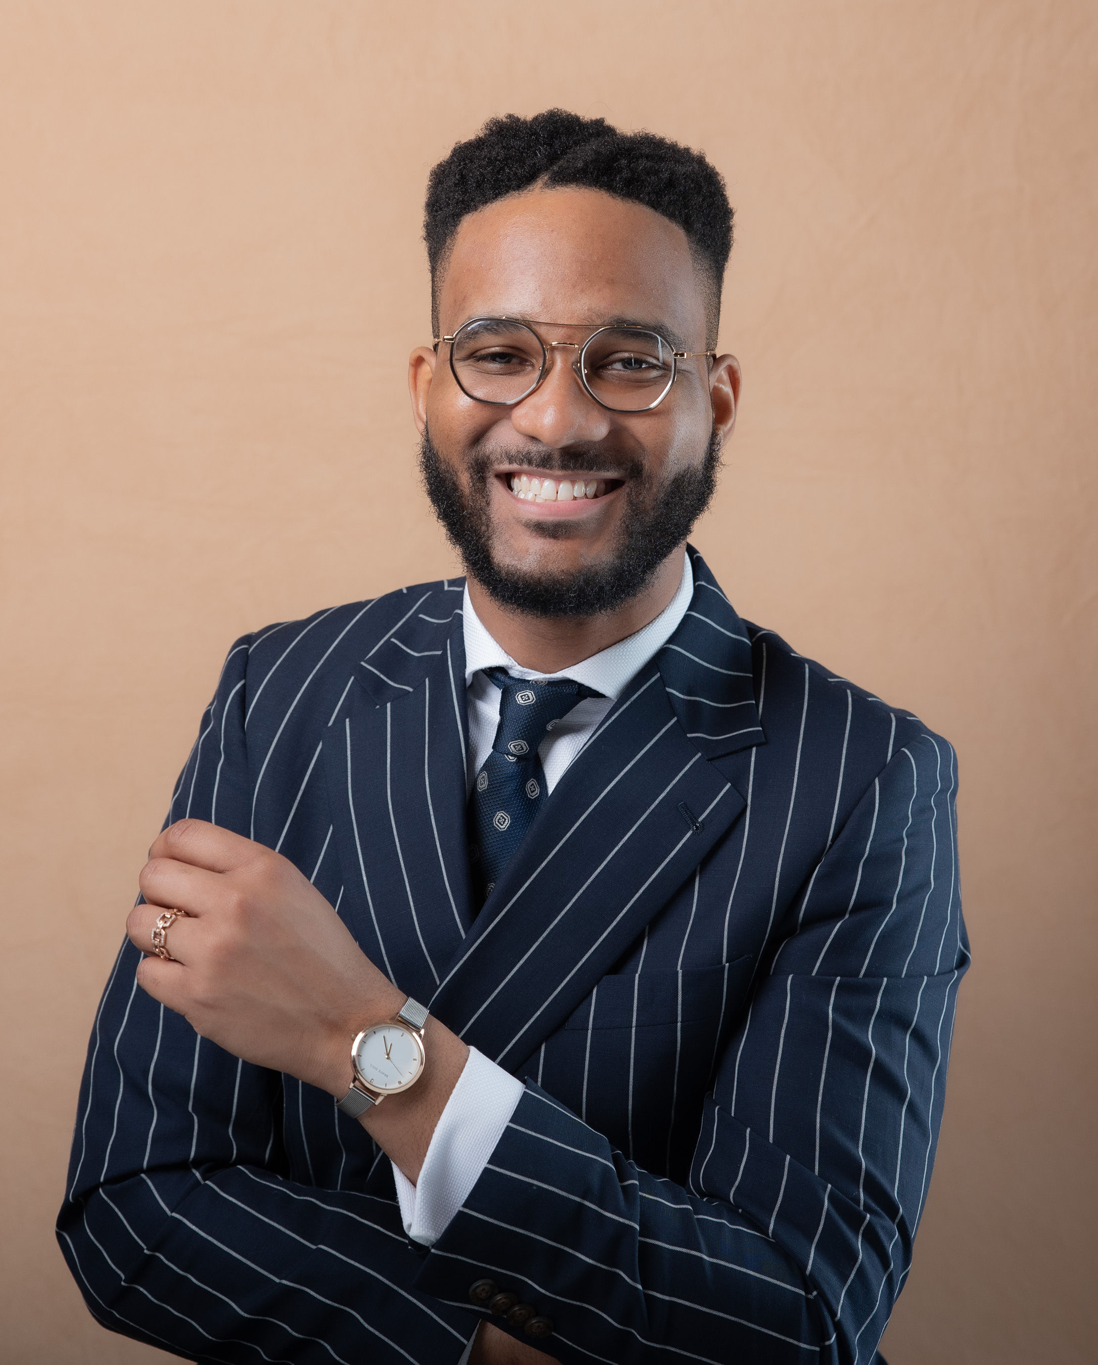
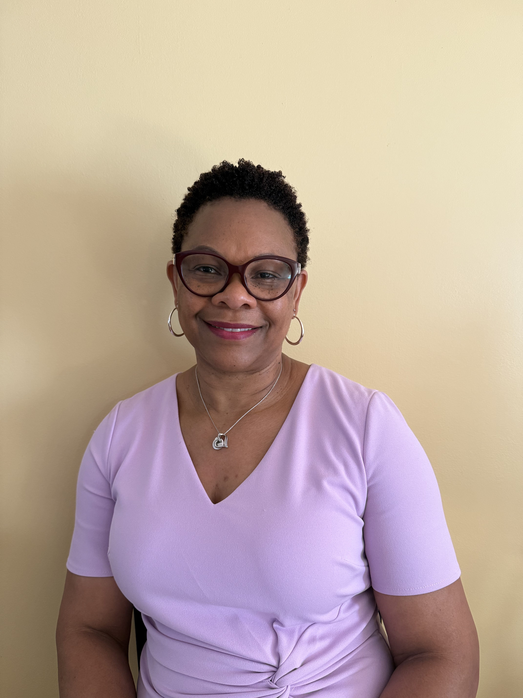
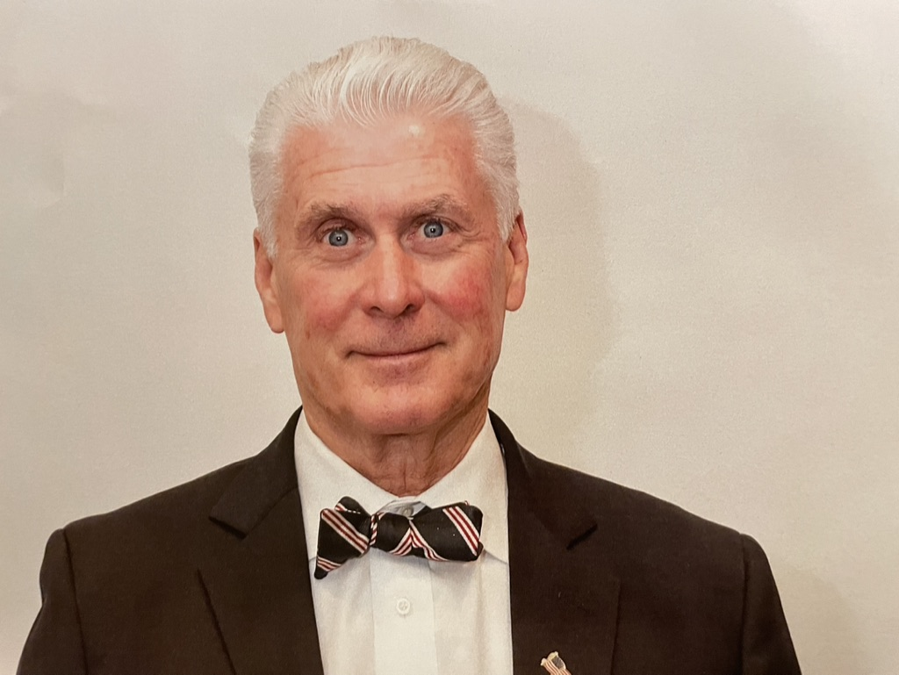
Who We Are:
Meet Our Committee Members
Bro. Edverette Brewster
Member since 2013
Sis. Michelle Walker-Dawes
Member since 2010
Bro. Matthew Dwyer
Member since 2017
Notes:
We have assembled a diverse team of church members with various skills and backgrounds. Each member has a clearly defined role, from candidate review to community engagement, ensuring a thorough and balanced search.

Slide 7
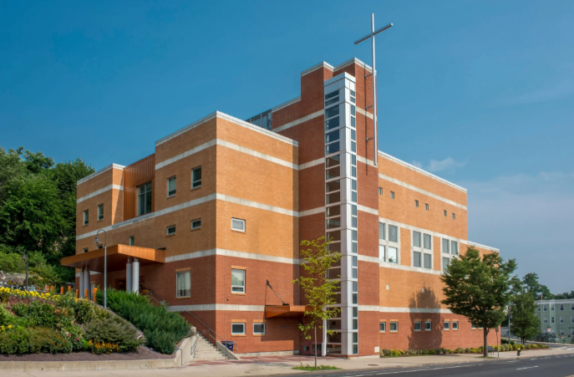
General Responsibilities
General responsibilities:
  The Pastor Search Commits (PSC) is entrusted with one of the most sacred responsibilities in the life of Morning Star Baptist Church: to discern and present the next Senior Pastor to lead this congregation into its next season of ministry. This task is not merely administrative – it is spiritual work, to be undertaken with prayer, patience, unity, and reliance on the Holy Spirit.
  As MSBC approaches the conclusion of 45 years of faithful Pastoral leadership, this committee will serve as a bridge between a treasured legacy and as an unfolding future. Our work must honor the past, discern the present, and prepare for the future, ensuring that the next Pastor is both God’s Choice and the Congregation’s joyful affirmation.
  The committee will work independently and prayerfully, seeking wise counsel when necessary. The outgoing Pastor will serve only as an advisor when requested. The authority for the search rests with this committee under the oversight of the Church’s constitution and the congregation’s final vote
Notes:
We are dedicated to maintaining transparency, prayerful discernment, and open communication with the congregation throughout this process. Our commitment is to serve the church's best interests at all times.

Slide 8
GUIDING PRINCIPLES
Prayerful Discernment
Transparency and Trust
Congregational Trust
Confidentiality and Integrity
Excellence and Due Diligence
Notes:
The committee's purpose is to prayerfully and diligently seek a pastoral candidate aligned with our church’s values and vision. Our mission is to support Morningstar Baptist Church by identifying a leader who will guide our spiritual growth.

Slide 9
What We Have Done: Progress Since November 2025
Notes:
We will review the key milestones achieved, including meeting timelines, development of candidate criteria, and how community input has shaped our search to date.

Slide 10

Timeline of Meetings and Key Milestones
Regular Committee Meetings
  The committee has held consistent meetings since November 2025 to coordinate the search process effectively.
  Leadership Engagement
  Met with the Diaconate and Ministerial Ministries.
  Consultations and Research
  Multiple meeting with other Ministries to discuss “Best Practices”, publications, podcasts, etc.
  Establishing Guidelines
  Guidelines were developed early in the process to ensure a clear and fair evaluation of candidates. (i.e. rubric, “what’s best for MSBC, bias elimination.
  Surveys
  Efficient way of gathering congregational perspectives.
  Website Development
  Dedicated link for potential candidate interactions
  Interview Process
  Established a 5 – Step Process that allows for appropriate vetting
Notes:
Since November 2025, the committee has held regular meetings to organize the search process, establish guidelines, and evaluate candidate applications to ensure we remain on track.

Slide 11
What We Will Do: Next Steps Toward Presenting a Candidate
Notes:
Looking ahead, we will focus on continuing interviews, refining candidate assessments, and preparing the congregation for the upcoming vote on the candidate we recommend.

Slide 12

Begin the
Search and Interview Process
Announce Nationally
  Utilize Nationally recognized job posting boards, social media outlets and MSBC website.
Accept Applications
  Beginning June 1, 2026.
  Screen
  Finalize the Senor Pastor profile (congregational input).
  Interviews
  4 rounds of interviewing focused on specific competencies. Rubric (scoring) driven.
  Targeted Presentation
  November 1, 2026
Notes:
The committee will conduct additional interviews and reference checks as we narrow down candidates to identify the best fit for Morningstar Baptist Church.

Slide 13
Visualizing the Vetting Process: Five-Stage Candidate Funnel
Notes:
This section provides a detailed overview of the multi-stage vetting process we use to evaluate pastoral candidates thoroughly and thoughtfully.

Slide 14


Application /Screening
Initial Application Screening
  Review all applications to ensure candidates meet the minimum required qualifications effectively.
Scheduling Interviews
Initial Interviews
  1st round involves WHO and WHY.
Interviews:
1st round
  Values Alignment Check
  Assess candidates to verify their alignment with the church’s core values and community needs.
Detailed Interviews
  1st round involves in-depth interviews focusing on pastoral experience and personal character evaluation.
2nd round
3rd & 4th
Round
Comprehensive Review
  The committee carefully analyzes all collected data to evaluate each candidate’s suitability and potential.

Slide 15
“Together we can, together we will”
Communication
Consistency is crucial. Using Church announcement, website and email will be the primary tolls utilized.
Most efficient way to data collect and assess information. We will offer both hard copies and electronic (website and QR Codes)
Regular Meetings
The congregation plays a crucial role in this process. We will need to meet on specific topic in order accomplish this assignment.
Surveys
Notes:
The Pastoral Search Committee remains dedicated to a prayerful, transparent, and thorough process. We appreciate your continued prayers and support as we seek the right pastoral leader for Morningstar Baptist Church.

Slide 16
DISCUSSION
Notes:
The committee's purpose is to prayerfully and diligently seek a pastoral candidate aligned with our church’s values and vision. Our mission is to support Morningstar Baptist Church by identifying a leader who will guide our spiritual growth.

