Slide 1
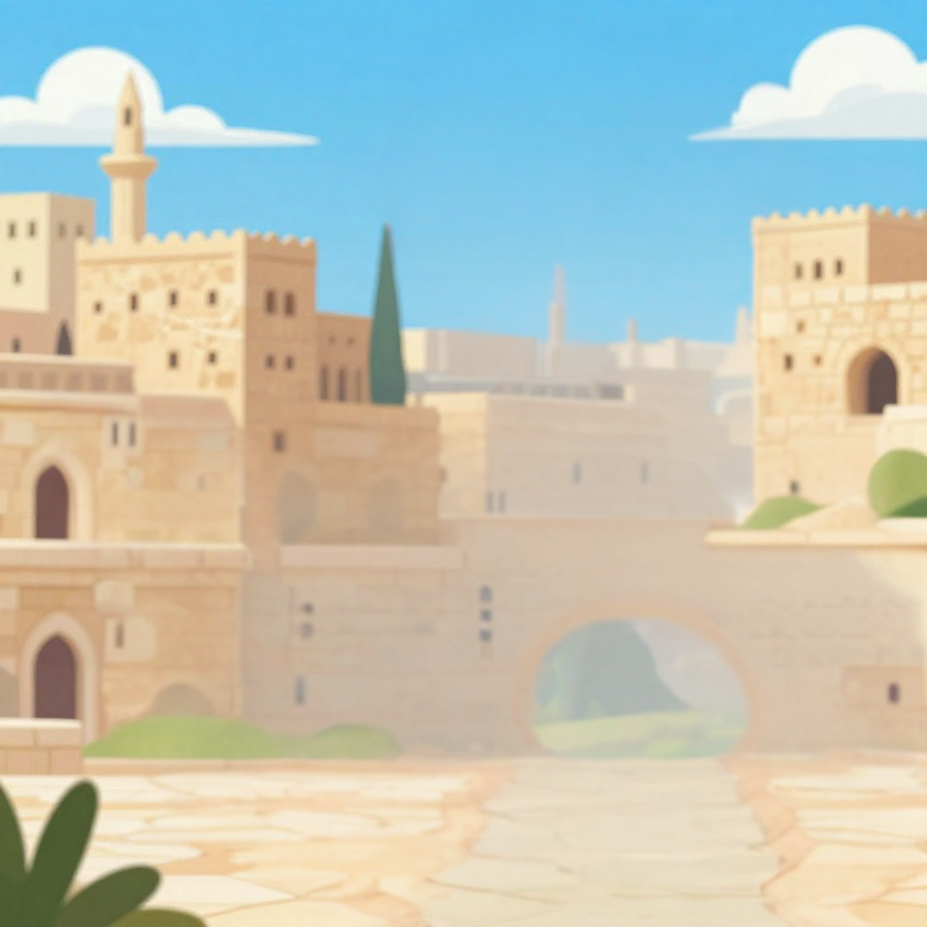

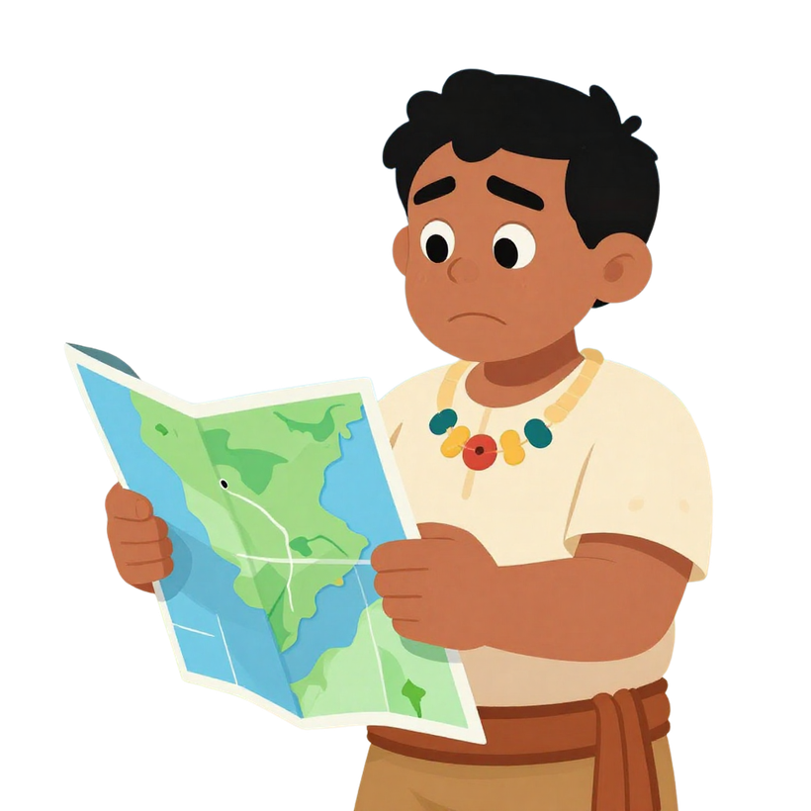
Trusting God When It’s Hard
Go Where?
Abraham’s Big Move
Unit 2
Week 1

Slide 2

Let’s Worship!!!

Slide 3
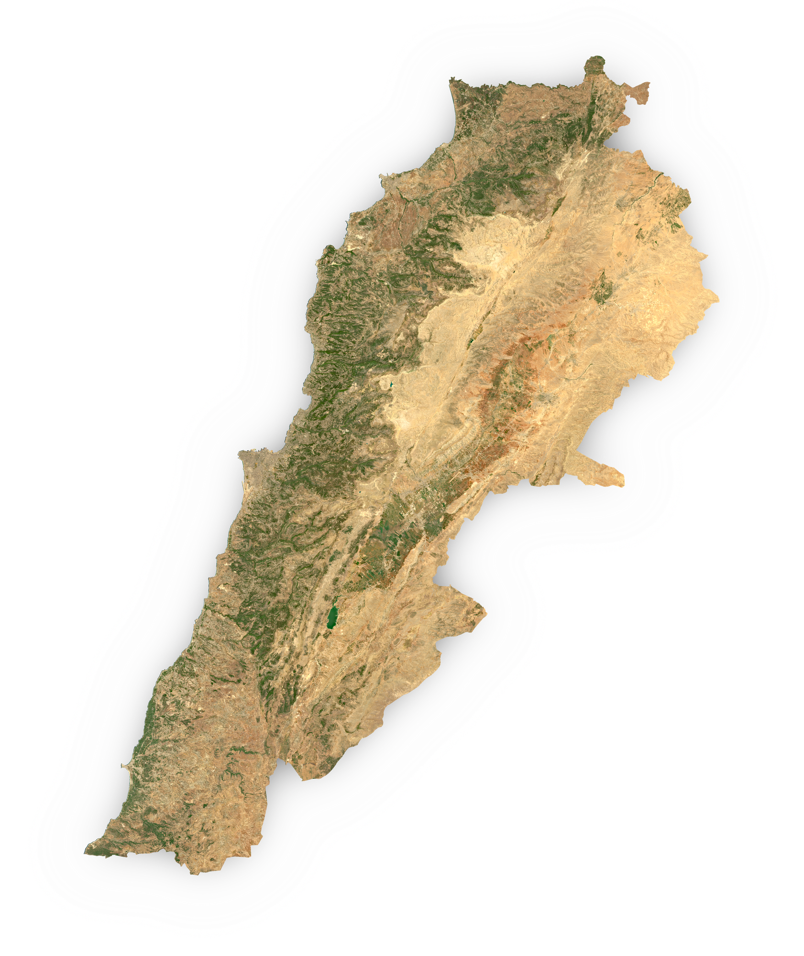
Focus Scripture
“I will show you the way to go.” – Genesis 12:1

Slide 4
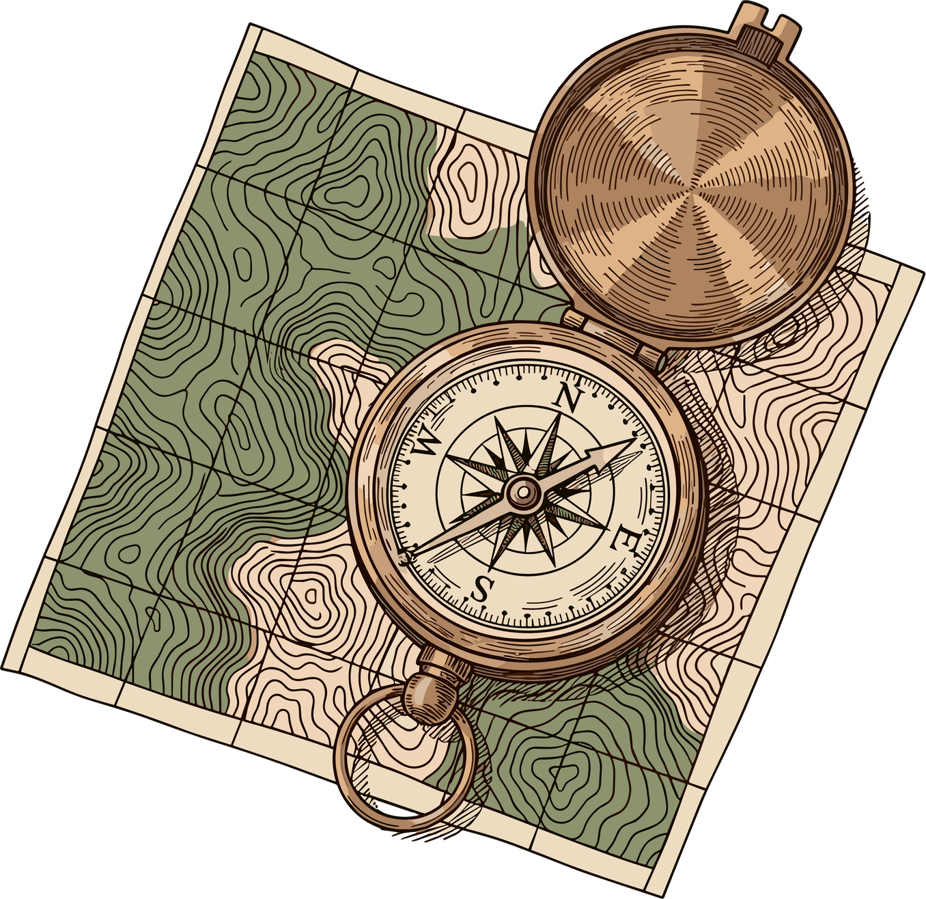
Something New
Have you ever had to move? Move to a new school or even a new home? How did you feel? It can feel scary to leave behind the people and places we know. That’s what happened to a man named Abram, later known as Abraham.

Slide 5
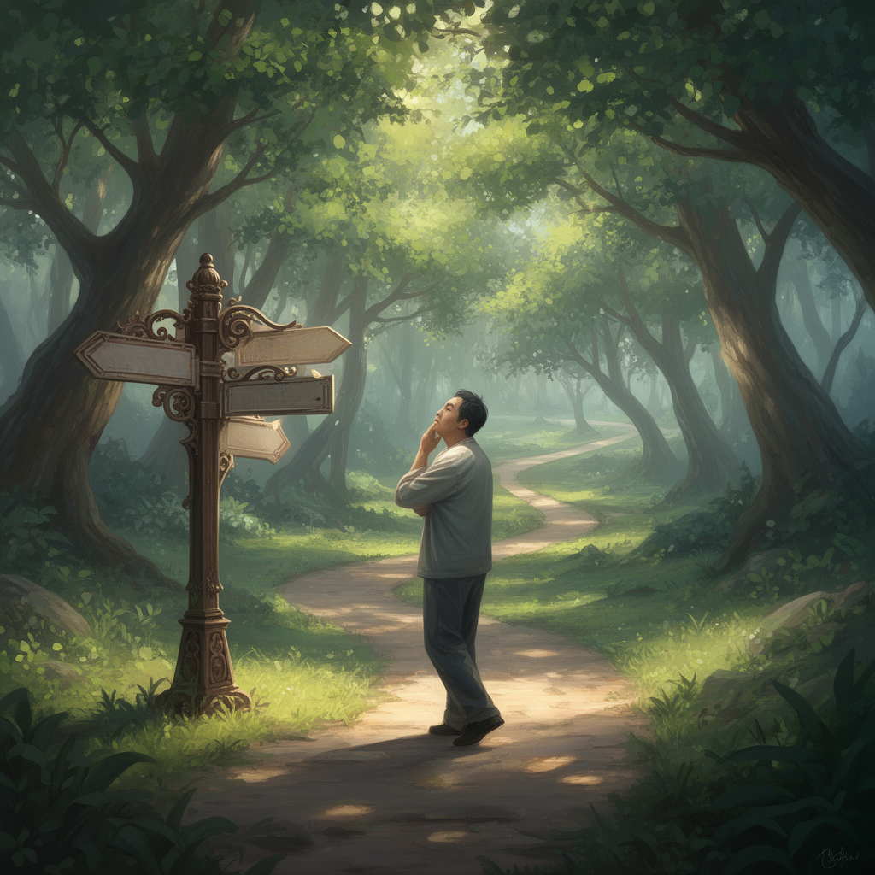
Trust and Follow
One day, Father God spoke to Abraham and told him, “Leave your home and your family, and go to the land I will show you.” Father God didn’t give him a map or a list of directions. He didn’t say what it would look like or how long it would take. All Abraham knew was that Father God was asking him to trust and follow.
Canaan
Harran
Babylon
Ur

Slide 6

That’s Hard
That’s a hard thing to do, isn’t it? But Abraham believed that Father God knew best, and he obeyed. He packed up everything, his wife Sarah, his servants, his animals, and all his things and began a journey into the unknown. Abraham didn’t complain or delay. He just trusted that wherever Father God was leading, it would be good.

Slide 7
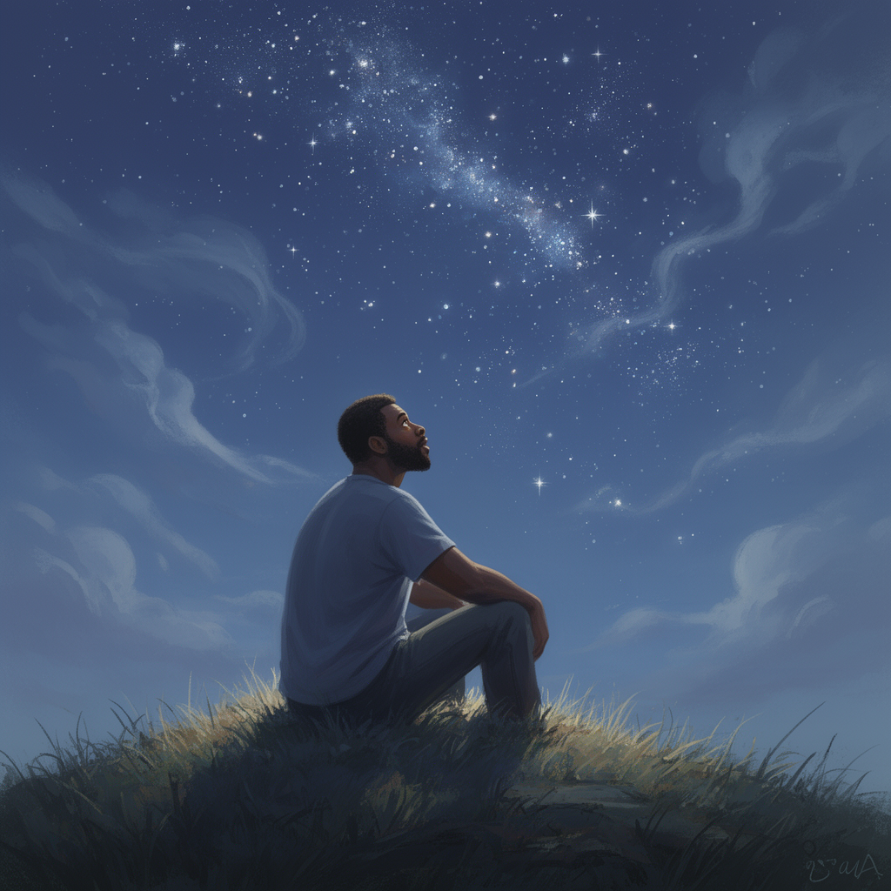

It Was Good
“I wil make you a great nation.”
And it was! Father God took Abraham on a journey that would change the world. He promised to bless Abraham, protect him, and make his family into a great nation.

Slide 8


Slide 9

Faithful Hearts
Sometimes, Father God asks us to do things that are hard or that we don’t understand. Maybe it’s being kind to someone who’s not kind to us, or trusting Him when we’re scared. But if we follow Him with a faithful heart, just like Abraham, we’ll see His promises come true in our lives too.

Slide 10
Let’s Remember:
Obeying Father God may not always be easy, but He will always lead us in the right direction.

Slide 11
Discussion Questions:
1. Why do you think it was hard for Abraham to leave his home?
2. How did Abraham show he trusted Father God?
3. What is something hard Father God might ask you to do that would take faith?

Slide 12
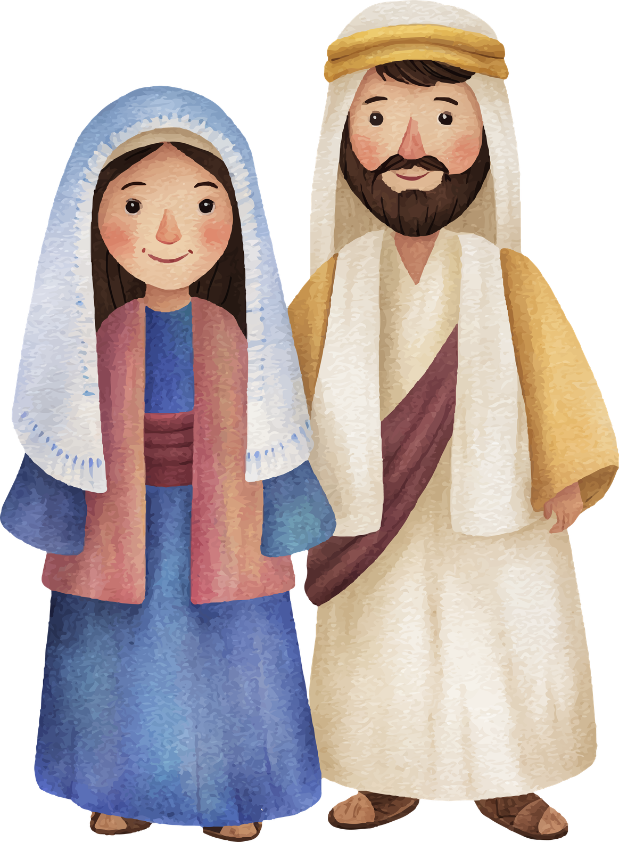
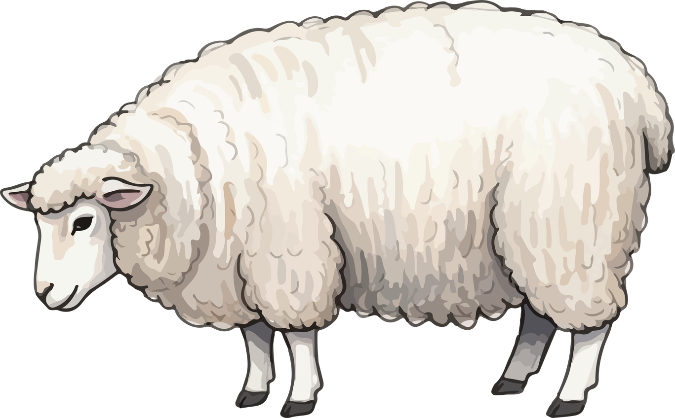


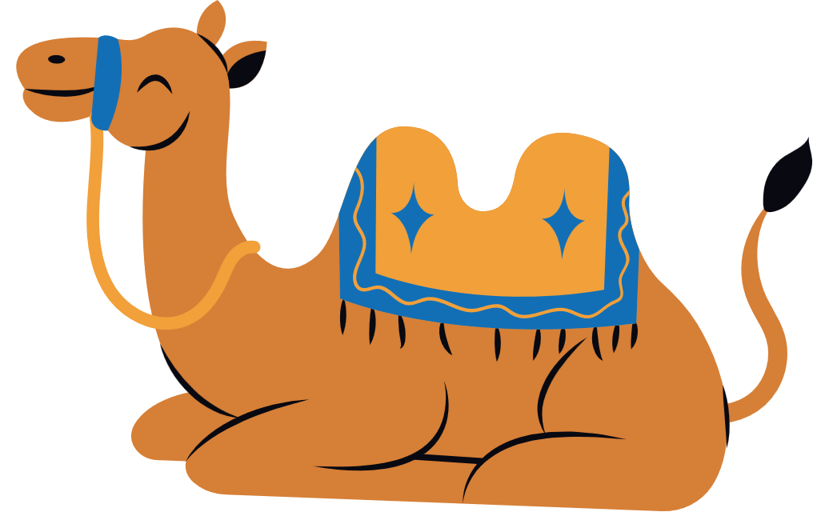

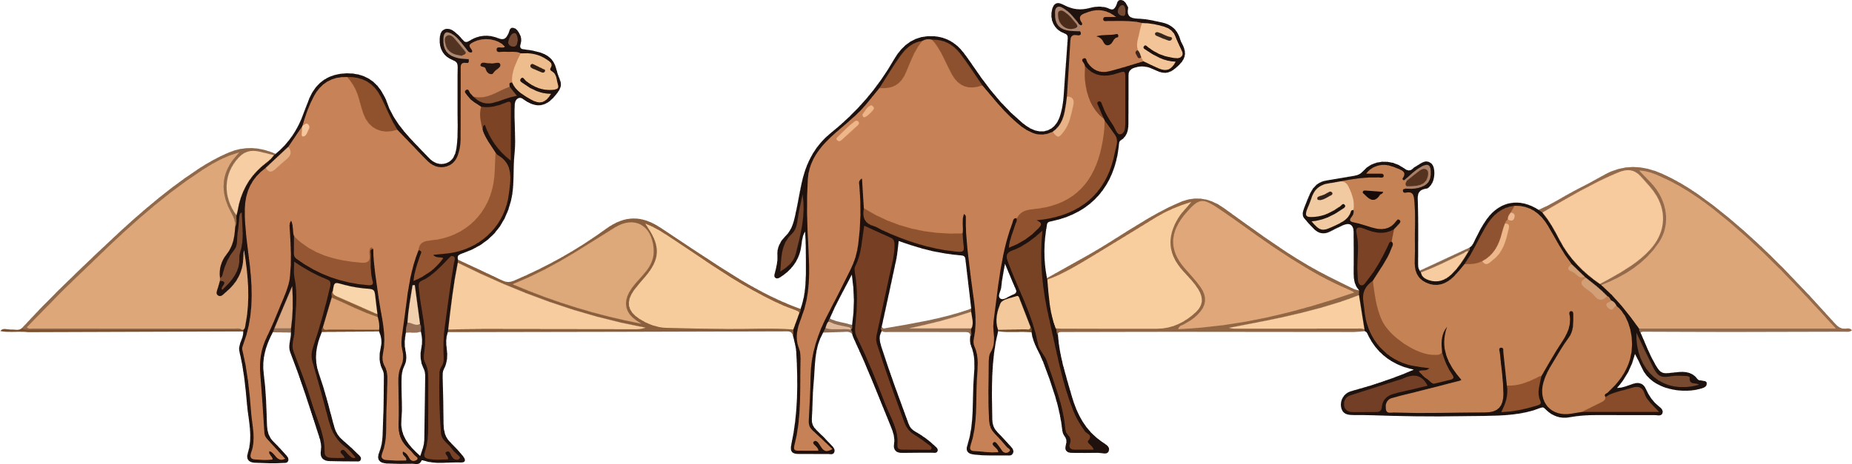

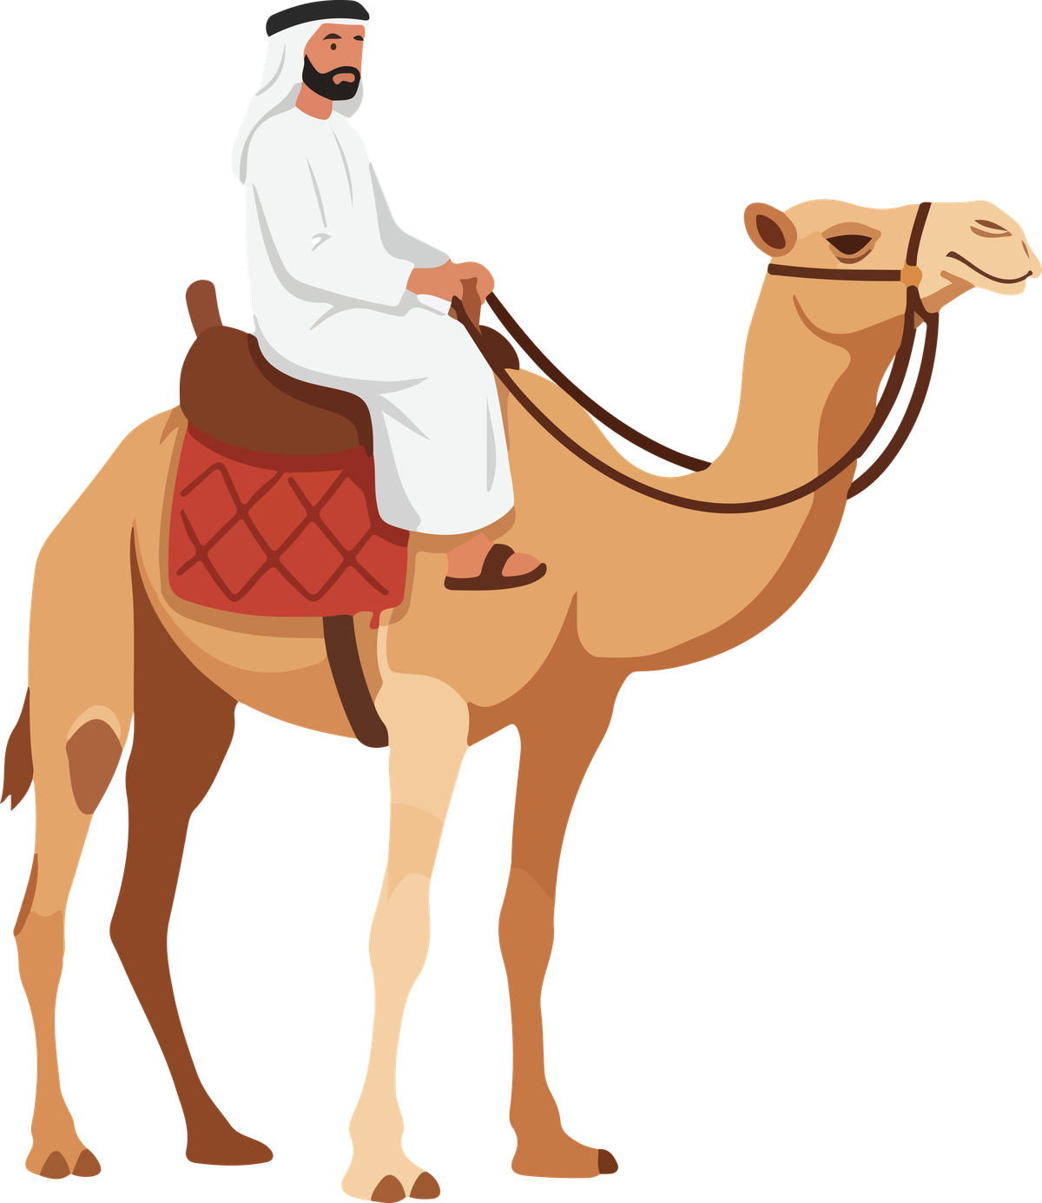
Activity
Abram take your family to a new place.
Help Abram and Sarai move through the maze.
This is home.

Slide 13
Prayer
Dear Father God, I don’t always understand what You are doing, but I want to trust You. Just like Abraham, help me to obey even when I don’t know where the road will lead. Thank You for being a good and faithful Father God who walks with me every step of the way. Amen.

