Slide 1
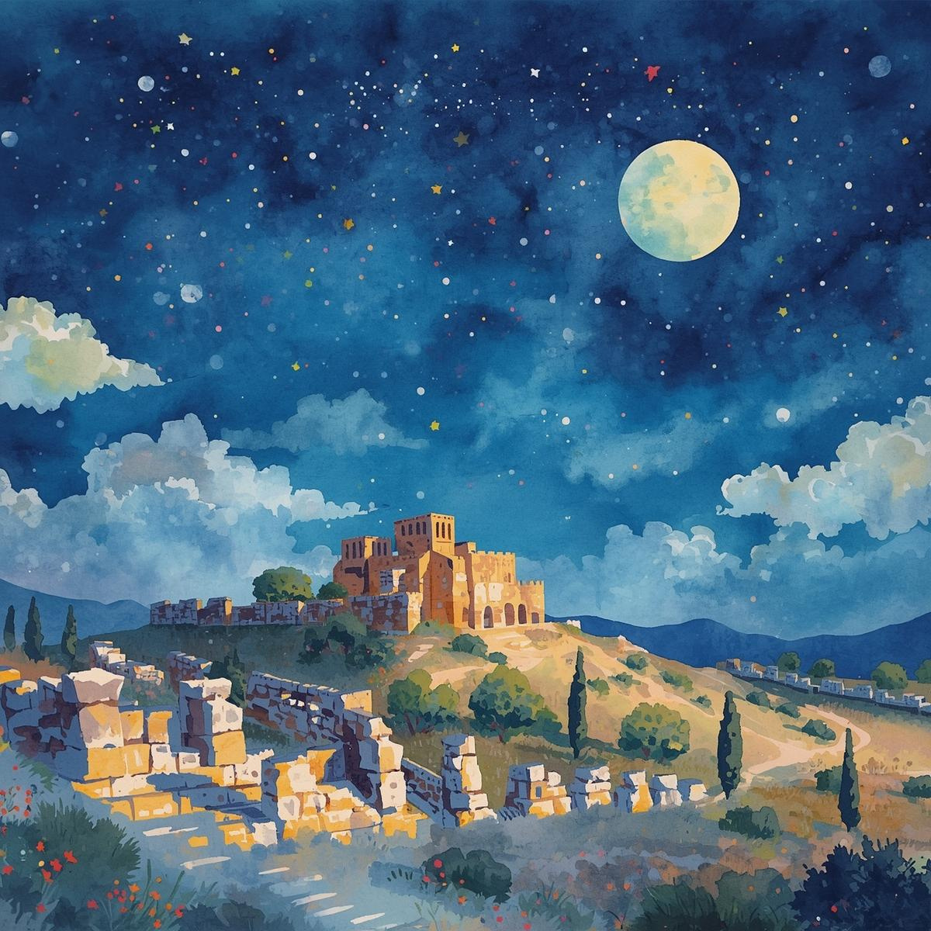


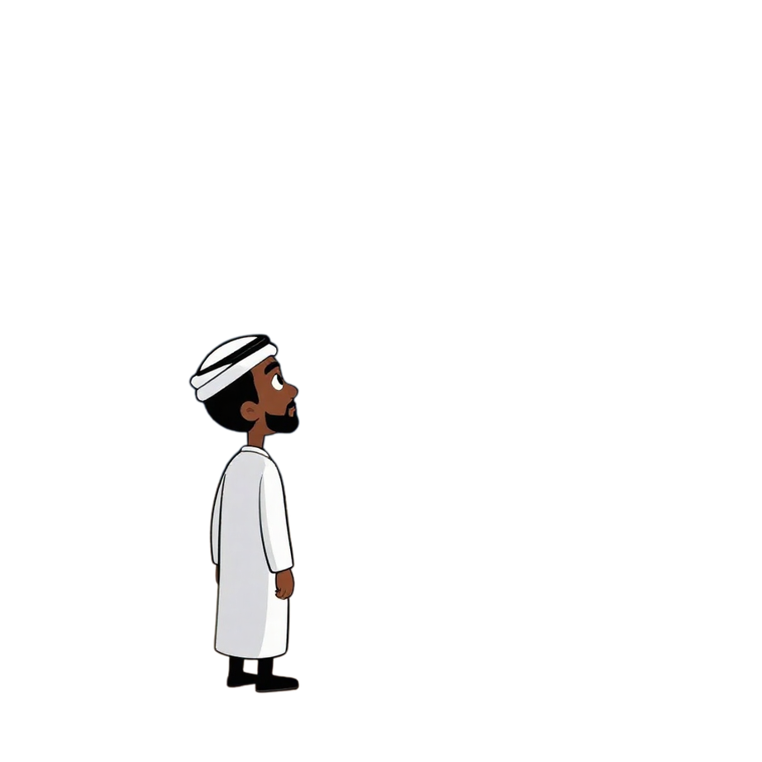
Trusting God When It’s Hard
Stars In The Sky
God’s Promise to Abraham
Unit 2
Week 2

Slide 2
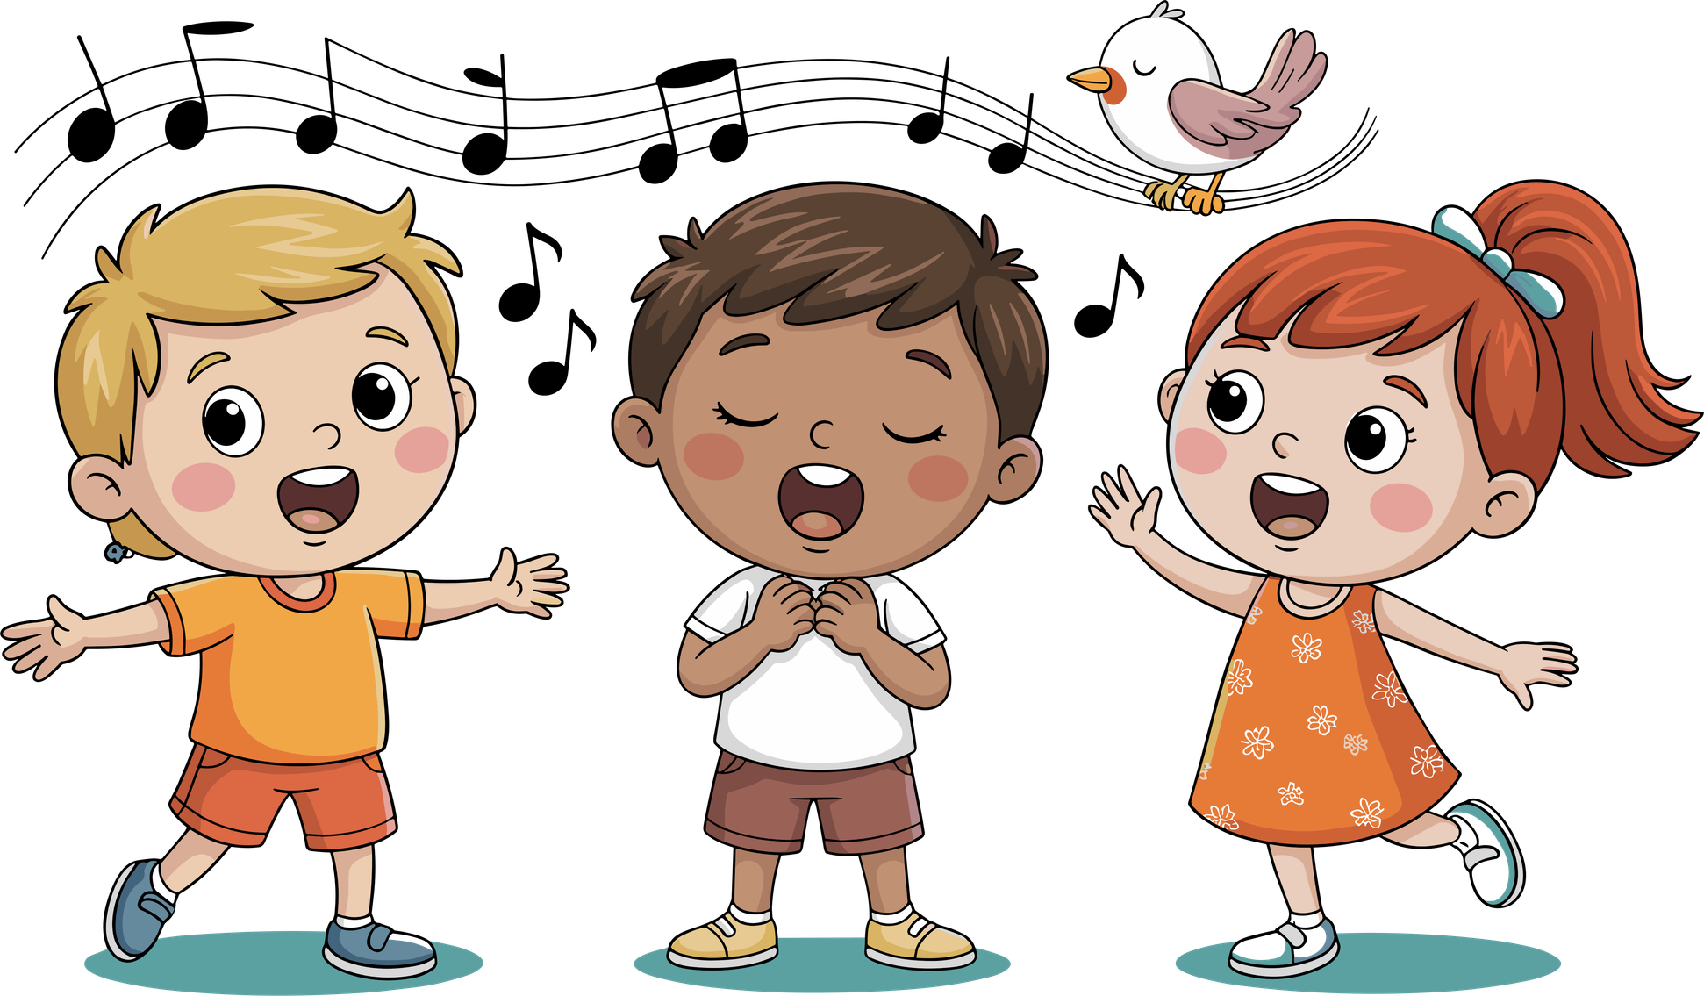
Let’s Worship!!!

Slide 3

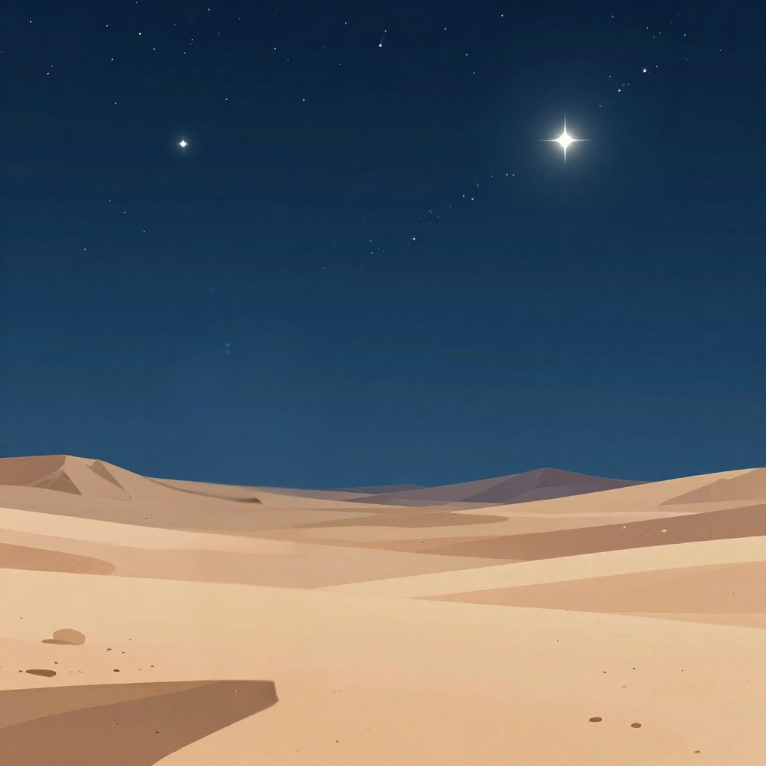

Focus Scripture
“Abraham believed the Lord.” – Genesis 15:6a

Slide 4
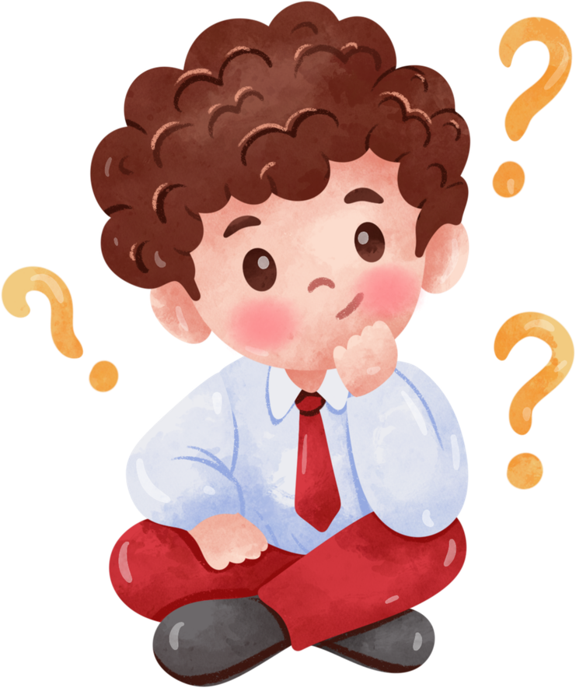
THE STARS
How many stars do you think are in the sky? Do you think you can count them?

Slide 5

Many Stars
It’s impossible to count all the stars in the sky! There are too many, and more appear the longer you look. That’s exactly what Father God told Abraham to do one night.

Slide 6
“Look Up at The Sky”
Father God had brought Abraham to a quiet moment and said, “Look up at the sky and count the stars if you can!” Then He said, “That’s how many children and grandchildren and great-grandchildren you will have.” Father God was promising to give Abraham a huge family that would become a great nation.

Slide 7
Abraham Believed
But there was one big problem Abraham didn’t have even one child. He and his wife Sarah were very old. From a human point of view, it looked impossible. But Abraham believed Father God anyway. He trusted that Father God could do a miracle, even when it didn’t make sense.

Slide 8
Father God Kept His Promise
20 years later God kept His Promise!!! Abraham and Sarah had a baby boy named Isaac, even though Sarah was 90 years old! Isaac grew up, had children, and their children had more children. Abraham's family became the nation of Israel and from that family line came Jesus, the Savior of the world!

Slide 9
Trust Father God
Sometimes God makes us wait for His promises. Sometimes it feels like nothing is happening. But when Father God speaks, we can trust Him. His timing is perfect, and He always keeps His word even if we have to wait longer than we’d like.

Slide 10
Reflection Questions
1. What did Father God show Abraham in the night sky?
2. Why was it hard for Abraham to believe this promise?
3. How can we stay faithful when we are waiting for something?

Slide 11


Slide 12
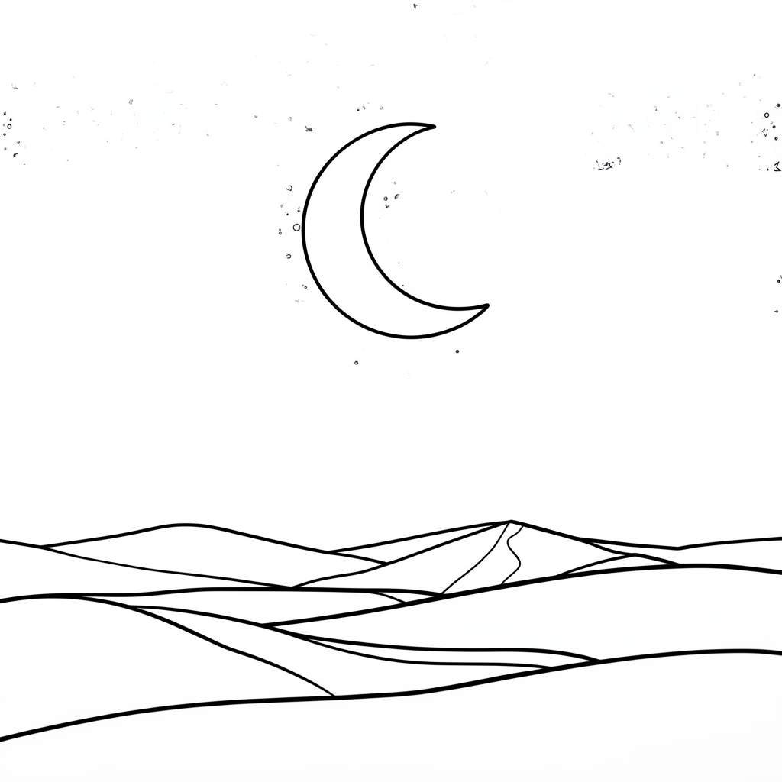
Activity
Draw how many stars you think were in the sky the night Father God spoke to Abraham.

Slide 13
Let’s Remember
When Father God makes a promise, He will always keep it, no matter how long it takes.

Slide 14

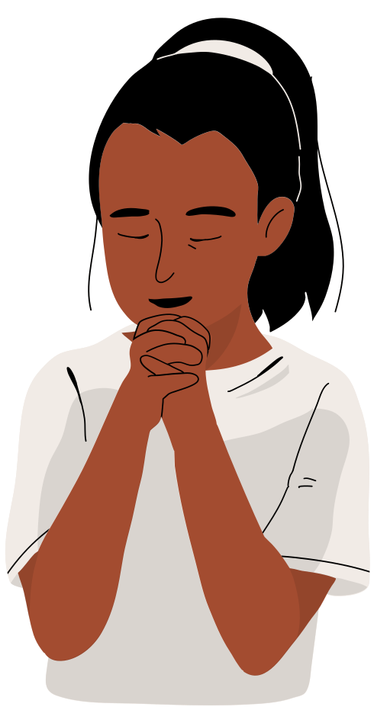
Prayer
Heavenly Father, thank You for being a promise-keeping God. Sometimes I get impatient when I have to wait, but help me to remember that You always do what You say You will do. Thank you for always keeping your word. Amen.

