Slide 1

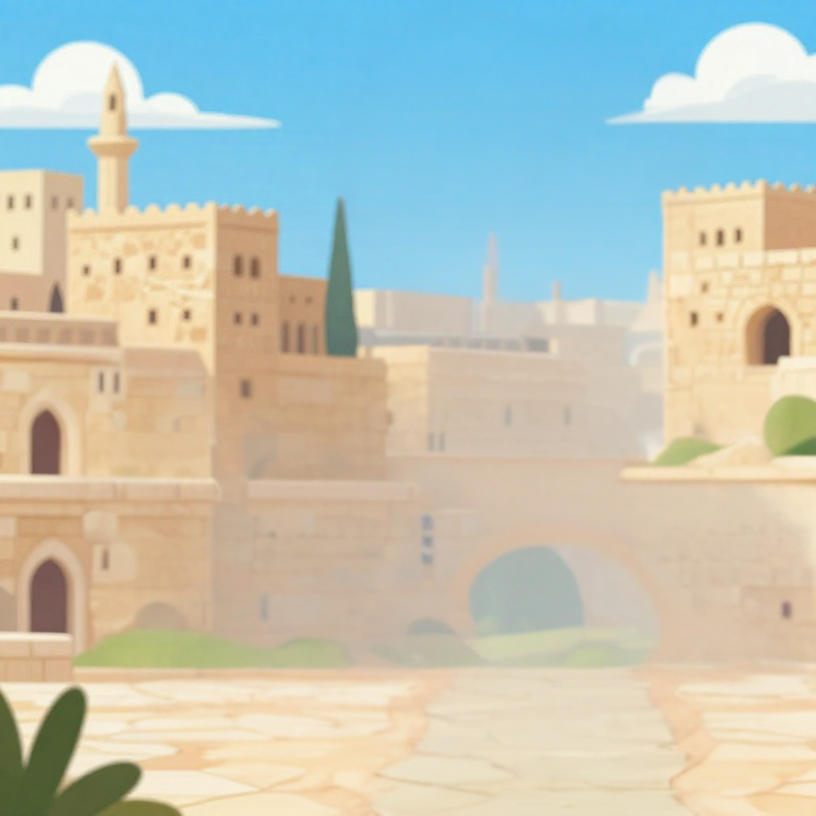
Trusting God When It’s Hard
From Prison To Palace
God’s Plan For Joseph
Unit 2
Week 4

Slide 2

FOCUS SCRIPTURE
Genesis 50:20 NIV
You intended to harm me, but God intended it for good to accomplish what is now being done, the saving of many lives.

Slide 3
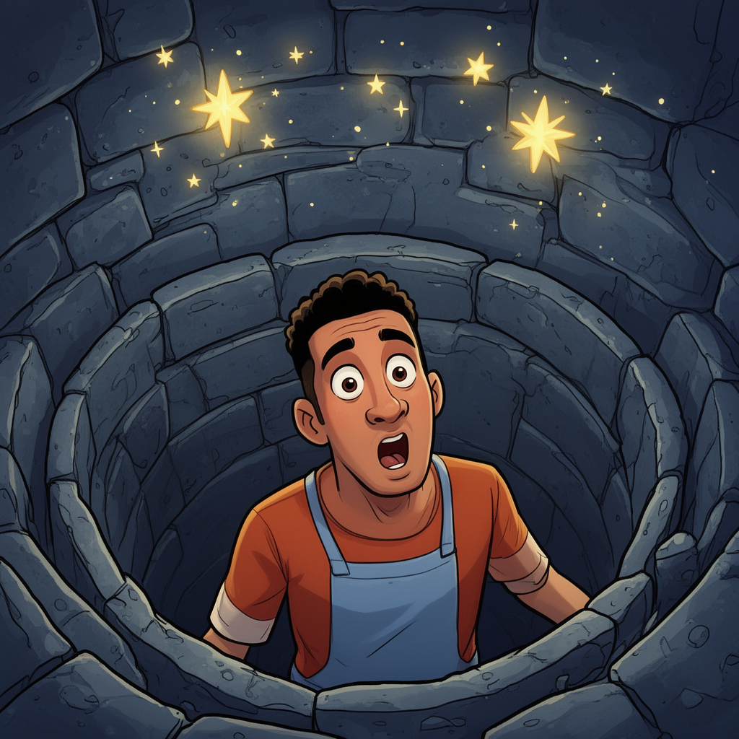
Doing What’s Right
Joseph had been through so much betrayed by his brothers, sold into slavery, and thrown into prison for something he didn’t do. It seemed like everything kept going wrong. But Joseph didn’t give up. He kept doing what was right, even when life was hard. And most of all, he trusted Father God.

Slide 4
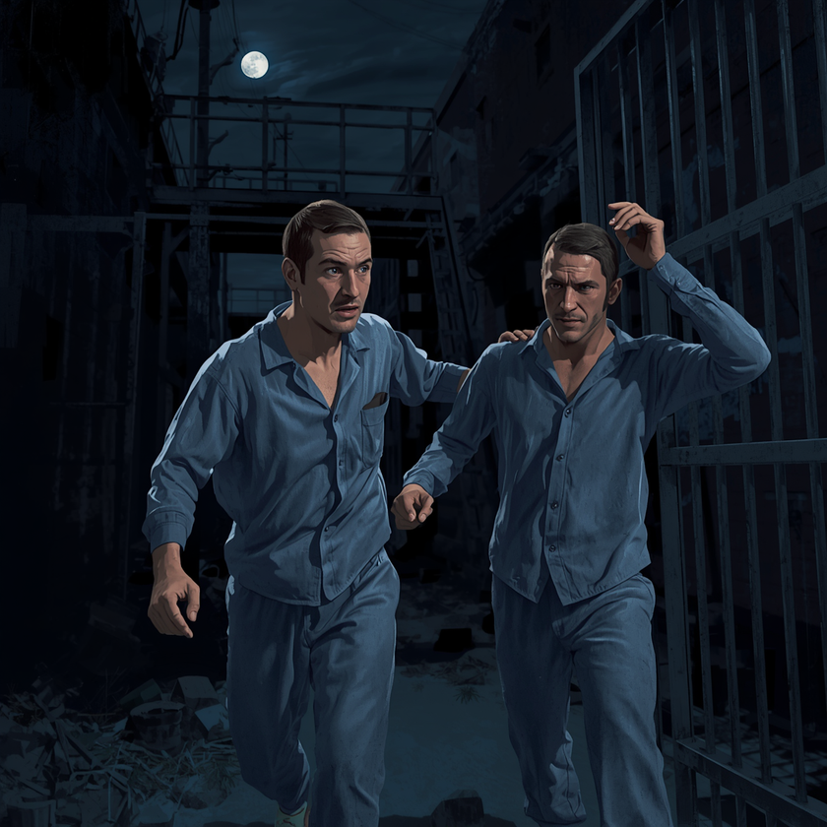
While in prison, Joseph helped other prisoners by explaining their dreams. One of them promised to tell Pharaoh about Joseph but he forgot for two whole years! Then one day, Pharaoh had a strange dream that no one could understand. Finally, the man remembered Joseph.

Slide 5
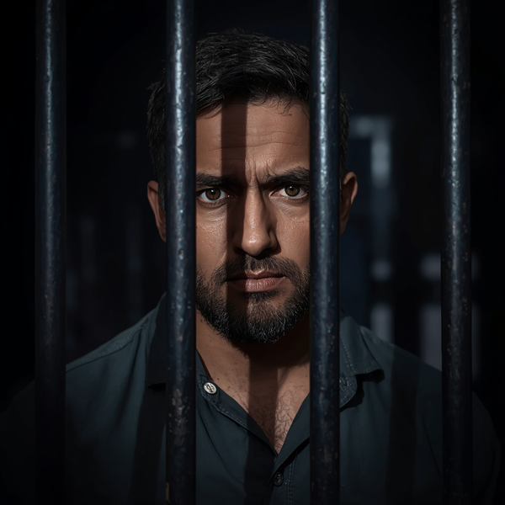
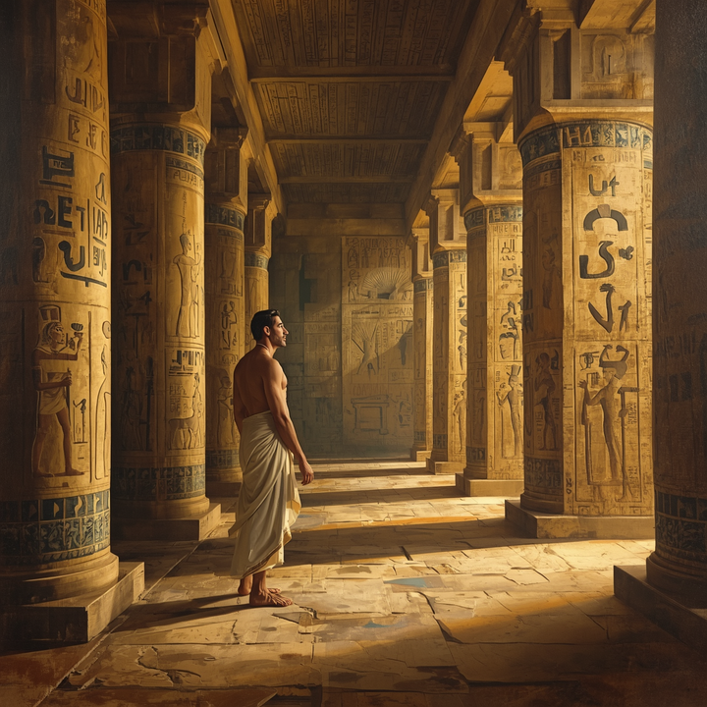
Joseph was brought out of prison and asked to explain the dream. He said the dream meant that a great famine was coming and that Egypt needed to save food. Pharaoh saw that Joseph was wise, so he made him the second most powerful man in Egypt. Just like that, Joseph went from prison to to palace!

Slide 6
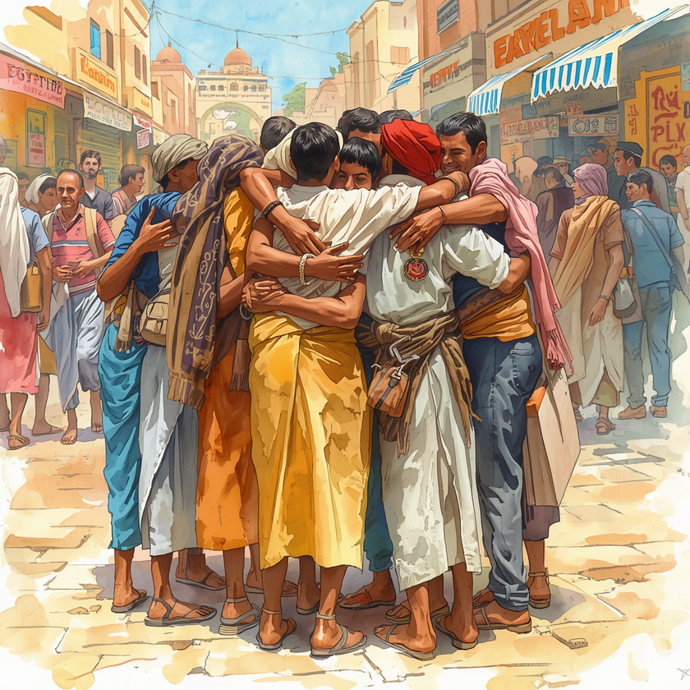
Behind The Scenes
Later, when the famine hit, Joseph’s brothers came to Egypt looking for food. They didn’t recognize him, but Joseph forgave them and helped them. He told them something powerful: “You planned to harm me, but Father God planned it for good.” Father God is always working behind the scenes.

Slide 7
Let’s Remember
Father God can turn our hardest moments into part of His greatest plan.

Slide 8

Video

Slide 9
Discussion Questions
How did Joseph end up in prison, and how did he respond?
What did Pharoh’s dream mean, and how did Joseph help?
How did Joseph show forgiveness to his brothers?

Slide 10
Activity:
Draw a line from the number to the correct picture.
Joseph in the palace.
Joseph gets a colorful coat.
Joseph was thrown into a well.
Joseph reunites with his brothers.
Joseph gets put in jail.
Joseph helpped the prisoners.

Slide 11
PRAYER
Dear Father God, thank you for turning hard times into something good. Help me to trust Your plan, even when I don’t see it yet. Like Joseph, help me to stay faithful and choose forgiveness. You are always working in my life, and I thank You for that. Amen

