Slide 1

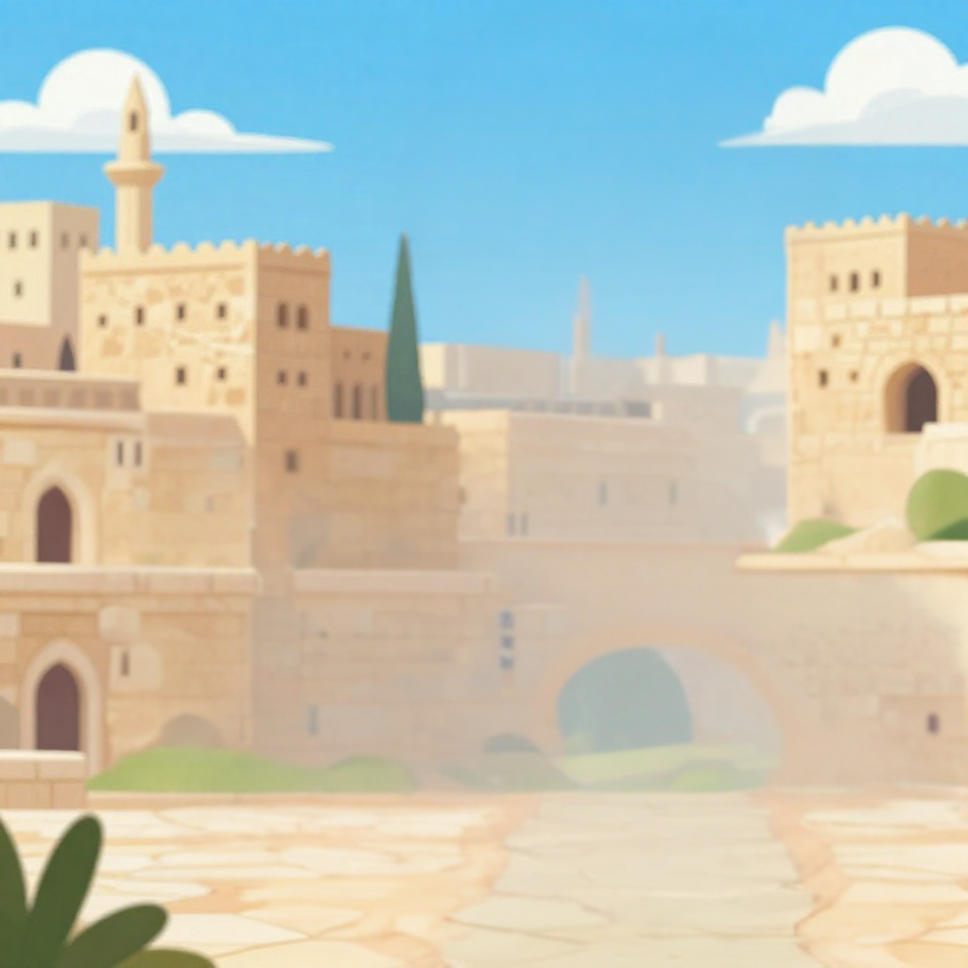
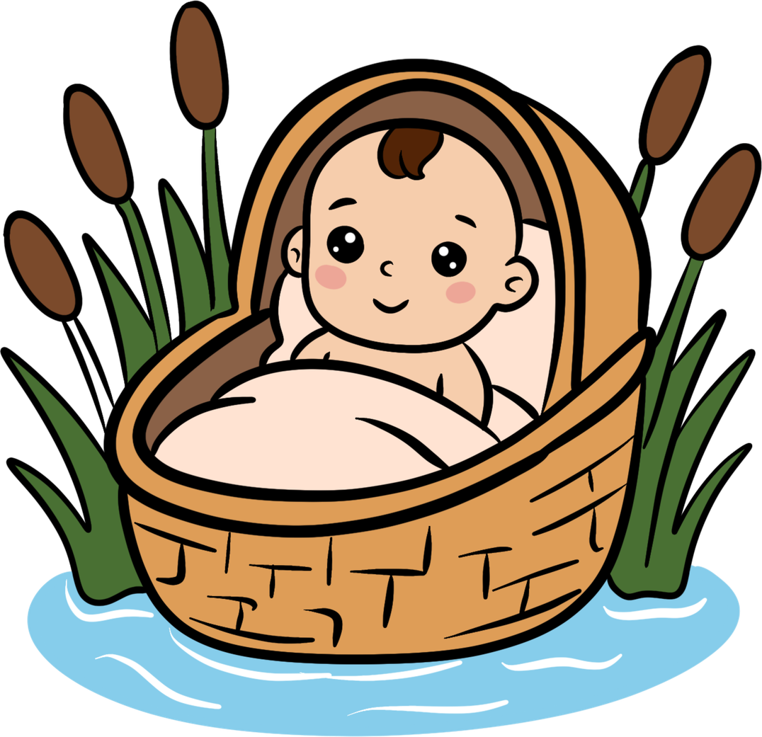
Trusting God When It’s Hard
A Baby in a Basket
God Protects Moses
Unit 2
Week 5

Slide 2
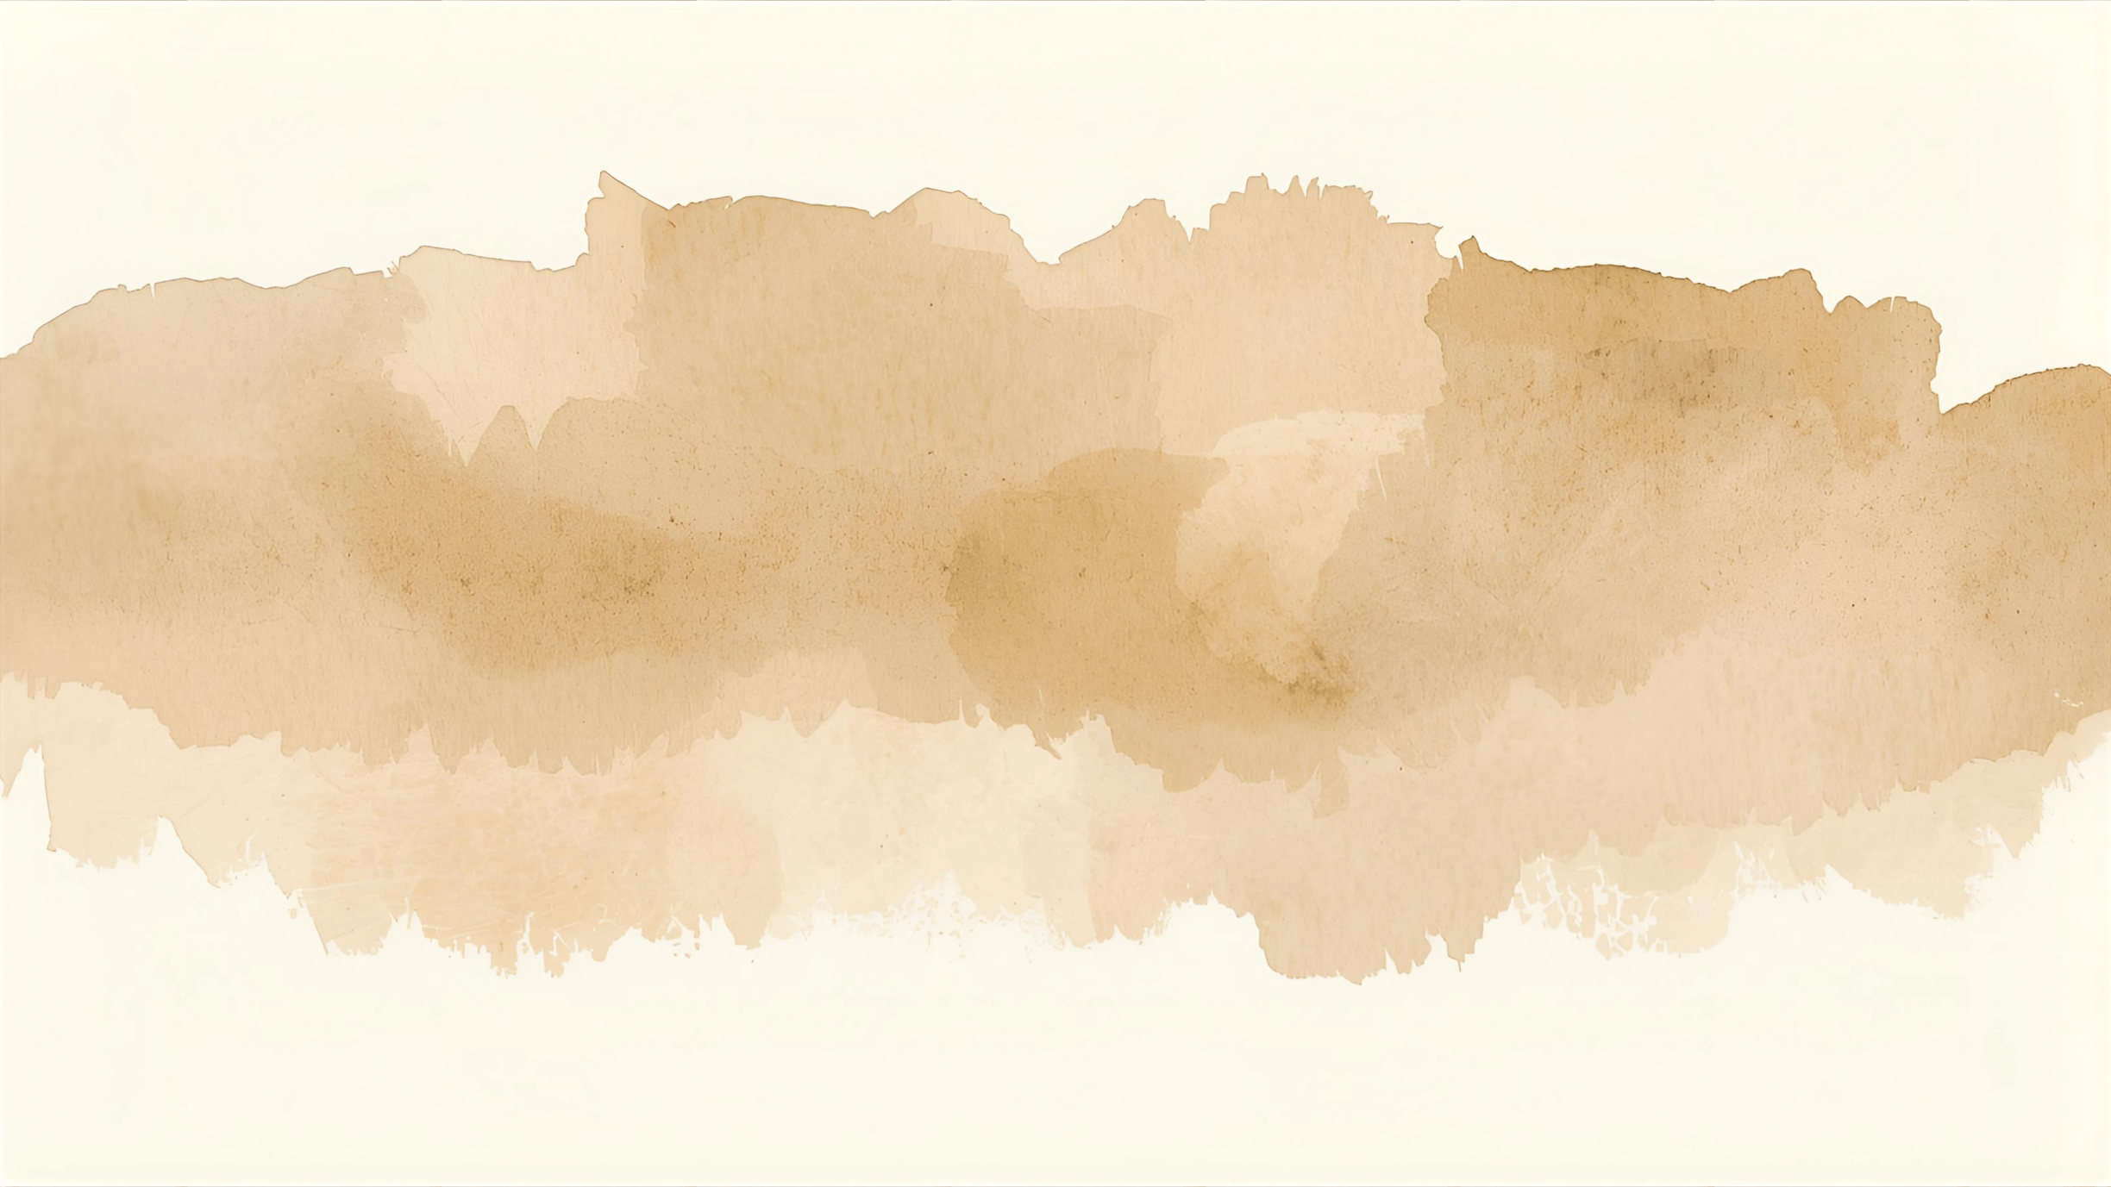
FOCUS SCRIPTURE
Proverbs 3:26 NIV
for the Lord will be at your side
and will keep your foot from being snared.

Slide 3
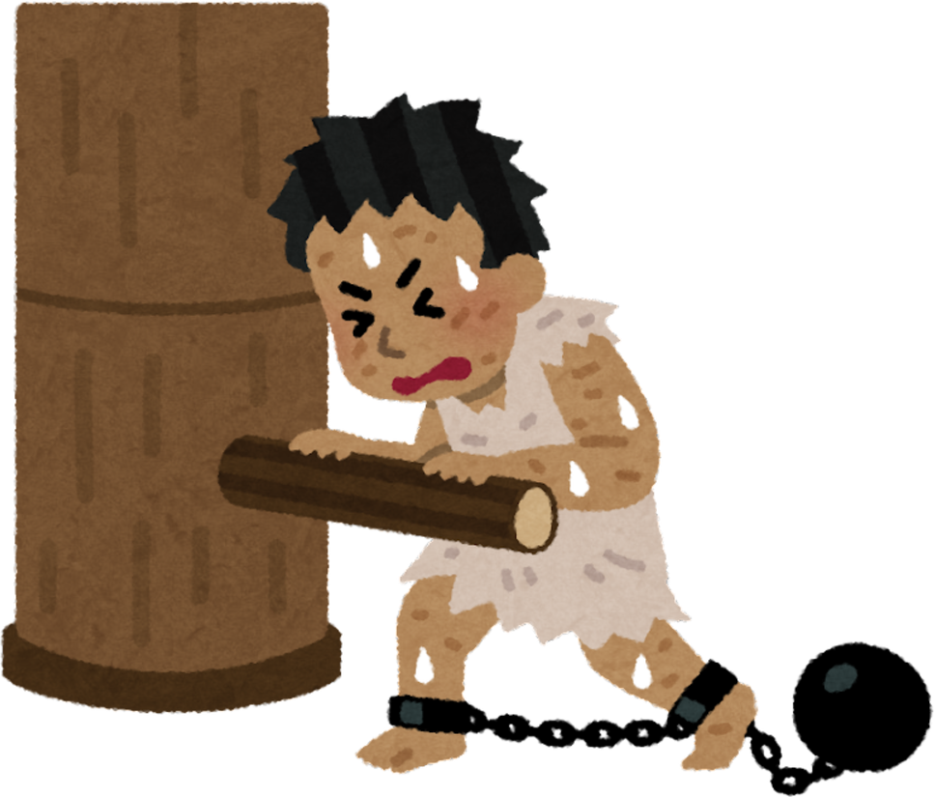
A long time after Joseph died, a new king ruled Egypt. He didn’t know about Joseph and didn’t like the Israelites, who had grown into a large group of people. This king was afraid they would become too powerful, so he made them slaves and treated them cruelly.

Slide 4
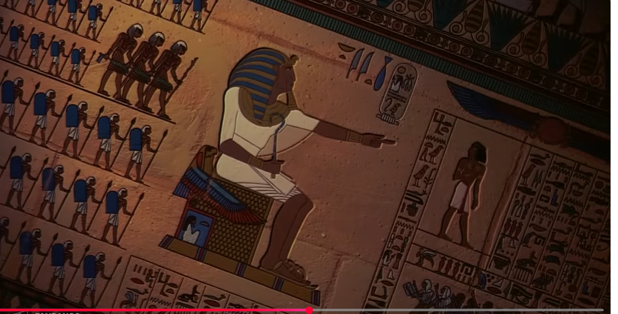
But things got even worse. The king made a terrible law: all baby boys born to the Israelites had to be killed. It was a very sad and scary time. But even in the darkest days, Father God was still watching over His people.

Slide 5
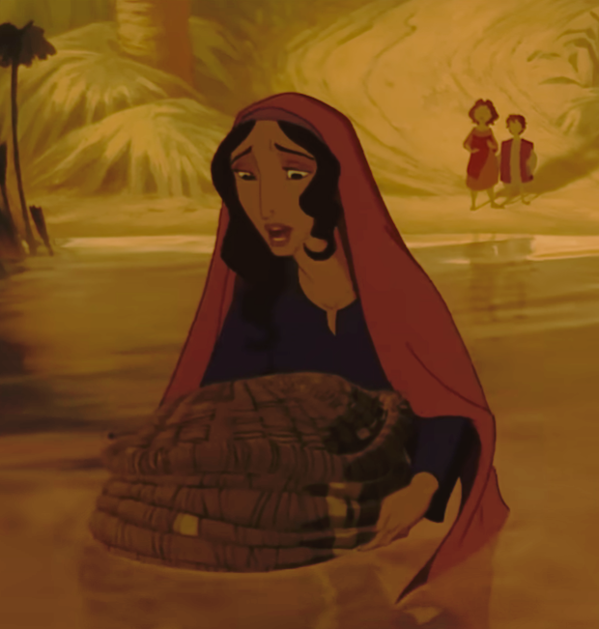
During that time, a baby named Moses was born. His mother loved him so much she hid him for as long as she could. When it became too dangerous, she made a little basket out of reeds, put Moses inside, and placed it in the river.

Slide 6
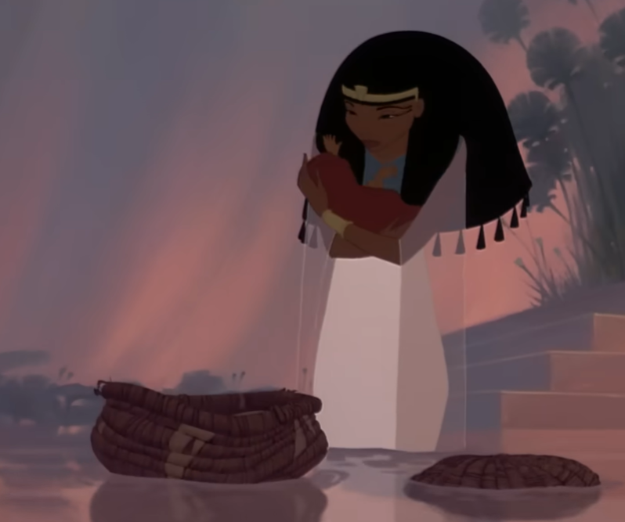
Can you imagine being that baby, floating in a basket? But Father God had a plan. He guided the basket right to the place where Pharaoh’s daughter was bathing. She saw the baby and felt compassion. She decided to raise Moses as her own son right in the palace of the king who wanted him dead!

Slide 7
Moses grew up safe and strong becasue Father God protected him. And later, Father God would use Moses to do amazing things like leading the Israelites out of slavery.

Slide 8
This story teaches us that even when things seem dangerous or confusing, Father God is our protector. He sees us, loves us, and has a special purpose for each of our lives.

Slide 9

LET’S REMEMBER
Father God is watching over us, even when we don’t understand what’s happening.

Slide 10
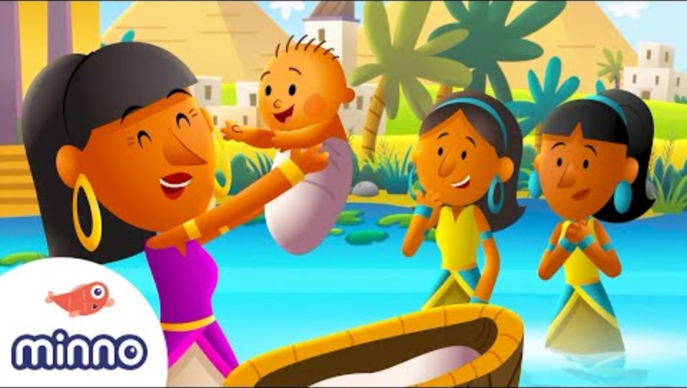

Slide 11
Discussion Questions
Why was it dangerous for baby boys to be born in Egypt during this time?
What did Moses’ mom do to keep him safe?
How did Father God protect and provide for Moses?

Slide 12
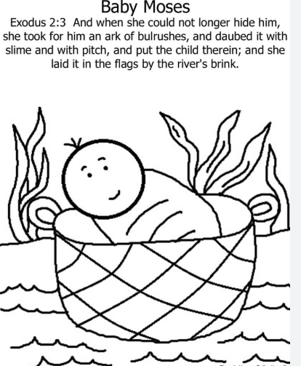

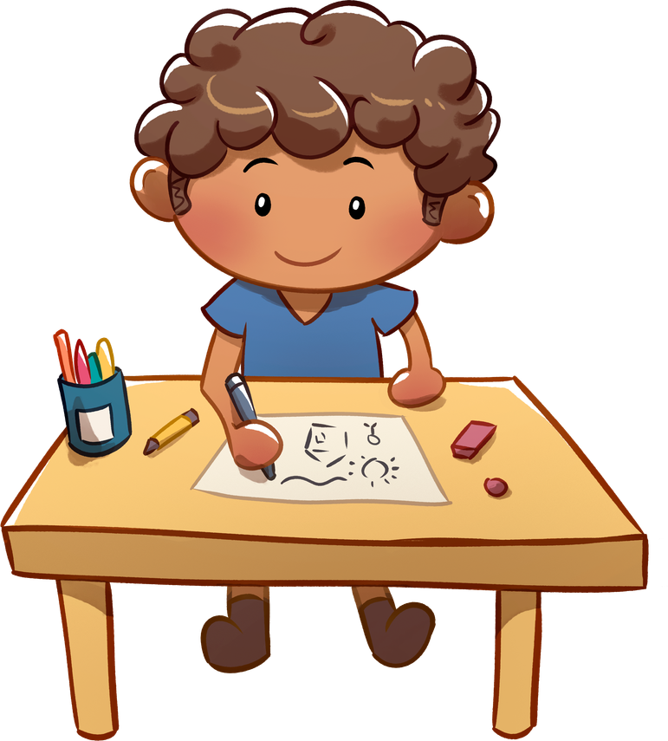
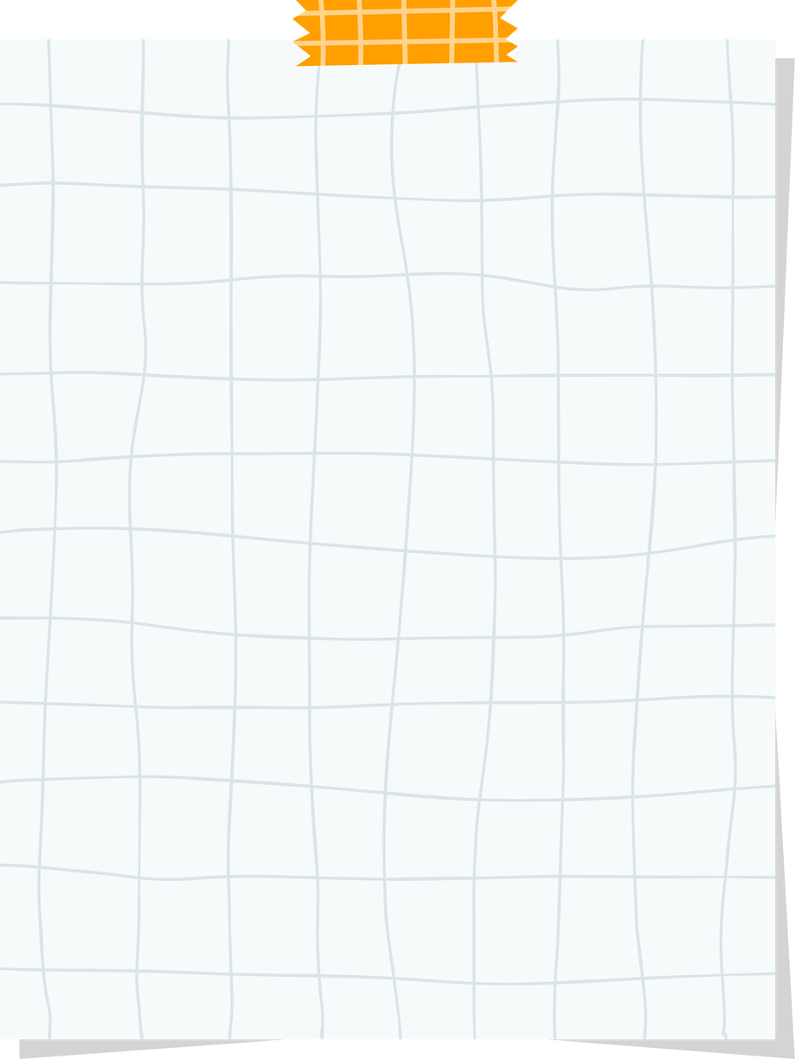
Activity - Draw baby Moses in a basket

Slide 13
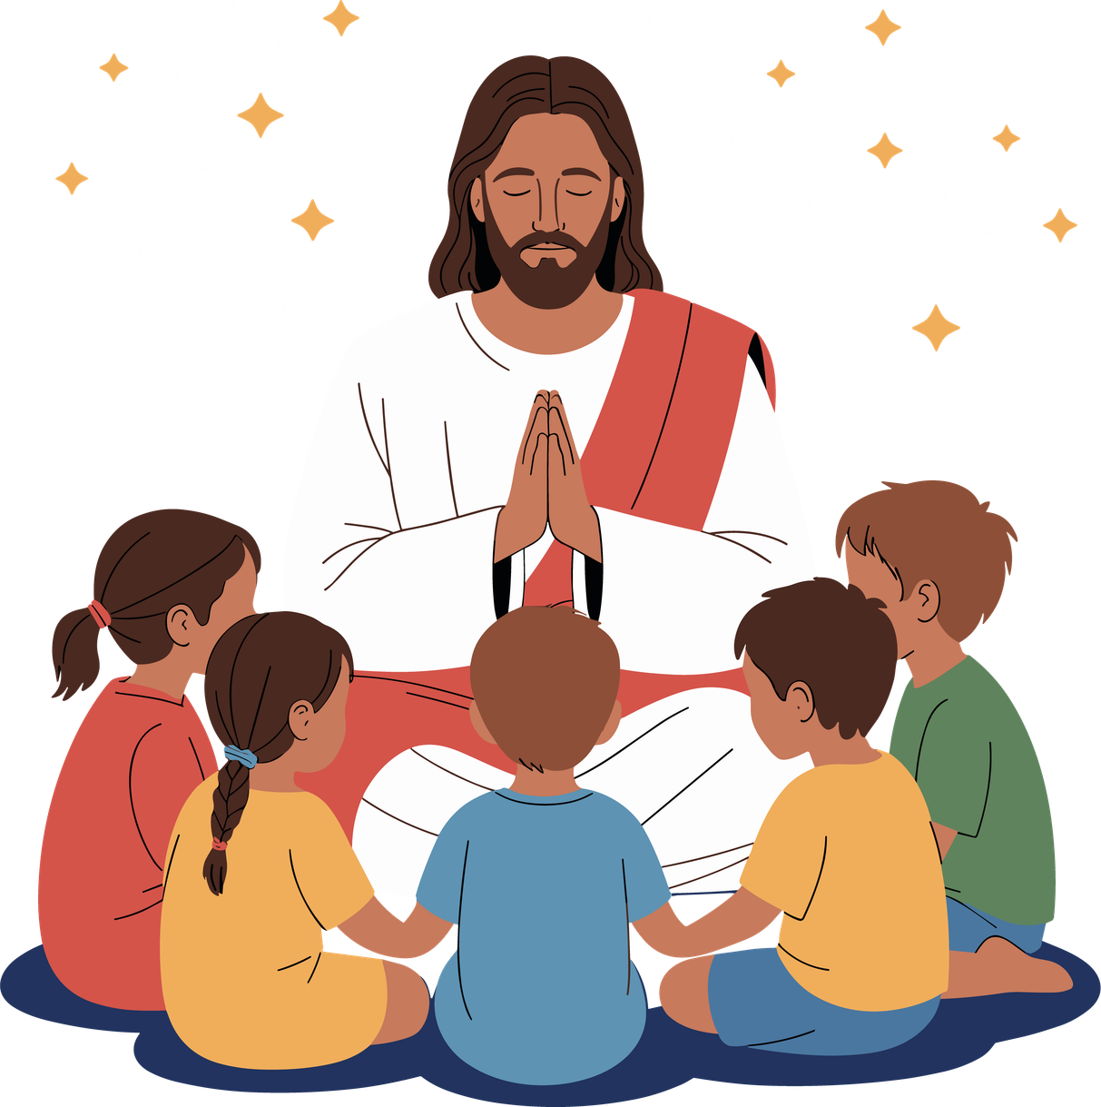
PRAYER
Dear Father God, thank You for watching over me just like You watched over Moses. Even when things around me are scary or sad, I know You are always close. Help me to trust that You have a good plan for my life and that You are always protecting me.
Amen.

