Slide 1

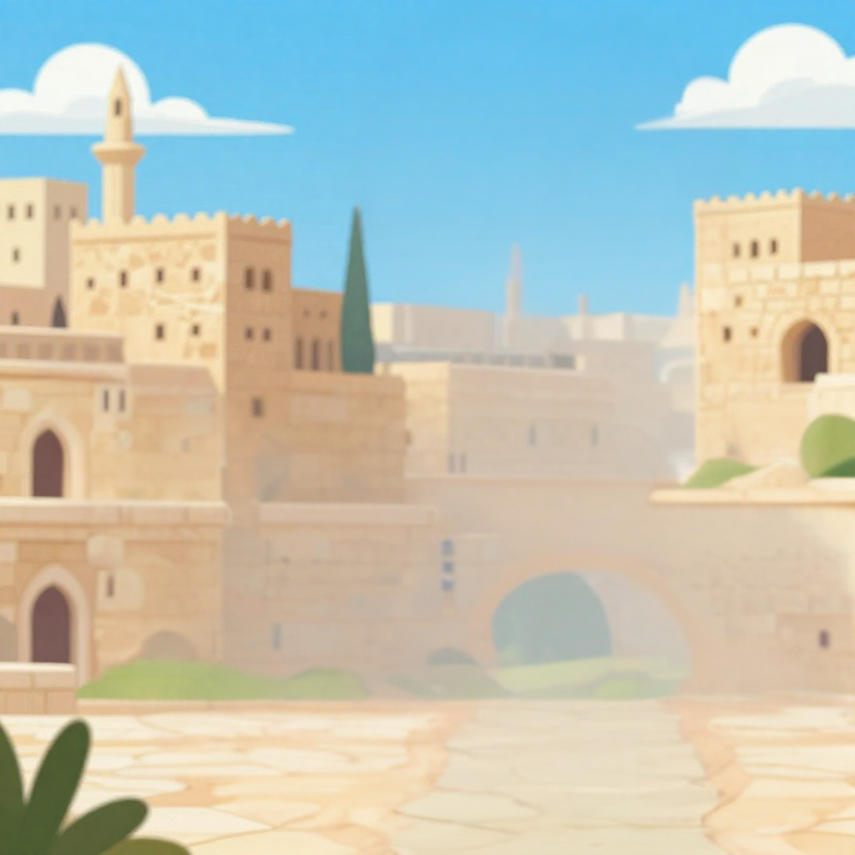
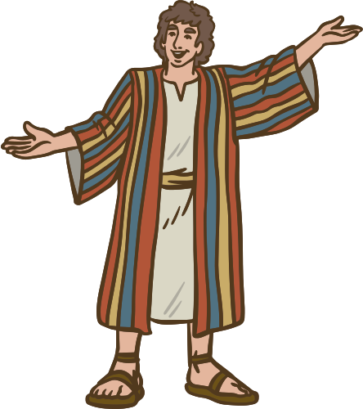
Trusting God When It’s Hard
The Coat of Many Colors
Joseph’s Ups and Downs
Unit 2
Week 3

Slide 2
Focus Scripture
Romans 8:28 NIV
And we know that in all things God works for the good.

Slide 3

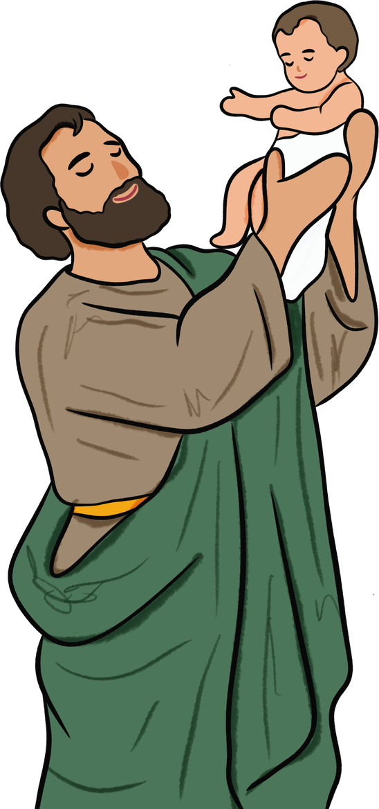
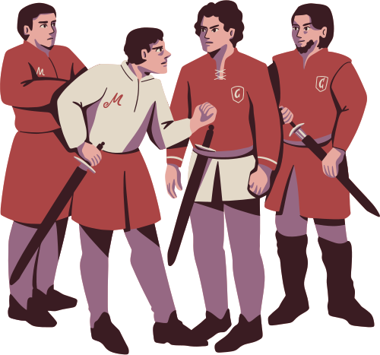
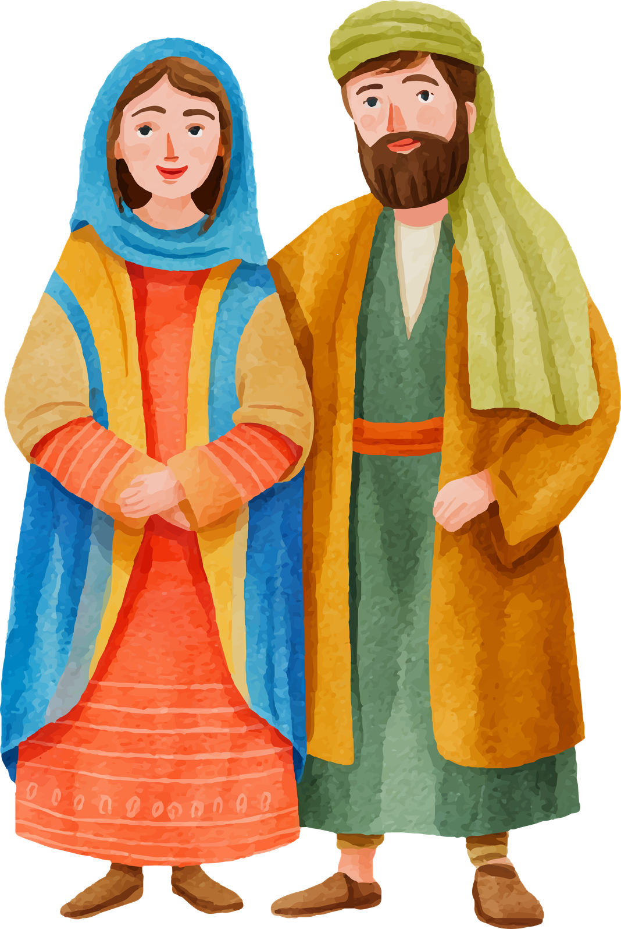
My favorite son!
The Gift and Jealousy
Jacob had twelve sons and his favorite was Joseph. Jacob gave Joseph a colorful coat. The gift made Joseph’s brothers jealous. Joseph also had dreams that one day his family would bow down to him.
Who does he think he is?
Thank you father!

Slide 4
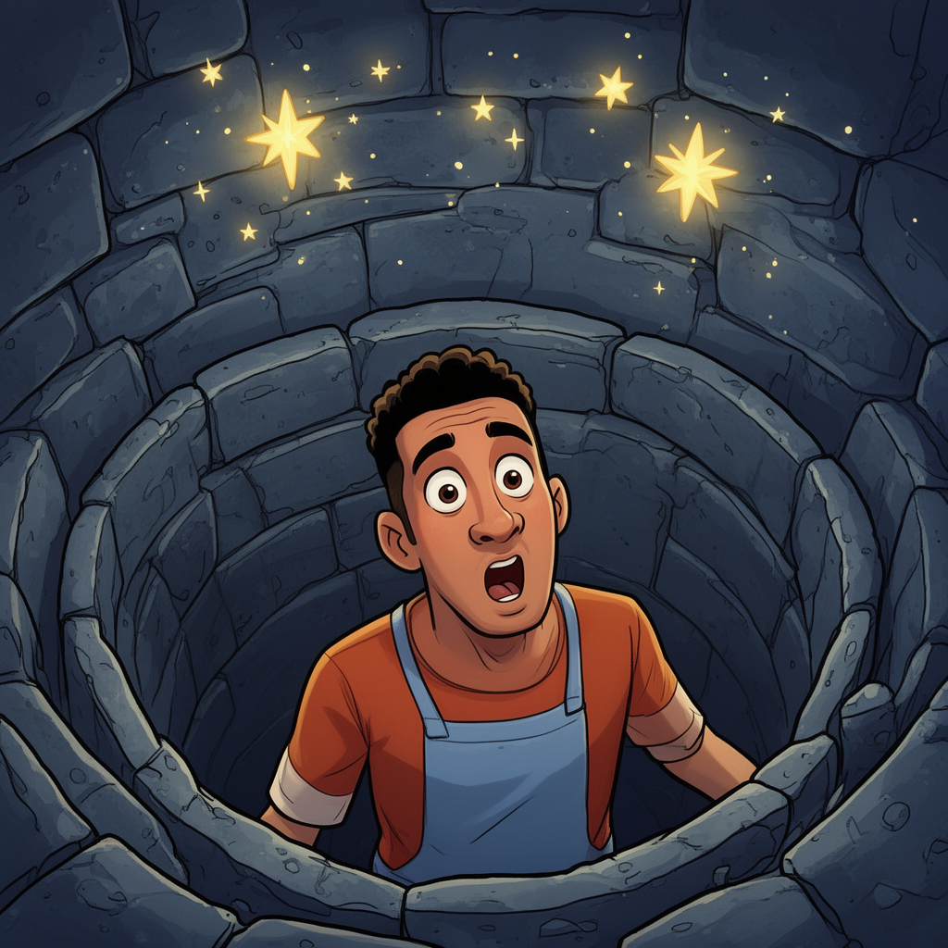
To Egypt
One day Joseph’s brothers had enough. So they thought to kill him, but Reuben thought to save him by putting him in a well until it was safe to take him back to their father. However, Joseph other brothers sold him to travelers that were going to Egypt instead.

Slide 5

How do you think Joseph felt? He was innocent and was taken far from home.

Slide 6
Father God is With Joseph
Jospeh was even thrown into prison for something he did not do. Yet he did not complain and Father God did not forget about him. God helped Joseph to understand dreams. Eventually Pharaoh, the king of Egpyt, asked Joseph to help him during the time of famine. becoming the second most powerful man in Egypt.

Slide 7
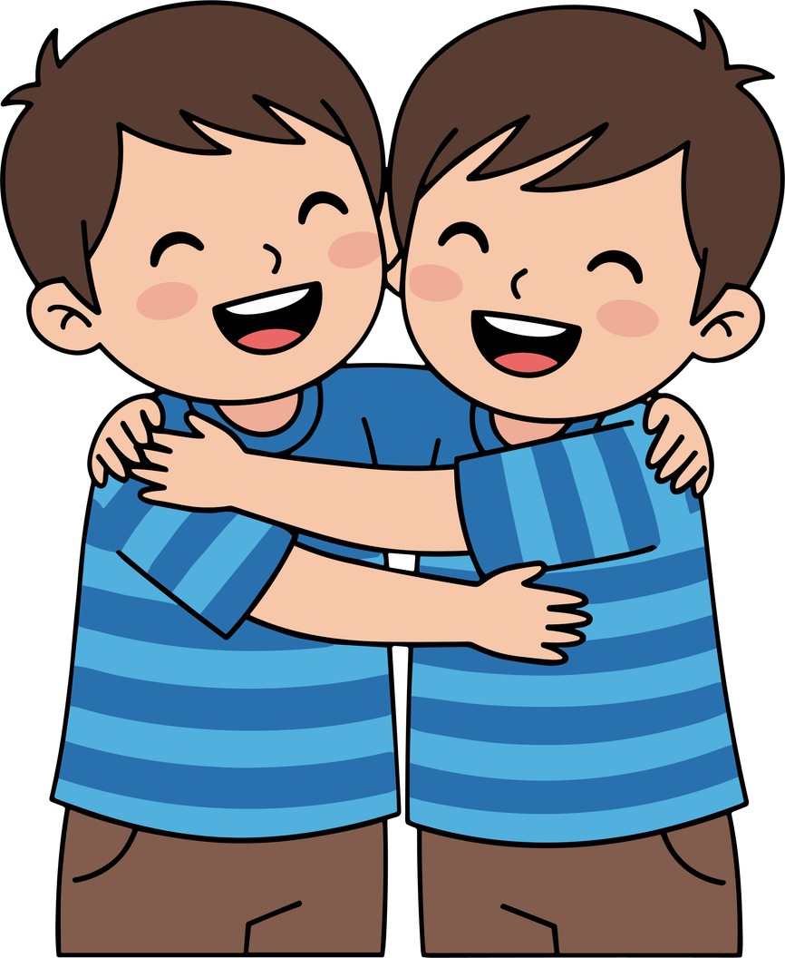
For the Good
Years later, Joseph’s brother came to Egypt for food. They did not notice Joseph, but he had forgiven them. He told his brothers, “You meant to hurt me, but Father God used it for good.” This story teaches us that even when life feels unfair, Father God is still working. He turns our pain into purpose and our problems into blessings when we trust Him.

Slide 8

Let’s Remember
Even when life is hard, God is still writing a beautiful story.

Slide 9
Discussion Questions
1. What made Joseph’s brothers jealous?
2. What bad things happened to Joseph, and how did he respond?
3. How can we trust God when life feels unfair or confusing?

Slide 10
Activity
On a piece of paper write or draw someone that you need to forgive.

Slide 11

Video

Slide 12
Prayer
Father God, thank You for the story of Joseph. His life had many ups and downs, but he never gave up on You. Help me to trust You when things don’t go my way. Use my hard times to shape me and help others. Thank You for your good plans for me, Amen.

