Slide 1







Courage to Stand For What’s Right
Being Bold in Faith
Unit 2
Week 1

Slide 2
Focus Scripture
Joshua 1:9 NIV
Have I not commanded you? Be strong and courageous. Do not be afraid; do not be discouraged, for the Lord your God will be with you wherever you go.”

Slide 3

DOING WHAT’S RIGHT
Sometimes it can be tough to stand up for what’s right, especially when we feel alone. It could look like going against a crowd, losing friends or even facing criticism.

Slide 4
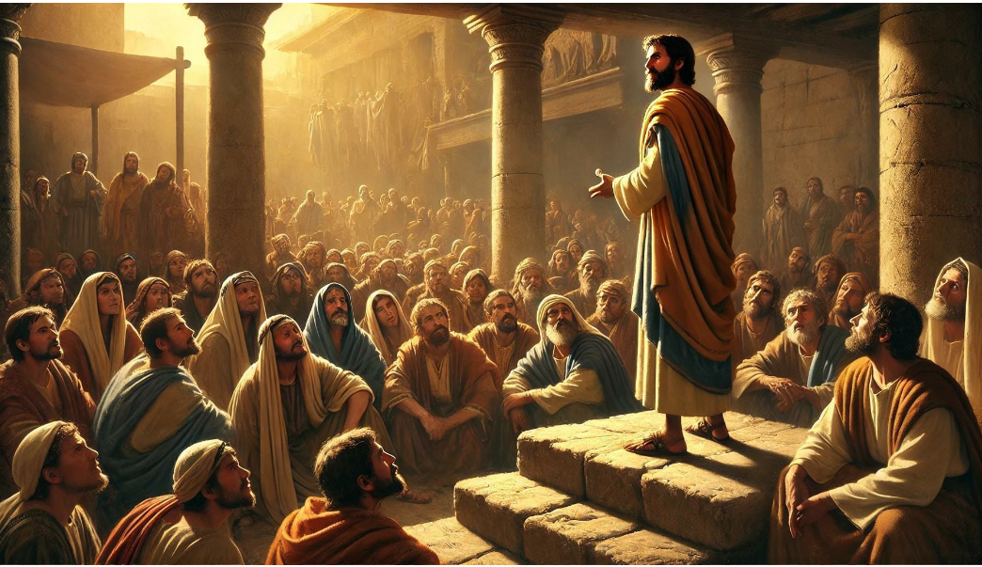
Being Bold in Faith

Slide 5
Stand Firm
Joshua 1:9 states that we are to not be afraid or discouraged because God is with us where ever we go. That means even in the toughest situations God is with us to help us do what is right. He gives us strength and wisdom to stand firm.

Slide 6
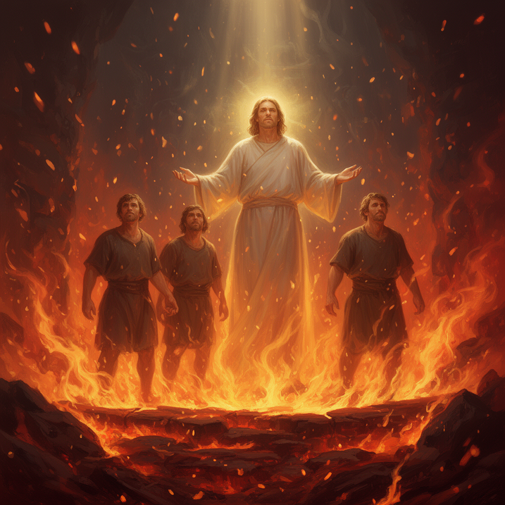
COURAGE THROUGH THE BIBLE
  Daniel in the lions den.
  Meshach, Shadrach, and Abednego.
Can you think of other stories in the Bible of someone who showed great courage in their faith?

Slide 7
GOD IS WITH US
Their stories are reminders that doing the right thing can be challenging and maybe even difficult, but God will always be with us.

Slide 8
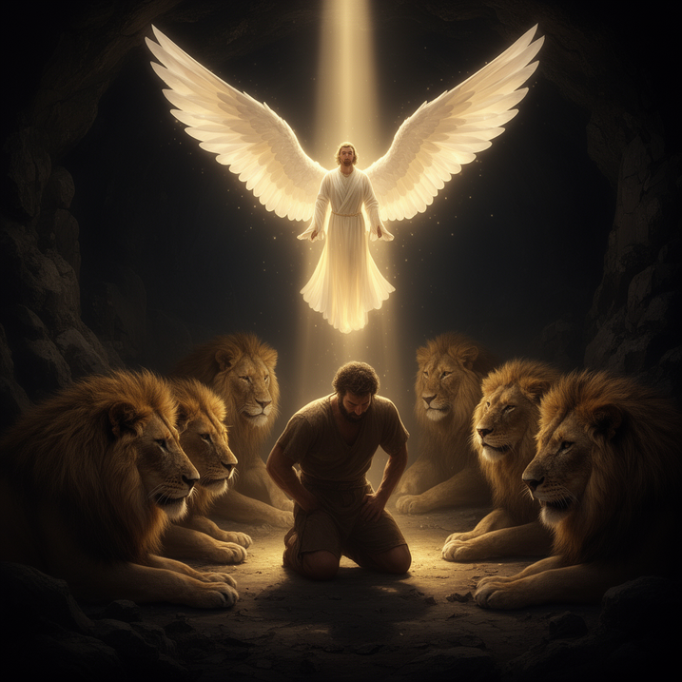


1
2
3
Courage = doing what’s right, even if its hard.
God promises to be with us when we stand up for truth.
Faith grows stronger when we rely on God’s strength.

Slide 9
FAITH IN A STORM

Slide 10
LIFE APPLICATIONS
There will be times in life when we have to make tough choices. Maybe your friends want to gossip, cheat, or pressure you to do something wrong. It might feel easier to just go along with them, but true courage means standing firm in what God says is right. The more we trust in God’s strength, the bolder we become in our faith.

Slide 11
HOW TO BE COURAGEOUS IN YOUR FAITH
  Pray for strength when hard choices are present.
  Surround yourself with friends who encourage you to do right.
  Remember God is always with you.
  Always speak the truth with kindness.

Slide 12
REFLECTIVE QUESTIONS
1. ​Have you ever been in a situation where it was hard to do the right thing? What did you do?
​2. ​How does knowing that God is with you help you be courageous?
​3. ​What is one way you can stand up for what’s right this week?

Slide 13
WRITE IT DOWN
WRITE DOWN YOUR ONE WAY HOW YOU WILL STAND UP FOR WHAT’S RIGHT THIS WEEK?

Slide 14
PRAYER
Dear God,
Help me to have the courage to stand for what is right, even when it’s difficult. Remind me that You are always with me and that I don’t have to be afraid. Give me strength to follow Your truth in all situations. Amen.

