Slide 1







Growing in Christlike Character
Discovering God’s Purpose for your Life
Unit 2
Week 2

Slide 2
Focus Scripture
Jeremiah 29:11 NIV
For I know the plans I have for you,” declares the Lord, “plans to prosper you and not to harm you, plans to give you hope and a future.

Slide 3

GOD HAS A PLAN FOR YOUR LIFE
Many people wonder, “What is my purpose in life?” As a teenager, you may be thinking about your future, your dreams, and what path you should take. The good news is that God has a purpose for you, and His plans are always good.

Slide 4

Jeremiah 29:11 tells us that God knows the plans He has for us—plans to give us hope and a future. This means that even when we feel unsure about what’s next, God is already guiding us. Sometimes, we may struggle to understand our purpose, but God reveals it step by step. He calls us to trust Him, follow His Word, and use our gifts to bring Him glory.

Slide 5
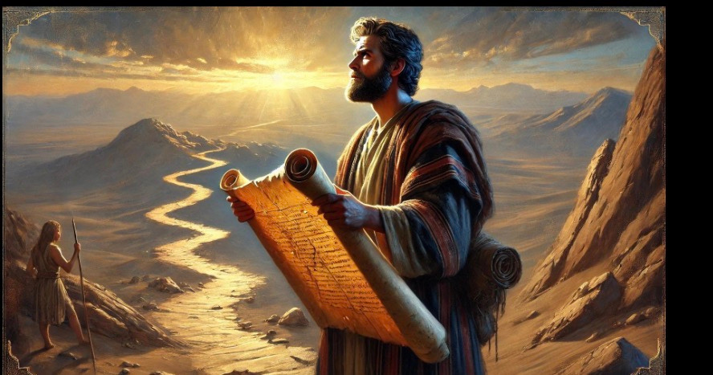
Sometimes, we may struggle to understand our purpose, but God reveals it step by step. He calls us to trust Him, follow His Word, and use our gifts to bring Him glory. Your purpose isn’t just about what career you choose—it’s about living a life that honors God, helps others, and fulfills His plan for you.

Slide 6

KEY LESSONS
  ​God has a unique purpose for each of us. ​
  ​We don’t need to know everything about the future—God is guiding us. ​
  Our purpose is found in loving and serving God and others.

Slide 7
LIFE APPLICATIONS
Finding your purpose doesn’t happen overnight. It takes prayer, patience, and trust in God. Here’s how you can discover God’s purpose for your life:
✅ Pray and ask God to guide your steps.
✅ Read His Word to understand what He desires for you.
✅ Use your talents and gifts to serve others.
✅ Trust that God’s timing is perfect, even when you don’t have all the answers. God’s purpose for your life is not just about the future—it’s about how you live for Him today.

Slide 8


God’s purpose for your life is not just about the future—it’s about how you live for Him today.

Slide 9
REFLECTIVE QUESTIONS
1. ​What talents or passions do you have that you could use to serve God?
​2. ​How does Jeremiah 29:11 encourage you when thinking about your future?
​3. ​What is one step you can take today to follow God’s purpose for your life?

Slide 10
PRAYER
Dear God,
Thank You for having a special purpose for my life. Help me to trust You, even when I don’t understand the future. Show me how to use my gifts to glorify You and help others. Amen.

