Slide 1







Growing in Christlike Character
Serving Others with a Willing Heart
Unit 2
Week 3

Slide 2
Focus Scripture
Galatians 5:13 NIV
You, my brothers and sisters, were called to be free. But do not use your freedom to indulge the flesh; rather, serve one another humbly in love.

Slide 3

THE HEART OF A SERVANT
Serving others is a powerful way to show God’s love. In Galatians 5:13, the Bible reminds us that we are called to be free, but we should use that freedom to serve others in love.

Slide 4
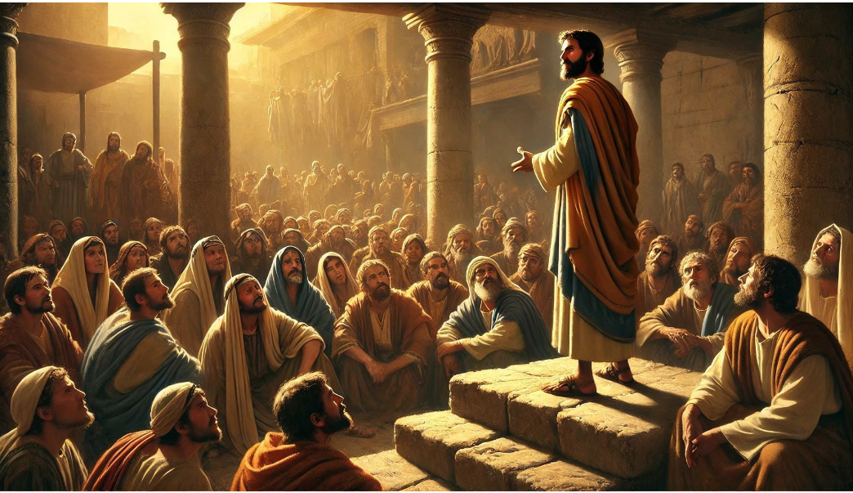
Jesus Our Greatest Example!

Slide 5
Servants Heart
Jesus came not to be served, but to serve. He washed the feet of His disciples, fed the hungry, healed the sick, and showed compassion to those in need.

Slide 6
IT CAN BE SIMPLE
Serving others doesn’t have to be big or complicated. It can be as simple as helping a friend, showing kindness, or offering encouragement. When we serve with a willing heart, we reflect Jesus to the world.

Slide 7
What Bible stories can you think of about someone who had a servants heart?

Slide 8
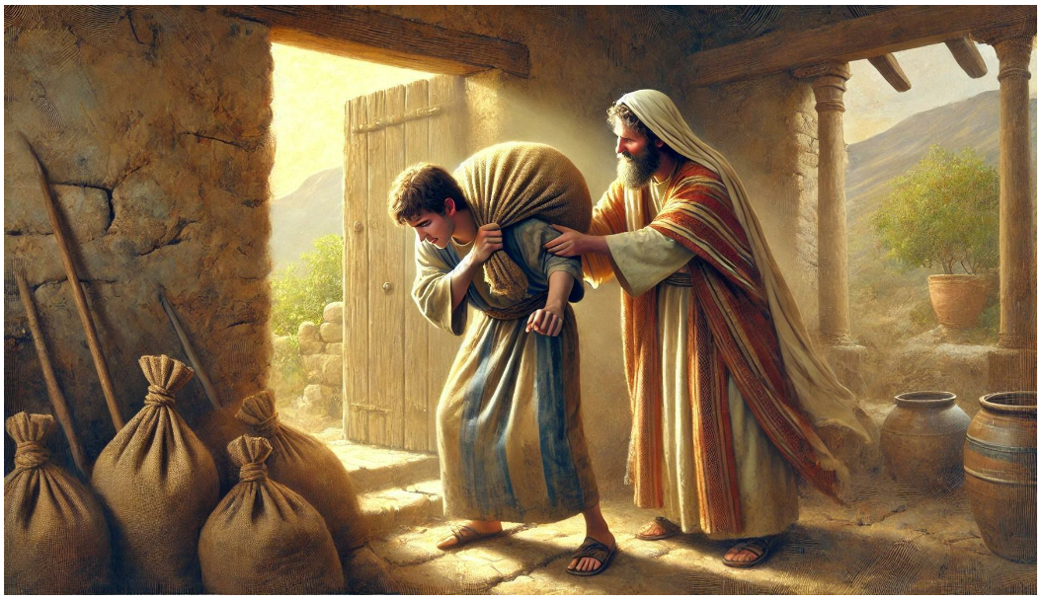
SERVANTS HEART

Slide 9
LIFE APPLICATIONS
It’s easy to focus only on ourselves—our goals, struggles, and needs. But when we take time to help others, we grow in love and humility.

Slide 10
WAYS TO SERVE WITH A WILLING HEART:
  Look for small ways to help someone each day.
  Be kind and encouraging, even when it’s not expected.
  Use your gifts and talents to bless others.
  Serve not for attention, but to glorify God. A heart that serves is a heart that reflects Jesus.

Slide 11
REFLECTIVE QUESTIONS
1. ​How has someone’s kindness or service impacted your life? ​
2. ​In what ways can you serve others in your family, school, or community?
​
3. ​What does it mean to serve others with love?

Slide 12
ENCOURAGE SOMEONE
DIGITAL ENCOURAGEMENT CARDS
USE CANVA OR GOOGLE SLIDES TO DESIGN DIGITAL "GET WELL" OR "THANK YOU" CARDS. YOU CAN THEN EMAIL OR TEXT TO AN ADULT FAMILY MEMBER OR SOMEONE IN THE CHRCH

Slide 13
PRAYER
Dear God,
Teach me to serve others with love and humility. Help me to follow Jesus’ example and look for ways to help those around me. Give me a heart that reflects Your kindness. Amen.

