Slide 1







Growing in Christlike Character
Building a Prayerful Life
Unit 2
Week 4

Slide 2
Focus Scripture
Philipians 4:6-7 NIV
Do not be anxious about anything, but in every situation, by prayer and petition, with thanksgiving, present your requests to God. And the peace of God, which transcends all understanding, will guard your hearts and your minds in Christ Jesus.

Slide 3

WHY IS PRAYER IMPORTANT
Prayer is how we communicate with God. It’s not just about asking for things—it’s about building a relationship with Him. In Philippians 4:6-7, the Bible tells us that instead of worrying, we should bring everything to God in prayer.

Slide 4
Prayer Helps Us To:
  Express gratitude for what God has done.
  Ask for guidance when we feel lost.
  Find peace in times of trouble.
  Grow closer to God every day.

Slide 5
FREINDSHIPS GROWS
Just like friendships grow stronger through regular conversations, our relationship with God deepens when we pray consistently.

Slide 6
KEY LESSONS
  Prayer is a way to connect with God and grow spiritually. ​
  ​We should pray about everything, not just when we need help.
  ​Prayer brings peace and helps us trust God more.

Slide 7
LIFE APPLICATIONS
It’s easy to forget to pray when we’re busy, but prayer should be a part of our daily lives.

Slide 8
BUILD A HABIT OF PRAYER
  Start and end your day with a short prayer.
  Pray before making big or small decisions.
  Thank God for the good things in your life.
  Be honest with God about your struggles. He cares about you.

Slide 9
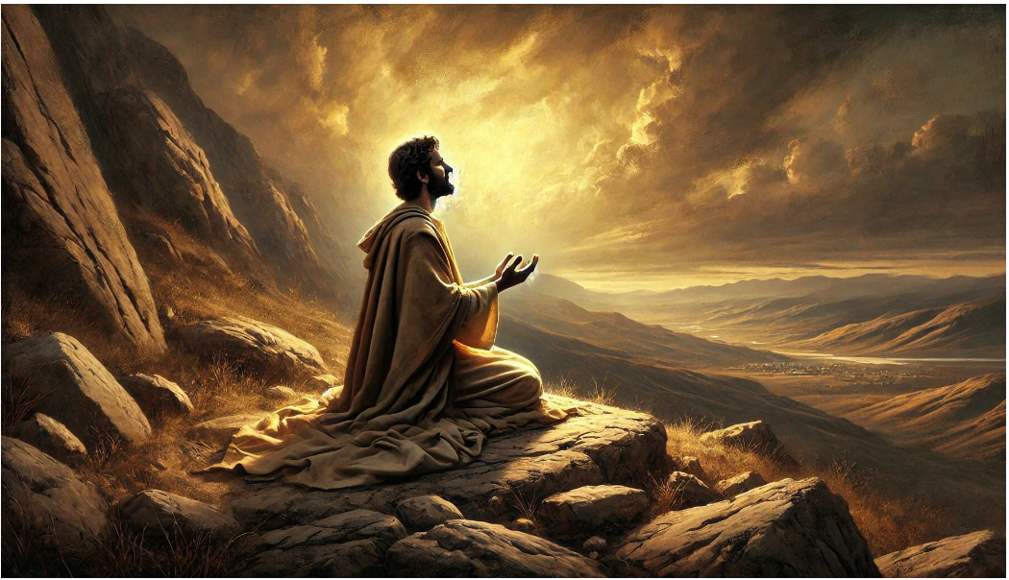
THE MORE WE PRAY, THE MORE WE EXPERIENCE GOD’S PEACE AND PRESENCE.

Slide 10
REFLECTIVE QUESTIONS
  How often do you take time to pray?
  What is something you need to bring to God in prayer today?
  How can prayer help you trust God more in difficult times?

Slide 11
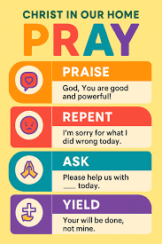
HOW TO PRAY

Slide 12
CHALLENGE
Write down 1-3 people you can pray for this week and pray for them once a day. The bible says what we make happen for others God will make happen for us!

Slide 13
PRAYER
Dear God,
Thank You for always listening when I pray. Help me to build a strong prayer life and trust You with everything in my heart. Teach me to talk to You daily and rely on Your wisdom. Amen.

