Slide 1







Growing in Christlike Character
Living With Integrity and Honesty
Unit 2
Week 5

Slide 2
Focus Scripture
Proverbs 10:9
Whoever walks in integrity walks securely,
but whoever takes crooked paths will be found out.

Slide 3

CHOOSING WHAT IS RIGHT
Integrity means doing the right thing, even when no one is watching. It’s about being honest, trustworthy, and standing firm in your values.

Slide 4
CHOOSING WHAT IS RIGHT
Proverbs 10:9 tells us that those who walk in integrity walk securely, but those who take dishonest paths will be exposed. This means that when we choose truthfulness and honesty, we don’t have to live in fear of getting caught in lies.

Slide 5
In today’s world, many people take shortcuts—cheating on tests, lying to avoid trouble, or being dishonest to get ahead. But God calls us to be people of integrity, even when it’s hard.

Slide 6
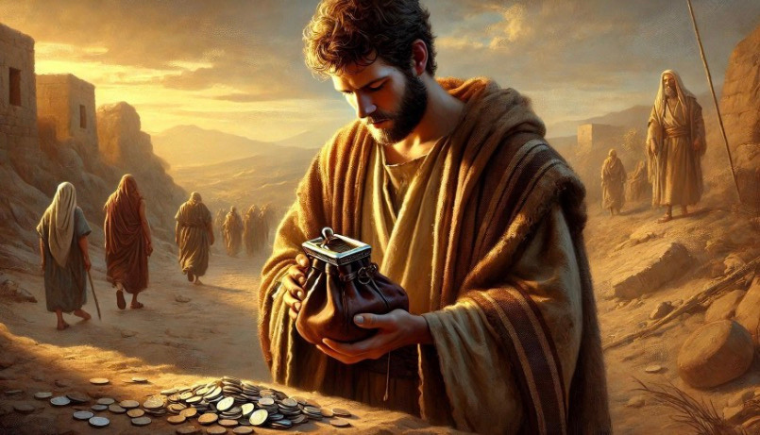
Jesus always lived with integrity, and as His followers, we should reflect His character. Being honest builds trust, respect, and a reputation of godliness.

Slide 7
Key lessons:
  Integrity means doing what is right, even when no one is watching.
  Honesty brings peace, while dishonesty leads to trouble.
  God blesses those who live truthfully.

Slide 8
LIFE APPLICATIONS
It’s not always easy to choose honesty, especially when lying seems like the easier option. But God wants us to be people of truth.

Slide 9
HERE’S HOW TO PRACTICE INTEGRITY EVERY DAY:
✅ Be honest in your words and actions.
✅ Admit mistakes instead of covering them up.
✅ Do the right thing, even when others don’t.
✅ Ask God for strength to stay truthful in difficult moments.

Slide 10

A person of integrity is someone others can trust and respect.

Slide 11
REFLECTIVE QUESTIONS
  ​Why is honesty so important in your daily life? ​
  Have you ever faced a situation where it was hard to tell the truth? What did you do?
  How can you be a person of integrity in school, at home, and with friends?

Slide 12

ACTIVITY
Let’s do a word search with names of some people in the bible who had integrity.
https://www.christianbiblereference.org/wj_PeopleOfFaith_0.htm

Slide 13
PRAYER
Dear God,
Help me to be a person of honesty and integrity. Teach me to always do what is right, even when it’s hard. Let my words and actions reflect Your truth. Amen.

