Slide 1


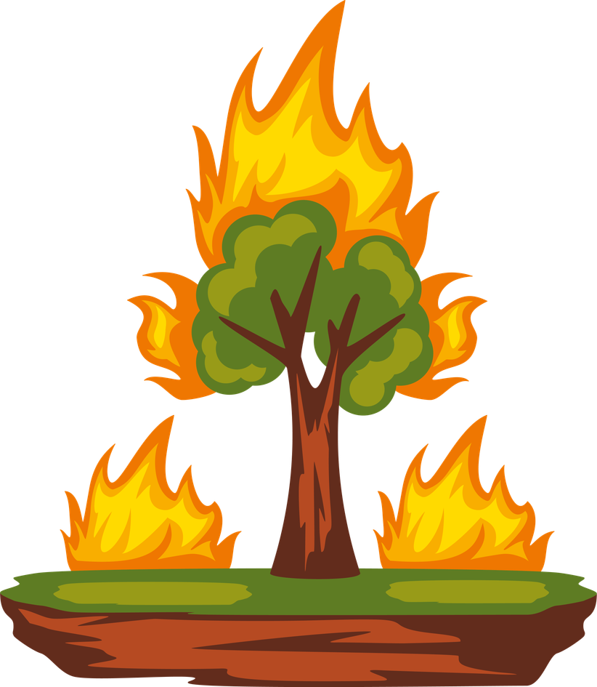
God Shows His Power
The Burning Bush
Unit 3: Week 1

Slide 2
Focus Scripture
“I will be with you.” – Exodus 3:12a
Unit 3

Slide 3
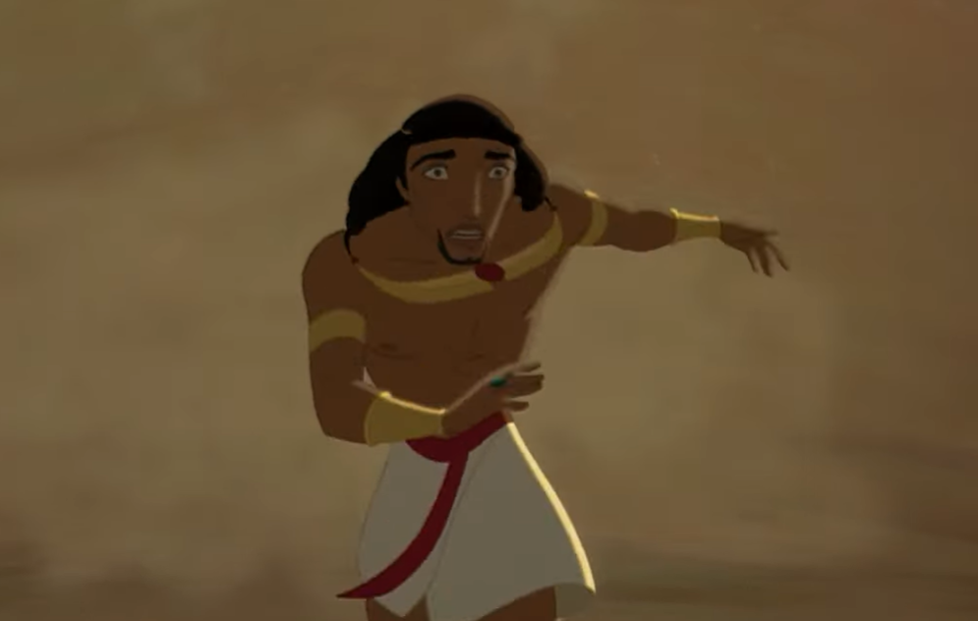
Moses had grown up in Pharaoh’s palace, but after making a big mistake, he ran away to a place called Midian. There, he became a shepherd, taking care of sheep. Moses probably thought he would stay in that quiet life forever but God had a different plan.

Slide 4
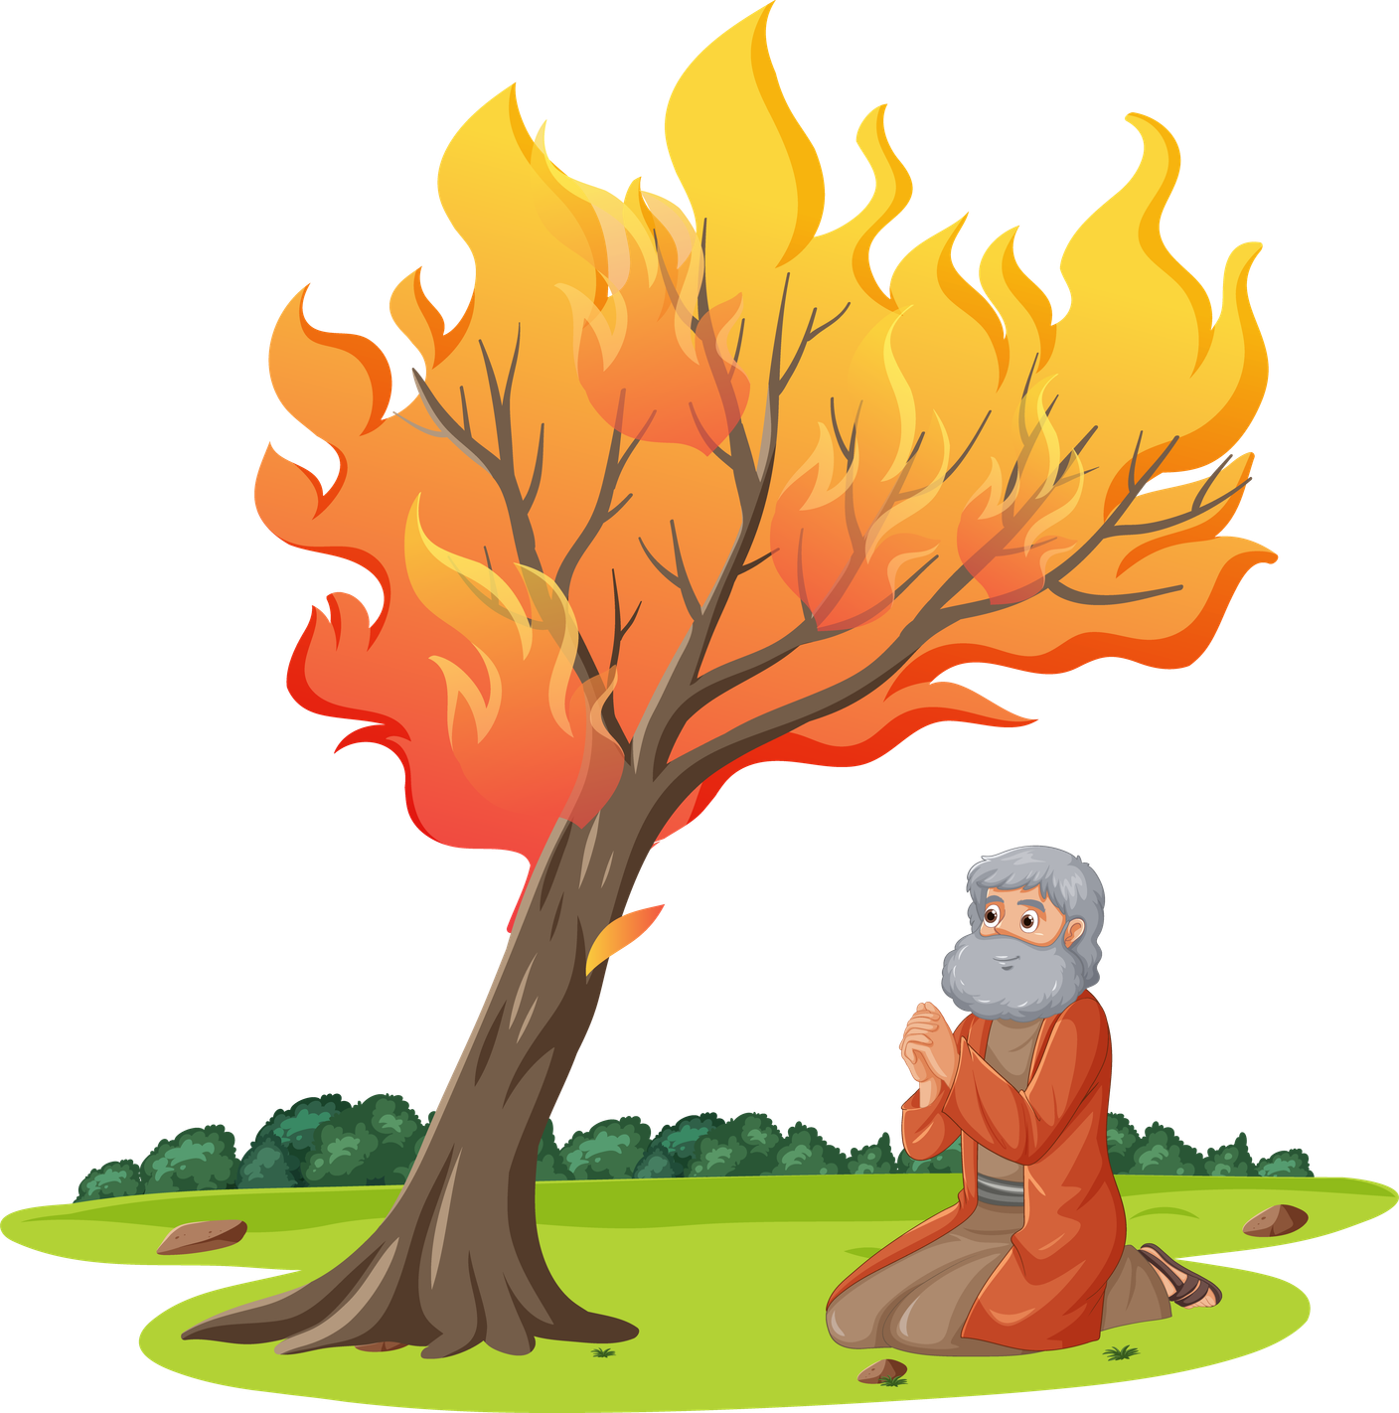
One day, while Moses was watching his sheep, he saw something strange: a bush was on fire, but it wasn’t burning up! As he got closer, he heard a voice calling his name, “Moses! Moses!” It was God speaking to him! Moses took off his sandals because he was standing on holy ground.

Slide 5
God told Moses He had seen how the Israelites were suffering in Egypt. He said, “I want to rescue them and I’m sending you to do it.” Moses was shocked. “Me? I can’t do that!” he said. But God answered, “I will be with you.”

Slide 6
Moses didn’t feel strong or brave. He thought he wasn’t a good speaker. But God didn’t choose him because he was perfect. He chose Moses because He had a powerful plan and promised to help him every step of the way.

Slide 7
Sometimes, we may feel too small or not good enough for big things. But God doesn’t look for perfect people. He looks for willing hearts. And when we say yes, He shows His power through us.

Slide 8
Let’s remember: God can use us in amazing ways when we listen and obey.

Slide 9
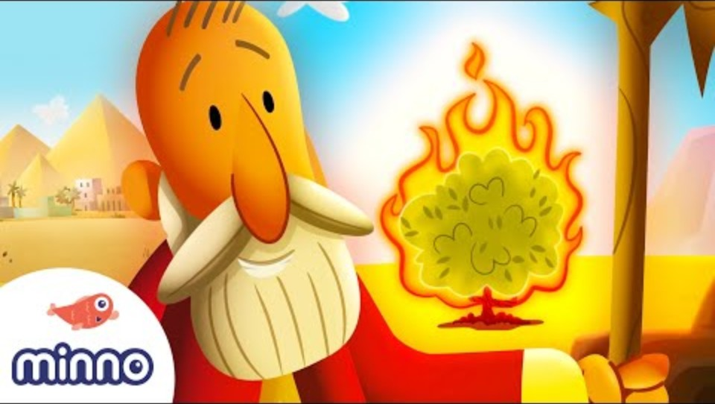

Slide 10
Discussion Questions
1. What made the burning bush so special?
2. How did Moses feel when God called him?
3. What can we do when God asks us to do something that feels hard?

Slide 11
The Mission
“I will be with you." -Exodus 3:12
“I will be with you." -Exodus 3:12

Slide 12
Prayer
Dear God, thank You for speaking to us and calling us to do big things, just like You called Moses. When I feel scared or unsure, help me remember that You are with me. Give me a heart that listens and obeys. Use me to do amazing things for Your glory. Amen.

