Slide 1


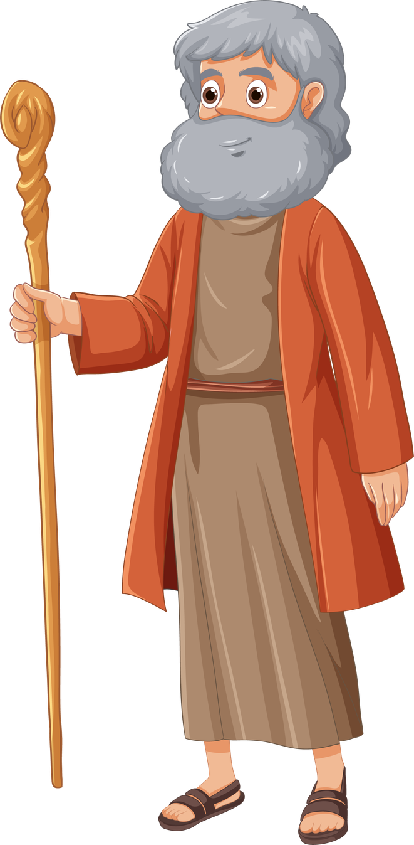
God Shows His Power
Let My People Go!
Unit 3: Week 2

Slide 2
Focus Scripture
“The Lord is great.” – Exodus 18:11a
Unit 3

Slide 3
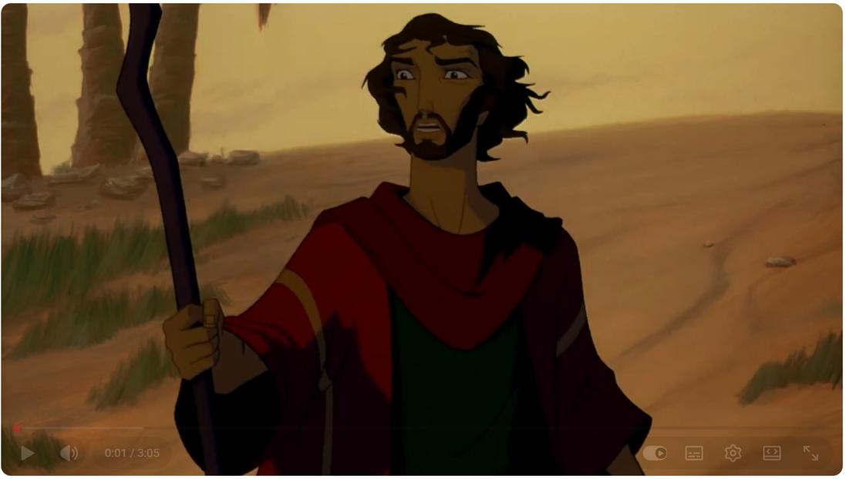
After Moses returned to Egypt, he went to Pharoah and gave him a message from Father God: “Let My people go.” But Pharaoh was stubborn. He said no and that made things much worse for the Israelites. They were forced to work even harder.
“Let My people go.”

Slide 4
But God wasn’t done. He showed His mighty power through a series of ten plagues. These weren’t just random events, they were signs to show Pharaoh and everyone in Egypt that Father God is the true and powerful King.

Slide 5


There were frogs, gnats, and flies. The river turned to blood. Animals died. People got painful sores. Hailstorm destroyed crops. There was darkness for three days. Each time, Pharaoh said no. But the final plague was the saddest, the death of every firstborn child in Egypt. Only the homes with lamb’s blood on the doorposts were protected.

Slide 6
That night became known as Passover, because God “passed over” those homes. Pharaoh finally gave in and told the Israelites to leave.

Slide 7
This story reminds us that Father God fights on behalf of His people. His power is not for display or show—it is for saving, protecting, and guiding us into freedom.

Slide 8
Let’s remember: Father God is powerful, and He uses His power to help His people.

Slide 9
Video

Slide 10
Discussion Questions
1. Why did Father God send plagues to Egypt?
2. What does Passover remind us of?
3. How does Father God show His power in your life today?

Slide 11
The Mission
“The Lord is great.”- Exodus 18:11a
“The Lord is great.”- Exodus 18:11

Slide 12
Prayer
Dear Father God, thank You for showing Your power in amazing ways. You are strong and mighty, but also loving and kind. Help me to trust You when life is hard and to remember that You are fighting for me, just like You did for the Israelites. Amen.

