Slide 1


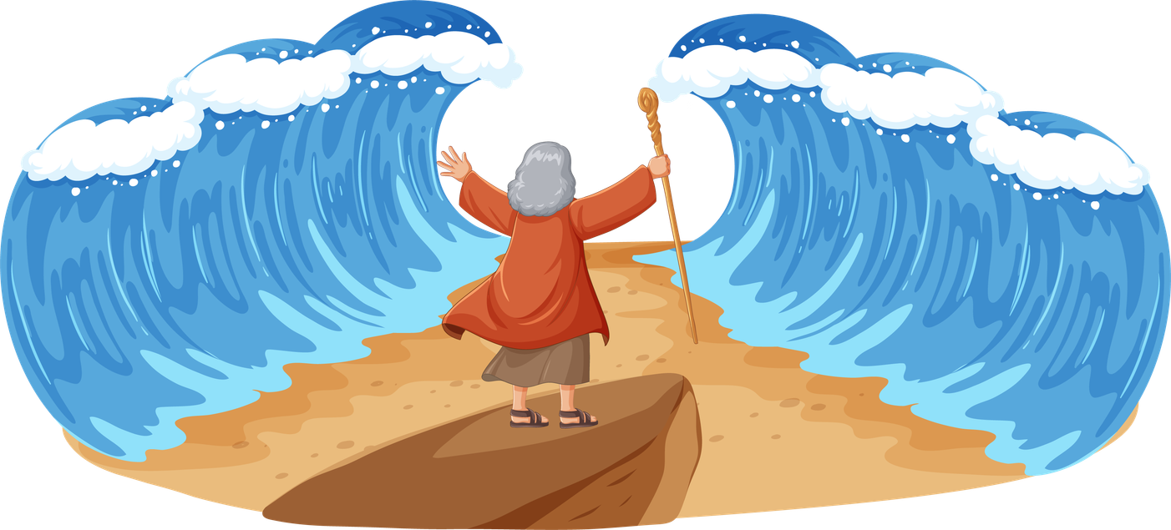
God Shows His Power
Water Walls!
Unit 3: Week 3

Slide 2
Focus Scripture
“Do not be afraid. Stand firm and see the Lord’s salvation.” – Exodus 14:13a
Unit 3

Slide 3
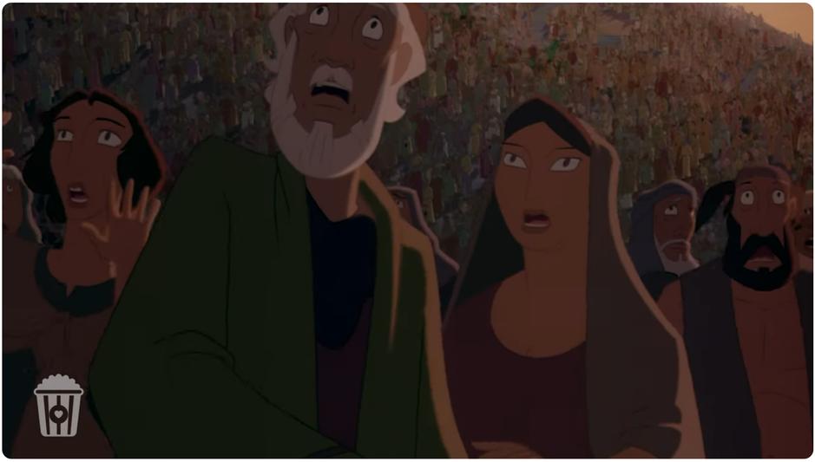
The Israelites were finally free! After hundreds of years of slavery, they were walking out of Egypt with Moses leading the way. But soon, Pharaoh changed his mind and sent his army to chase them. The Israelites looked ahead and saw the Red Sea, and behind them were Pharaoh’s chariots.
They were trapped!

Slide 4
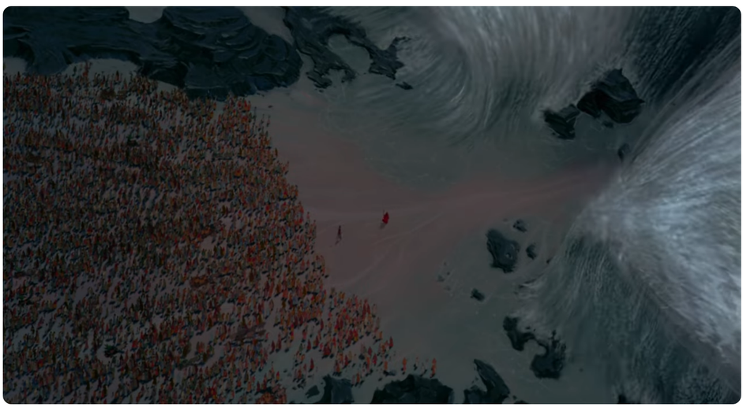
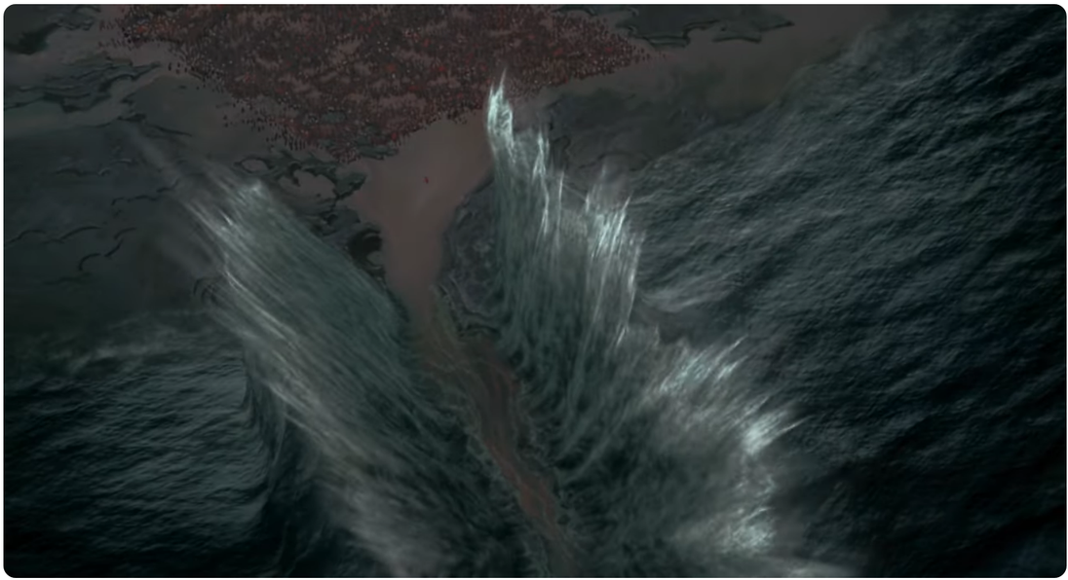
The people were scared. They cried out to Father God and shouted at Moses, “Why did you bring us here to die?” But Moses stood strong. He told the people, “Don’t be afraid. Just watch God is going to do something amazing!”

Slide 5
Father God told Moses to stretch out his staff over the sea. And right before their eyes, the water split in two, creating giant walls of water on both sides. The Israelites walked across on dry ground!

Slide 6
When the Egyptian army tried to follow, Father God closed the sea, and they were swept away. Father God had saved His people with a mighty miracle. They danced, sang songs, and praised God for what He had done.

Slide 7
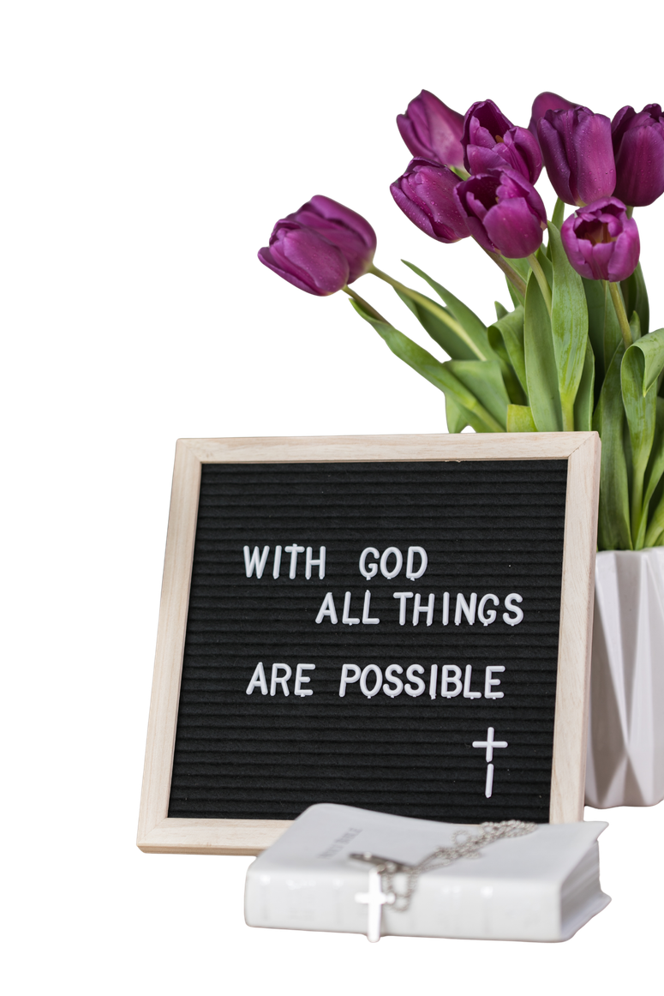
This story shows us that even when things look impossible, nothing is too hard for our Father God. When we feel surrounded by problems, we can trust Him to make a way.

Slide 8
Let’s remember: Father God can do the impossible when we trust and obey Him.

Slide 9


Slide 10
Discussion Questions
1. How did Father God protect the Israelites from Pharaoh’s army?
2. What did Moses do to part the sea?
3. How can we trust Father God when we feel trapped or afraid?

Slide 11
The Mission
“Do not be afraid. Stand firm and see the Lord’s salvation.” -Exodus 14:13a
“Do not be afraid. Stand firm and see the Lord’s salvation.” -Exodus 14:13

Slide 12
Prayer
Father God, You are the One who makes a way when there is no way. Thank You for the story of the Red Sea that shows how powerful and caring You are. Help me to stand firm and trust You when I feel scared or stuck. I know You are always with me. Amen.

