Slide 1




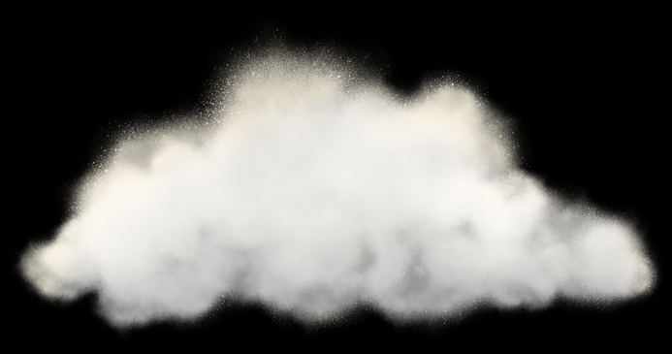
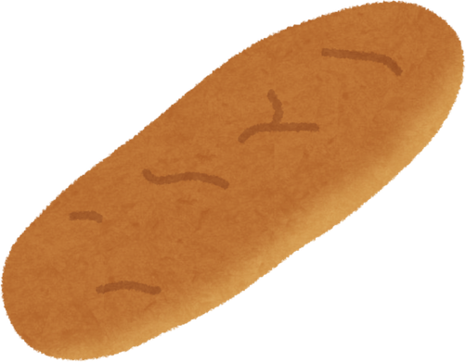
God Shows His Power
Bread From The Sky
Unit 3: Week 4

Slide 2
Focus Scripture
“God... gives you food to eat.” – Deuteronomy 8:10a
Unit 3

Slide 3
After the Israelites crossed the Red Sea, they began a long journey through the wilderness. They were finally free from slavery, but now they had a new problem: there was no food! The people were tired, hungry, and started to complain.
OH NO! There’s no food!
Show me your hungry face. Show me your tired face.

Slide 4
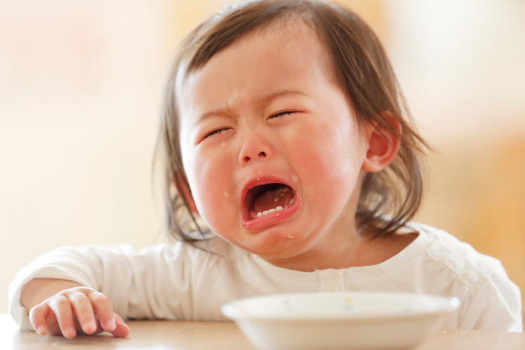


They said, “Why did we leave Egypt? At least we had food there!” They forgot how badly they had been treated as slaves. Even after all the miracles God had done, they were starting to doubt His care.
Name the Emotion

Slide 5
But Father God didn’t get angry. Instead, He showed His love by providing what they needed bread from the sky! Every morning, when they woke up, tiny flakes covered the ground. The people called it manna, which means, “What is it?” It was sweet and tasty, like wafers with honey.

Slide 6
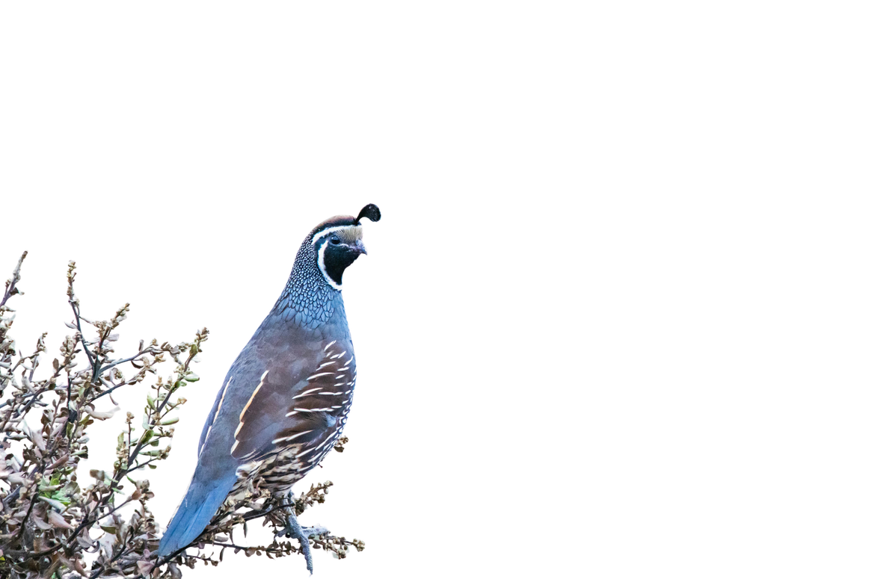
Father God told them on the sixth day, they were allowed to gather twice as much so they could rest on the Sabbath. Father God also provided quail (a kind of bird) in the evenings for meat. He took care of every single need. The Israelites learned that they could depend on Father God every day.

Slide 7


Count the quails and the bread. Then tell me are they more than, equal or less than.

Slide 8
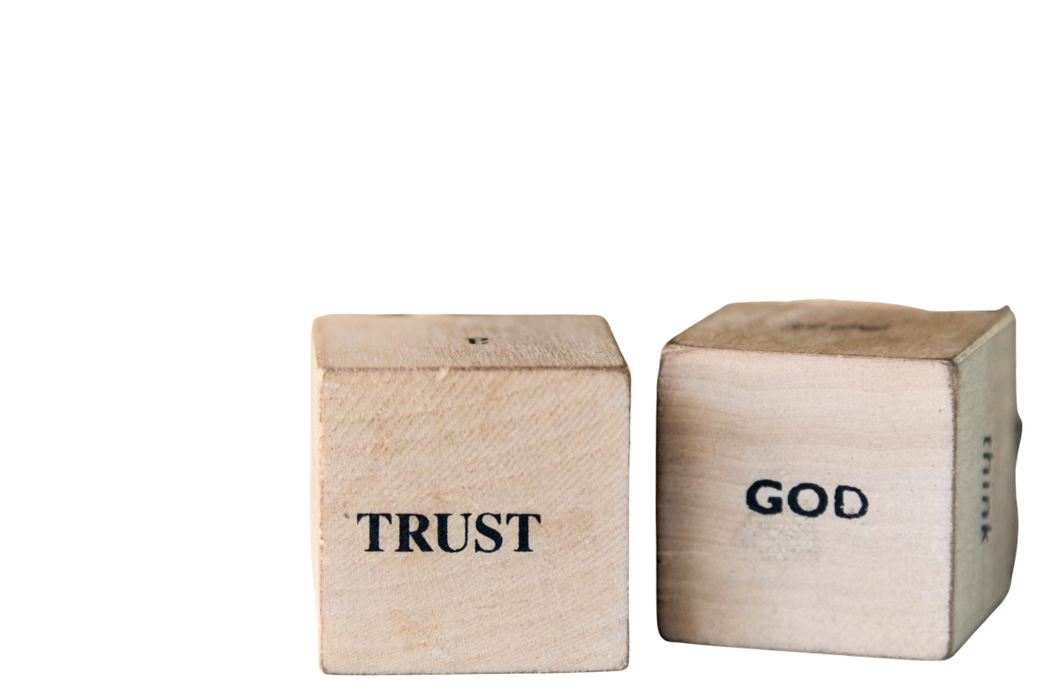
This story teaches us that Father God provides, even when we’re in dry, difficult places. We may not always get what we want, but Father God gives us what we need, right on time.

Slide 9
Let’s remember: Father God is our provider, and we can trust Him every single day.

Slide 10


Slide 11
Discussion Questions
1. What did Father God send to feed the Israelites in the desert?
2. Why did Father God tell them to gather just enough manna each day?
3. How does Father God take care of your needs today?

Slide 12


The Mission
“God... gives you food to eat.” -Deuteronomy 8:10a
“God... gives you food to eat.”
-Deuteronomy 8:10

Slide 13
Prayer
Father God, thank You for being a good provider. Just like You gave the Israelites manna, You give me everything I need. Help me to trust You each day and not worry about tomorrow. Teach me to be thankful for Your daily blessings. Amen.

