Slide 1


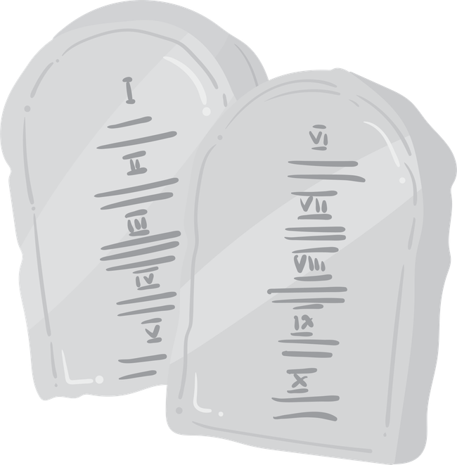
God Shows His Power
The Ten Commandments
Unit 3: Week 5

Slide 2
Focus Scripture
“Love God... and love your neighbor.” – Matthew 22:37-39
Unit 3

Slide 3


After Father God led the Israelites out of Egypt and cared for them in the desert, He wanted to teach them how to live as His special people. So He called Moses to climb a mountain, Mount Sinai. There, in a cloud filled with thunder and lightning, Father God gave Moses something very important: Ten Commandments written on stone tablets.
The Ten Rules of Love
Count to figure out the equation.
+
5
+
5=

Slide 4



These weren’t just rules to follow, they were Father God’s loving instructions for how people should live. They helped the Israelites know how to love Father God and each other.

Slide 5
The first few commandments were about loving Father God:
  Put Father God first.
  Don’t worship idols.
  Respect Father God’s name.
  Keep the Sabbath day holy.
How many commandments are there about loving Father God?

Slide 6
The rest were about loving others:
  Honor your parents.
  Don’t hurt others.
  Be faithful in marriage.
  Don’t steal.
  Don’t lie.
  Don’t want what others have.

Slide 7
Father God didn’t give these commandments to be mean. He gave them because He loves us and wants us live in peace, kindness, and honesty. Jesus later said that all the commandments could be summed up in two simple things. Love Father God and love your neighbor.

Slide 8
Following Father God’s rules doesn’t earn His love, it’s how we respond to His love. When we obey Him, we show that we trust Him and want to live His way.

Slide 9
Let’s remember: Father God’s rules are good and show us how to love well.

Slide 10


Slide 11
Discussion Questions
1. Why did Father God give the Israelites the 10 Commandments?
2. What do the commandments teach us about how to treat Father God and others?
3. How can you show love to Father God and people around you this week?

Slide 12

The Mission
“Love God... and love your neighbor.” -Matthew 22:37-39
“Love God... and love your neighbor.” -Matthew 22:37-39

Slide 13
Prayer
Father God, thank You for giving us the 10 Commandments to help us live in love and peace. I want to follow Your ways and treat others with kindness and respect. Help me to love You with all my heart and love others the way You do. Amen.

