Slide 1
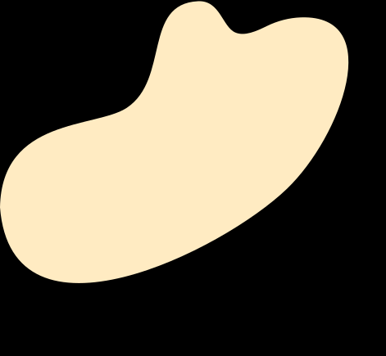
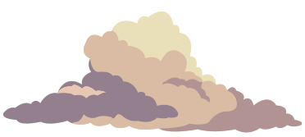

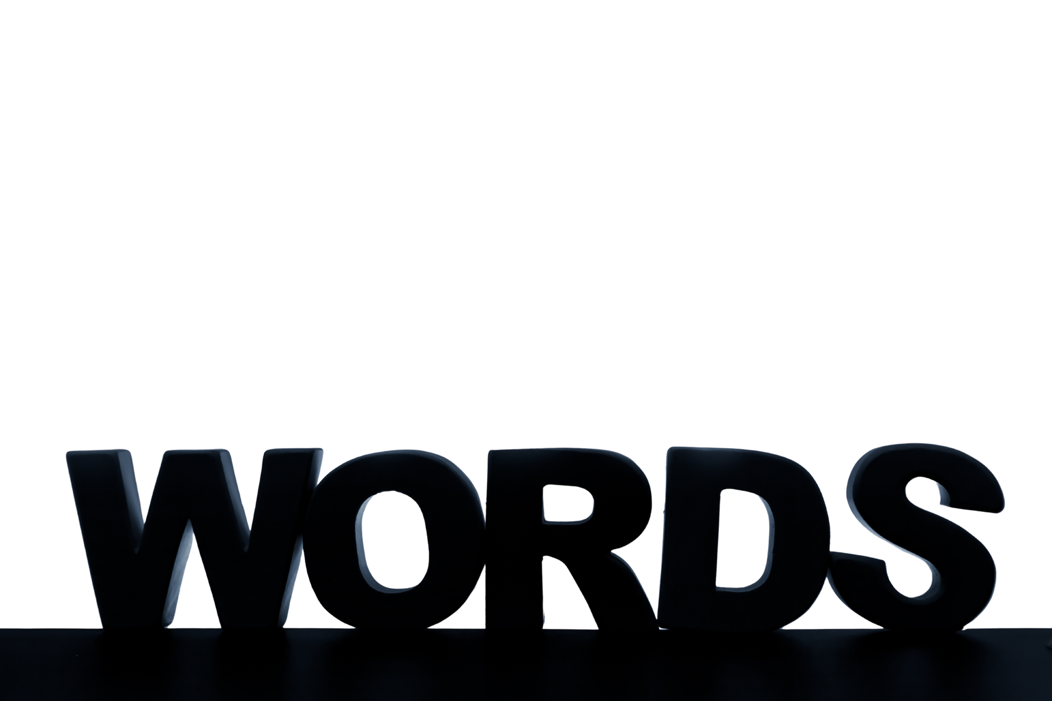



REAL LIFE, REAL FAITH
Understanding the Impact of
Unit 3 Week 1

Slide 2
FOCUS SCRIPTURE
“The tongue has the power of life and death, and those who love it will eat its fruit.”
-Proverbs 18:21‬ ‭NIV‬‬

Slide 3
WORDS HAVE POWER
The words we speak can either build others up or tear them down. Proverbs 18:21 reminds us that “the tongue has the power of life and death.” This means that our words can bring encouragement, healing, and joy—or they can cause pain, anger, and destruction.

Slide 4
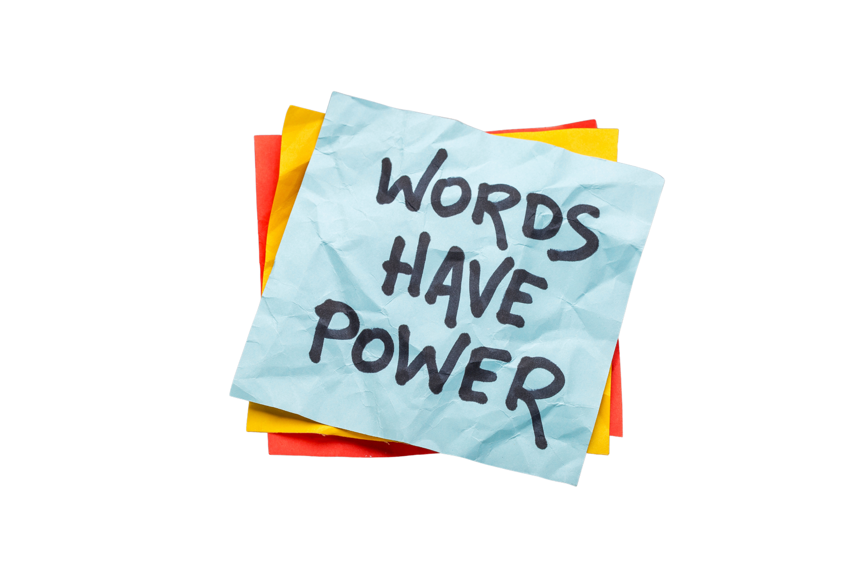
We’ve all experienced the power of words. Encouraging words can make someone’s day better, while negative words can leave deep scars. As followers of Christ, we are called to speak with love, kindness, and truth.

Slide 5
Jesus always used His words to bless, teach, and uplift others. He reminds us that we will be held accountable for every word we speak (Matthew 12:36). This is why we must be careful not to gossip, lie, or use words that hurt others. Instead, we should use our words to bring hope, peace, and encouragement.

Slide 6
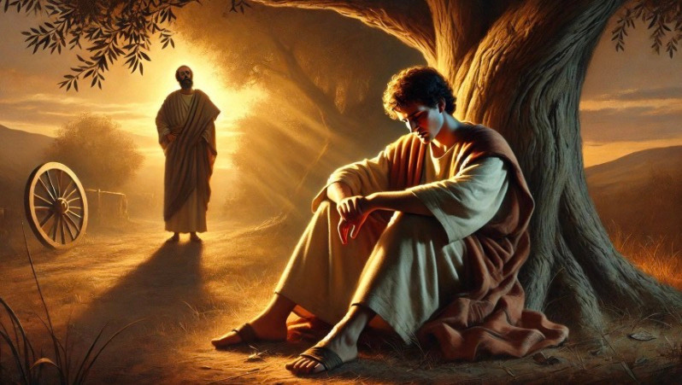
KEY LESSONS
Words have power—they can heal or hurt. ​
God wants us to use our words to bring life and encouragement.
Being mindful of what we say reflects Christ’s love.

Slide 7

BEFORE SPEAKING, WE SHOULD ASK OURSELVES:
✅ Will this word encourage or hurt someone?
✅ Am I using my words to reflect Christ?
✅ Is it necessary or better left unsaid?
CHOOSING OUR WORDS WISELY HELPS US BUILD STRONG RELATIONSHIPS, HONOR GOD, AND BRING PEACE TO THOSE AROUND US.

Slide 8
REFELCTIVE QUESTIONS
1. ​Can you remember a time when someone’s words encouraged or hurt you? How did it make you feel? ​
2. ​What are some ways you can use your words to bless others? ​
3. ​How can you avoid using words that hurt or tear others down?

Slide 9
ACTIVITY
The Crumpled Paper/Heart Experiment:
Preparation: Ask everyone to have a piece of paper and a pen ready.
The Crumple: Have students think of a time someone said something mean to them. For every mean word or phrase they recall, they must crumple their paper slightly.
The Apology: Ask them to "apologize" to the paper and try to smooth it out perfectly.
The Lesson: This illustrates that while apologies are important, the "wrinkles" (emotional scars) remain.

Slide 10
PRAYER
Dear God,
Help me to use my words wisely. Teach me to speak with kindness, encouragement, and love. Let my words reflect You and bring peace to those around me. Amen.

