Slide 1

REAL LIFE, REAL FAITH
Respecting and Honoring Parents
Unit 3 Week 2

Slide 2
FOCUS SCRIPTURE
“Honor your father and your mother, so that you may live long in the land the Lord your God is giving you.”
-Exodus 20:12

Slide 3
WHY HONORING PARENTS MATTERS
God commands us in Exodus 20:12 to honor our father and mother so that we may live a blessed life. Honoring our parents is not just about obedience- it’s about respect, gratitude, and love.

Slide 4
Jesus Himself respected His earthly parents (Luke 2:51) and obeyed God’s command. By following His example, we show humility and maturity. Honoring our parents doesn’t mean they are always right, but it means treating them with kindness, patience, and appreciaton.
Honor = kindness, patience, and appreciation.

Slide 5
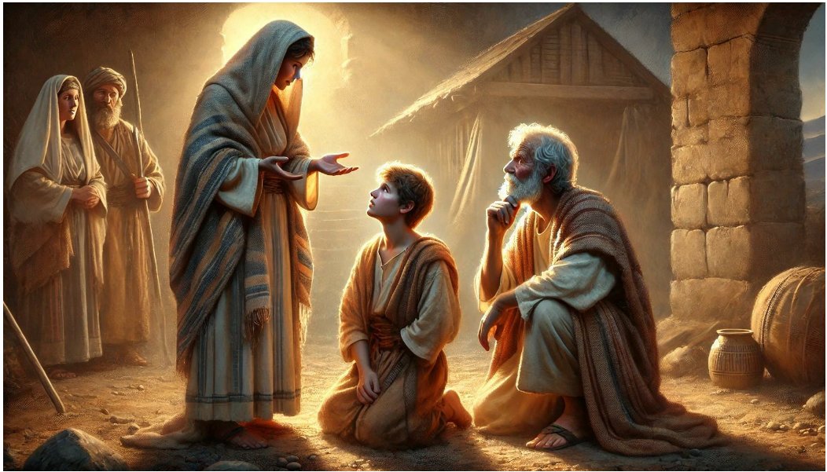
KEY LESSONS
Honoring parents is a command from God, not just a suggestion.
Respecting parents teaches us patience and humility.
God blesses those who show love and obedience to their parents.
WHEN HONORING OUR PARENTS, WE HONOR GOD.

Slide 6
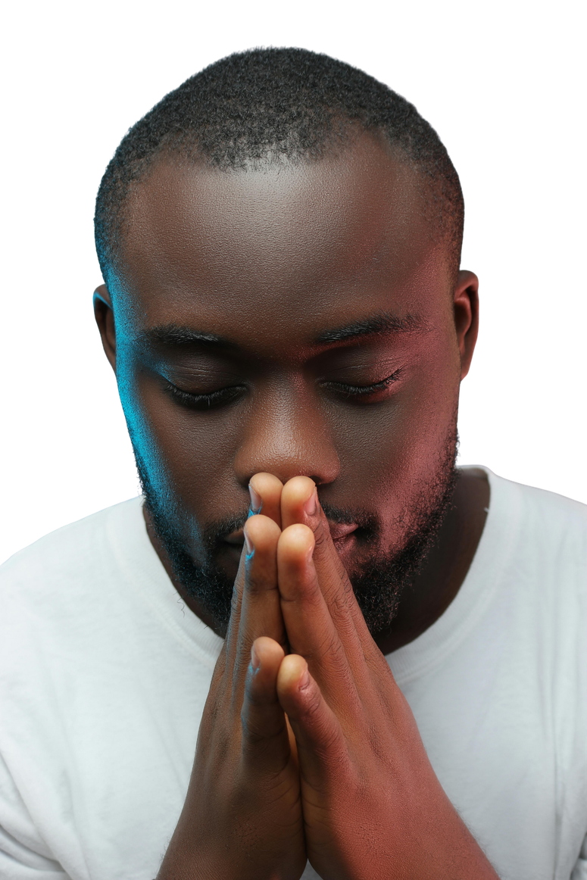
HERE ARE WAYS TO SHOW HONOR:
✅ Listen to their advice, even if you don’t always agree.
✅ Express gratitude for their love and support.
✅ Be patient and avoid arguing disrespectfully.
✅Pray for them and seek God’s wisdom in family relationship.
THERE MAY BE TIMES WHEN WE FEEL FRUSTRATED OR MISUNDERSTOOD, BUT CHOOSING TO HONOR OUR PARENTS BRINGS PEACE AND STRENGTHENS RELATIONSHIPS.

Slide 7
REFELCTIVE QUESTIONS
What does honoring your parents look like in your daily life?
How can you handle disagreements with your parents in a respectful way?
Why do you think God promises blessings to those who honor their parents?

Slide 8

ACTIVITY
Today is Mothers Day! Be sure to wish your mom a Happy Mother’s Day!
Use Canva, Powerpoint or use paper and colors to create a mothers day card!
You will need to:
Write a kind message: use 3-5 strengths about your mother
Draw a picture or include a picture of you and your mom toghether if you have one.
Be creative and include what you want to show you love your mom!

Slide 9
PRAYER
Dear God,
Thank You for my parents and the role they play in my life. Help me to respect, love, and honor them, even when it’s difficult. Give me patience and understanding to follow Your command. Amen.

