Slide 1






REAL LIFE, REAL FAITH
The Value of True Friendship
Unit 3 Week 3

Slide 2
FOCUS SCRIPTURE
“A friend loves at all times,
and a brother is born for a time of adversity.”
-Proverbs 17:17‬ ‭NIV‬‬

Slide 3
WHY TRUE FREINDSHIP MATTERS
Friendship is a gift from God, but not all friendships are equal. Some friends bring us closer to God, while others can lead us away from Him. Proverbs 17:17 tells us that “a friend loves at all times.” A true friend is there in good times and bad, supporting and encouraging us in the right direction.

Slide 4

Jesus shows the greatest example of friendship. He loved His disciples, forgave their mistakes, and always spoke truthfully. He even said, “There is no greater love than to lay down one’s life for one’s friends” John 15:13.
Friendship=
Trust, loving, and loyalty.

Slide 5
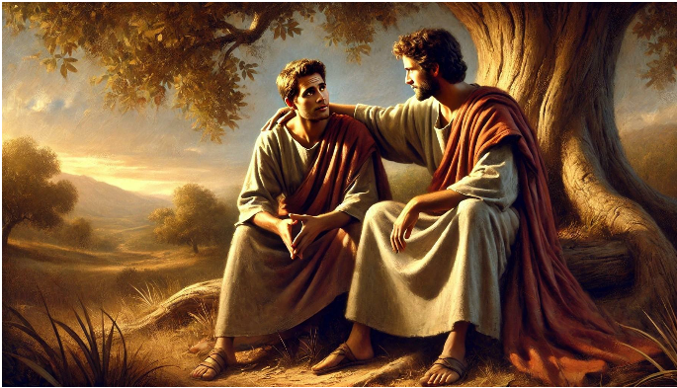
KEY LESSONS
  A true friend is loving, loyal and trustworthy.
  Friendships should strengthen our faith, not weaken it.
  Jesus is our greatest example of what it means to be a true friend.
CHOOSING FRIENDSHIPS THAT HONOR GOD AND WALKING AWAY FROM RELATIONSHIPS THAT LEAD INTO SIN OR TEMPTATION

Slide 6

HERE’S HOW TO BUILD STRONG, GOD-HONORING FRIENDSHIPS:
✅ Be a friend who listens, encourages, and prays for others.
✅ Surround yourself with people who hlp you grow in faith.
✅ Be honest, kind, and loyal, even when it’s difficult.
✅Let go of friendships that lead you into negativity or sin.
GOD BLESSES FRIENDSHIPS THAT REFLECT HIS LOVE.

Slide 7
REFELCTIVE QUESTIONS
  What qualities do you look in a good friend?
  How can you be a beter friend to those around you?
  Are there any friendships in your life that need to be strenghthened or changed?

Slide 8
ACTIVITY
Friendship Activity

Slide 9
PRAYER
Dear God,
Thank You for the gift of friendship. Help me to be a true and loyal friend, and guide me to friendships that honor You. Teach me to love, forgive, and encourage others as Jesus did. Amen.

