Slide 1






REAL LIFE, REAL FAITH
Standing Strong Against Peer Pressure
Unit 3 Week 4

Slide 2
FOCUS SCRIPTURE
“ Do not conform to the pattern of this world, but be transformed by the renewing of your mind. Then you will be able to test and approve what God’s will is—his good, pleasing and perfect will.”
-Romans 12:2 ‭NIV‬‬

Slide 3
PRESSURE THE RIGHT WAY
Peer pressure is something everyone faces, especailly as a teenager. Whether it’s pressure to fit in, act a certain way, or make choices that go against yout values, it can be difficult to stand your ground when everyone around you is doing something different.

Slide 4

Romans 12:2 tells us not to conform to the patterns of this world but to be transformed by renewing our minds. This means we shouldn’t follow the crowd blindly just to be accepted. Instead, we should allow God’s truth to shape our decisions.
Putting God’s truth above other’s opinion= confidence to make right choices.

Slide 5
RECOGNIZING THESE PRESSURES HELPS US PREPARE AND STAND STRONG WHEN WE FACE THEM.
Direct pressure: When someone tells you to do something wrong.
Indirect pressure: When you feel like you must act a certian way to be accepted.
Self-imposed pressure: When you push yourself to meet unrealistic expectations to impress others.

Slide 6
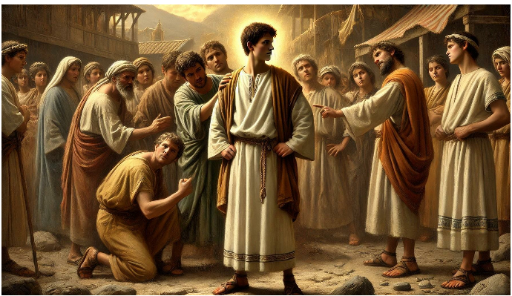
KEY LESSONS
Peer pressure is real, but we don’t have to give in to it.
God calls us to stand firm in our faith and make the right choices.
When we seek God’s approval instead of people’s, we find true confidence.
Handling peer pressure requires strength, wisdom and courage.

Slide 7
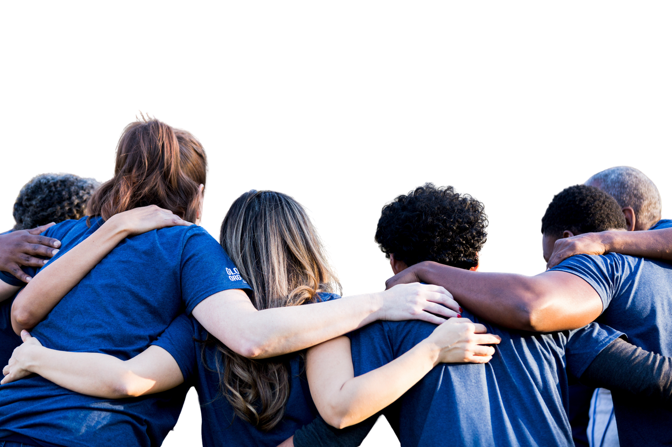
HOW TO STAY STRONG WHEN FACED WITH PRESSURE:
✅ Know your values- Decide ahead of time what you will and won’t do.
✅ Surround yourself with godly friends- Choose friends who encourage you to do what’s right.
✅ Learn to say no- You don’t have to explian yourself when making the right decisions.
✅Pray for wisdom- Ask God for the strength to stand firm.
✅Look at the long-term effects- Think about the conseuences before making a choice.

Slide 8
REFELCTIVE QUESTIONS
Have you ever felt pressures to do something you knew was wrong? How did you respond?
Why is it important to seek God’s approval rather than people’s?
How can you prepare yourself to handle peer pressure in a godly way?

Slide 9
ACTIVITY
Use a Thumbs Up if you prefer TikTok over YouTube.
Use a Thumbs Up if you secretly like pineapple on pizza.
Use a Thumbs Up if you have ever bought clothes just because they were trending.
Use a Thumbs Up if you would stay silent if a friend made a joke you didn’t like.
Use a Thumbs Up if you have ever pretended to like a song or movie just to fit in.
Use a Thumbs Up if you would look at your phone if everyone else at the table did.
Use a Thumbs Up if you would buy an expensive water bottle just because everyone has it.
Use a Thumbs Up if you would skip a class if your group of friends decided to walk out.
Use a Thumbs Up if you would let a friend copy your major homework assignment.
Use a Thumbs Up if you would get into a car with an unsafe driver because you didn't want to make a scene.

Slide 10
CLOSING
Which question made you hesitate the most, and why did it feel harder to answer?
On Zoom, it takes less than a second to see what everyone else is doing. In real life, peer pressure works the exact same way. It is a split-second instinct to look around and copy the crowd so we don't feel left out. Moving forward this week, just pause for three seconds before you 'click your button' in real life, and make sure your choice is actually what the Lord would want. Thanks for playing!

Slide 11
PRAYER
Dear God,
Help me to stand firm in my faith, even when others pressure me to do what is wrong. Give me the wisdom to make good choices and the strength to follow Your truth. Surround me with friends who encourage me to do what is right. Amen.

