Slide 1







REAL LIFE, REAL FAITH
Finding your Identity in Christ
Unit 3 Week 1

Slide 2


FOCUS SCRIPTURE
“Therefore, if anyone is in Christ, the new creation has come: The old has gone, the new is here!”
-2 Corinthians‬ ‭5‬:‭17‬ ‭NIV‬‬

Slide 3
WHO ARE YOU?
Many people struggle with identity—who they are and what defines them. The world often tells us that our worth comes from our appearance, talents, popularity, or success. But these things can change, and they don’t define who we truly are.

Slide 4
The Bible tells us in 2 Corinthians 5:17 that when we accept Christ, we become a new creation. Our identity is no longer based on what others say about us but on who God says we are.

Slide 5
IN GOD’S EYES, YOU ARE:
  Loved – God’s love for you is unconditional (Romans 8:38-39). ​
  Chosen – You are not an accident; God has a purpose for you (1 Peter 2:9).
  Valuable – You are fearfully and wonderfully made (Psalm 139:14). ​
  Forgiven – No matter your past, God offers you a fresh start (Ephesians 1:7). ​
  A Child of God – You belong to Him (John 1:12).

Slide 6

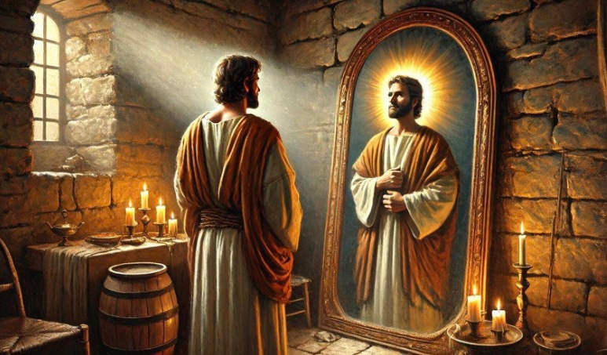
When we find our identity in Christ, we no longer have to seek approval from the world. Instead, we can walk with confidence, knowing that we are loved, accepted, and created for a purpose.

Slide 7
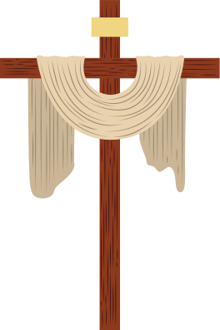
KEY LESSONS
  Our true identity is found in Christ, not in what the world says about us.
  God created us with love, value, and purpose. ​
  Knowing who we are in Christ helps us live with confidence and joy.

Slide 8
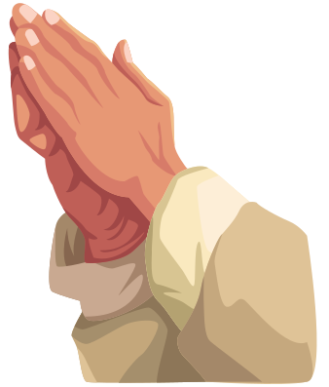
Life Application
It’s easy to let opinions, social media, or comparisons shape how we see ourselves. But when we fully embrace our identity in Christ, we can live with peace and purpose.

Slide 9
HERE’S HOW TO FOCUS ON WHO YOU ARE IN GOD:
✅ Remind yourself of God’s truth daily—read His Word.
✅ Reject negative thoughts and replace them with God’s promises.
✅ Stop comparing yourself to others—God made you unique.
✅ Find confidence in being God’s child, not in seeking approval from others.

Slide 10

When we know who we are in Christ, we can live with boldness and joy.

Slide 11
REFELCTIVE QUESTIONS
1. ​Have you ever struggled with finding your identity? What made it difficult? ​
2. ​How does knowing you are loved and chosen by God change the way you see yourself?
​3. ​What steps can you take to focus on your identity in Christ instead of the world’s opinions?

Slide 12
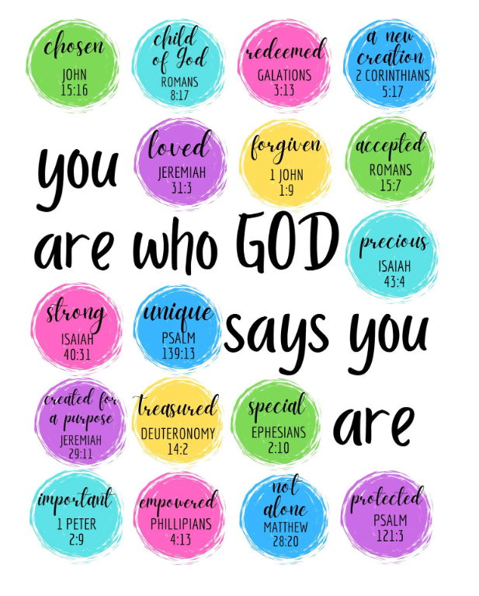
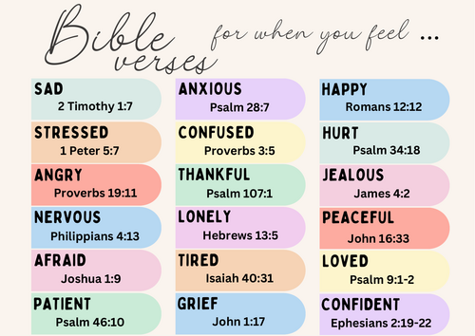
ACTIVITY
Journaling - "God says I am"
List pressures you face on one side of a page, and on the other, write what God's Word says about them.

Slide 13
PRAYER
Dear God,
Thank You for creating me with purpose and value. Help me to see myself through Your eyes, not through the world’s standards. Remind me daily that I am loved, chosen, and made new in You. Amen.

